Slide 1

Indian Institute of Information Technology
Allahabad
Object Oriented Methodology

Slide 2
Cube with 3d Computer Animation
Fabricated By ( Group no. 37 ) :
Ramavath Vasanth Naik ( IIT2020096 )
Lakshya Bhardwaj ( IIT2020097 )
Tarun Harishchandra Pal ( IIT2020098 )
Sahil Pote ( IIT2020240 )

Slide 3
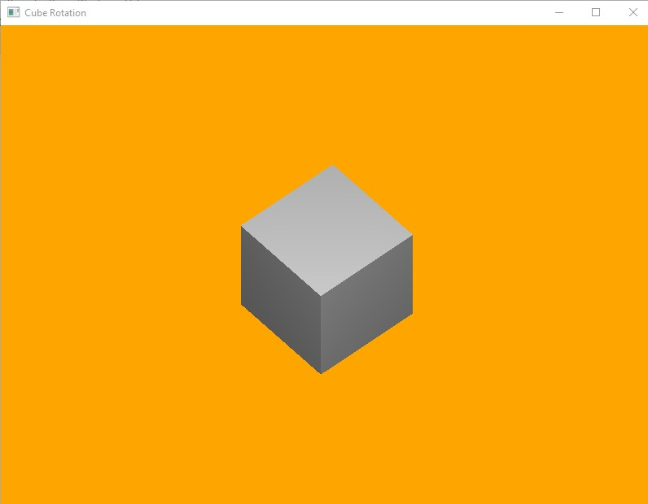
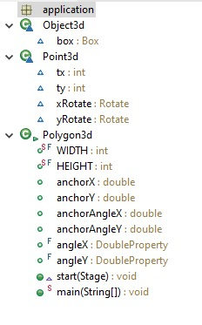
About The Application
This project involves how a 3d cube can be rotated through the matrix operations and how the rotation properties can be used to design such a implementation in JavaFX.
This generally involves how a cube is rotated when the program starts the 2d cube is appeared on the screen then as we drag along the axis we get the rotation along the direction it is been dragged.
What we have used:-
We have used the JavaFX SDK for developing this project which mainly involves a cube and the rotation properties we have made cube with the inbuilt JavaFX class and used anchor properties and event listeners for rotating the cube the object can be anything but the main thing is to rotate

Slide 4


About utilised Resources
Primarily, the IDE ( Integrated Development Environment ) used here is eclipse.
The whole interface of the application is designed using JavaFX.
We have used Components & Properties of JavaFx
The inside sight of application, the operational part of the application is created using JAVA programming language in object oriented manner.

Slide 5
UML
( Unified Modelling Diagram )
UML Diagram is basically the model of whole project from in and out.
It makes the person to understand the system in much easier way .
UML diagram is categorised into many different types of diagrams. Some of them are listed below :
Use Case Diagram
CRC Diagram
Class Diagram
Deployment Diagram

Slide 6
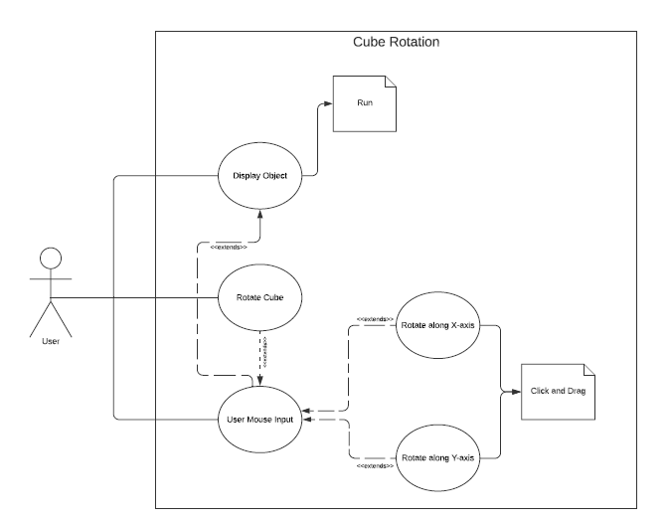
Use Case Diagram

Slide 7
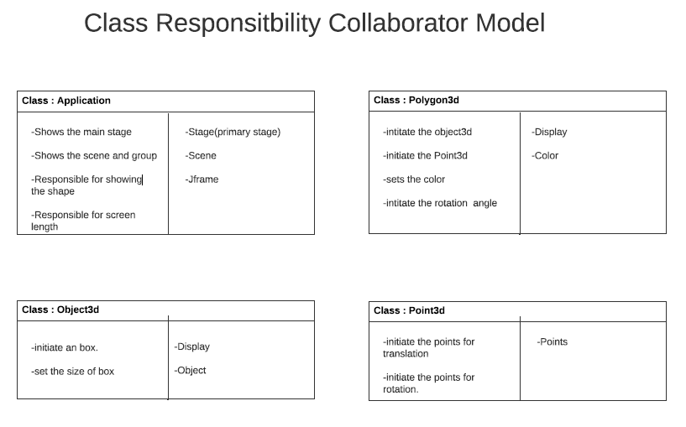
CRC Diagram

Slide 8
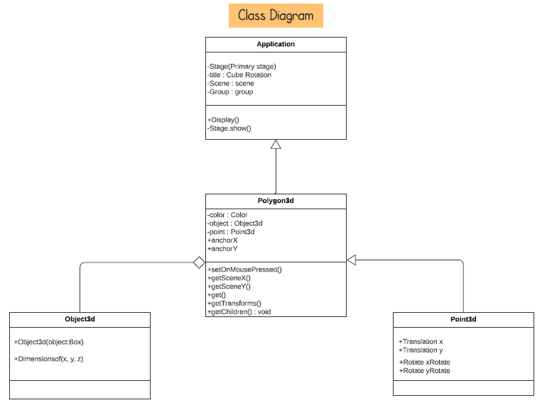
CLASS Diagram

Slide 9
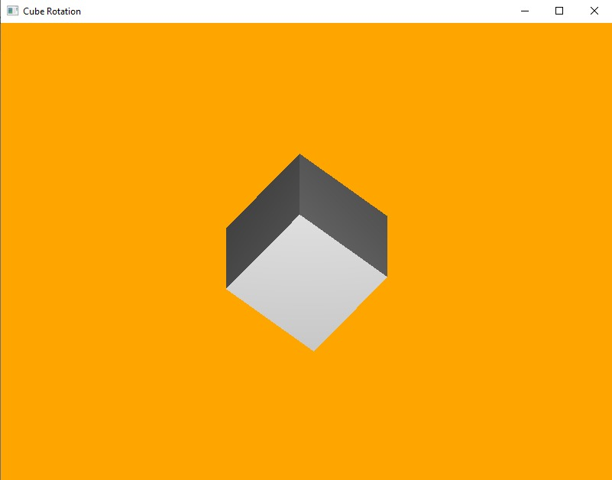
Glimpses of Application

Slide 10
Thank You…..!!!

