Slide 1

INDIAN INSTITUTE OF TECHNOLOGY, DELHI MASTER IN TECHNOLOGY, ROBOTICS
Autonomous Mobile Robot Navigation with Dynamic Obstacle Avoidance in Indoor Environments
PRESENTED BY :- PAWAN KUMAR (2024JRB2031)
GUIDE :- PROF. SK SAHA

Slide 2
PROBLEM STATEMENT:
Autonomous Navigation System for Novus MR500 Industrial Robot :Workspace Setup, Sensor & Topic Validation , SLAM + Map Creation, Localization(AMCL), Navigation, Navigation with Obstacle Avoidance, Final Integration & Testing

Slide 3
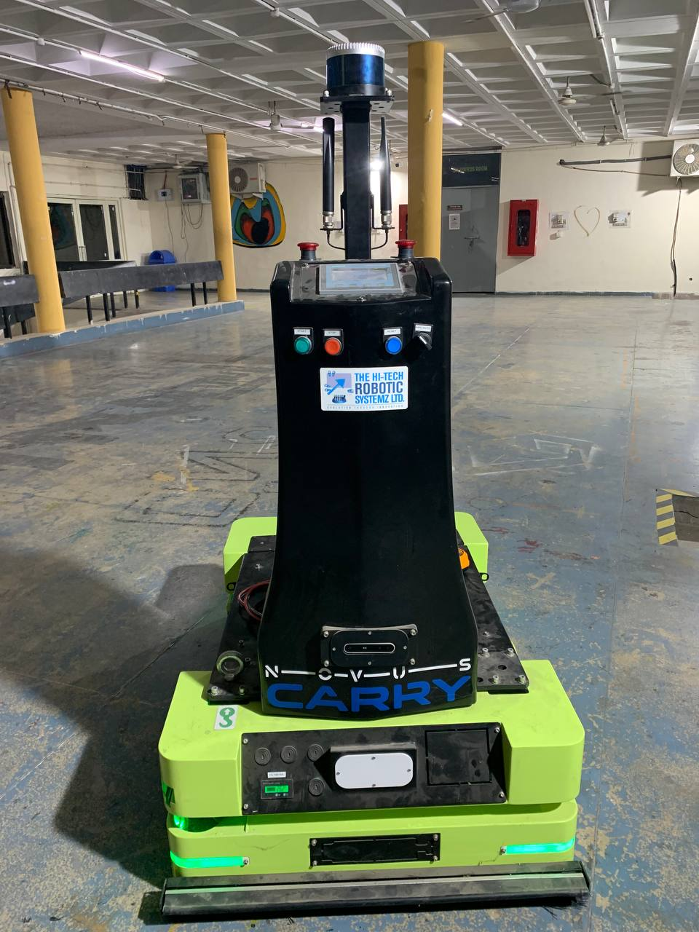
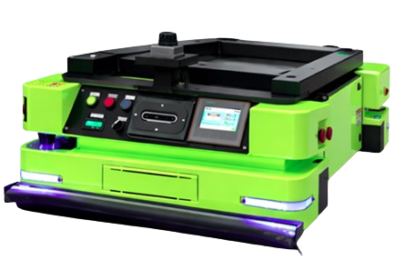
INTRODUCTION:
This project optimizes autonomous navigation for the Novus MR500, a 500 kg-payload industrial robot. Using ROS Noetic with LiDAR, depth cameras, and safety scanners, it applies SLAM, localization, and path planning for safe operation in industrial environments.

Slide 4

MAPPING(Gmapping):
Gmapping is a highly popular, highly efficient algorithm and software package used in robotics for laser-based SLAM (Simultaneous Localization and Mapping).

Slide 5
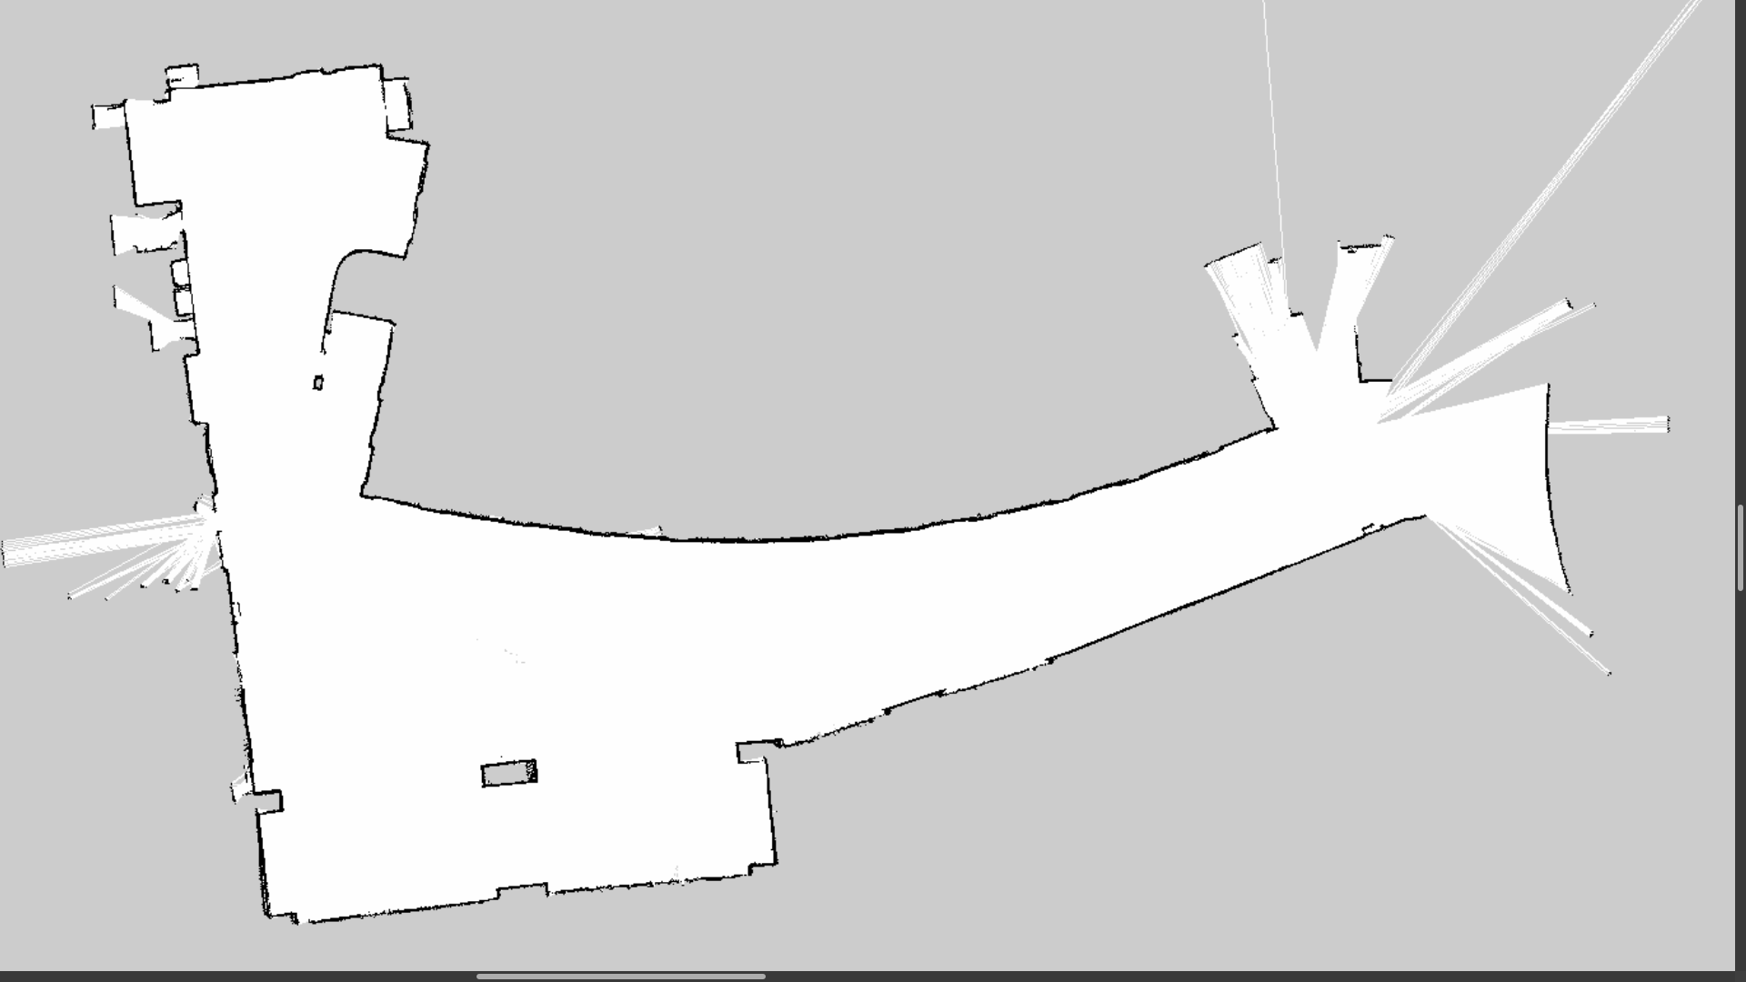
MAP:
Mapped Area: Approximately 2,000 square meters

Slide 6
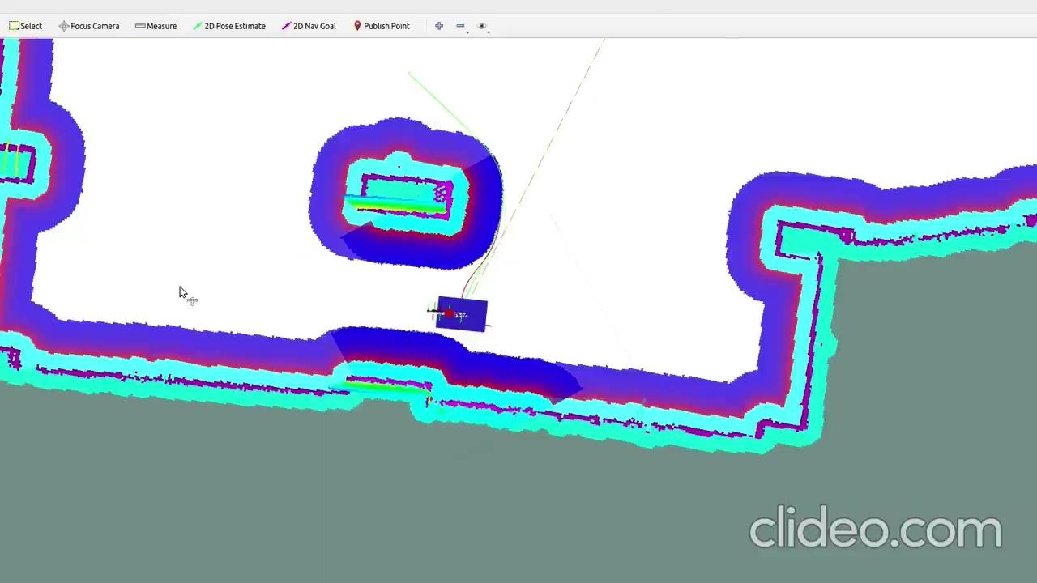
NAVIGATION:
First, I used a 2D LiDAR and odometry to run Gmapping, which built a 2D map of the space in real-time. Once the map was saved, I fed it into the navigation pipeline. I used AMCL to handle the robot's localization on that map, and move_base to calculate global paths and send velocity commands to the wheels so the robot could navigate safely to a designated goal.

Slide 7
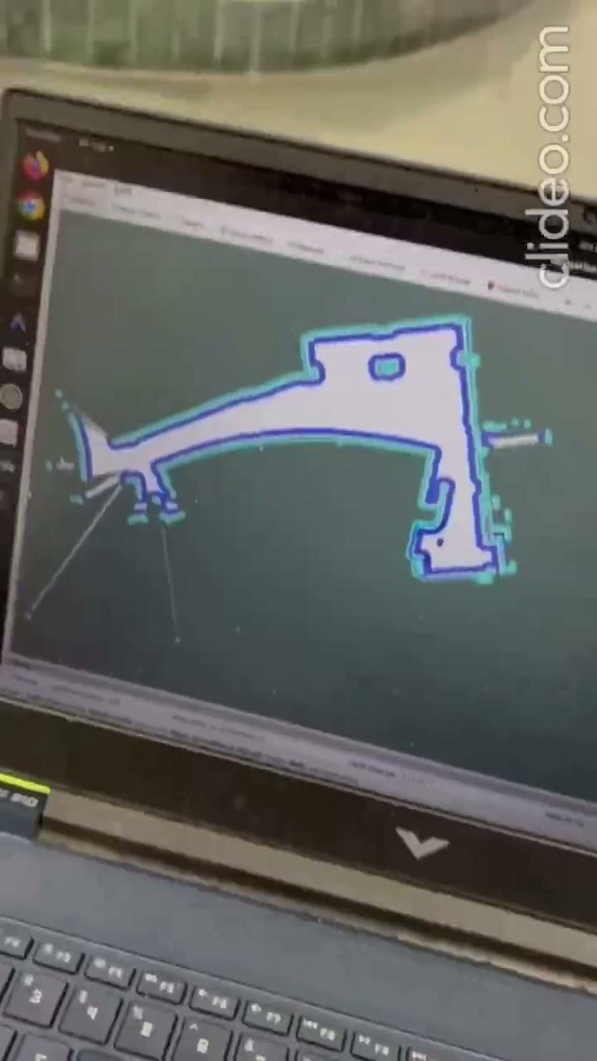
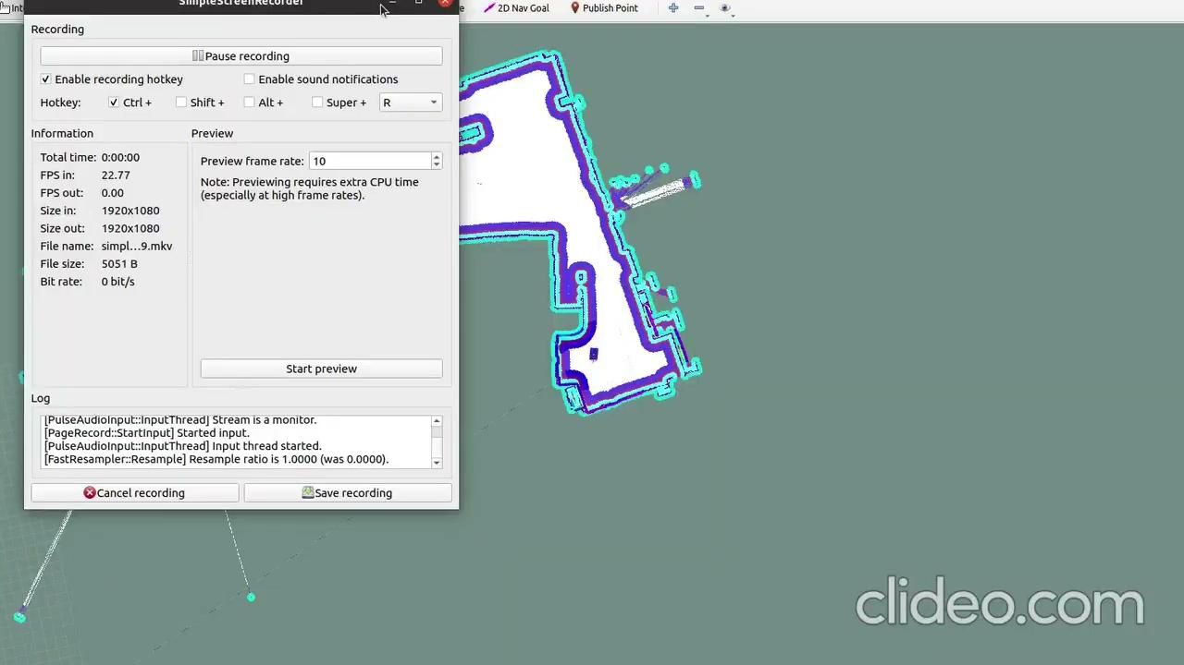
NAVIGATION:

Slide 8
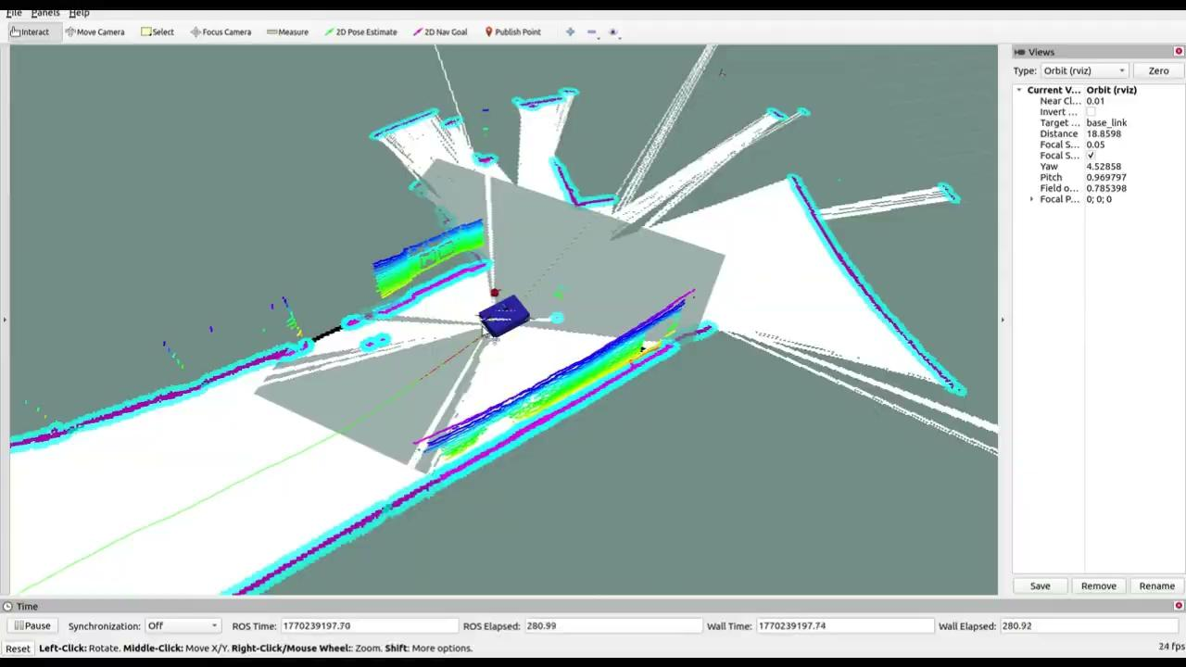
NAVIGATION with Dynamic Obstacle:

Slide 9
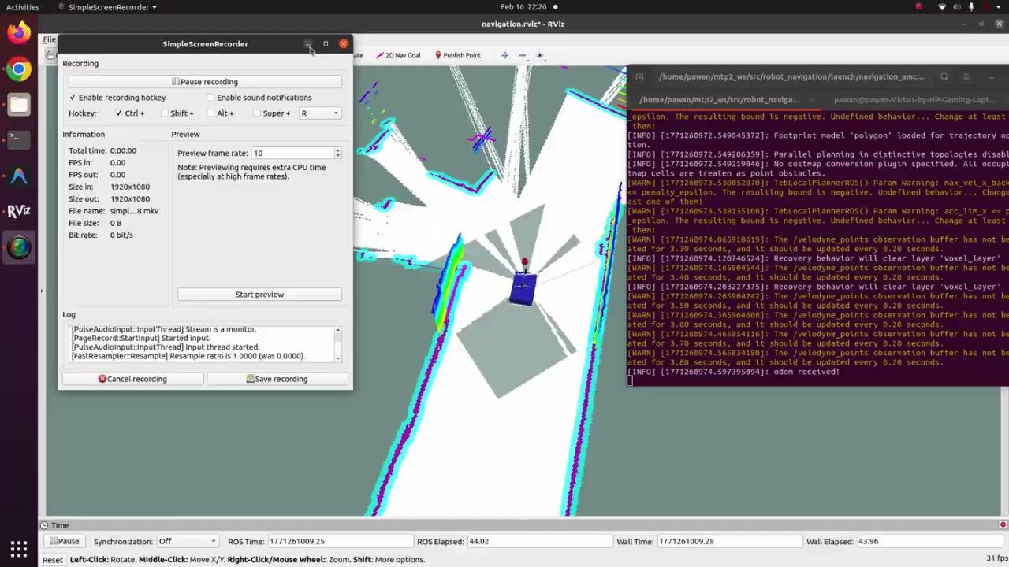
Costmap Issue with Dynamic Obstacle:

Slide 10
Persistenting ghost obstacles.: I encountered a persistent ghost obstacle issue where dynamic obstacles remain on the costmap even after moving away. Despite trying multiple configuration approaches - observation persistence, time-based decay, raytrace clearing - the obstacles wouldn't clear properly.
My solution: I wrote an auto-clearer script that periodically resets the costmap every 5 seconds. This doesn't affect navigation performance because the costmap continuously rebuilds from live sensor data. It's a practical workaround for what appears to be a ROS costmap clearing bug. This demonstrates real-world engineering - when the ideal solution isn't available, I implement a pragmatic workaround that achieves the desired result.

Slide 11
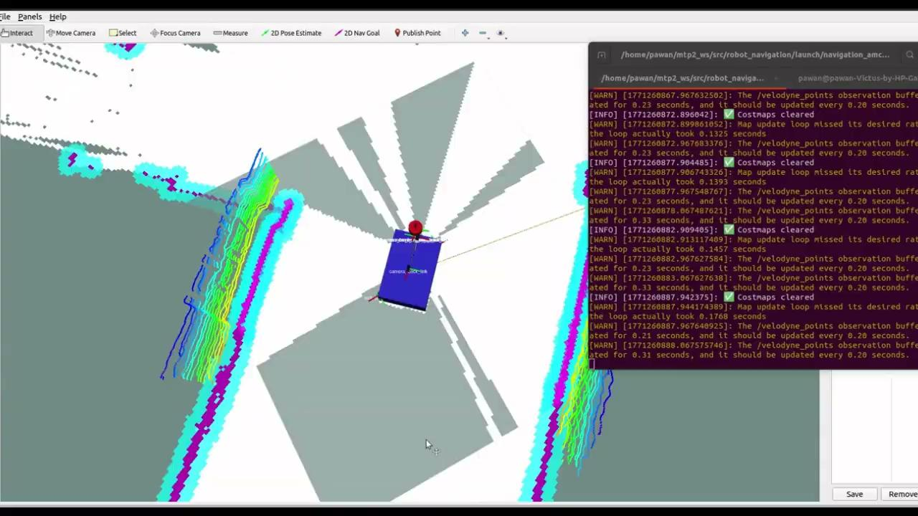
Costmap issue resolved(auto_clearer_costmap.py):

Slide 12
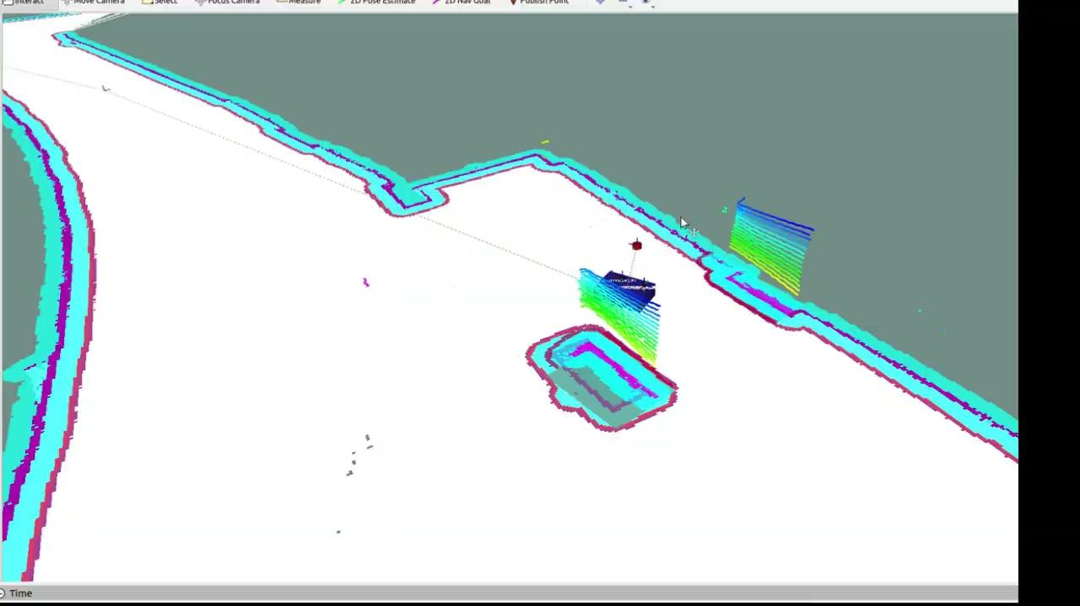
Costmap issue resolved(raytrace_range fix):

Slide 13
Next Task:
I had two main objectives:
First were addressing the remaining issues like the costmap clearing bug. => ReSolved
Second, and this is the key direction my professor has guided me toward - implement map switching/stitching for large-scale navigation.
Currently, we use one large 8000×8000 map which causes CPU load.
The plan is to divide large environments into smaller map segments - approximately 600-800 square meter tiles - and implement dynamic map switching as the robot moves between areas.
This would allow navigation across very large buildings or campuses without the memory and CPU overhead of one massive map.
The challenge will be seamless switching and maintaining localization during map transitions.

Slide 14
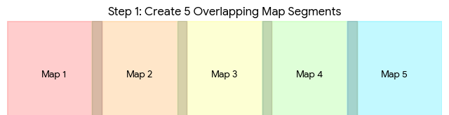
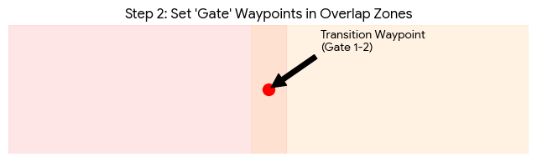
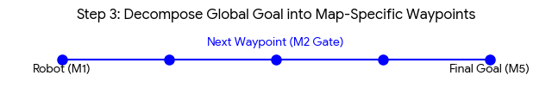
Proposed Solution :

Slide 15
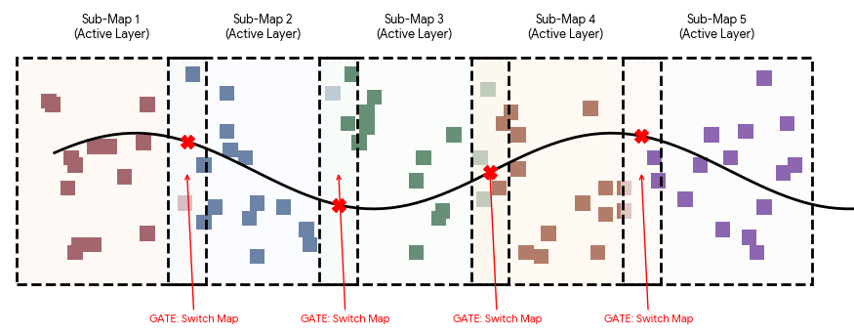
Proposed Solution:
Transition Triggered( Kill old map_server + Launch new map_server + wait for /map + clear costmap of 1st map + auto_localize and set initial pose + initialized costmap onto map2)

Slide 16
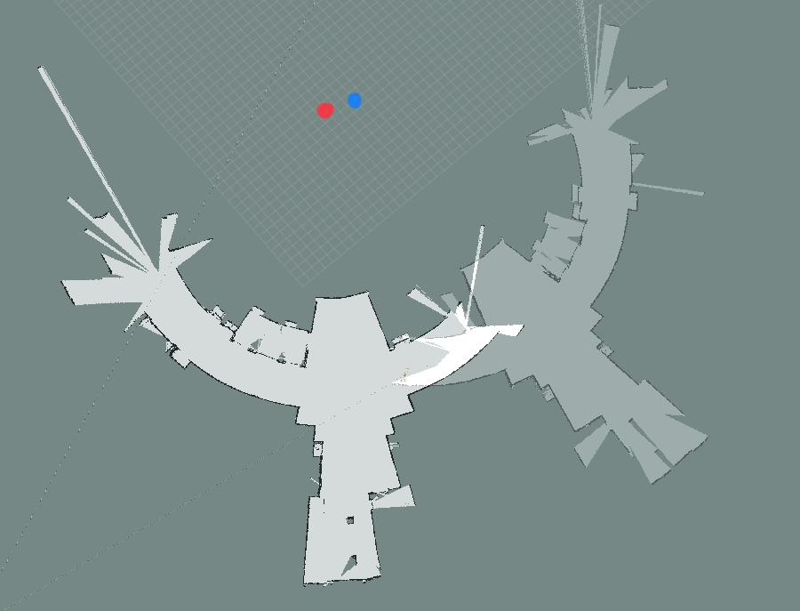
Proposed Solution : Common Areas

Slide 17
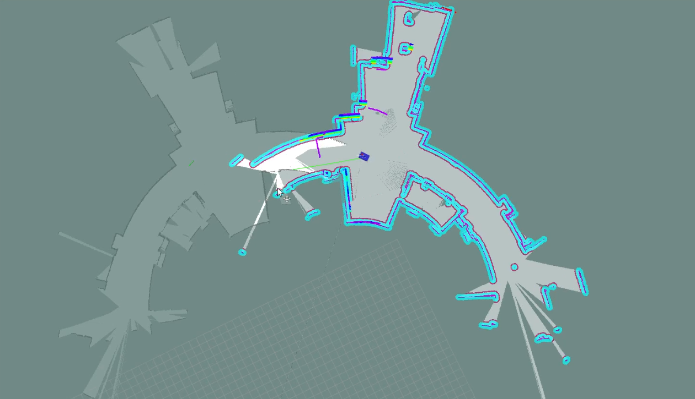
Why Are the Two Maps Not Aligned?
Both maps were built in separate SLAM sessions, and each session started with a different robot orientation, so the coordinate frames of the two maps are not the same. When displayed together in RViz, they appear rotated relative to each other because there is no common global reference between them.

Slide 18
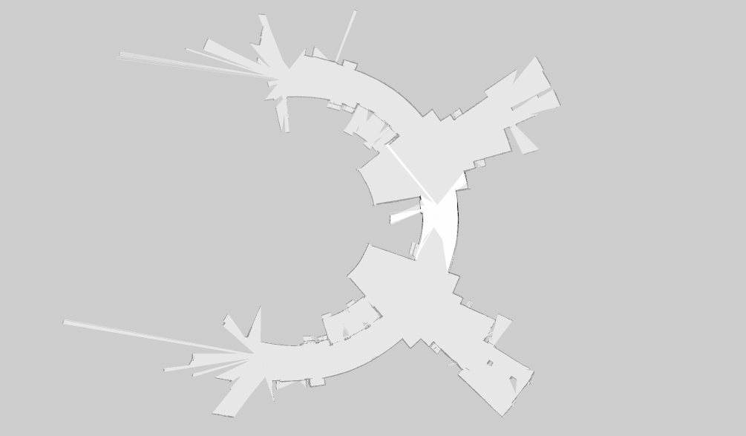
Proposed Solution : Common Areas(map1+map2)

Slide 19
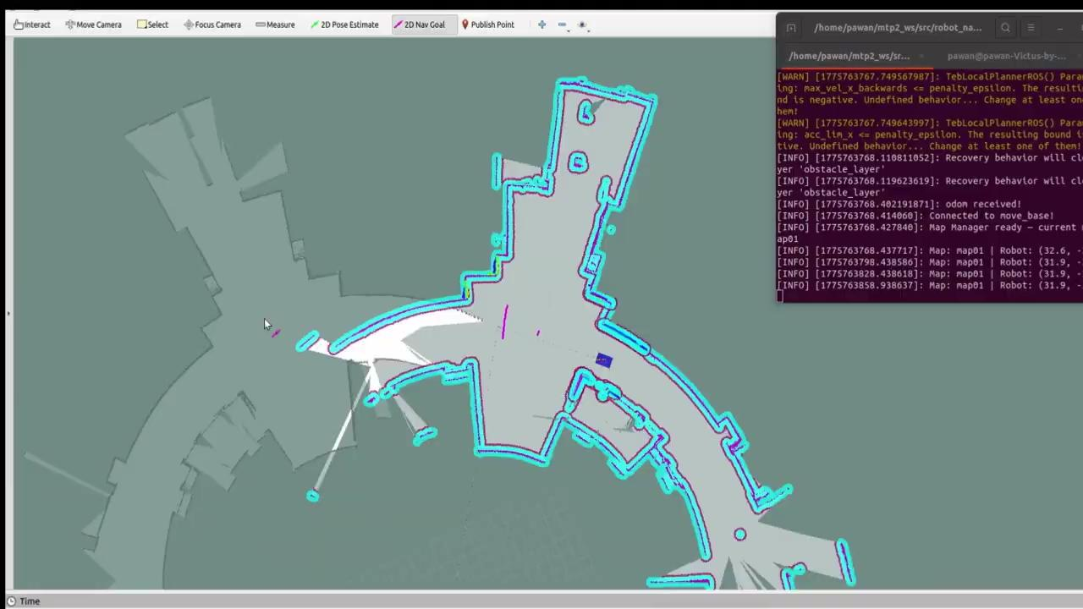
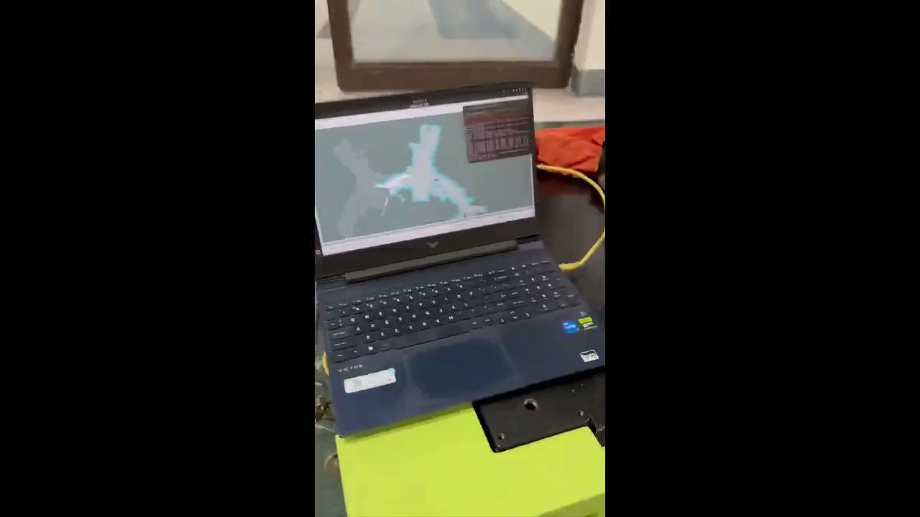
Navigation (Map1 -> Map2):

Slide 20
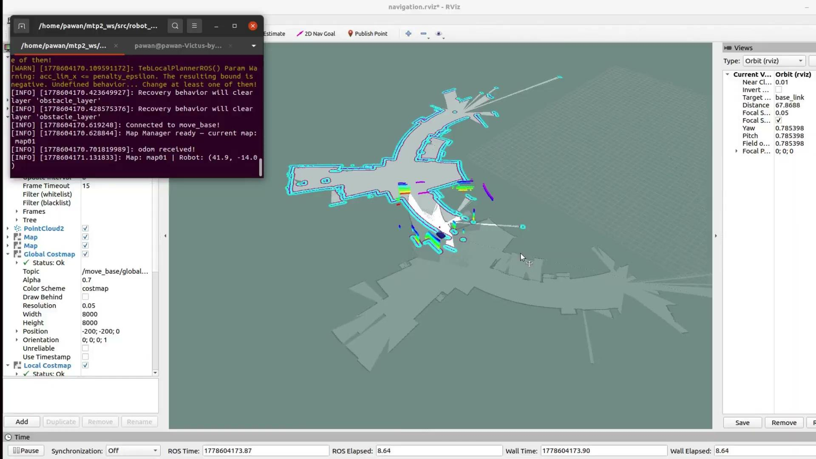
Navigation (Map2 -> Map1):

Slide 21
Future Work:
1. Multi-map scaling:
Extend the map-tiling framework to 3-4 maps covering an entire building door, maintaining a connectivity graph of tile adjacencies for meta-level path planning. This would enable navigation across facilities as large as hospital wings or university campuses.
2. Automated map alignment:
Develop an algorithm that automatically identifies the overlap region between adjacent SLAM maps using shared scan features (ICP on boundary scan fragments), removing the manual polygon definition requirement.
3.Long-duration reliability testing:
Conduct 6+ hour continuous navigation trials to validate localization stability over extended operation periods, identifying and addressing edge cases such as symmetric corridor ambiguity and AMCL kidnap recovery.

Slide 22

Hosting RoboRide Event:
Purpose of RoboRide:
RoboRide showcased the Novus Robot at IIT Delhi, conducting 35–40 sessions with 100+ joy rides to evaluate performance and reliability, gather user feedback, promote robotics research, and assess readiness for interactive and industrial deployment.
Took feedback from the Rider.

Slide 23
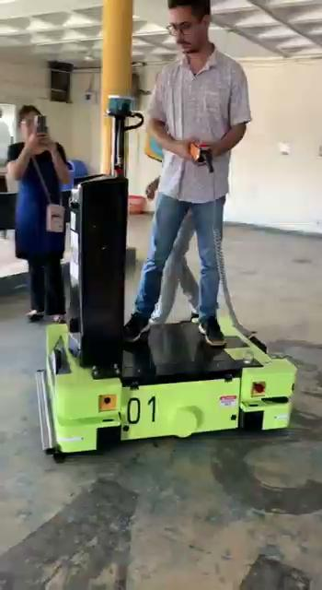
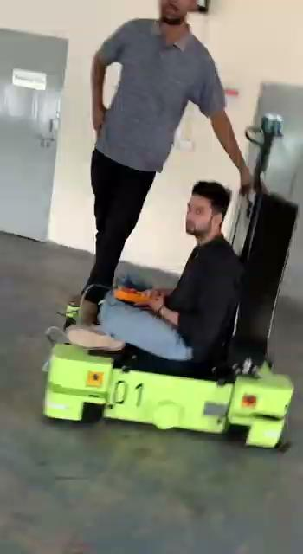
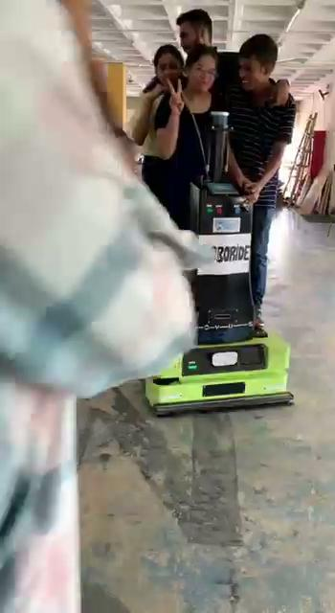
Hosting RoboRide Event Videos:

Slide 24
common_areas:
# ── map01 → map02 ──
# trigger_polygon: the transition area measured in MAP01 coordinates
# drop_polygon: the SAME physical area measured in MAP02 coordinates
- from_map: "map01"
to_map: "map02"
route_point: {x: 38.85, y: -15.6, yaw: 0.0}
trigger_polygon:
- {x: 38.0, y: -14.8}
- {x: 38.2, y: -16.3}
- {x: 39.6, y: -16.4}
- {x: 39.6, y: -14.9}
drop_polygon:
- {x: 40.8, y: -15.4}
- {x: 40.3, y: -16.7}
- {x: 41.7, y: -17.4}
- {x: 42.5, y: -15.7}
# ── map02 → map01 ──
# trigger_polygon: the transition area measured in MAP02 coordinates
# drop_polygon: the SAME physical area measured in MAP01 coordinates
- from_map: "map02"
to_map: "map01"
route_point: {x: 41.325, y: -16.3, yaw: 3.14}
trigger_polygon:
- {x: 40.8, y: -15.4}
- {x: 40.3, y: -16.7}
- {x: 41.7, y: -17.4}
- {x: 42.5, y: -15.7}
drop_polygon:
- {x: 38.0, y: -14.8}
- {x: 38.2, y: -16.3}
- {x: 39.6, y: -16.4}
- {x: 39.6, y: -14.9}

Slide 25
Thank You

Slide 26
Proposed Solution (6-Stage Map Switching):
Stage 1 → Kill old map_server (free the /map topic)
Stage 2 → Launch new map_server (publish new /map)
Stage 3 → Wait for /map (synchronize — don't proceed with a stale map)
Stage 4 → Clear costmaps (1st) (force static layer to reload from new /map)
Stage 5 → Auto-localize (tell AMCL where the robot is in the new map)
Stage 6 → Clear costmaps (2nd) (rebuild costmaps around the correct pose)
(i) Kill old map_server + Launch new map_server + wait for /map + clear costmap of 1st map + auto_localize and set initial pose

