Slide 1

Notes:
Hello, my name is Francois Schmitt, I am a student of the BSc Honours Data Science and AI Online Degree Programme at IIT Guwahati, and this is my Trimester 8 term project: Does Machine Learning Beat the Credit Scorecard? (state name, programme and project verbally, face visible)

Slide 2
THE PROBLEM
Probability of Default: the Highest-Stakes Model in Banking
The task: estimate the probability that a loan applicant defaults, using only information available on the day of application.
Why it matters: PD models drive accept/reject decisions, pricing, and, under Basel and IFRS 9, regulatory capital and provisions.
The status quo: banks still use logistic-regression scorecards, a forty-year-old technology, because they are stable and explainable.
The ML claim: benchmarking papers report boosted trees dominate, but they score models almost exclusively by AUC, the area under the ROC curve.
The question: does the ML advantage survive the criteria a lender actually needs?
1. Discrimination
Can the model rank bad borrowers above good ones? (area under the ROC curve, AUC; and KS)
2. Calibration
Can the predicted PD be taken at face value? (Brier, ECE, reliability)
3. Profit
Does the model make money at its accept/reject cutoff?
Notes:
The problem: PD estimation from origination-time data only. Banks use scorecards for regulatory reasons; the literature says ML wins but measures only discrimination. My project tests all three criteria.

Slide 3
TOOLS AND TECHNOLOGIES
A Reproducible Python Stack, CPU Only
Language
Data
Models
Workflow
Python 3.13
pandas
NumPy
kagglehub
scikit-learn
XGBoost
LightGBM
SciPy
Jupyter
VS Code
Git / GitHub
LaTeX
Everything is scripted: one command reproduces the full study, about 18 minutes on a laptop; all seeds fixed, one shared vintage split.
Notes:
Quick tools mention: Python 3.13, pandas for data, scikit-learn plus XGBoost and LightGBM for models, everything in a modular package on GitHub; one command reproduces the study in about 18 minutes.

Slide 4
DATASET
Lending Club Personal Loans, Engineered Against Leakage
621,022
151 → 23
12.6 → 14.9%
30,000
36-month loans, 2007-2015
columns after leakage whitelist
default rate, train → test vintage
UCI Taiwan clients (robustness)
Small unsecured consumer loans
FICO credit score: floor 662, median 692, an approval cutoff
Size
$500 to the $35,000 ceiling, median $10,000, $342 a month
Purpose
57% debt consolidation, 24% credit card: refinancing
Price
5.3% to 29.0%, mean near 12%
Housing
46% mortgage, 43% renting, 10% owned
Borrower
median income $60,000, debt-to-income ratio 17%
Grades
A to D is 96% of the book; E to G only 4.3%
The leakage filter is the hard work: of the 151 raw columns, most are post-origination servicing fields (payments received, recoveries, hardship flags) that trivially predict the outcome. I kept an explicit whitelist of 23 origination-time fields.
Out-of-time split: train on 2007-2013, calibrate on 2014, test on 2015, exactly how a deployed model meets the future. The rising default rate across vintages is the drift a real model faces.
Notes:
Dataset: public Lending Club loans, and worth a moment on what they actually are. Small unsecured consumer loans, median ten thousand dollars over three years, mostly people refinancing more expensive credit-card debt. Note the FICO floor: from 2009 the minimum score in every single vintage is exactly 662, which is an approval cutoff, not a coincidence. Nobody genuinely subprime is in this sample, which is part of why the achievable AUCs sit near 0.68. Then the two key decisions: the origination-time whitelist against leakage, and the out-of-time vintage split.

Slide 5
APPROACH AND CODE
One Pipeline, Four Models, Identical Information
The creditrisk package
The baseline is honest: an industry-style WoE scorecard, not a strawman logistic regression on raw inputs.
Same information for everyone: all four models see the identical 23 features; preprocessing cannot explain the gaps.
Calibration is separated from fitting and profit uses real cash flows: repaid loans earn their interest, charged-off lose 65% of principal.
data whitelist + vintage split
woe / scorecard binning, IV screen, points
models XGBoost, LightGBM, MLP
calibration Platt + isotonic on 2014
metrics AUC, KS, Brier, ECE, DeLong
decision profit sweep over cutoffs
pipeline orchestration, 5 seeds each
Kept: 23 origination-time fields
Discarded: 128 columns
loan_amnt · term · int_rate · installment · grade · sub_grade
annual_inc · dti · emp_length · home_ownership · purpose
fico · revol_util · inq_last_6mths · delinq_2yrs · open_acc · revol_bal · total_acc · mort_acc · pub_rec
total_pymnt · total_rec_prncp · recoveries · collection_recovery_fee · last_pymnt_amnt · last_fico_range_high
Known only after the loan was funded. total_rec_prncp equals the loan amount for every repaid loan: it is the answer, not a feature.
Notes:
Walk through the package on screen here. The design principles: an honest scorecard baseline, identical information for all four models, calibration separated from fitting, and profit from real cash flows. Then the concrete version of the leakage decision: on the left what I kept, all knowable on the day of application; on the right what I threw away. Point at total_rec_prncp: principal received to date equals the loan amount for every repaid loan, so a model using it scores near-perfectly and has learned nothing.

Slide 6
EVALUATION
Three Questions, Each With Its Own Metrics
Discrimination: AUC, KS
AUC, the area under the receiver operating characteristic curve: the probability a random defaulter is ranked riskier than a random good borrower. KS, Kolmogorov-Smirnov: the maximum distance between the two score distributions. Both ignore whether the PD values themselves are right.
Calibration: Brier, ECE, reliability
Among loans assigned PD near q, do a fraction q actually default? Brier: mean squared error of the probability. ECE: average gap between predicted PD and observed default rate over 10 bins.
Decision quality: profit, with significance
Realized profit per 1,000 applicants across accept/reject cutoffs, from actual cash flows. Significance throughout: DeLong test for correlated AUCs, 1,000-resample bootstrap CIs.
Why three? A model can gain AUC while its probabilities become less trustworthy; 'best model' is undefined until the question is fixed.
Notes:
Define the metrics before showing numbers: AUC and KS for ranking, Brier and ECE for calibration, realized profit for decisions, with DeLong and bootstrap significance everywhere. The point: the three questions can rank models differently.

Slide 7
RESULTS 1 OF 4
Discrimination: the Trees Win, the Neural Net Loses
Model | AUC | KS | ΔAUC vs scorecard (DeLong)
Scorecard | 0.6767 | 0.2570 | baseline
XGBoost | 0.6850 | 0.2701 | +0.85 pts, p < 10⁻⁵⁴
LightGBM | 0.6843 | 0.2693 | +0.72 pts, p < 10⁻⁴⁸
MLP | 0.6716 | 0.2542 | −0.17 pts, p = 0.024 (worse)
Statistically decisive: 283,026 test loans give enormous power; the boosted-tree edge is unambiguous.
Economically modest: +0.85 AUC points, not the +8 to +15 sometimes quoted from random-split studies.
Deep learning does not pay: the MLP is significantly worse than the forty-year-old scorecard, on tabular credit data.
Why so close? The features include the platform's own risk pricing (grade, interest rate), and the out-of-time split denies flexible models the flattery of a random split.
Notes:
First results: XGBoost +0.85 AUC points over the scorecard, LightGBM close behind, both overwhelmingly significant by DeLong. The MLP actually loses to the scorecard. Explain why the gap is modest.

Slide 8
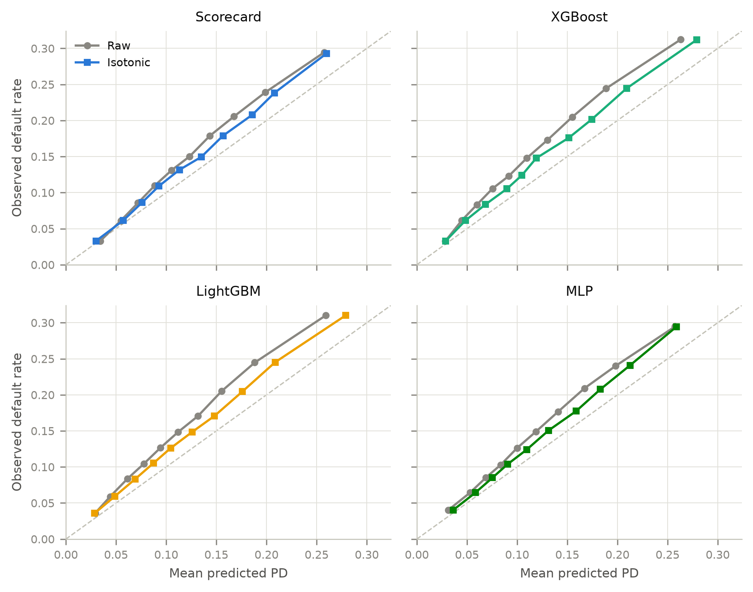
RESULTS 2 OF 4
Calibration: Every Raw Model Under-Predicts the Future
Read the diagonal: a calibrated model's curve lies on it. Every raw curve (grey) sits above: the 2015 vintage defaulted more than the training years, so all models under-predict PD.
Raw trees are worst: ECE 0.034 vs the scorecard's 0.025; margin-maximizing ensembles are not probability models.
Isotonic recalibration helps everyone but cannot anticipate drift that was not yet visible in 2014.
The scorecard beats the trees on calibration: ECE 0.0175 vs XGBoost's 0.0214 after identical recalibration. The trees keep the better Brier score, which also rewards discrimination.
Notes:
Reliability diagrams: raw curves above the diagonal because of vintage drift. Isotonic recalibration on 2014 removes most but not all bias. The trees never match the scorecard on calibration; this is why regulators monitor rather than trust PD models.

Slide 9
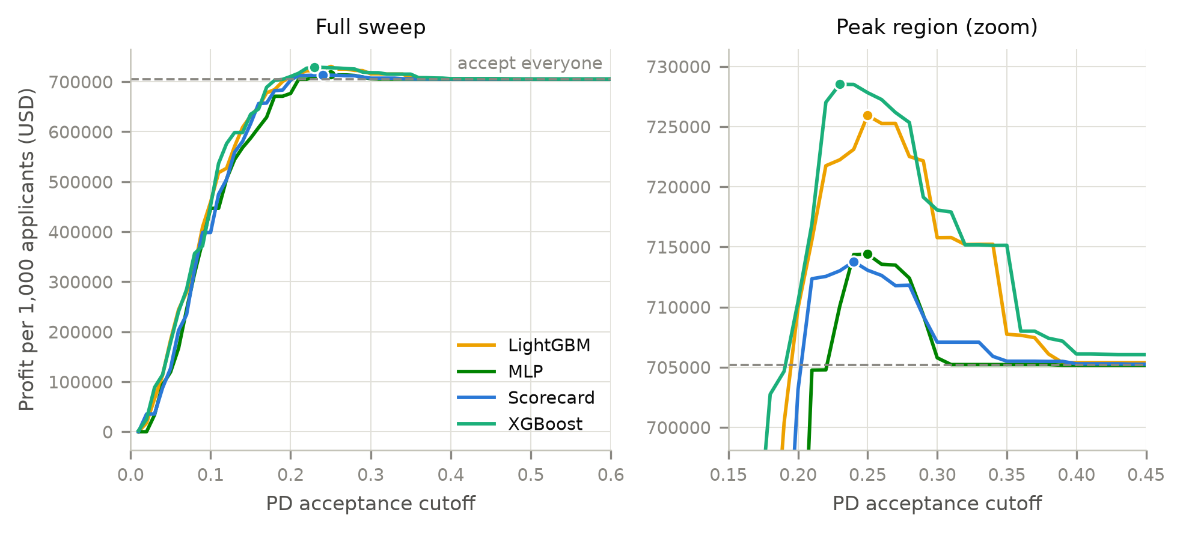
RESULTS 3 OF 4
Profit: the AUC Gap Becomes Money at the Cutoff
Accepting everyone already earns $705 per applicant; interest income dominates this portfolio.
Scorecard: reject the riskiest 6.7% for +1.2% profit.
XGBoost: reject 9.3% for +3.3%, that is +$14,700 per 1,000 applicants over the scorecard (+2.1%).
Scale decides adoption: a modest edge worth millions at bank volume, and nothing at credit-union volume.
Notes:
Profit curves from actual cash flows. The whole battle happens in the zoomed panel: XGBoost's optimal policy makes 2.1% more than the scorecard's. Modest per applicant, linear in volume.

Slide 10
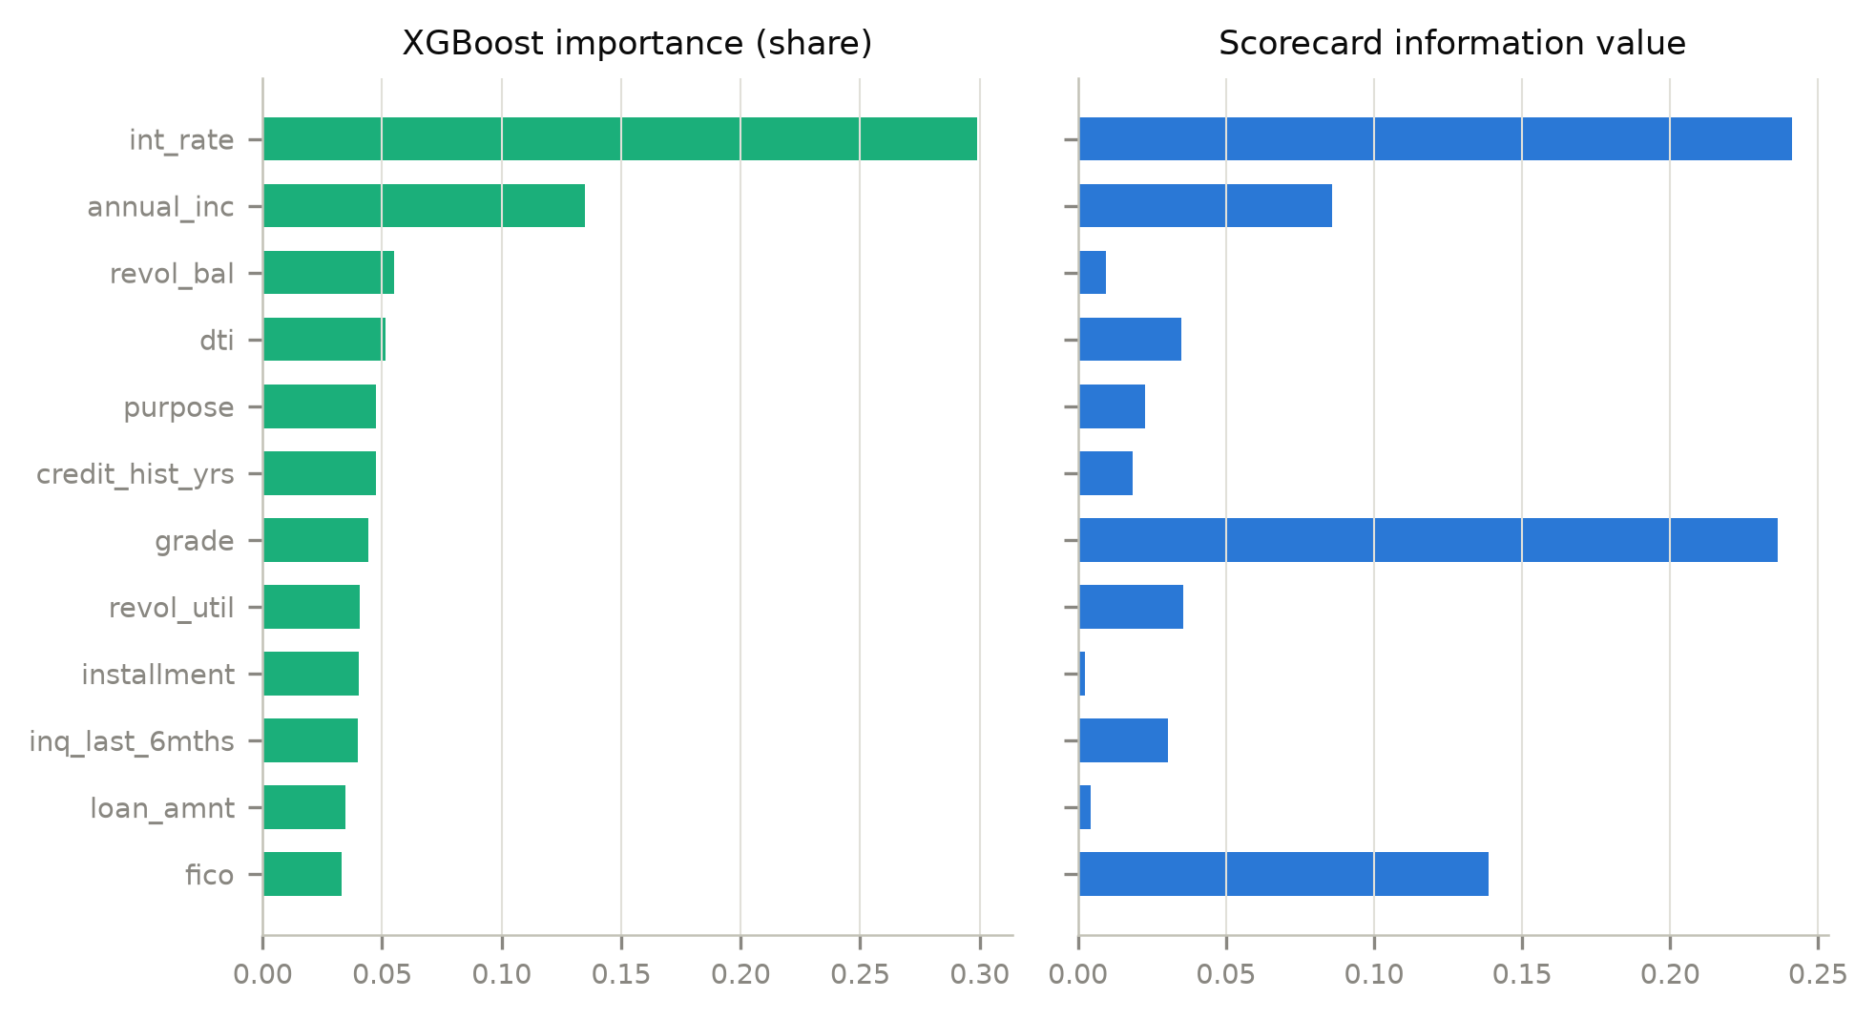
RESULTS 4 OF 4
What Did the Models Learn? Mostly the Same Thing
Both families agree that the platform's own pricing (interest rate, grade) carries the most signal; rank correlation 0.56.
They disagree in encoding: the scorecard leans on sub-grade and FICO bins; XGBoost prefers the continuous interest rate and income.
Interpretability trade-off: the scorecard is a readable sum of points per applicant; the ensemble needs post-hoc explanation tools.
Notes:
Feature importance vs information value: both models rely on the platform's risk pricing, so all four models largely re-rank loans Lending Club already ranked. The scorecard stays point-readable.

Slide 11
ABLATION
What If We Hide Lending Club's Own Pricing?
The concern: grade, sub-grade and interest rate are one variable in three notations, the platform's own risk assessment. They supply 36% of XGBoost's gain and 43% of LightGBM's. So are the models assessing credit risk, or just re-ranking loans Lending Club already ranked?
Variant A
Drop grade, sub-grade, interest rate. 20 features left.
Model | Baseline | Variant B | Change
XGBoost | 0.6850 | 0.6637 | −0.021
LightGBM | 0.6843 | 0.6622 | −0.022
MLP | 0.6716 | 0.6428 | −0.029
Scorecard | 0.6767 | 0.6397 | −0.037
Variant B
Also drop installment: with the term fixed at 36 months it tracks the rate at ρ = 0.998, so A still leaks pricing through it. B is the honest test.
The pricing was hiding the ML advantage, not creating it: the scorecard degrades almost twice as fast as the trees, so XGBoost's lead grows from +0.83 to +2.39 AUC points, and its profit edge to $15,400 per 1,000 applicants.
The trees used the proxy; the scorecard could not: the scorecard scores 0.6397 under both variants because its information-value screen had already discarded installment as too weak. The old-fashioned screen was the protection.
Notes:
The honest follow-up experiment. The platform's grade and rate are legitimate inputs for an investor, but they narrow the question. Rerunning without them: every model gets worse, the scorecard worst, so the ML advantage nearly triples. And the scorecard's IV screen had already thrown out the installment proxy that both tree ensembles were quietly using.

Slide 12
ROBUSTNESS AND LIMITATIONS
Same Ranking on an Independent Dataset
Honest limitations
UCI Taiwan credit-card default (30k clients)
Accepted loans only: all models inherit Lending Club's own selection; reject inference is an open problem.
Simple profit model: undiscounted, fixed LGD of 0.65, no partial recoveries or prepayment.
Platform grades kept as features: realistic for an investor; the ablation shows this understates the ML advantage by about 3x.
One market, one test vintage: 2015 was benign; a recession vintage could reorder the calibration findings.
My scorecard is unconstrained: expert binning with monotonicity constraints would likely close part of the gap.
XGBoost 0.788 vs scorecard 0.772 AUC: +1.50 pts, p = 2.8×10⁻⁶
MLP 0.766 again below the scorecard
Scorecard again best ECE after identical recalibration
Notes:
Taiwan reproduces the ranking, so it is not a Lending Club artifact. Then the honest limitations: reject inference, simple cash-flow model, platform grades as features, single benign test vintage.

Slide 13
WRAP-UP
A Qualified Yes: ML Wins, but Narrowly, and Only the Trees
Boosted trees beat the scorecard on all three criteria: discrimination (+0.85 AUC pts, p < 10⁻⁵⁴), Brier after identical recalibration, and profit (+2.1% at the optimal cutoff).
But the margins are modest and uneven: the MLP loses to the scorecard outright, and the scorecard stays better calibrated than either tree ensemble.
The margin depends on the information set: withholding the platform's own pricing widens XGBoost's lead from 0.83 to 2.39 AUC points, so the headline number understates what ML offers a lender underwriting from bureau data directly.
What I learned: leakage control was the highest-leverage work in the project; the model ranking changes with the question asked; and vintage drift is why PD models are monitored, not trusted.
Future work: reject inference, default-timing survival models, discounted cash flows, monotonic gradient boosting, a recession-vintage stress test.
Code, results and report: github.com/iitgF/T8 François Schmitt · 23035010523 · BSc (Hons) DSAI, IIT Guwahati
Notes:
Wrap up: qualified yes. Recap the three criteria, the learnings, and future work. Point to the GitHub repo where everything reproduces with one command. Thank the viewer.

