Slide 1

INTERNSHIP/TERM PROJECT
Forecasting Daily Equity Volatility: Can Machine Learning Beat Classical Models?
Student Name :
François Schmitt
Student ID :
23035010523
Indian Institute of Technology Guwahati
Email ID :
f.schmitt@op.iitg.ac.in
Programme :
BSc. (Hons.) Data Science & AI
Course Code :
DA 379
BSc. (Hons.) Data Science & Artificial Intelligence
Online Degree Programme
Course Name :
Term Project
Trimester :
IX

Slide 2
Introduction
What is the project about, and why?
Volatility: the size of an asset's daily price swings. It drives option pricing, value-at-risk, margins and position sizing.
A key asymmetry: the direction of tomorrow's return is unpredictable, but its size is strongly persistent, so it can be forecast.
Classical models: GARCH-type models have exploited this persistence for four decades.
The question: can machine learning (XGBoost) and deep learning (LSTM) forecast next-day volatility better than these classical baselines?
The approach: test every model fairly, in one harness, with no look-ahead bias, and check whether any difference is statistically real.

Slide 3
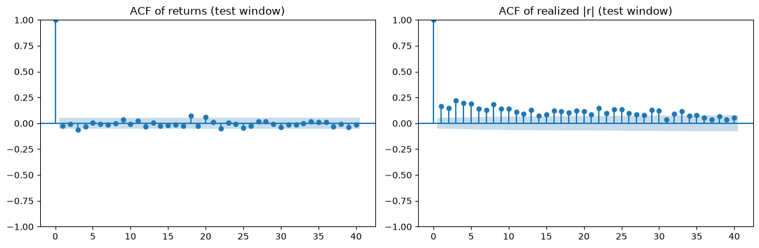
Why Volatility Can Be Forecast
Direction is noise; size is persistent
Returns: show no autocorrelation. Past returns do not predict the direction of the next one.
Absolute returns: show strong, slowly decaying autocorrelation. Big days cluster together.
Volatility clustering: this persistence is the one signal every model in this study exploits.

Slide 4
Objectives
1. Build honest classical baselines: naive, rolling, EWMA, and the GARCH family (GARCH, GJR-GARCH, EGARCH).
2. Build a leak-free walk-forward evaluation with RMSE, MAE, QLIKE and the Diebold–Mariano test.
3. Build a walk-forward XGBoost forecaster with justified features.
4. Build and regularize an LSTM forecaster with explicit anti-leakage guards.
5. Compare all models on one shared test window and test whether the differences are significant.
6. Deliver a reproducible, modular codebase.

Slide 5
Dataset: S&P 500 Daily Returns
Source: Yahoo Finance (^GSPC), auto-adjusted close
4,650
trading days
2008–2026
18.5 years
70 / 30
train / test split
1,395
out-of-sample days
Returns: daily log returns, the standard object for volatility models.
Preprocessing: log-difference adjusted closes; no other cleaning needed.
Test window: the final 30% (2020-12-07 to 2026-06-29), shared by every model.
Stress test: the window contains the 2022 bear market and the April-2025 tariff shock.

Slide 6
Tools & Technologies
Language
Python 3.13
Data
pandas
NumPy
yfinance
Models
arch (GARCH)
XGBoost
PyTorch (LSTM)
statsmodels
Workflow
Jupyter
VS Code
Git / GitHub
LaTeX
The five heavy model fits run in parallel processes; the full pipeline reproduces end-to-end in about one minute.

Slide 7
The Models
Eight forecasters, from three-parameter recursions to a neural network
Classical
Naive: yesterday's squared return
Rolling(21): variance of last 21 days
EWMA(0.94): RiskMetrics decay
GARCH(1,1): ω + α r² + β σ²
GJR / EGARCH: add the leverage effect
Learned
XGBoost: gradient-boosted trees, refit monthly
LSTM: reads 20 days of features
Shared features: recent returns, realized variance
Shared target: log smoothed forward variance
Guarded: train-only scaling, early stopping

Slide 8
Evaluation: A Leak-Free Walk-Forward
No look-ahead: the forecast for a day uses only data up to the day before. All models share one test window.
Periodic refit: classical and ML models are re-estimated about monthly, then rolled forward on observed data.
QLIKE (headline): robust to noise in the squared-return proxy, and it punishes under-prediction of variance.
RMSE / MAE: point accuracy on the volatility scale, for interpretability.
Diebold–Mariano: tests whether a gap in loss between two models is statistically real, not luck.

Slide 9
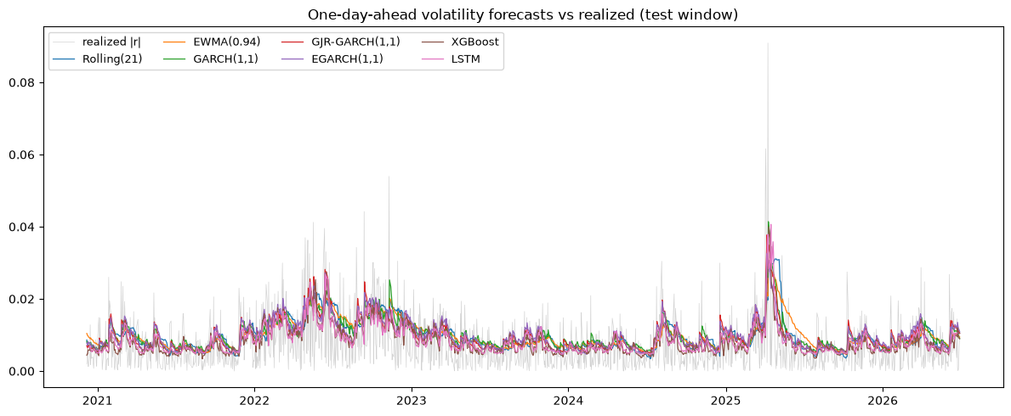
Results: Leaderboard
Out-of-sample, 1,395 days, sorted by QLIKE (lower = better)
Model | RMSE | MAE | QLIKE
EGARCH(1,1) | 0.00728 | 0.00556 | 1.5042
GJR-GARCH(1,1) | 0.00731 | 0.00554 | 1.5091
LSTM | 0.00686 | 0.00499 | 1.5287
GARCH(1,1) | 0.00751 | 0.00576 | 1.5569
EWMA(0.94) | 0.00750 | 0.00573 | 1.5814
XGBoost | 0.00691 | 0.00496 | 1.5911
Rolling(21) | 0.00762 | 0.00571 | 1.6344
Naive | 0.00951 | 0.00672 | 5440.5
All models track the same clusters. EGARCH(1,1) wins on QLIKE; the LSTM ranks 3rd, ahead of plain GARCH; the learned models take the best RMSE (LSTM) and MAE (XGBoost).

Slide 10
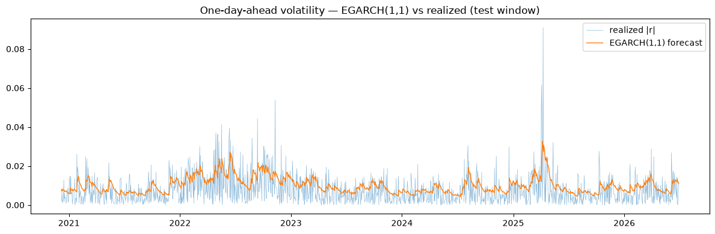
Is the Winner Really Better?
The best model vs the best baseline
EGARCH(1,1) gives the lowest QLIKE; GJR-GARCH is statistically tied (p = 0.47).
Leverage matters: both beat plain GARCH(1,1) decisively (p < 0.0001) on this window.
LSTM: third place, ahead of plain GARCH, and statistically tied with the winner (p = 0.19).
QLIKE 1.504
EGARCH(1,1), best model
p < 0.0001
EGARCH vs plain GARCH: significant

Slide 11
Why Do the Leverage Models Win?
Leverage effect: the test window is dominated by two sharp crashes (2022 and April 2025), and the leverage term turns a big fall directly into higher next-day variance.
Right objective: the GARCH family is fit by maximum likelihood on variance; the learned models train on a smoother substitute target.
Small data: roughly 3,250 noisy training days favours simple recursions over neural networks.
QLIKE asymmetry: it rewards fast reactions to spikes, and the GARCH recursion reacts the very next day.
Limitations: single asset and window, a noisy proxy, and deliberately modest hyperparameter tuning.

Slide 12
Conclusion & Takeaways
Answer: no. A monthly-refit EGARCH(1,1) gives the best QLIKE; no learned model beats the leverage GARCH family where it matters.
Nuance: the LSTM ranks third, ahead of plain GARCH, and is statistically tied with the winner; LSTM and XGBoost take the best RMSE and MAE.
Leverage matters: on a window with two asymmetric crashes, EGARCH and GJR significantly beat plain GARCH.
Main lesson: a leak-free walk-forward harness and the choice of metric matter more than model complexity.
Future work: intraday realized variance, extra inputs like the VIX, and multi-asset training.
Project artifacts
Code: github.com/iitgF/T9
Report: LaTeX (Overleaf)
Notebook: consolidated, runs end-to-end

