Slide 1

INDIAN INSTITUTE OF TECHNOLOGY GANDHINAGAR
PG Diploma in AI-ML and Agentic AI Engineering · Cohort 2 · Build 1
BRIEF A · GROWTH · GROUP 12
Which part of my business is short?
Tests grew 5.81% in H1 2026 (461,630 vs 436,302 tests) against an 18.21% plan, so we are 54,110 tests short. Clinic fell 11.1% while Home collection grew 38.4%.
Gurunath Hirve · Harshit Agrawal · Mihir Soni
Notes:
Say the question and the claim, nothing else. Twenty seconds. H1 means January to June. We planned 18.21% more tests than last year, we got 5.81%, and that leaves us 54,110 tests short. Clinic fell, Home grew.

Slide 2
1 · THE QUESTION
1 / 6
The problem and the approach we use
The problem
Her words: “Show me the part of my business that is short, by how much, and where.”
We planned 18.21% more tests in Jan–Jun 2026 (H1 2026) than in Jan–Jun 2025. We got only 5.81% more: 461,630 vs 436,302 tests.
That leaves us 54,110 tests short of the plan (515,740 tests).
The approach we use, step by step
Count every booked test in Jan–Jun 2025 and Jan–Jun 2026.
Split the growth into patients × visits per patient × tests per visit.
Compare each city with its plan, then split each city into Clinic and Home.
Look month by month to see when growth slowed.
Decide where Operations should look first.
Indian Institute of Technology Gandhinagar · PG Diploma in AI-ML and Agentic AI Engineering · Cohort 2 · Build 1
Notes:
One minute. Her three asks map to our answer: which part (Clinic), by how much (54,110 tests, 12.40 points of growth), and where (Jaipur, Chennai and Bangalore). Then walk the five steps. The decision this drives: where Operations looks first. A test means one test line in a booking; a visit is one booking.

Slide 3
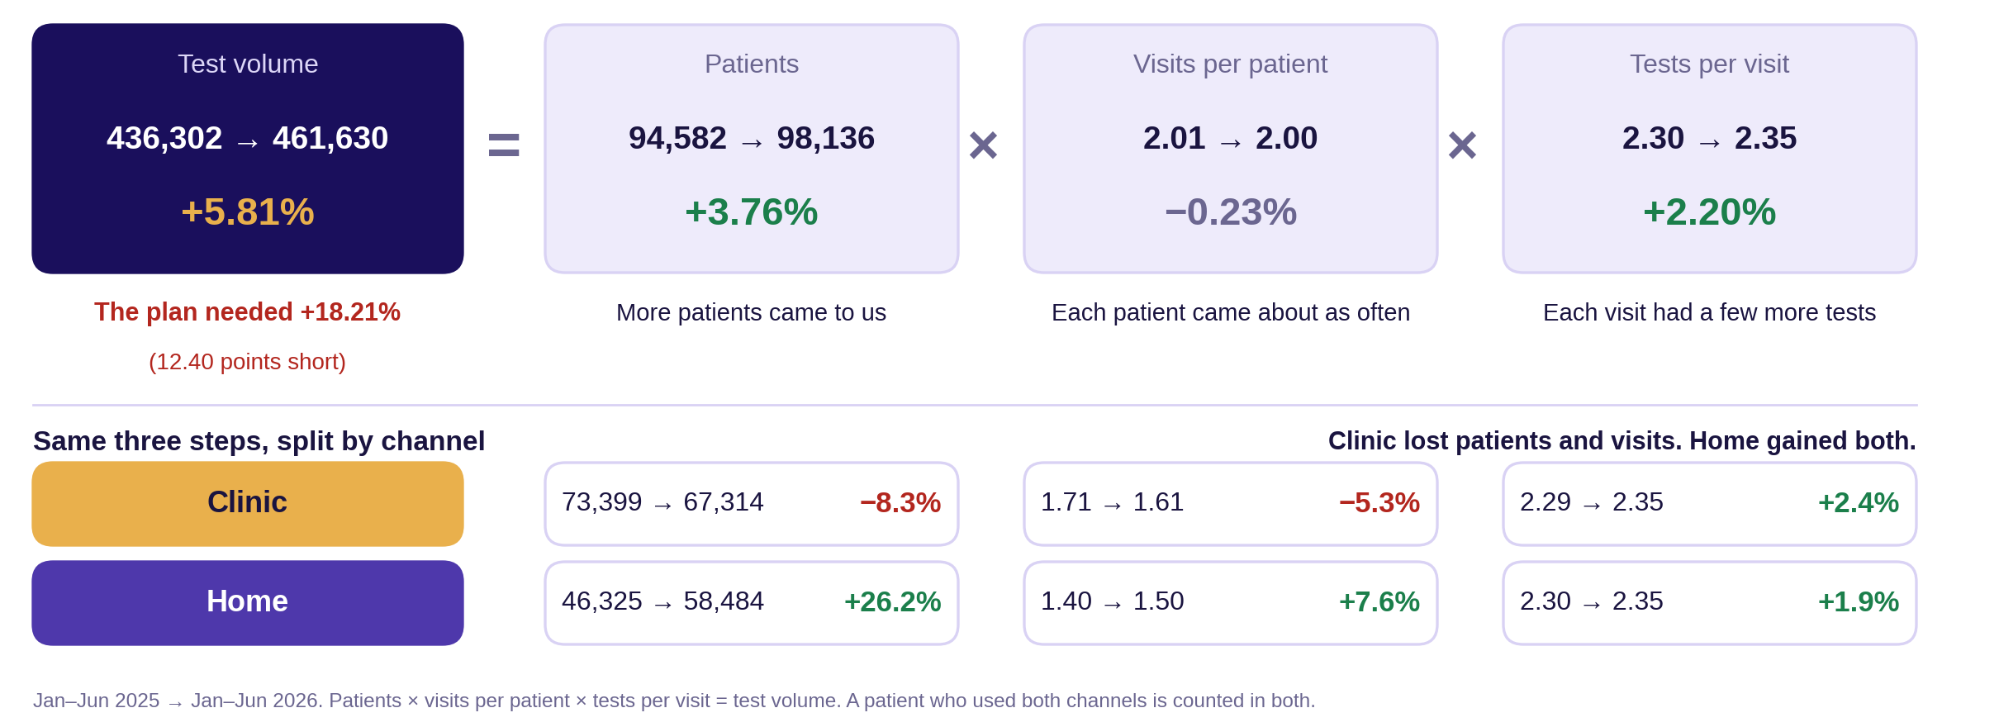
2 · THE PICTURE
2 / 6
What grew: patients, visits and tests
Indian Institute of Technology Gandhinagar · PG Diploma in AI-ML and Agentic AI Engineering · Cohort 2 · Build 1
Notes:
Ninety seconds. Point at two things: the top row and the Clinic and Home rows. Top row: test volume = patients x visits per patient x tests per visit. Growth came from more patients (+3.76%) and a few more tests per visit (+2.20%); visits per patient did not change. Bottom rows: Clinic lost patients (-8.3%) and visits per patient (-5.3%); Home gained both (+26.2% and +7.6%). Patient counts use patient IDs; we checked that no two IDs share the same phone and name, so IDs equal real people.

Slide 4
3 · THE CLAIM
3 / 6
We are 54,110 tests short of plan
Tests grew 5.81% in H1 2026 (461,630 vs 436,302), not the 18.21% planned. Clinic fell 11.1% and is below last year in all six cities; Home grew 38.4%.
Indian Institute of Technology Gandhinagar · PG Diploma in AI-ML and Agentic AI Engineering · Cohort 2 · Build 1
Notes:
Say the sentence. Stop. Count to two. The silence is the point; the slide has one sentence so the room reads it twice. Honest detail if asked: if Clinic had stayed flat, growth would still be only 13.1%, below the 18.21% plan. Clinic is the drag (-7.31 points) and Home the lift (+13.11 points).

Slide 5
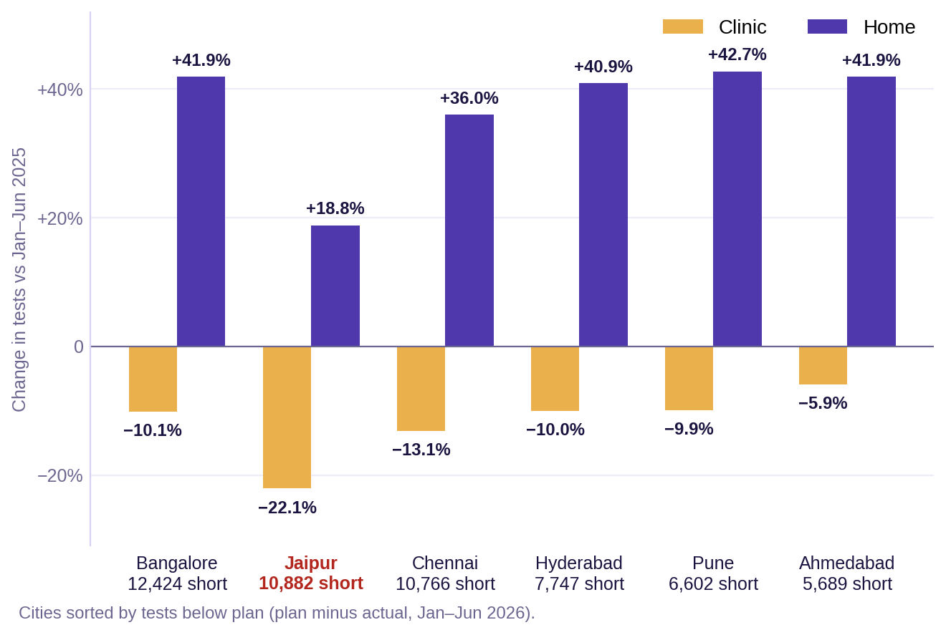
4 · THE EVIDENCE
4 / 6
Clinic is down in every city; Home is up
Number 1: 461,630 of 515,740 planned tests (89.5%), Jan–Jun 2026. Every month was between 87% and 93% of plan.
Number 2: Clinic −11.1% (255,301 vs 287,186 tests) and Home +38.4% (206,329 vs 149,116 tests), Jan–Jun 2026 vs 2025.
Number 3: 34,072 of the 54,110 missing tests (63%) are in Bangalore, Jaipur and Chennai. Jaipur is the only city with fewer tests than last year (−8.1%).
Indian Institute of Technology Gandhinagar · PG Diploma in AI-ML and Agentic AI Engineering · Cohort 2 · Build 1
Notes:
Two minutes. Each number with what it is measured against, said aloud. Number 1: 89.5% of plan, and no month reached plan. Number 2: Clinic -31,885 tests, Home +57,213 tests, net +25,328. Number 3: Bangalore 12,424, Jaipur 10,882, Chennai 10,766 below plan; the six city gaps add up to exactly 54,110. On the chart: amber is Clinic, purple is Home. Clinic is below last year in every city; Jaipur is worst (-22.1%) and its Home growth is also the weakest (+18.8%).

Slide 6
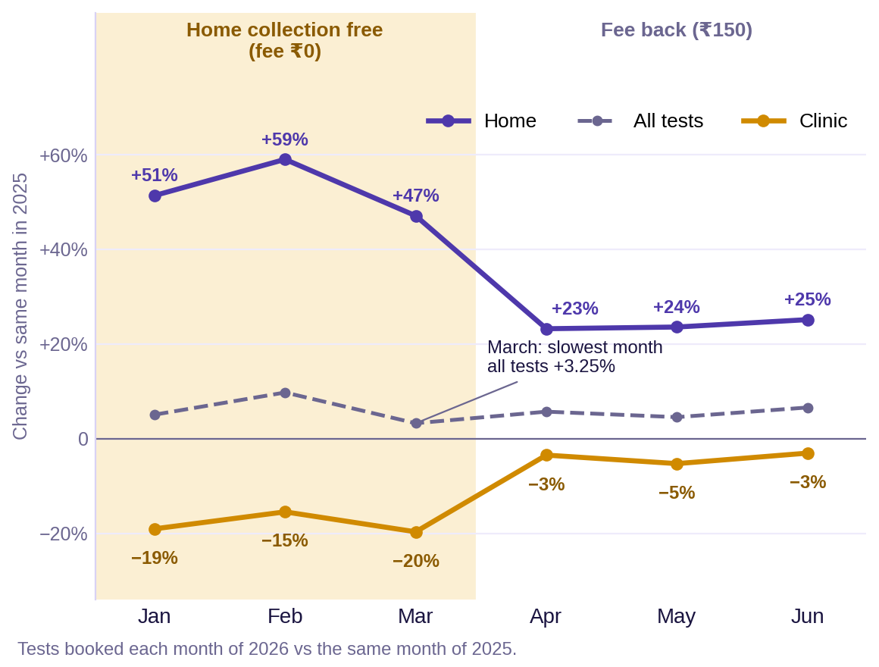
5 · THE CAVEAT AND THE ALTERNATIVE
5 / 6
What could change the answer
The free home offer (main caveat)
Home collection was free in Jan–Mar 2026 (the ₹150 fee was ₹0).
In those 3 months Clinic fell 18.1%. After the fee came back, Clinic fell only 3.9%.
So some Clinic patients may have moved to Home, not left us. We have not tested this yet.
A data check
1,500 rescheduled visits (Apr–Jun) are counted twice: 3,541 test lines. Without them, growth is +4.99%, not +5.81%.
The approach we rejected
Counting lab results instead of bookings. Results exist for only 82% of booked tests, and the plan follows bookings. Growth would be +5.76%, almost the same.
Indian Institute of Technology Gandhinagar · PG Diploma in AI-ML and Agentic AI Engineering · Cohort 2 · Build 1
Notes:
Ninety seconds. One main caveat with its size, one data check, one rejected approach. Offer: Home fee was Rs 0 for all 48,869 Home bookings in Jan-Mar 2026 (about Rs 73 lakh of fees given up). Clinic fell 18.1% in those months and 3.9% in Apr-Jun, so part of the Clinic fall may be patients switching. This is a pattern, not proof. Data check: 1,500 rescheduled Nova bookings in Apr-Jun also keep their original booking; 3,541 H1 test lines are the same visit counted twice. Removing them gives 458,089 tests, +4.99%, and the gap becomes 57,651. March was the slowest month (+3.25%); Bangalore Clinic had the biggest drop that month (-2,671 tests). Rejected: lab results table, 357,769 vs 378,358 rows, +5.76%.

Slide 7
6 · THE ACTION
6 / 6
Our solution: a four-week Clinic review
Do (starting Monday), step by step
Report Clinic and Home separately from now on.
Start a four-week Clinic review: Jaipur (Clinic −22.1%), Chennai (−13.1%) and Bangalore (−10.1%) first.
Check three things: open clinic slots, clinic capacity, and how many bookings turn into visits.
Hold the free-home offer money until a small test shows who the offer reached.
It costs
Team time for the four-week review. The Q1 offer gave up about ₹73 lakh in home fees (48,869 bookings × ₹150).
If we are wrong, it costs
If the Clinic loss is real and we wait six months: about 31,885 Clinic tests stay lost (about ₹2.2 crore at ₹690 a test).
If the offer created real new demand and we stop it: we may lose part of the extra Home tests (+39,555 in Q1).
With two more days
Find out who used the free offer, and remove the double-counted rescheduled visits (headline becomes +4.99%).
Indian Institute of Technology Gandhinagar · PG Diploma in AI-ML and Agentic AI Engineering · Cohort 2 · Build 1
Notes:
One minute. Say the four steps, then the cost, then the cost of being wrong. No thanks, no summary. Then say questions and stop talking. Numbers: Clinic lost 31,885 tests in six months; at the average 2026 Clinic price of about Rs 690 that is about Rs 2.2 crore at list price. The data shows where the change happened, not why, so the review checks causes before any big spend.

Slide 8
Questions
The approach log, the decisions log and the challenges log are open in the repository:
https://github.com/iitgn-1711/c2-build1-brief-a-group-12.git
Backup slides follow: A decisions · B cities · C city and channel · D months · E free home offer · F data checks
Notes:
Leave this up during questions. When asked why this and not that, open the approach-log row on screen rather than answering from memory.

Slide 9
APPENDIX A
Appendix 1 / 6
Appendix A · The decisions that moved the headline
Rule 1: Count test lines from booking_tests.csv (1,315,183 rows over 18 months), keeping only Jan–Jun 2025 and Jan–Jun 2026. The lab results table has rows for only 82% of tests and gives +5.76%, so it was not used. Effect on the headline: none (this is the base).
Rule 2: Remove repeated booking rows: 1,279,308 rows become 568,007 unique booking IDs (711,301 exact repeats). No booking ID has two different cities, channels or sources. Effect: none on test counts; each test stays linked to one booking.
Rule 3: Clean names: “Bengaluru” (107,661 test rows) becomes “Bangalore”, and CLINIC / HOME in capitals (26,543 Nova bookings) becomes Clinic / Home. 0 test rows are left without a channel. Effect: none on the total; without this Bangalore would split into two cities.
Rule 4 (still open): Rescheduled visits are not removed. 1,500 Nova bookings (Apr–Jun 2026) replace an earlier booking, so 3,541 test lines are counted twice. Effect: removing them gives +4.99%, not +5.81%.
Every other check is in the notebook: data_analysis.ipynb
Indian Institute of Technology Gandhinagar · PG Diploma in AI-ML and Agentic AI Engineering · Cohort 2 · Build 1
Notes:
Backup slide: shown only if the panel asks. Do not present it. Rule 4 is the one to mention honestly: the notebook headline is +5.81%; after removing double-counted rescheduled visits it is +4.99% (458,089 tests, 57,651 below plan, 13.22 points of growth short).

Slide 10
APPENDIX B
Appendix 2 / 6
Appendix B · Every city against its plan
City | Jan–Jun 2025 | Jan–Jun 2026 | Growth | Plan | Plan growth | Below plan | Share of gap | % of plan
Bangalore | 100,070 | 107,661 | +7.6% | 120,085 | +20.0% | 12,424 | 23.0% | 89.7%
Jaipur | 45,149 | 41,490 | −8.1% | 52,372 | +16.0% | 10,882 | 20.1% | 79.2%
Chennai | 80,267 | 83,146 | +3.6% | 93,912 | +17.0% | 10,766 | 19.9% | 88.5%
Hyderabad | 73,237 | 78,674 | +7.4% | 86,421 | +18.0% | 7,747 | 14.3% | 91.0%
Pune | 60,653 | 65,575 | +8.1% | 72,177 | +19.0% | 6,602 | 12.2% | 90.9%
Ahmedabad | 76,926 | 85,084 | +10.6% | 90,773 | +18.0% | 5,689 | 10.5% | 93.7%
All six cities | 436,302 | 461,630 | +5.81% | 515,740 | +18.21% | 54,110 | 100% | 89.5%
Plan growth = plan ÷ Jan–Jun 2025 tests. The plan asked for 16% to 20% growth in each city. No city got close: the best, Ahmedabad, grew 10.6% against 18.0%.
Jaipur is the only city that shrank (−8.1%) and is at 79.2% of plan. Bangalore, Jaipur and Chennai together are 34,072 tests (63%) of the 54,110 gap.
Indian Institute of Technology Gandhinagar · PG Diploma in AI-ML and Agentic AI Engineering · Cohort 2 · Build 1
Notes:
Backup slide. All numbers come from the notebook city table (cell 11): tests 2025, tests 2026, planned tests, tests below plan. Plan growth, share of gap and % of plan are simple divisions of those numbers. Bangalore is counted from both spellings (Bangalore and Bengaluru).

Slide 11
APPENDIX C
Appendix 3 / 6
Appendix C · Clinic and Home in every city
City | Clinic 2025 | Clinic 2026 | Clinic growth | Home 2025 | Home 2026 | Home growth | All tests growth
Bangalore | 66,025 | 59,356 | −10.1% | 34,045 | 48,305 | +41.9% | +7.59%
Jaipur | 29,685 | 23,122 | −22.1% | 15,464 | 18,368 | +18.8% | −8.10%
Chennai | 53,032 | 46,093 | −13.1% | 27,235 | 37,053 | +36.0% | +3.59%
Hyderabad | 48,187 | 43,386 | −10.0% | 25,050 | 35,288 | +40.9% | +7.42%
Pune | 39,900 | 35,964 | −9.9% | 20,753 | 29,611 | +42.7% | +8.12%
Ahmedabad | 50,357 | 47,380 | −5.9% | 26,569 | 37,704 | +41.9% | +10.60%
All six cities | 287,186 | 255,301 | −11.1% | 149,116 | 206,329 | +38.4% | +5.81%
Clinic is below last year in all six cities (−5.9% to −22.1%). Home is above last year in all six (+18.8% to +42.7%).
Jaipur is weakest on both: Clinic −22.1% and Home only +18.8%. Net change: Home +57,213 and Clinic −31,885 tests = +25,328 tests.
Indian Institute of Technology Gandhinagar · PG Diploma in AI-ML and Agentic AI Engineering · Cohort 2 · Build 1
Notes:
Backup slide. Source: notebook cell 11 (channel summary) and the city-by-channel counts. Clinic -11.10% (-31,885 tests, -7.31 points of total growth); Home +38.37% (+57,213 tests, +13.11 points). If Clinic had stayed flat, total growth would be +13.11%, still below the 18.21% plan.

Slide 12
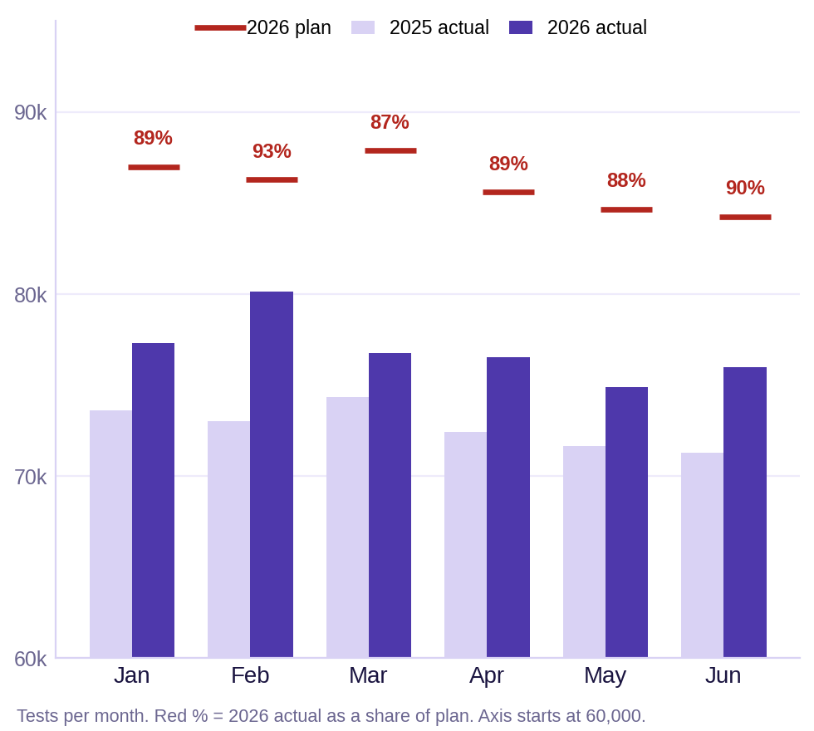
APPENDIX D
Appendix 4 / 6
Appendix D · Month by month
Month | 2025 | 2026 | Growth | Plan | % of plan | Below plan
January | 73,596 | 77,321 | +5.06% | 87,002 | 88.9% | 9,681
February | 73,007 | 80,123 | +9.75% | 86,293 | 92.8% | 6,170
March | 74,356 | 76,770 | +3.25% | 87,882 | 87.4% | 11,112
April | 72,428 | 76,558 | +5.70% | 85,616 | 89.4% | 9,058
May | 71,632 | 74,883 | +4.54% | 84,678 | 88.4% | 9,795
June | 71,283 | 75,975 | +6.58% | 84,269 | 90.2% | 8,294
Jan–Jun | 436,302 | 461,630 | +5.81% | 515,740 | 89.5% | 54,110
No month reached plan: every month was 87% to 93% of plan. The gap is steady, not one bad month.
March grew slowest (+3.25%). The biggest drop that month was Bangalore Clinic: −2,671 tests (−22.9%).
February grew fastest (+9.75%).
Indian Institute of Technology Gandhinagar · PG Diploma in AI-ML and Agentic AI Engineering · Cohort 2 · Build 1
Notes:
Backup slide. Source: notebook cells 13 to 16 and 24 to 25. Monthly plan totals come from plan_2026_H1.csv (sum of the six cities). Cumulative gap in tests versus last year reached +25,328 by June.

Slide 13
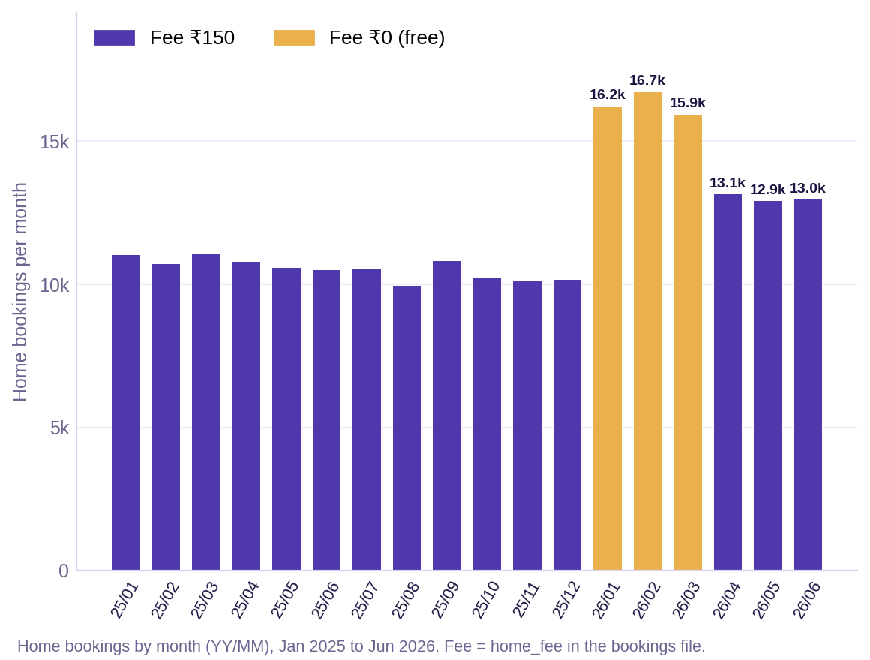
APPENDIX E
Appendix 5 / 6
Appendix E · The free home collection window
Channel | Period | 2025 | 2026 | Change | Growth
Clinic | Jan–Mar | 145,486 | 119,186 | −26,300 | −18.1%
Clinic | Apr–Jun | 141,700 | 136,115 | −5,585 | −3.9%
Home | Jan–Mar | 75,473 | 115,028 | +39,555 | +52.4%
Home | Apr–Jun | 73,643 | 91,301 | +17,658 | +24.0%
All tests | Jan–Mar | 220,959 | 234,214 | +13,255 | +6.0%
All tests | Apr–Jun | 215,343 | 227,416 | +12,073 | +5.6%
The home fee was ₹150 in every month except Jan–Mar 2026, when it was ₹0 (48,869 Home bookings; about ₹73 lakh of fees given up).
Total growth was similar in both periods (+6.0% and +5.6%), but the mix changed: Clinic fell much more while the offer ran.
This is a pattern, not proof. There is no control group, and we do not know who used the offer.
Indian Institute of Technology Gandhinagar · PG Diploma in AI-ML and Agentic AI Engineering · Cohort 2 · Build 1
Notes:
Backup slide. Source: home_fee column of bookings_combined.csv, unique bookings, channel Home. Fee was Rs 150 on every Home booking in 2025 and Apr-Jun 2026, and Rs 0 on every Home booking in Jan-Mar 2026 (48,869 bookings x Rs 150 = about Rs 73.3 lakh). Home growth stayed high after the fee returned (+24.0%), so part of the Home gain looks real, not only offer-driven.

Slide 14
APPENDIX F
Appendix 6 / 6
Appendix F · Data checks and the cold run
Data checks (all passed)
0 booking IDs with a different city, channel, source or month.
0 test rows without a booking channel; 0 test rows without a patient ID.
One patient per booking. 309,217 patient IDs = 309,217 people (no two IDs share a phone and name).
City gaps add up to 54,110 tests; Home +57,213 and Clinic −31,885 add up to +25,328.
Good to know
Revenue at list price grew faster than tests: +14.1% (₹27.9 crore to ₹31.8 crore), because the average price per test rose 7.8% (₹639 to ₹689). The plan is for test volume, so we did not use revenue.
The cold run (fill in after the run)
Headline after a fresh run: 461,630 vs 436,302 tests (+5.81%), the same as the claim slide. Add the date, who ran it, the runtime and the commit.
Indian Institute of Technology Gandhinagar · PG Diploma in AI-ML and Agentic AI Engineering · Cohort 2 · Build 1
Notes:
Backup slide. Revenue at list price uses test_price from booking_tests: Rs 278,759,748 in Jan-Jun 2025 and Rs 318,029,532 in Jan-Jun 2026. Cold run details (date, person, runtime, commit) are not in the data; fill them in after you rerun the notebook from a fresh environment.

