Slide 1
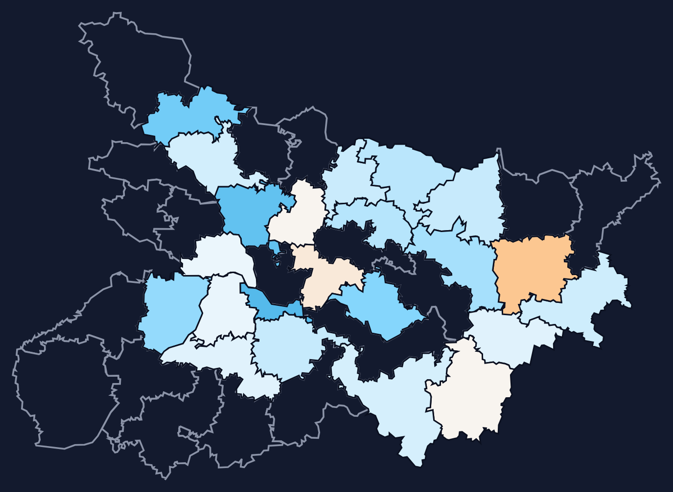
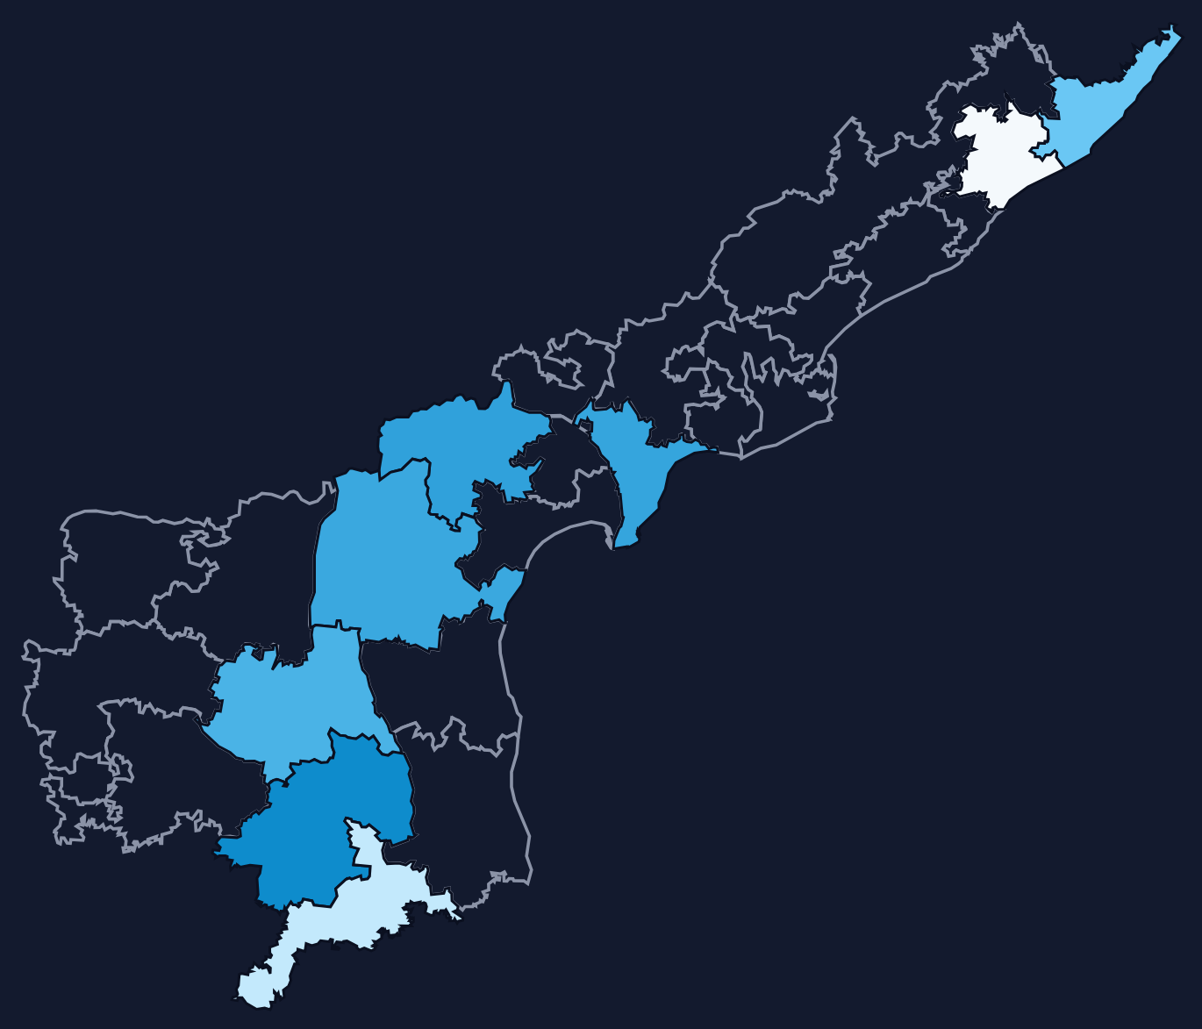
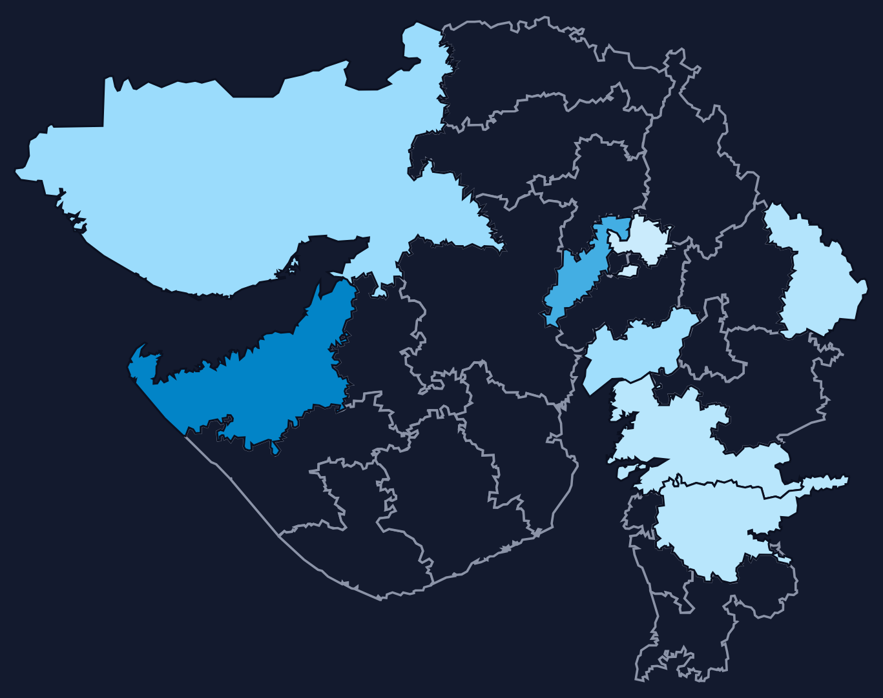
MP·ASSETS
LOK SABHA AFFIDAVIT ANALYTICS
PROJECT PRESENTATION
Assets & Re-contestation of Members of Parliament
BIHAR
How declared wealth of Lok Sabha candidates changed across the 2014, 2019 and 2024 general elections in Andhra Pradesh, Bihar and Gujarat
● 3 ELECTIONS · 2014–2024
Nivas · Gagan · Balaram
ANDHRA PRADESH
GUJARAT
MP·ASSETS
01 / 10
Notes:
Title slide. Team: Nivas, Gagan, Balaram.

Slide 2
PIPELINE / SOURCES
● 3 ELECTIONS · 2014–2024
Two sources, nine state-year datasets

MyNeta (ADR)

Wikipedia results

EasyOCR
● Full candidate lists for every constituency
● Party, age, education, criminal cases
● Total assets and liabilities from affidavits
● Winning MP for every constituency
● 2014, 2019 and 2024, verified against ECI reports
● Used to label each candidate winner / non-winner
● Some asset totals were published only as images
● EasyOCR on Colab T4 GPUs read the numbers
● 373 asset values recovered this way
SCRAPE DATES
17 Oct
17 Oct
18 Oct
20 Oct
25 Oct
2014 candidates
2019 candidates
2014 & 2019 winners
2024 candidates
2024 winners
MP·ASSETS
02 / 10

Slide 3
APPENDIX / TERMS OF USE
● 3 ELECTIONS · 2014–2024
Data sources and terms of use

MyNeta · ADR

Wikipedia
Candidate affidavit data compiled by the Association for Democratic Reforms from ECI filings. Used for non-commercial academic research, credited to MyNeta / ADR. Pages were fetched with a 2-second pause between requests.
Winner lists from the 2014, 2019 and 2024 election pages. Text is licensed CC BY-SA 4.0, so reuse needs attribution and the same licence. Requests were sent 1 second apart with a descriptive User-Agent.

Constituency boundaries
geo/india_pc_2019_simplified.geojson, DataMeet parliamentary boundaries (2008 delimitation). Credit DataMeet when the map is shown.
MP·ASSETS
10 / 10

Slide 4
PIPELINE / FILE STRUCTURE
● RAW · INTERIM · CLEAN
How the data files are organised
PROJECT FOLDERS

Raw → interim → clean
raw/ scraped CSVs, never edited
Raw files are never edited. Each stage reads the previous folder and writes a new one, so any step can be re-run.
├─ andhra_2014.csv … gujarat_2024.csv
└─ loksabha_winners_…_normalized.csv
File names

interim/ one sub-folder per stage
Pattern state_year.csv (e.g. bihar_2019.csv). Source and scrape date are logged in the report, not yet in the name.
├─ ocr_data/ image values read by OCR
├─ cleaned_raw_data/ parsed to ints, -1 = missing

Data dictionary
└─ cleaned_data/ incomplete + duplicate rows dropped
cleaned_data_dictionary.csv: column, dtype, unit, source and allowed range for every column of all nine files.
clean/ final tables used for analysis
geo/ constituency boundaries (GeoJSON)
cleaned_data_dictionary.csv

Format: CSV, checked on read-back
raw_data_metadata.csv
Small flat tables (~4.9 MB in total), readable in any tool and easy to diff. Read back, Age, assets, liabilities and Recontester load as int64 and winner as bool.
MP·ASSETS
04 / 10

Slide 5
PIPELINE / MISSINGNESS
● χ² TEST · α = 0.05
Why the 50 incomplete rows were dropped
TEST
COMPARED WITH
MAR IF
χ² independence, per file and column
education · criminal case · zero liabilities · age group / asset tercile
p < 0.05 and min expected count ≥ 1
FILE
AGE (MISSING)
TOTAL ASSETS (MISSING)
What the tests say
Andhra 2014
MCAR 7
MAR 8 · zero liab. p = 0.002
● Assets: MAR in all three Andhra files, tied to zero liabilities. MNAR (small fortunes left blank) cannot be ruled out.
● Age: no test rejects in any file, so it is consistent with MCAR.
● Liabilities: never missing.
● Decision: only 50 rows (21 ages, 30 assets) are affected and most tests have little power, so rows are dropped, not imputed.
Bihar 2014
MCAR 6
MCAR · low power 2
Gujarat 2014
MCAR 5
MCAR · low power 1
Andhra 2019
MCAR · low power 3
MAR 5 · zero liab. p = 0.007
Bihar 2019
none missing
MCAR · low power 2
Gujarat 2019
none missing
MCAR · low power 1
Andhra 2024
none missing
MAR 11 · zero liab. p = 0.009
Bihar 2024
none missing
none missing
Gujarat 2024
none missing
none missing
MP·ASSETS
05 / 10

Slide 6
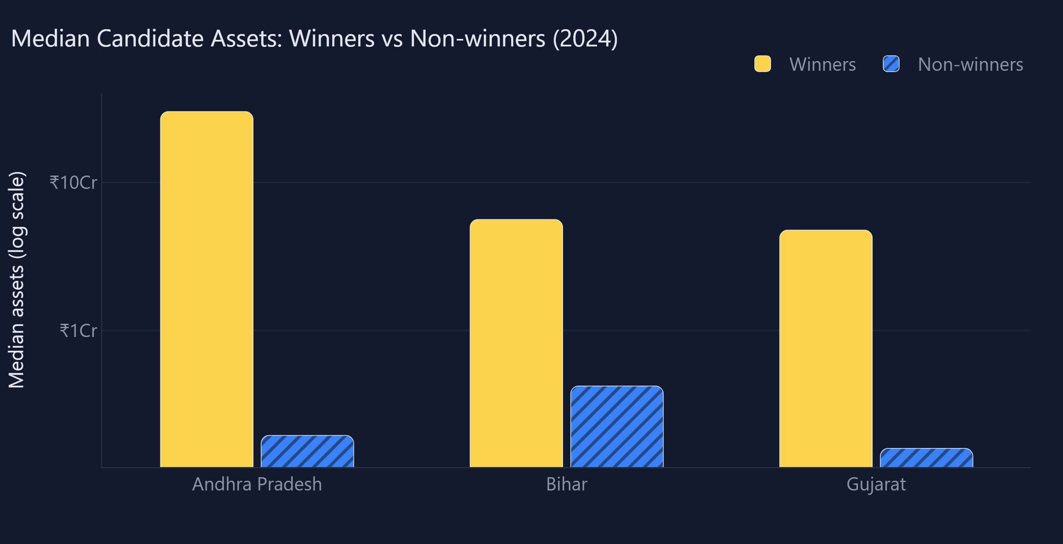
ANALYTICS / WEALTH
● 3 ELECTIONS · 2014–2024
Winners are far richer than non-winners
ANDHRA PRADESH · 2024
155×
₹30.2 Crores vs ₹19.5 Lakhs
BIHAR · 2024
13×
₹5.6 Crores vs ₹42.1 Lakhs
GUJARAT · 2024
30×
What this shows: median declared assets on a log scale; each step up is ten times more wealth.
₹4.8 Crores vs ₹15.9 Lakhs
MP·ASSETS
06 / 10

Slide 7
CONCLUSIONS
● 3 ELECTIONS · 2014–2024
Key findings

Winners are wealthier

Re-contesters get richer
In every state and election the median winner declared 8× to 155× the assets of a median non-winner.
Returning candidates' assets rose by a median 33–64% between elections; winners gained crores, losers lakhs.

Andhra Pradesh stands out

Percentages tell a subtler story
Highest declarations: ₹7,698 Cr held by 2024 winners and a ₹26.5 Cr median rise for sitting MPs.
In Andhra and Bihar, losers' median % growth matched or beat winners' (small, low base), so absolute and relative change should be read together.
MP·ASSETS
07 / 10

Slide 8
PROJECT / WRAP-UP
● 3 ELECTIONS · 2014–2024
Limitations, team and libraries
Limitations & next steps
Team contributions
● Self-declared affidavit values, not audited wealth
● Only linked re-contesters enter growth figures; many seats stay unlinked
● Small samples per state (8–22 winners per interval)
● OCR and fuzzy matching may still miss a few records
● We considered only General Election results.
N
Nivas
MyNeta scraping, visualisation, data cleaning, re-contest matching
G
Gagan
Wikipedia scraping, missingness tests, dashboard design
B
Balaram
Asset OCR, re-contest matching, deduplication, final report
LIBRARIES USED
● Scraping
● OCR
● Cleaning & matching
● Statistics
● Dashboard
requests · bs4 · Selenium · lxml
EasyOCR (Colab GPU)
pandas · NumPy · RapidFuzz
SciPy · Matplotlib · Seaborn
Dash · Plotly · Dash Bootstrap
MP·ASSETS
08 / 10

