Slide 1
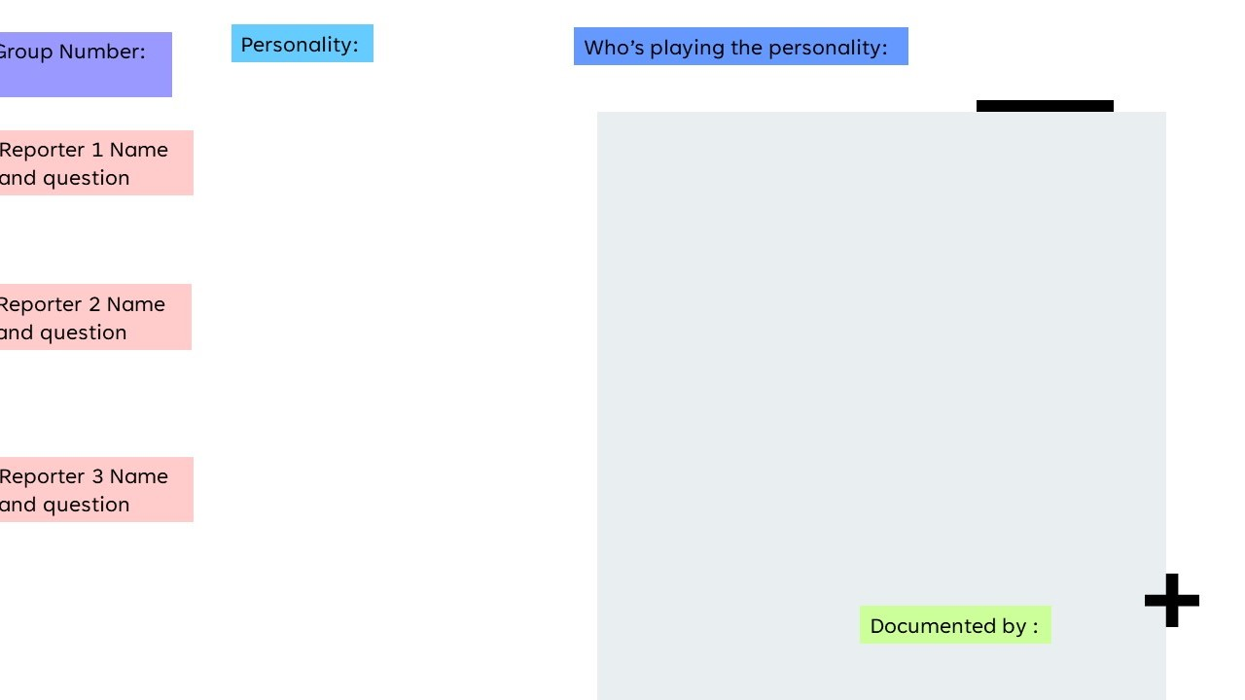
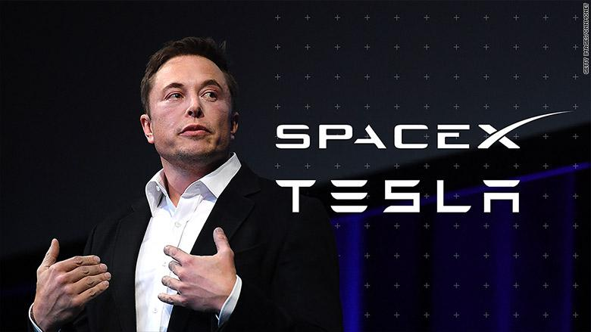
3
Elon Musk
David Alen (20BCAB44)
Jathin (20CMS36)
You stated earlier that hyperloop is the future of transportation, how exactly does this hyperloop work? Do you think it’s easy to achieve it?
Anzil (20BCAB74)
How did you feel when you were named as one of the 75 most influential people of 21st century by Esquire magazine?
Syed Akbar (20BCAB69)
So, I have a quick question, How is X Æ A-12 doing?
Date: 7/12/2021
Yuktha (20CMS26)

