Slide 1

EduVision-SlideGen
Slide*Minds
AI-powered Slide Generation for Smarter Learning

Slide 2
EduVision-SlideGen A Project by Slide*Minds
Objective:
Automate creation of educational slides with AI, making learning resources more engaging, accessible, and time-efficient.
Purpose:
Save time for students & teachers in preparing learning material.
Goal:
Deliver clear, visually consistent presentations quickly.
Smarter Learning, Simplified

Slide 3



Meet the Team – Slide*Minds
Supriyo Mondal
b24bs1377
Shouvik Dhar
b24bs1349
Bishal Talukdar
b24bs1539

Slide 4
How EduVision-SlideGen Works
Built with Streamlit + OpenAI API + python-pptx, EduVision demonstrates the power of combining AI with automation for real-world applications.
Features
AI-generated slide outlines (titles +3-4 bullet points per slide)
Export as Powerpoint (.pptx) file
Simple, interactive UI built in Streamlit
Secure API integration (using enviornment variables)

Slide 5
Tech Stack
Frontend/UI → Streamlit
AI Model → OpenAI GPT ( gpt-40-mini )
Presentation Export → python-pptx
Language → Python 3
Execution → Python scripts developed and run in VS Code

Slide 6
Workflow
1. Upload Notes: User uploads a .txt or .md file
2. Ai Processing: OpenAi API generates slide structure
3. Slide Export: The outline is converted into a real .pptx
4. Download: User downloads the final PowerPoint
→ This project was built as part of the Semester Break Product
Challenge and demonstrates practical application of AI + Data
Science tools.

Slide 7
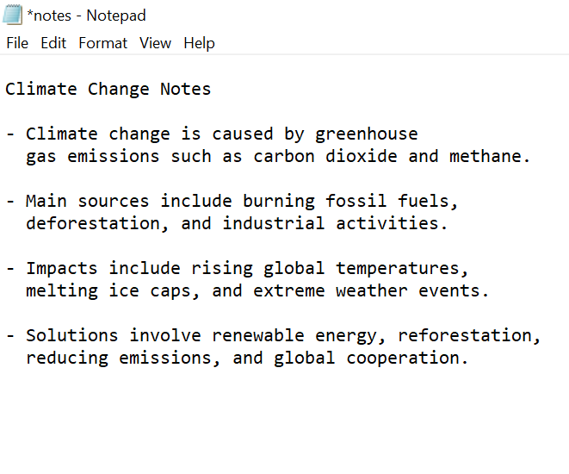
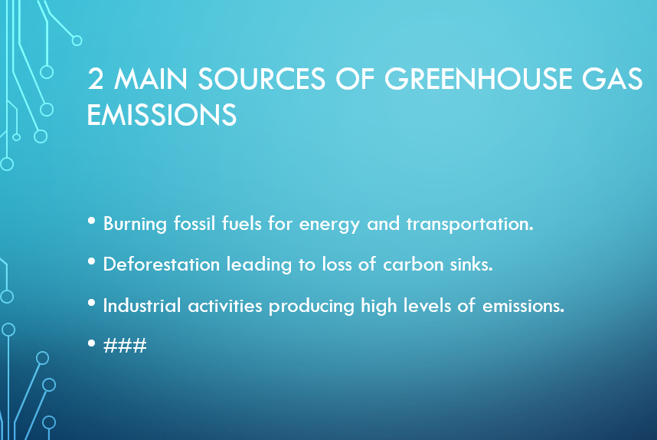
Results & Output
Before
After

Slide 8
Thank you

