Slide 1
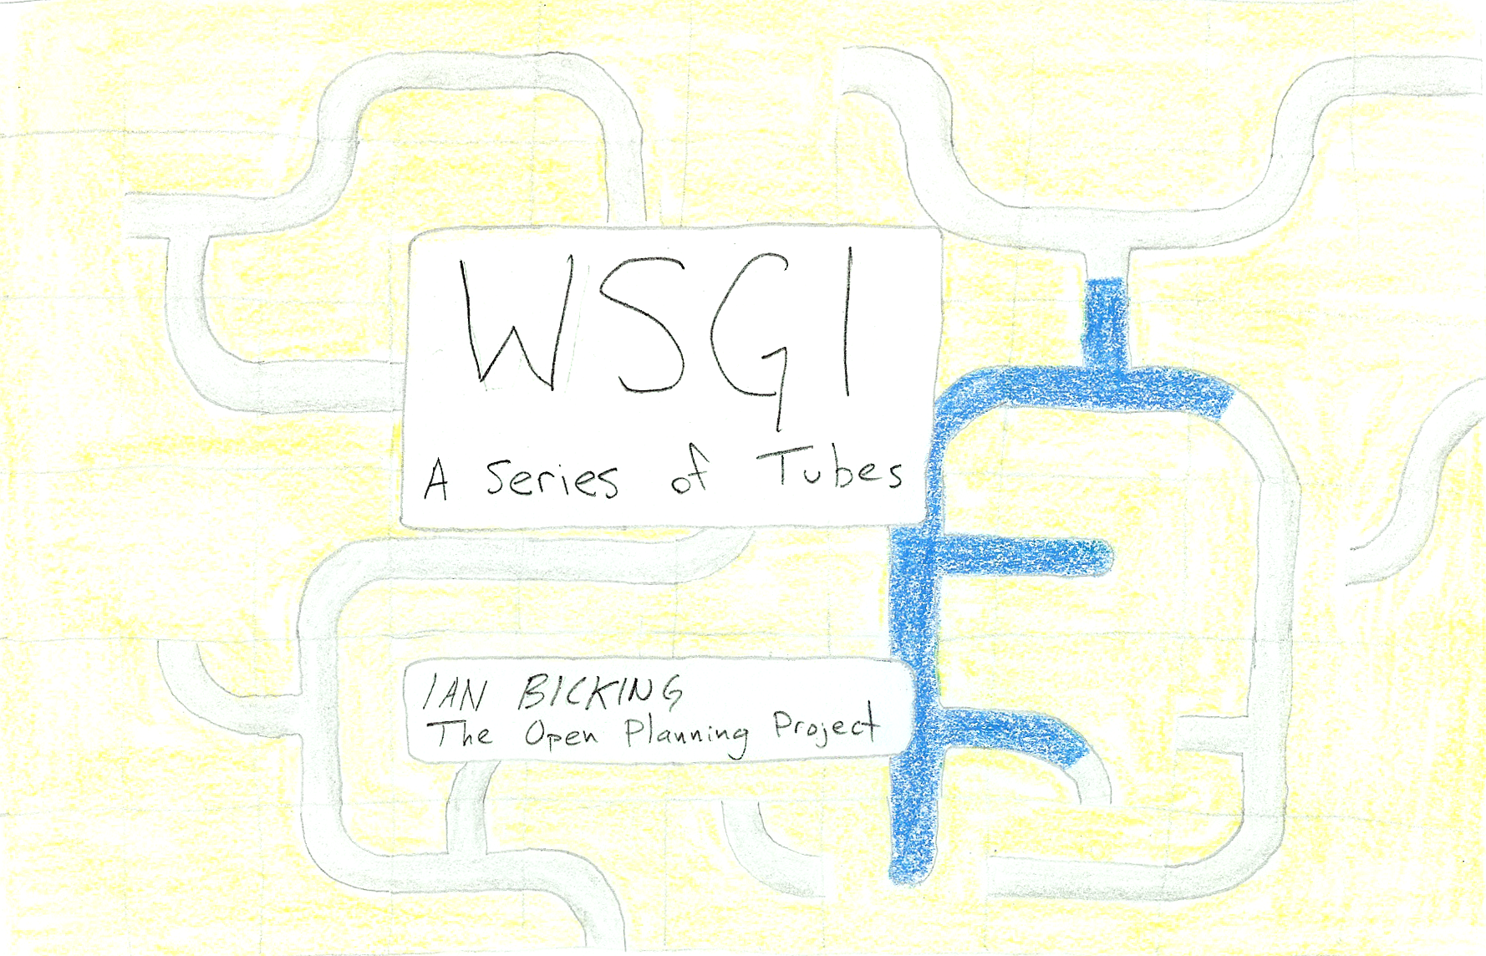

Slide 2
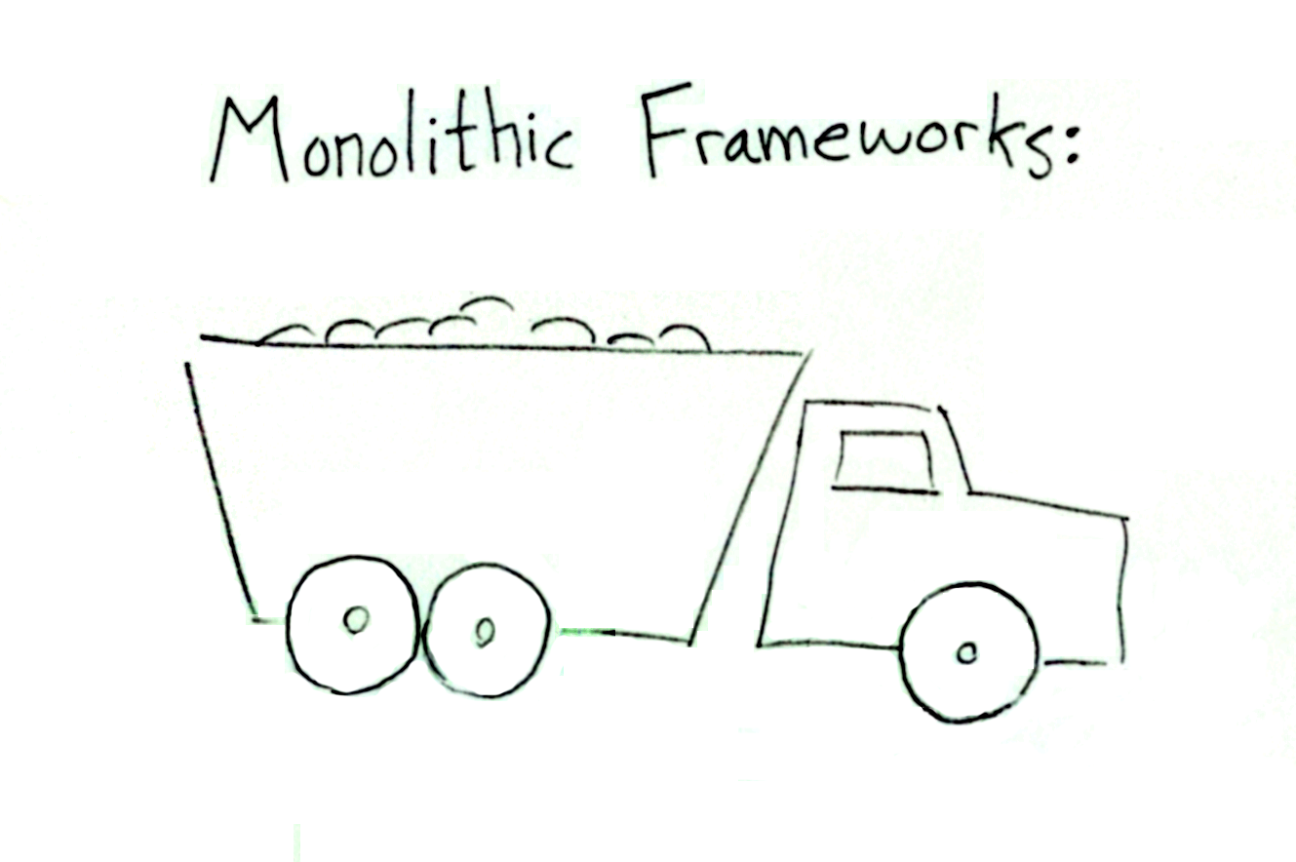

Slide 3
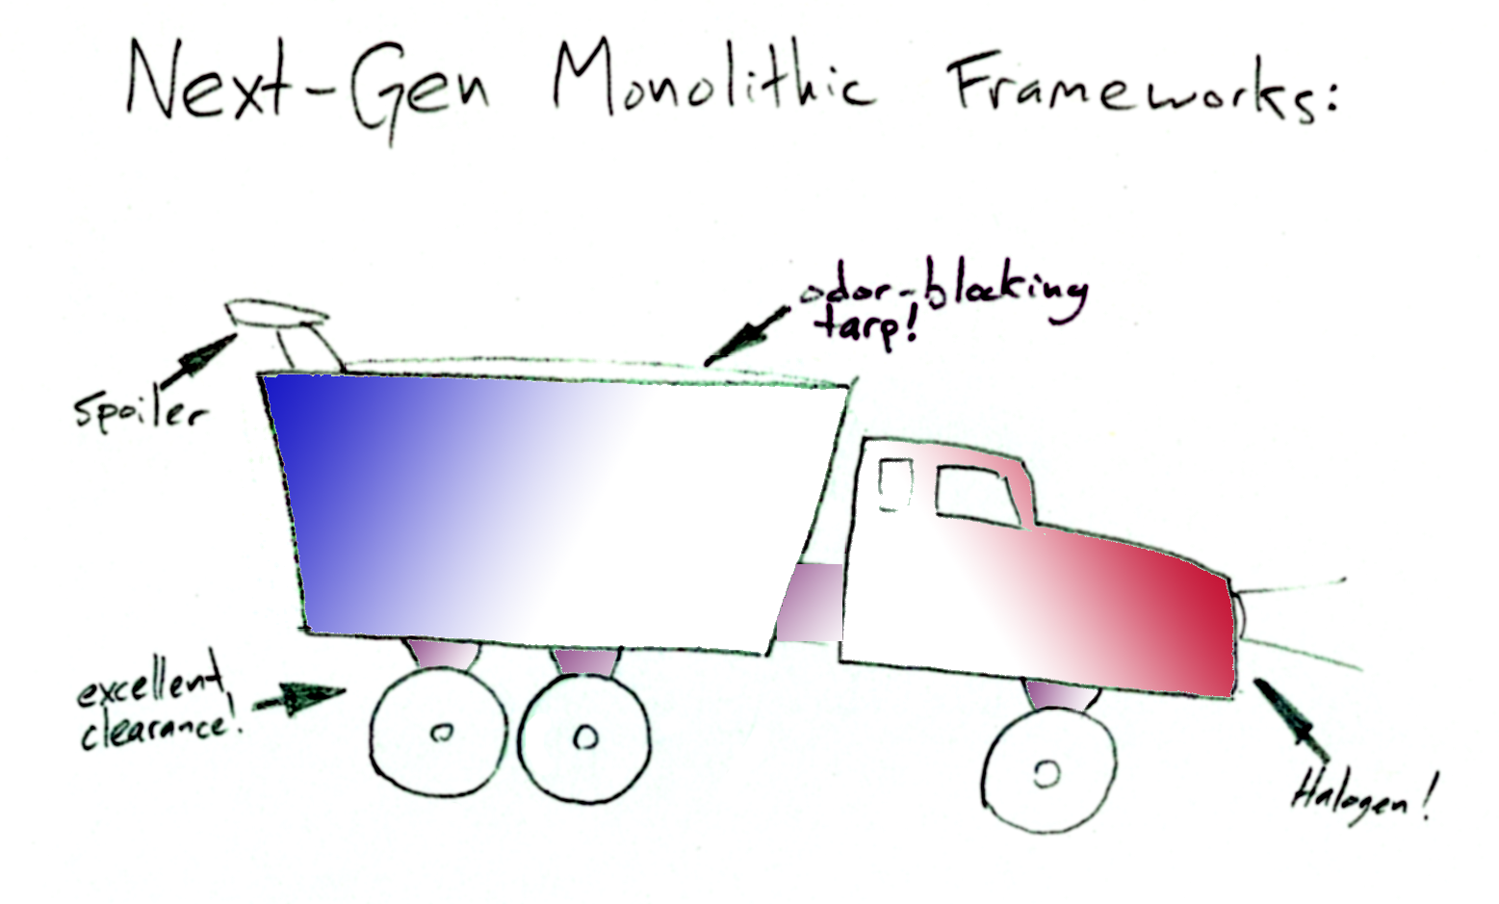

Slide 4
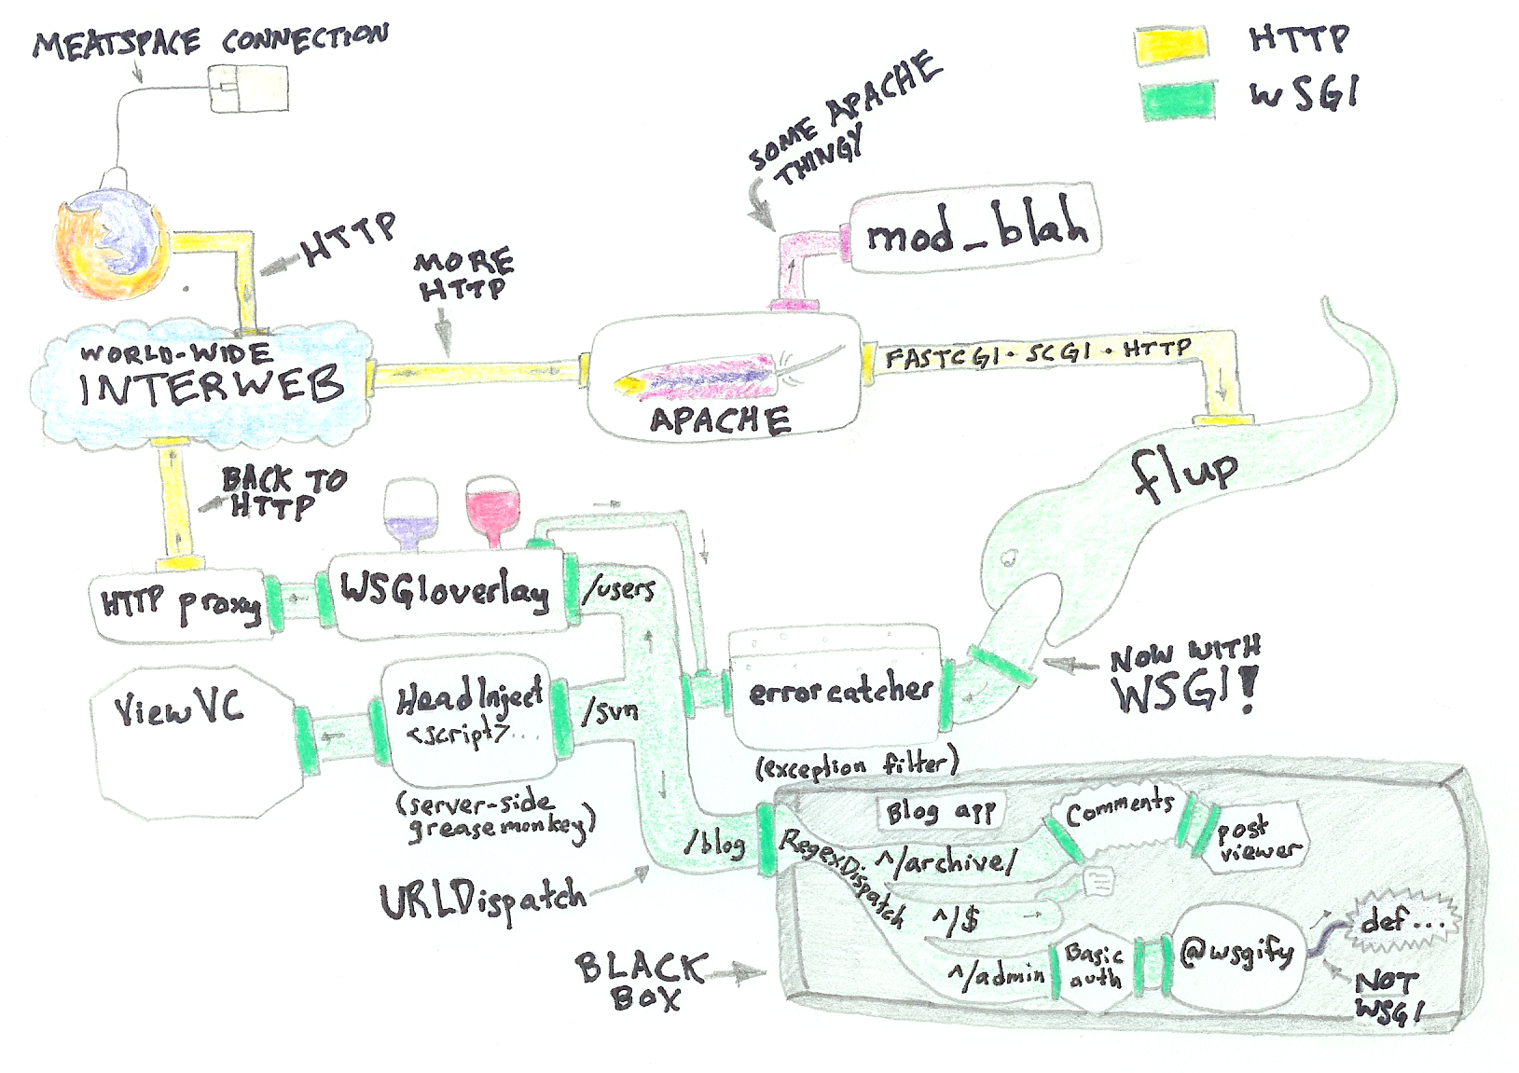

Slide 5
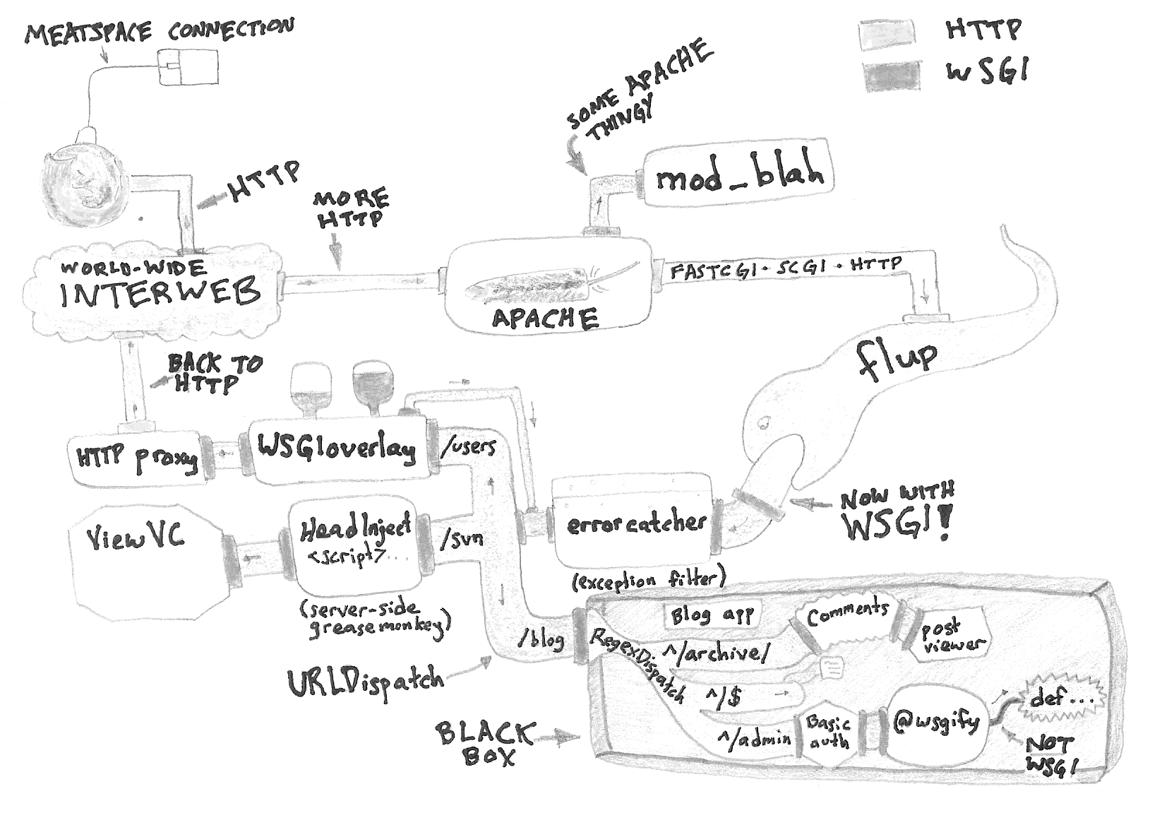
TUBES!

Slide 6
WSGI IS
TUBES!
Note: WSGI is not actually made
from tubes, it is a calling convention described in PEP 333

Slide 7
Now to go back in time...

Slide 8


Slide 9
CGI!

Slide 10
How Does CGI Work?
You run a CGI program
The headers and other request metadata goes in the environment
The request body goes in stdin
The response headers are sent first (plus response status)
After a blank line, the response body

Slide 11
CGI Is Super-Great!
It's really simple!
There's no dark corners!
There's no interactions!
It looks just like HTTP!
CGI Is Only OK!
You start a new process for each request.
That is slow.
Other than that it's super-great!

Slide 12
Conclusion:
CGI was a honking great idea – let's do more of those!

Slide 13
More Great Things About CGI
It's not Java servlets, there are no controllers, it's not MVC
It's not a framework
It doesn't have any opinion on what your script does
It's somewhat extensible through the environment

Slide 14
More Great Things About CWSGI
It's not Java servlets, there are no controllers, it's not MVC
It's not a framework
It doesn't have any opinion on what your script application does
It's somewhat very extensible through the environment

Slide 15
CGI is HTTP serialized as a script invocation

Slide 16
CWSGI is HTTP serialized as a script invocation
function call

Slide 17
CGI Is Boring

Slide 18
WSGI Is Way Less Boring...

Slide 20
The Classic Example
(a quick review...)
def simple_app(environ, start_response):
status = '200 OK'
headers = [('Content-type', 'text/html')]
start_response(status, headers)
return ['<html><head><title>Simple App</title></head>\n'
'<body><h1>Simple App!</h1></body></html>']

Slide 21
The Classic Example
def simple_app(environ, start_response):
status = '200 OK'
headers = [('Content-type', 'text/html')]
start_response(status, headers)
return ['<html><head><title>Simple App</title></head>\n'
'<body><h1>Simple App!</h1></body></html>']
WSGI Application

Slide 22
The Classic Example
def simple_app(environ, start_response):
status = '200 OK'
headers = [('Content-type', 'text/html')]
start_response(status, headers)
return ['<html><head><title>Simple App</title></head>\n'
'<body><h1>Simple App!</h1></body></html>']
WSGI environment:
Always a plain dictionary
Contains CGI-ish variables like QUERY_STRING, SCRIPT_NAME, PATH_INFO
Contains headers like HTTP_HOST, HTTP_AUTHENTICATION
wsgi.input: the body of the request
wsgi.errors: stream for errors
wsgi.other_stuff: some information about process model (e.g., threads)
Custom keys that can contain anything

Slide 23
The Classic Example
def simple_app(environ, start_response):
status = '200 OK'
headers = [('Content-type', 'text/html')]
start_response(status, headers)
return ['<html><head><title>Simple App</title></head>\n'
'<body><h1>Simple App!</h1></body></html>']
start_response:
A callback
You give it the status and headers of the response
And optionally a fallback exception if headers can't be sent
It returns a “writer”: you can use this to push content to the browser
Usually you don't want to use that

Slide 24
The Classic Example
def simple_app(environ, start_response):
status = '200 OK'
headers = [('Content-type', 'text/html')]
start_response(status, headers)
return ['<html><head><title>Simple App</title></head>\n'
'<body><h1>Simple App!</h1></body></html>']
status & headers:
Status is the status code and reason ('200 OK', '404 Not Found', etc)
Headers is a list of [(header_name, header_value), ...]
The types are very specific; only strings, a list, and two-tuples

Slide 25
The Classic Example
def simple_app(environ, start_response):
status = '200 OK'
headers = [('Content-type', 'text/html')]
start_response(status, headers)
return ['<html><head><title>Simple App</title></head>\n'
'<body><h1>Simple App!</h1></body></html>']
app_iter:
The body of the response
An iterator that produces strings
A list is a very simple iterator, even if it is a list of one element
Only strings: no unicode!

Slide 26
Now you know WSGI!

Slide 27
Applications?
Exercise left to the reader
Use a WSGI-based framework:
Pylons
wsgize
RhubarbTart
Clever Harold
Paste WebKit / Wareweb
Who else wants on board?
Write your own: let a thousand frameworks bloom

Slide 28
Servers?
Lots of options:
Flup: FastCGI, SCGI, AJK
wsgiref: HTTP
Twisted: HTTP
paste.httpserver
CherryPy: HTTP
paste.fixture (testing)
wsgi_intercept (clever urllib hack)

Slide 29
TUBES?
WHERE ARE THE

Slide 30
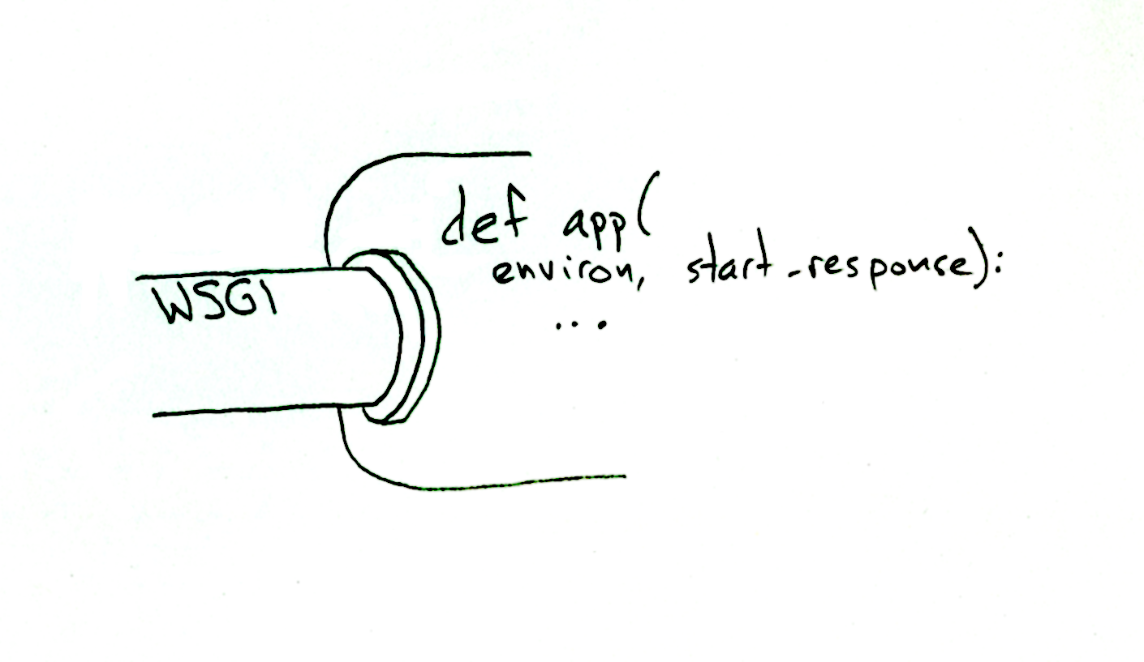

Slide 31
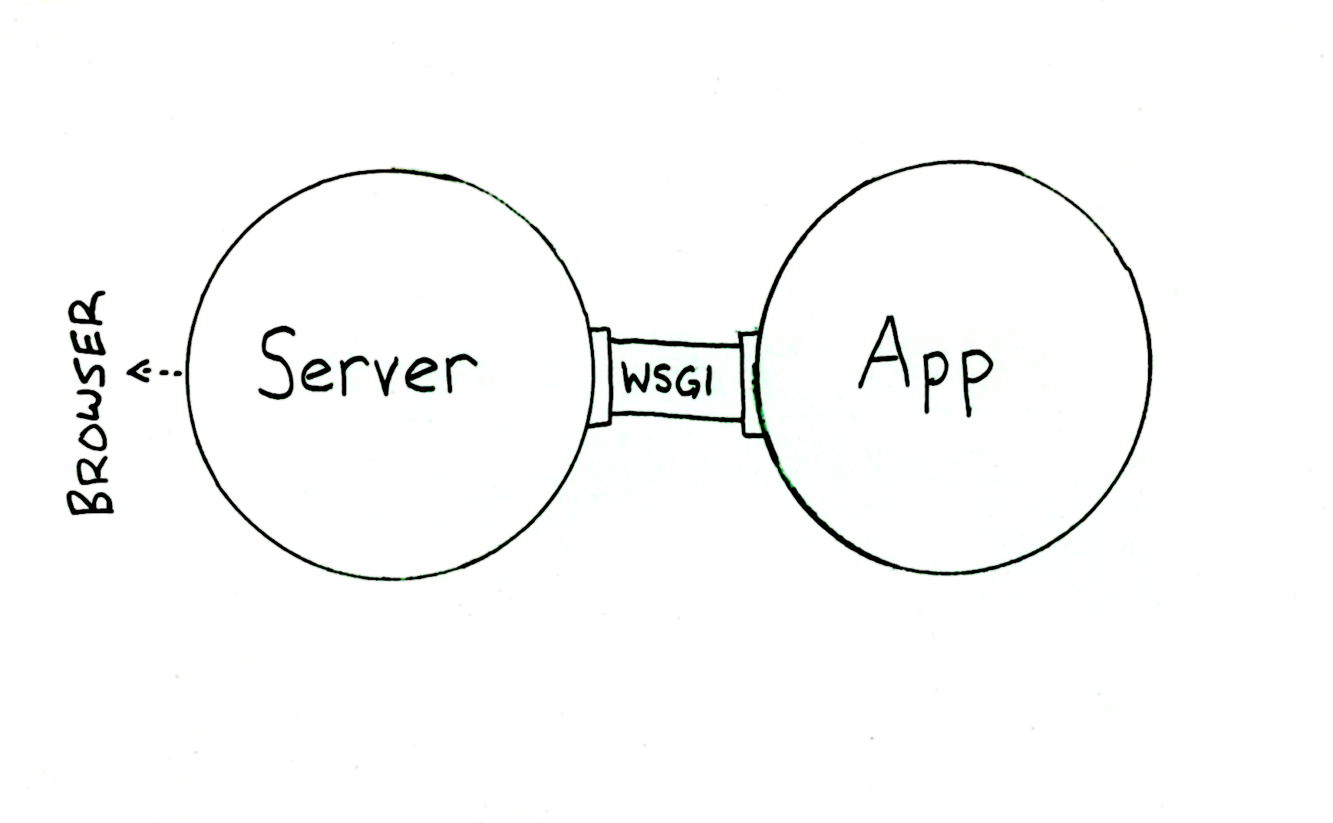

Slide 32
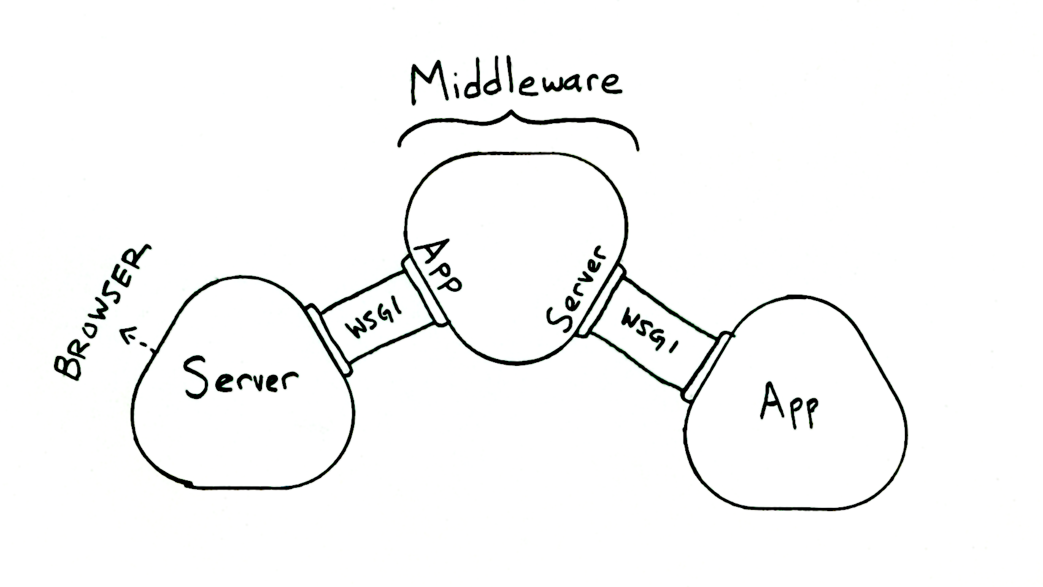

Slide 33
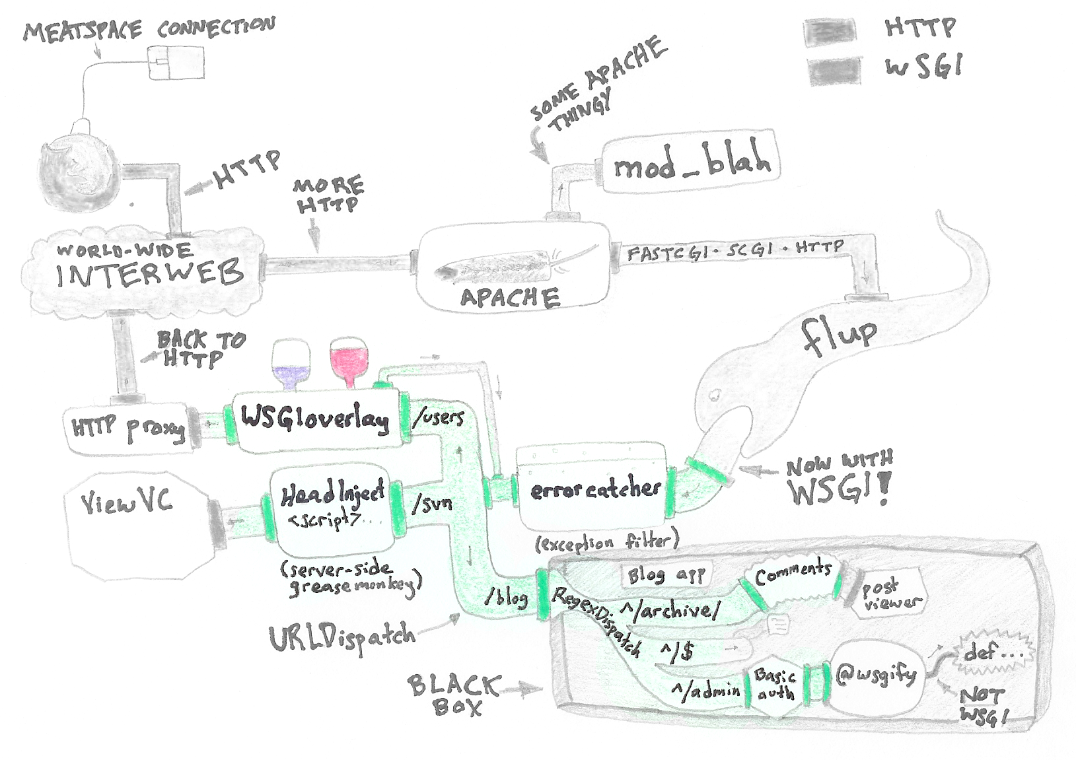
Middleware (highlighted):

Slide 34
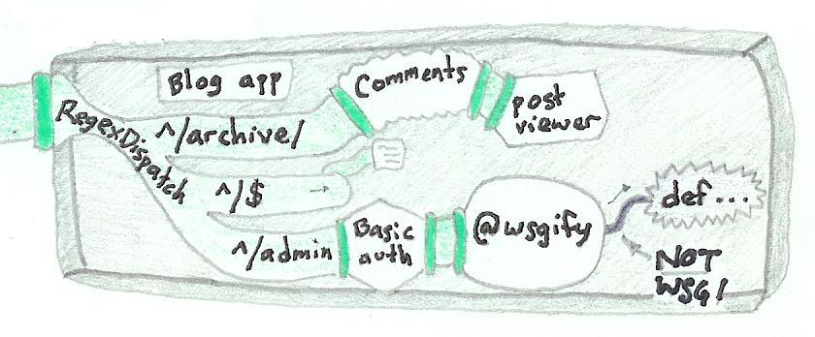
Creating an application...
Connection to outside world
WSGI inside (but only you have to know that)

Slide 35
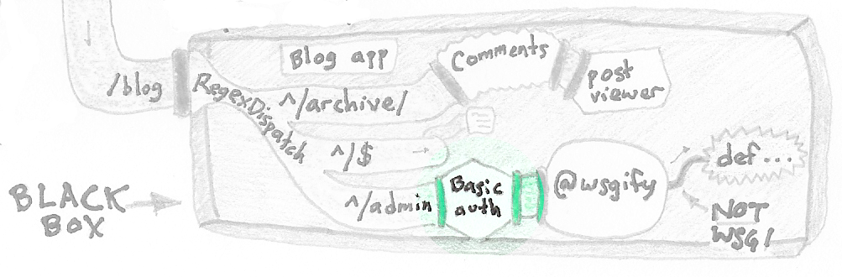
What comes in:
HTTP_AUTHORIZATION = 'Basic <base64:username:password>'
What goes out:
environ['REMOTE_USER'] = 'username'
Note: authentication is ripe for extraction from applications. REMOTE_USER gives a simple standard for communicating information from the middleware to applications.

Slide 36
Fancier Authentication:
Username still goes in environ['REMOTE_USER']
401 still indicates login is required
Cookie Authentication:
Reads the Cookie header (HTTP_COOKIE)
Gets username and signature from cookie
If signature is correct, sets REMOTE_USER
Watch response, if 401 Unauthorized, then redirect to login page

Slide 37
The setup:
import sha
import paste.request
class CookieMiddleware(object):
def __init__(self, app, secret, login_location):
self.app = app
self.secret = secret
self.login_location = login_location

Slide 38
The Implementation:
def __call__(self, environ, start_response):
cookies = paste.request.get_cookie_dict(environ)
login = cookies.get('__login')
if login:
login = login.decode('base64')
username, sig = login.split(':', 1)
expect_sig = sha.new(username + self.secret).digest()
if expect_sig == sig:
environ['REMOTE_USER'] = expect_sig
def repl_start_response(status, headers, exc_info=None):
if status.startswith('401'):
status = '307 Temporary Redirect'
headers.append([('Location', self.login_location)])
return start_response(status, headers, exc_info)
return self.app(environ, repl_start_response)

Slide 39
Check the cookie / authenticate
The Implementation:
def __call__(self, environ, start_response):
cookies = paste.request.get_cookie_dict(environ)
login = cookies.get('__login')
if login:
login = login.decode('base64')
username, sig = login.split(':', 1)
expect_sig = sha.new(username + self.secret).digest()
if expect_sig == sig:
environ['REMOTE_USER'] = expect_sig
def repl_start_response(status, headers, exc_info=None):
if status.startswith('401'):
status = '307 Temporary Redirect'
headers.append([('Location', self.login_location)])
return start_response(status, headers, exc_info)
return self.app(environ, repl_start_response)

Slide 40
The Implementation:
def __call__(self, environ, start_response):
cookies = paste.request.get_cookie_dict(environ)
login = cookies.get('__login')
if login:
login = login.decode('base64')
username, sig = login.split(':', 1)
expect_sig = sha.new(username + self.secret).digest()
if expect_sig == sig:
environ['REMOTE_USER'] = expect_sig
def repl_start_response(status, headers, exc_info=None):
if status.startswith('401'):
status = '307 Temporary Redirect'
headers.append([('Location', self.login_location)])
return start_response(status, headers, exc_info)
return self.app(environ, repl_start_response)
Catch 401, turn into redirect

Slide 41
Application Farming:
You've made some great program
Instead of installing it once, you want to install it a thousand times

Slide 42
An Application to Farm...
class BlogApplication(object):
def __init__(self, database):
self.database = database
def __call__(self, environ, start_response):
(your application goes here)

Slide 43
Farming it:
def dispatch_on_host(environ, start_response):
host = environ['HTTP_HOST']
match = re.search(r'^(.*).yetanotherblogservice.com$', host)
database = 'sqlite:///var/blog-dbs/%s.db' % match.group(1)
app = BlogApplication(database)
return app(environ, start_response)

Slide 44
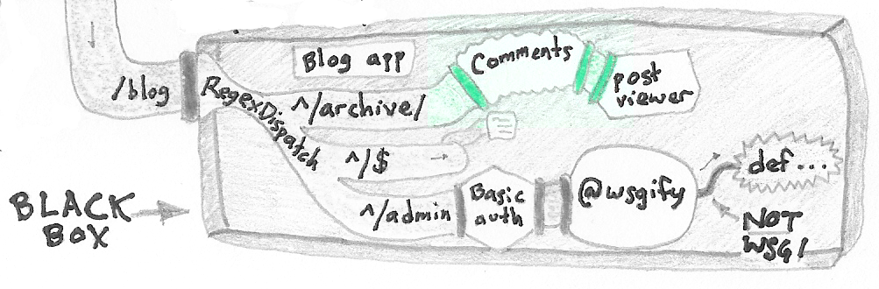
What comes in:
PATH_INFO = '/_comments/*' →
process comment submission
PATH_INFO = anything else →
send to wrapped application
What goes out:
content from application →
add any comments associated with page

Slide 45
comments.py:
Browser
Request
Is the user submitting a new comment?
to: /_comment/
NO
YES
Add any comments associated with the page
Send request to “wrapped” app
Process submission, redirect user

Slide 46
Not Quite Middleware:
Not all requests are passed onto the next application
But does anyone really care if it is “middleware” or “something else”?
(I don't)

Slide 47
New Topic:
Microframeworks

Slide 48
New Topic:
Microframeworks
Example:
Building a REST API

Slide 49
The Code: http://pythonpaste.org/ohm/
from ohm import server
class ConfigApp(server.ApplicationWrapper):
theme_uri = server.Setter(
validator=validators.URL())
domain = server.Setter(
validator=DomainValidator())
aliases = server.Setter(
validator=All(ForEach(DomainValidator()), LineConverter()))
remote_uris = server.JSONSetter(
validator=RemoteURIValidator())
redirects = server.JSONSetter(
validator=RewriteValidator())
wsgi_app = ConfigApp(a_config_object)
GET /remote_uris => [{“path”: “/”,
“remote_uri”: “http://localhost:8080”}]
a_config_object.remote_uris
PUT /remote_uris => (new data)
a_config_object.remote_uris = (new data)

Slide 50
What A Wonderful Framework!
The code is so short and to-the-point!
What A Horrible Framework!
It doesn't do anything!
It doesn't:
Let me put things in different modules
Make templates easy
Support things like POST
Decode forms
Give even basic access to request data

Slide 51
Opinionated frameworks:
Don't do lots of things
Tell you that it's for your own good
Don't give you a way out
Microframeworks:
Don't do lots of things
Limited scope, not limited perspective
Play well with others

Slide 52
A Case Study
(implementation still in progress...)

Slide 53


