Slide 1

SpartanHub
Final Project
CMPE-281 Cloud Technologies
A Twitter-like Marketplace for Pictures
Team Ace-traordinary:
Ravijeta Kommalapati
Ramya Dharwada
Nasrajan Jalin
Masi Nazarian
San Jose State University | Department of Computer Engineering
Professor Paul Nguyen
Spring 2019

Slide 2
Outline
Problem Statement & Overview
UI Design
Architecture
Database
Demo
Challenges
Q&A

Slide 3
A portal for spartans to order food online
Register as a user and log into your SpartanHub account
Choose from inventory
Add food items to cart
Proceed to checkout
Fill in payment information
Place Order

Slide 4












Picasso :: Technology Stack

Slide 5
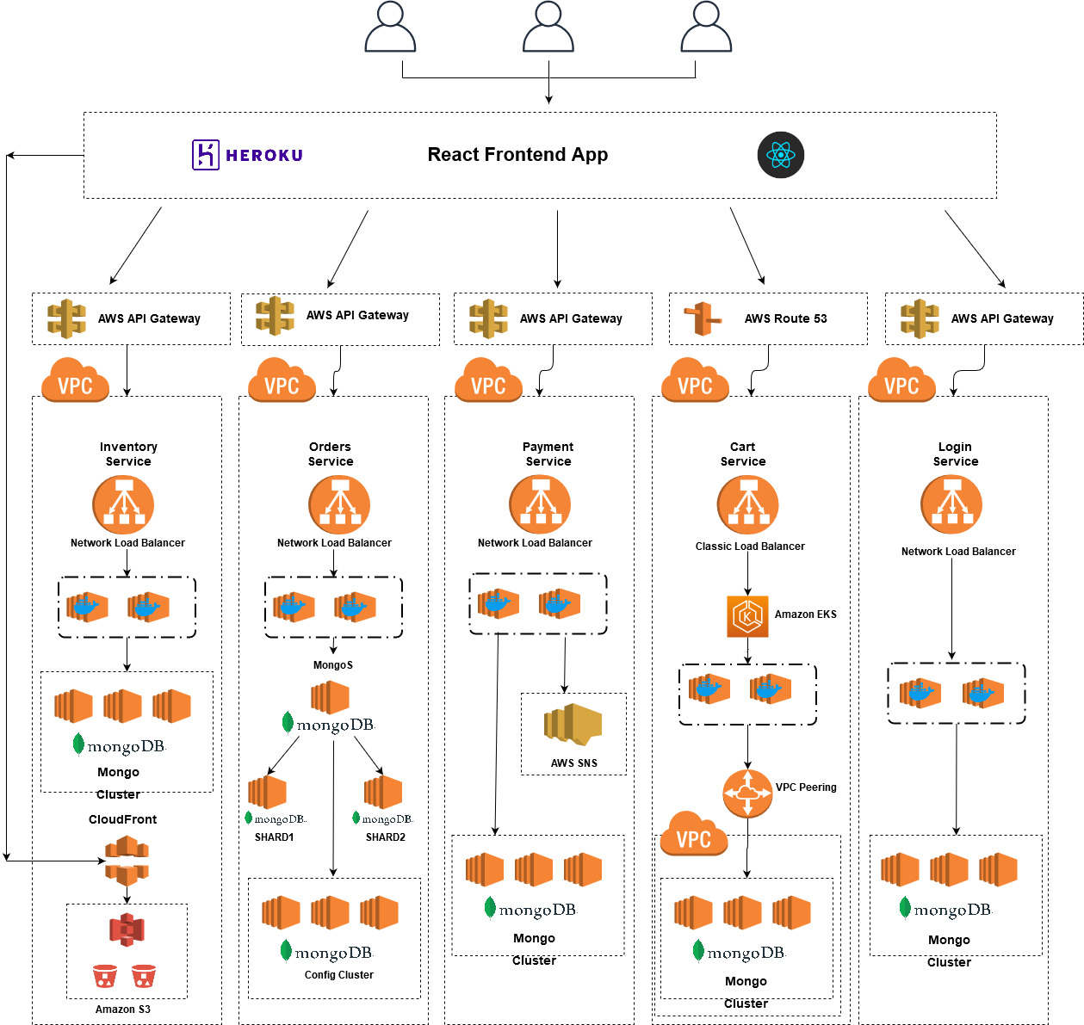
SpartanHub : Architecture
ReactJs | Heroku
MongoDB Cluster
Amazon S3
Amazon Cloudfront
Docker
Amazon SNS
AWS API Gateway

Slide 6
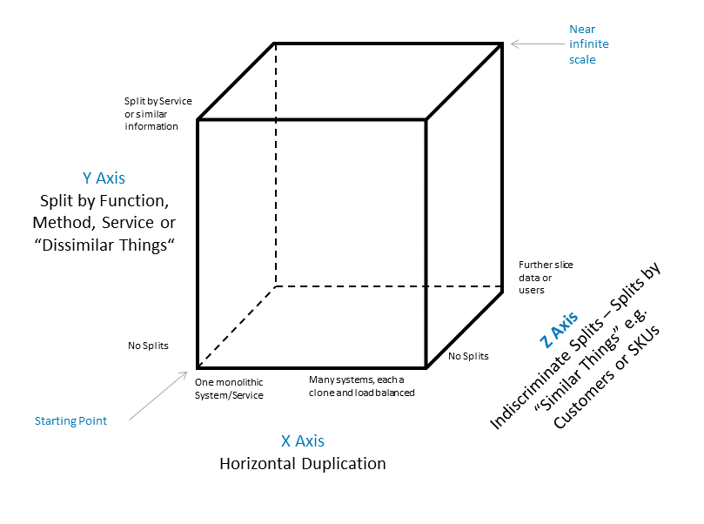
AKF Scale Cube
X-Axis
Load balanced multiple instances for each microservice
Y-Axis
Microservices structure to decouple functionalities
Z-Axis
Database sharding for Orders service

Slide 7
Demo [ ]

Slide 8
Challenges
HTTPS over Kong API -self signed certificate
CD using Github actions
EKS implementation
Mongo Db sharding
Go Integration with SNS

Slide 9
Q&A
Thank You! :)

