Slide 2





HTML5
templates
Router
routing
require
DOM events
model events
views
interacts
DOM
sync
models
update
DOM
model updates
data sources

Slide 3



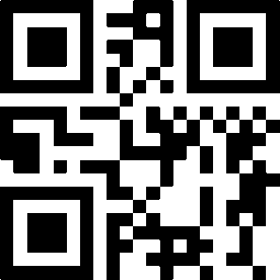
Backbone
Handlebars
PhoneGap
QR code reader

Slide 4
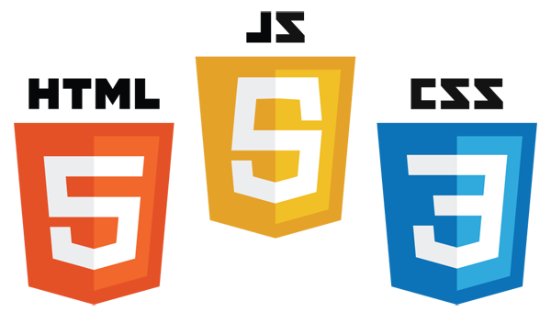
Logic
& data
Structure
Presentation
& layout

Slide 5
