Slide 1

MOF
M3
c2
c2
UML
UML BRIDGE
MM_{X}
M2
c2
c2
c2
M1
profile.uml
application
m1.uml
UML
m1.mm_{x}

Slide 2
MOF
c2
c2
UML
in
UMLprofile2MOF
out
MM_{X}
c2
in
profile.uml

Slide 3
UML2MM_{X}
out
UML2MM_{X}Generator
in
in
in
UML
MM_{X}
c2
profile.uml
in
in
in
MM_{X}2UMLGenerator
out
MM_{X}2UML

Slide 4
MOF
M3
c2
c2
Annotation MM
slicer
MM_{sliced}
M2
out
c2
annotates
in
M1
am_{x}

Slide 5
MOF
M3
c2
c2
c2
Annotation MM
MM_{x}
slicer
MM_{sliced}
M2
in
out
c2
annotates
in
M1
am_{x}

Slide 6
MOF
M3
c2
MM_{sliced}
transformation slicer
Sliced UML2MM_{x}
M2
in
out
UML2MM_{x}
in
M1

Slide 7
MM_{x}
slicer
MM_{sliced}
M2
in
out
annotates
in
M1
am_{x}

Slide 8
MM_{sliced}
transformation slicer
M2
in
in
out
M1
UML2MM_{x}
UML2MM_{sliced}

Slide 9
MM_{x}
annotates
am_{x}
in
in
MMslicer
out
MM_{sliced}

Slide 10
MM_{sliced}
UML2MM_{x}
MM_{x}2UML
in
in
Tslicer
out
UML2MM_{sliced}
MM_{sliced}2UML

Slide 11
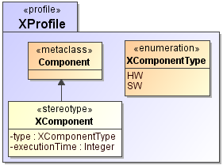
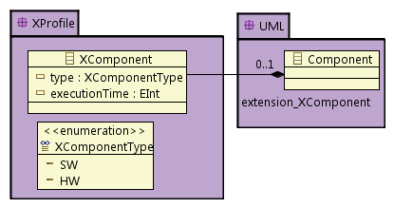
UML
MOF

Slide 12
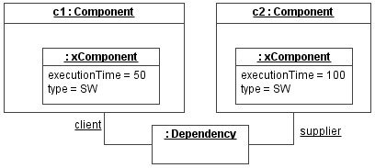

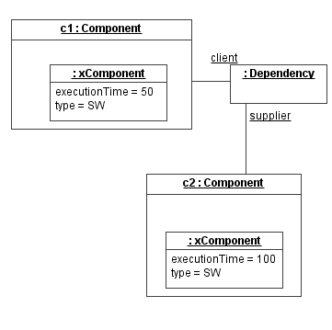
UML
MOF

Slide 13

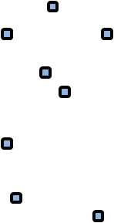
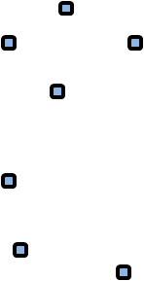
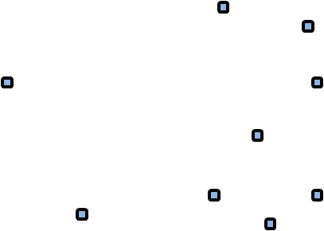
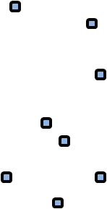
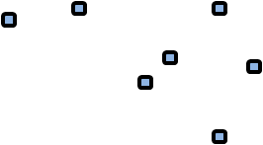
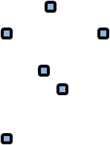
UML metamodel
UML
Profile
Relevant
metaclasses

Slide 14
UML metamodel
UML
Profile
Relevant
metaclasses

Slide 15
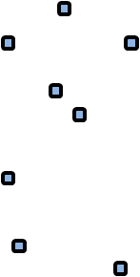
UML metamodel
extension
UML profile

Slide 16
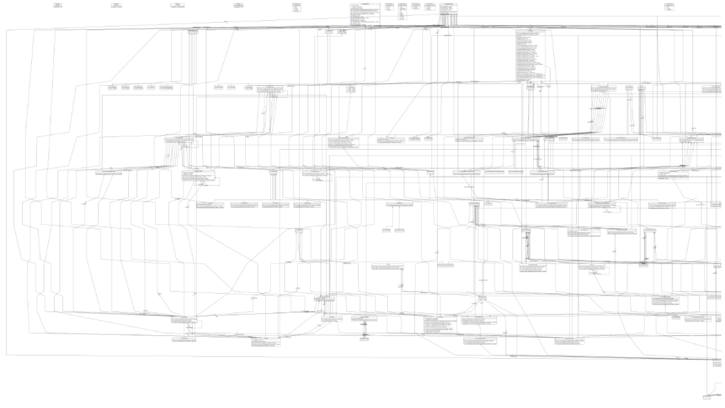
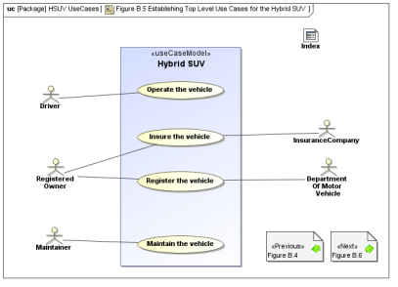
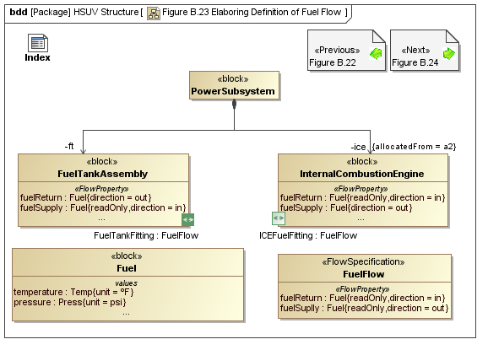
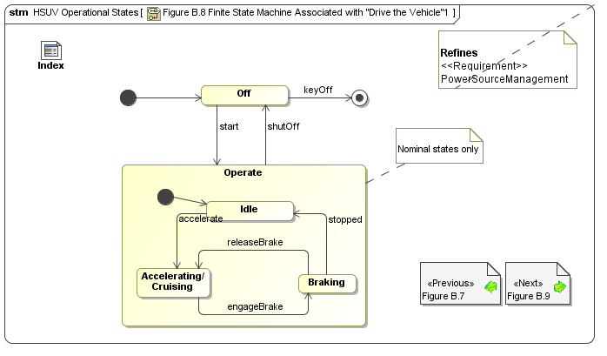
UML metamodel
relevant concepts
c2
c2
c2

Slide 17
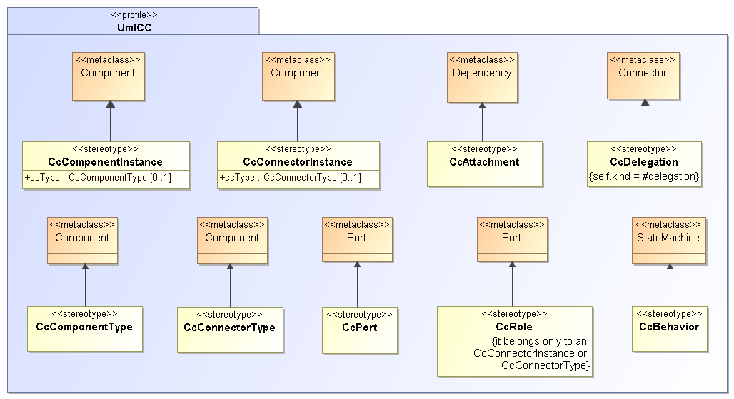
UML metamodel
relevant concepts
extensions

Slide 18
UML metamodel
relevant concepts
Component diagram
Sequence diagram
Use case diagram
Activity diagram
...

