Slide 1
Texture Quality Extensions to Image Quilting
Nick Vavra

Slide 2
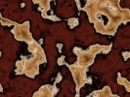
Texture Synthesis
Input: small sample texture image
Goal: more of that texture
Idea:
  Model the process that generates the texture
  Take random samples from the model
  Use samples to build the output image
Uses: make larger texture images, hole filling, compression

Slide 3
Image Quilting
Put patches into output image with overlap
Input texture is a Marchov Random Field
  Determine a point by looking at neighbors
Sample patches directly from input image
  Find matches for the overlap region (SSD)
  Choose a matching patch randomly
  Insert patch into the image
  Lather, rinse, repeat in raster scan order

Slide 4
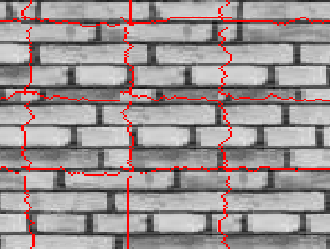
Stitching
Blending works, but not great
Instead find a good boundary
  Use the min error path through the overlap

Slide 5
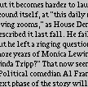
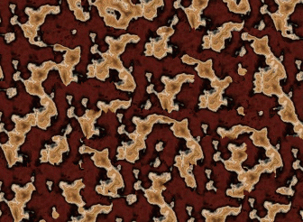
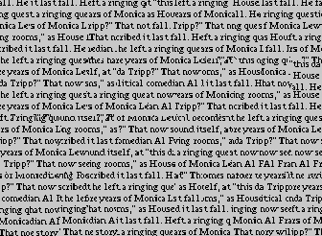
Image Quilting Results

Slide 6
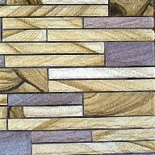
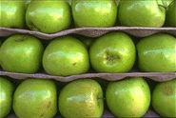
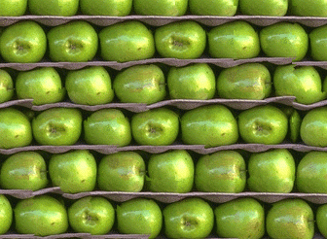
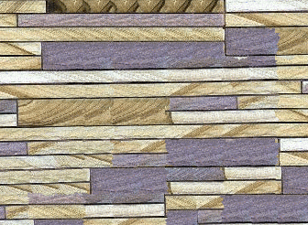
These need a little help

Slide 7
Extensions
Output quality usually very good
Sometimes get patch boundary artifacts
Proposed extensions
  Backtrack if no good match is found
  Match based on SSD and min path quality
Extensions still under development

