Slide 1
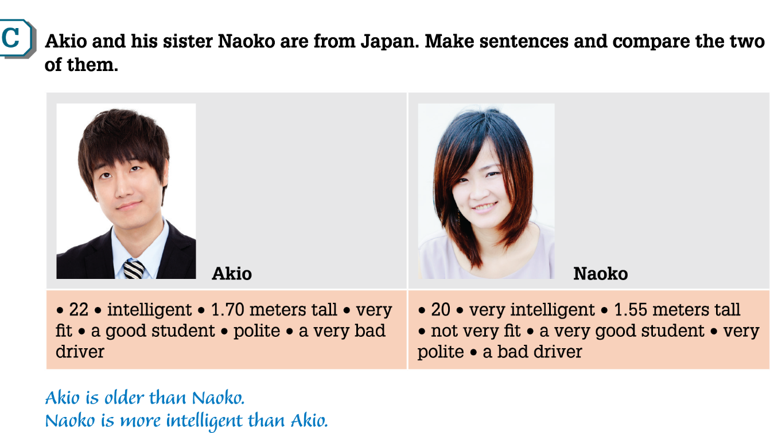
UNIT 6
Out and about: Page 46

Slide 2
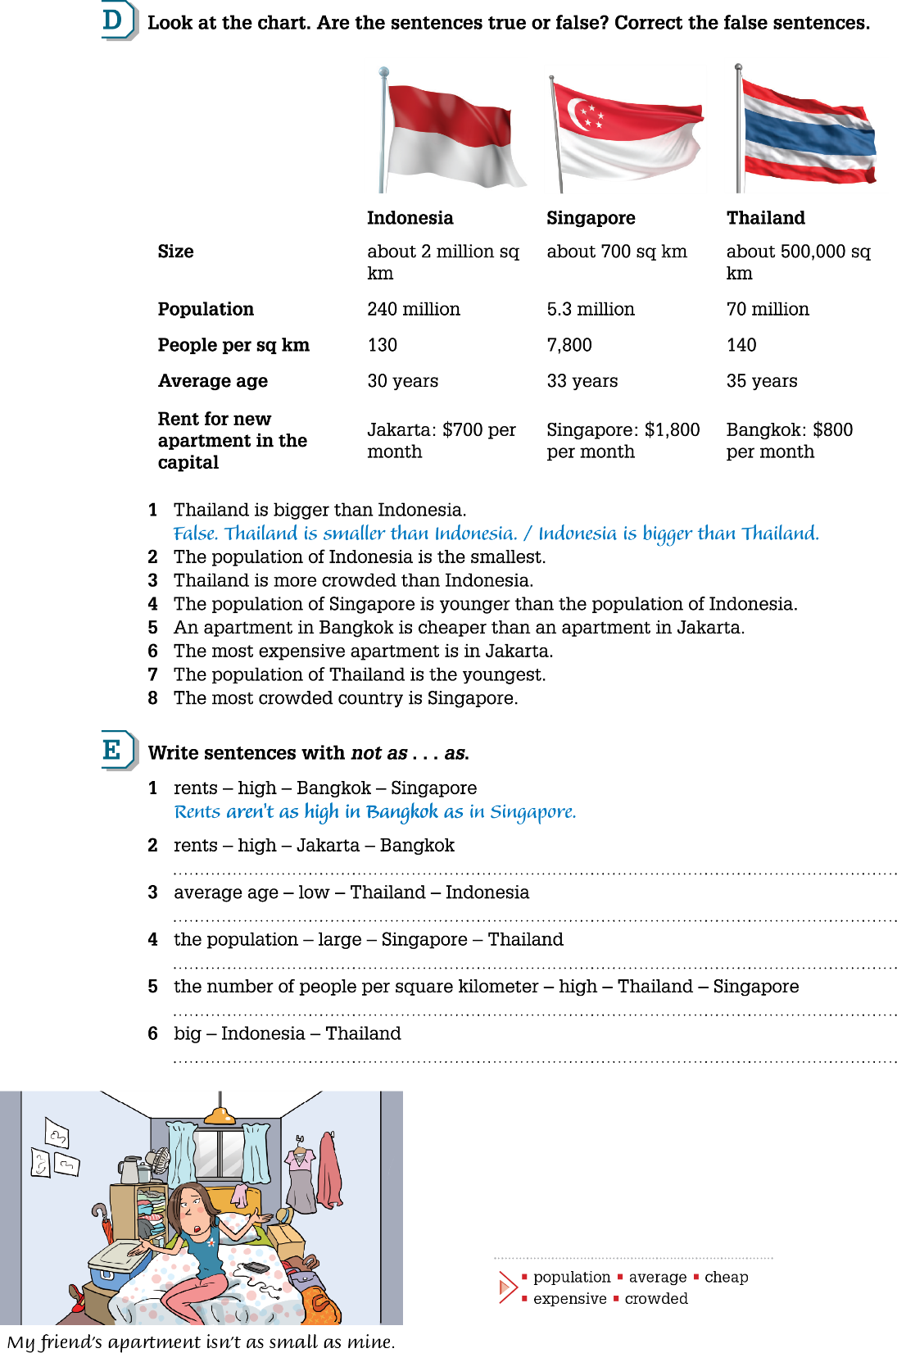
UNIT 6
Out and about: Page 47

Slide 3
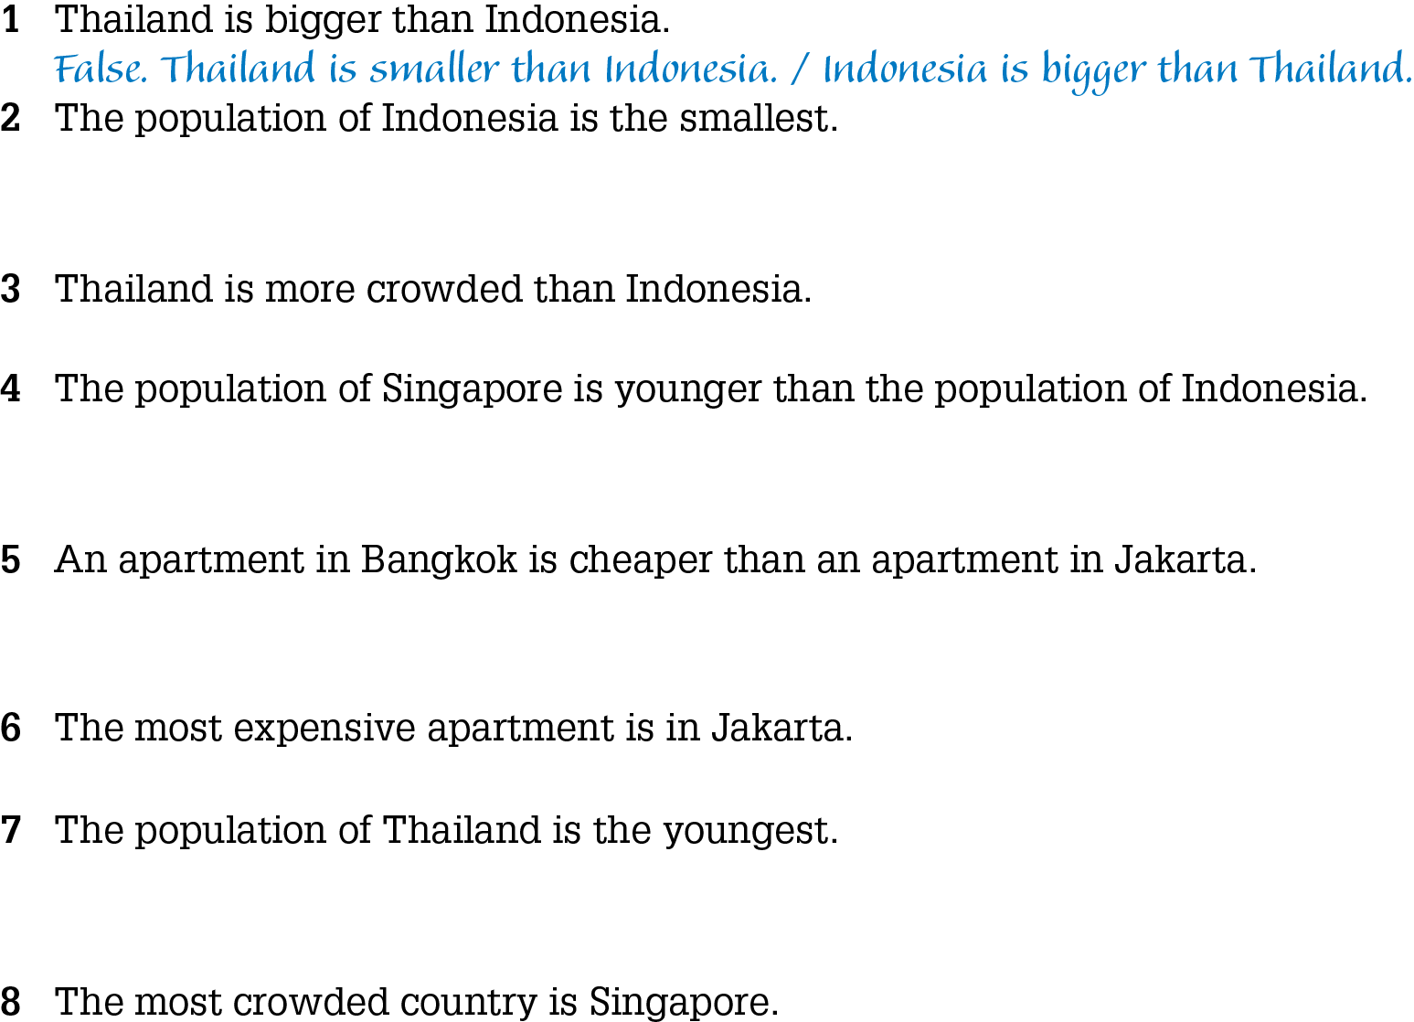
UNIT 6
Out and about: Page 47

Slide 4
UNIT 6
Out and about: Page 47

Slide 5
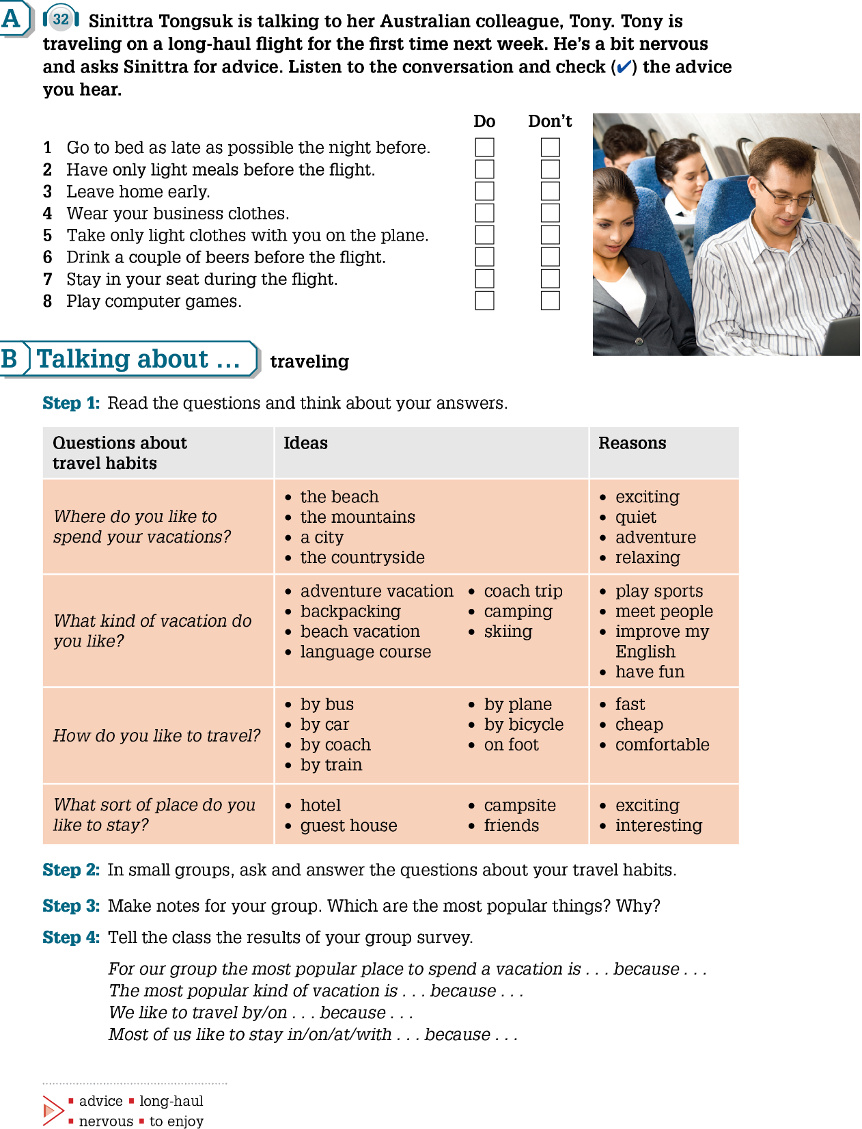
UNIT 6
Out and about: Page 48
4

Slide 6
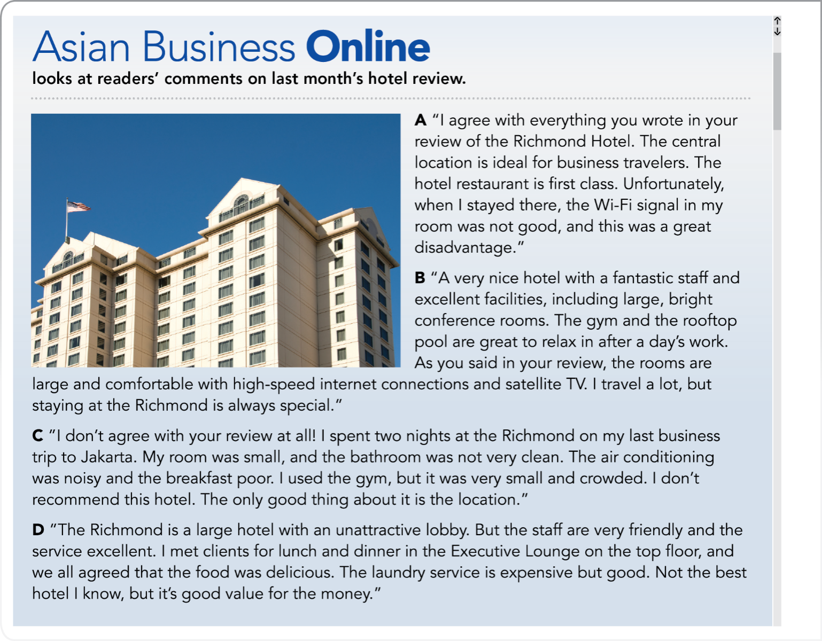
UNIT 6
Out and about: Page 51

