Slide 1


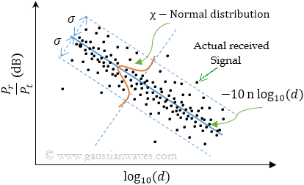

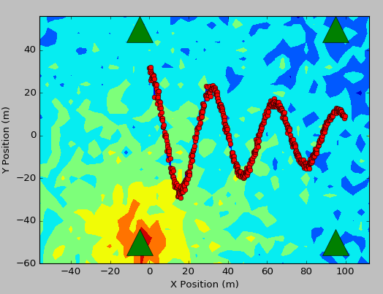
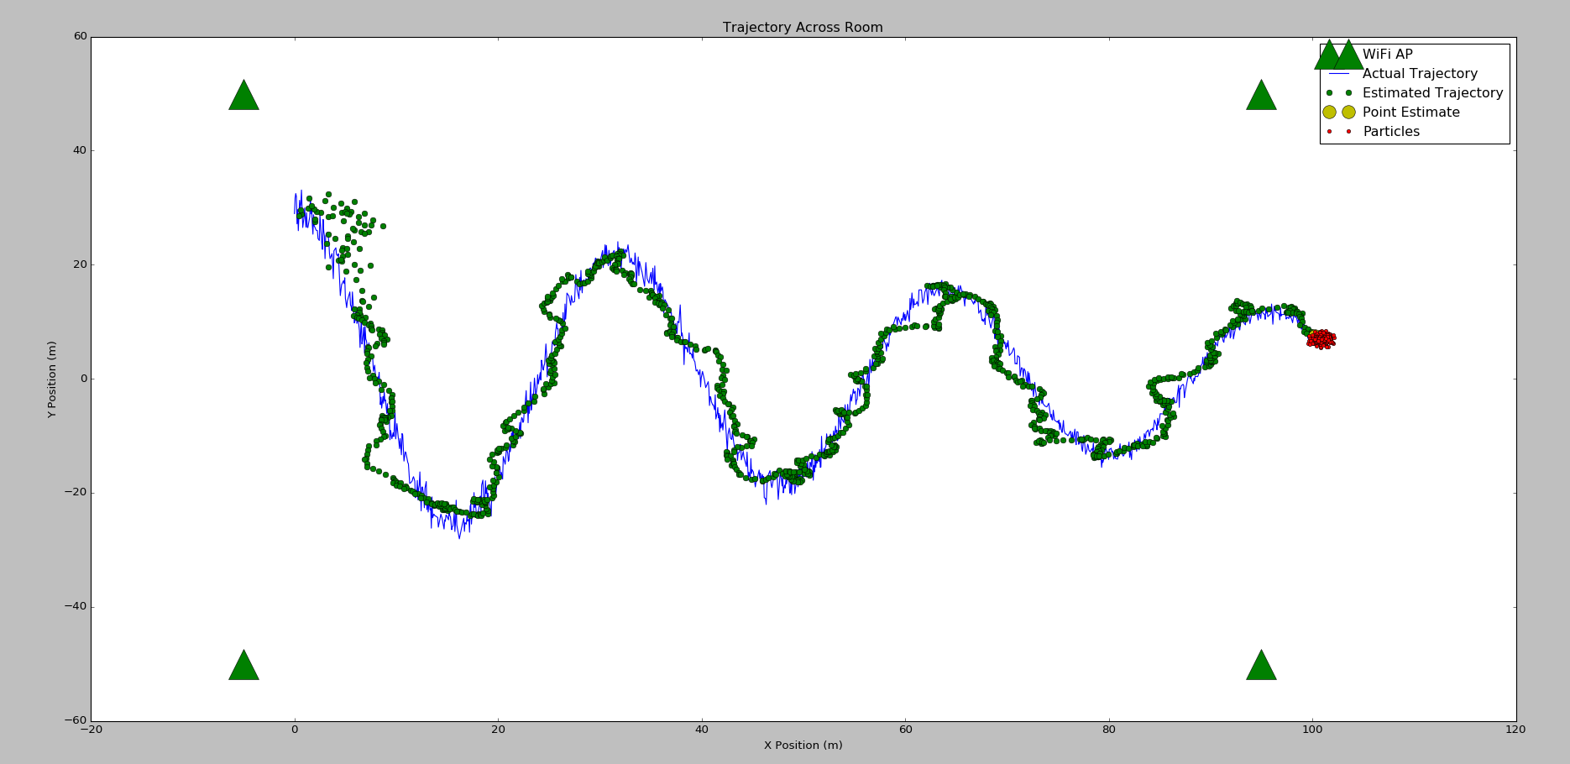
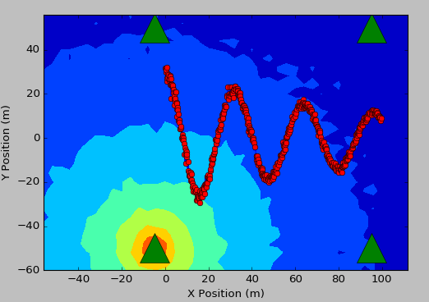
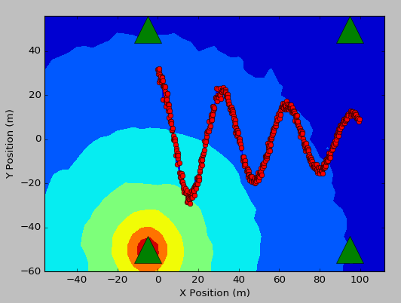
WLAN Based Indoor Localization
The goal of this project is to create a low-cost solution for indoor tracking that can be easily integrated into Zebra mobile computers. This project was performed within the Systems Engineering group, under Larry D’Agati.
A Bayesian approach is taken to solve this problem of indoor localization. The sole source of information that is used in this state-space estimation problem is the received signal strength from a network of WLAN access points. The technique that is used is known as Particle Filtering, which is a robust method similar to the Kalman Filter, but unlike the Kalman filter, the Particle Filter can be reliably used in highly nonlinear and non-Gaussian systems. In addition to the state-space estimate that is produced by the Particle Filter, a 3rd order autoregressive-moving average filter is applied to reduce noise.
Sequential Monte Carlo Importance Resampling:
Log-Normal Path Loss:
ARMA(3, 1):

Offline Averaging

Convolution
Smoothing
Benefits to Zebra
Benefits to Me
Possible applications include:
Autonomous guiding through commercial buildings (i.e. hospitals, office buildings, department stores, warehouses).
Locating lost or misplaced devices.
Tracking workers through office buildings (i.e. locating mailroom employees).
Locating injured people in case of an emergency.
Tracking customers in a retail environment to improve analytics.
This project helped improve my skills in efficient numerical computation, state-space estimation, teamwork, and general engineering problem solving skills. It was great to work alongside another intern who is very skilled in the field of mobile application development. My overall experience at Zebra Technologies was great. This has been my second Zebra internship. There is still much more work to be done on this project, and I would be happy to continue working on this after my summer internship is complete.
For additional information, contact: Ian Jacobse (ian.jacobsen.92@gmail.com)

