Slide 1
Car Pooling Mobile Application
Presented by
Ijas Ahamed A

Slide 2
AGENDA
Introduction
Purpose and Benefits
Target Audience
Future scope
Existing System
Proposed System
Connecting Users and Drivers
Components Of The Application
Features Of User App
Features Of Driver App
Snapshots
Conclusion

Slide 3
INTRODUCTION
Carpooling, also known as ridesharing, involves individuals sharing a single vehicle for commuting, with the aim of optimizing resources, reducing costs, and minimizing environmental impact.
Shared commuting routes, cost-sharing among participants, and a focus on environmental sustainability are integral components of carpooling.
Carpooling fosters a sense of community among participants who share common routes, enhancing social interactions and shared responsibilities.
Participants in a carpool share commuting expenses, including fuel costs, tolls, and parking fees, resulting in financial benefits for both drivers and passengers.
Carpooling contributes to environmental sustainability by reducing the overall number of vehicles on the road, thereby lowering carbon emissions and supporting broader conservation efforts.

Slide 4
PURPOSE AND BENEFITS
Efficient Resources Utilization: Optimize the utilization of vehicles and reduce the number of individual cars on the road. Alleviate traffic congestion and decrease the overall environmental impact.
Cost Savings: Provide a cost-effective alternative to traditional transportation methods. Users can share expenses, reducing the financial burden of commuting for both drivers and passengers.
Environmental Sustainability: Mitigate the environmental impact of individual car usage. Promote sustainable practices by reducing carbon emissions and lowering the overall ecological footprint.
Reduced Environmental Impact: Lower carbon emissions and decreased air pollution contribute to environmental conservation efforts.

Slide 5
Time Savings: Reduced travel time through carpooling lanes and optimized routes, leading to quicker and more efficient commutes.
Convenience and Flexibility: Flexible scheduling and route options provide convenience, catering to the diverse needs of users.
Flexible Commuting Options: Provide flexibility in commuting schedules and routes. Users can find matches that suit their specific preferences, making the carpooling experience more convenient and adaptable to individual needs.
Enhanced Safety: The community-based approach, coupled with safety features, creates a secure environment for shared rides.
Reduced Parking Demand: Fewer individual vehicles mean reduced demand for parking spaces, addressing parking challenges in urban areas.

Slide 6
TARGET AUDIENCE
Daily Commuters: Individuals who have a regular commuting routine, such as going to work or school, and are seeking a cost-effective and convenient transportation option.
Urban Residents: People residing in densely populated urban areas where traffic congestion and parking challenges are common, making carpooling an attractive alternative.
Professionals: Working professionals who want to reduce commuting costs, save time, and contribute to environmental sustainability by sharing rides with colleagues.
Budget-Conscious Individuals: People who are conscious of their transportation expenses and seek cost-efficient alternatives for their daily commutes.
Companies and Employees: Organizations looking to promote sustainable commuting options for their employees, fostering a sense of community among colleagues.

Slide 7
FUTURE SCOPE
Explore the integration of emerging technologies such as Artificial Intelligence (AI), Machine Learning (ML), and Internet of Things (IoT) to enhance predictive analytics, improve matching algorithms, and provide a more intelligent and personalized carpooling experience.
Implement advanced safety features, such as real-time monitoring, AI-driven anomaly detection, and emergency response systems, to ensure the safety and security of both passengers and drivers.
Collaborate with smart city initiatives to integrate the app with urban infrastructure, enabling better traffic management, optimizing routes, and contributing to the development of smart and connected cities.
Expand the app's scope by integrating various transportation modes, such as bikes, scooters, and public transit, providing users with a comprehensive mobility solution for their daily commute.

Slide 8
EXISTING SYSTEM
UberPOOL is a feature within the Uber app that enables users traveling in the same direction to share a ride. It allows passengers to split the cost of the trip, making it a more economical option.
Lyft Line is Lyft's carpooling service that matches riders heading in the same direction. It aims to reduce costs for passengers while maintaining the convenience of a ride-hailing service.
Waze Carpool is a feature within the Waze navigation app that connects drivers and riders with similar commutes. It is designed to facilitate carpooling among individuals who share common routes to work or other destinations.
Zimride, now known as Lyft Business, initially started as a long-distance carpooling platform for college students. It has since evolved into a broader ride-sharing service.

Slide 9
PROPOSED SYSTEMS
Develop an intuitive and visually appealing user interface using Flutter, ensuring a seamless and engaging experience for both drivers and passengers.
Implement a robust user authentication system to secure user accounts. Allow users to create and manage profiles, including personal information, preferences, and payment details.
Integrate a user-friendly ride request feature allowing passengers to input their destination and schedule.
Create a separate interface for drivers to register, submit required documentation, and manage their availability.
Integrate navigation features for optimal route planning, considering traffic conditions and real-time updates.

Slide 10
CONNECTING USERS AND DRIVERS
User Registration: Users create accounts with essential details. Registration includes preferences such as commuting routes, departure times, and vehicle preferences.
Driver On boarding: Drivers register with information on their vehicle, availability, and commuting routes. Verification process to ensure driver reliability and safety.
Real-Time Matching Algorithm: Advanced algorithm matches users with compatible drivers based on route, timing, and preferences. Notifications sent to both users and drivers for potential matches.
Interactive Interface: User-friendly interface for easy navigation and interaction. Features for users to view and choose potential drivers based on profiles and ratings.

Slide 11
In-App communication: Integrated messaging system for seamless communication between users and drivers. Facilitates coordination, addressing any questions or concerns.
Payment Integration: Seamless payment system for users to compensate drivers. Fair cost distribution based on factors like distance and fuel prices.
Community Building: Forums and events to foster a sense of community among users and drivers. Promotes positive interactions and shared experiences.
Environmental Impact Awareness: Highlights the environmental benefits of carpooling. Users and drivers can track their collective contribution to sustainability.
Continuous Improvement: Regular updates and improvements based on user feedback and evolving needs. Ensures the platform remains efficient, reliable, and user-friendly over time.

Slide 12
COMPONENTS OF THE APPLICATION
User App
Drivers App
Firebase

Slide 13
FEATURES OF USER APP
Login
In-Built GPS
Drivers Location
Taxi ETA
Review the Drivers
Alerts & Notifications
Live Tracking

Slide 14
FEATURES OF DRIVER APP
Easy Registration
Route Optimization
Availability Status
Review Experience
Ride Request Alert
Viewing Users Details

Slide 15
FEATURES OF THE APPLICATION
Instant Booking is possible Anytime, Anywhere.
Cost-Effective travel solutions are guartneed.
The Apps are User Friendly and have Great UI features.
Scheduled Booking can be made with the App.

Slide 16
SNAPSHOTS

Slide 17
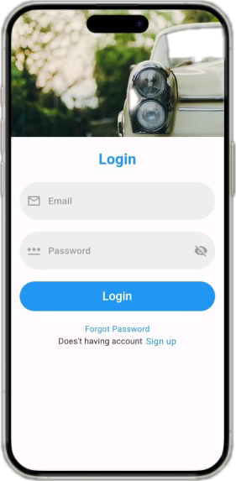
LOGIN PAGE
When for the First time any user visits our site it looks like this
The User can directly login if they have an account
If the user doesn’t have an they have to create a account by signing up

Slide 18
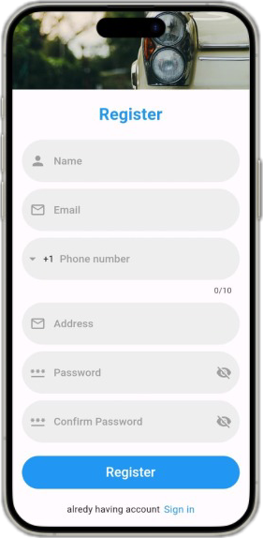
SIGN UP PAGE
If the user doesn’t have an account they have to create an Account signing up
Once they sign up they will become registered user.
If the user is a Driver he has to Register his car details in Car registration page.

Slide 19
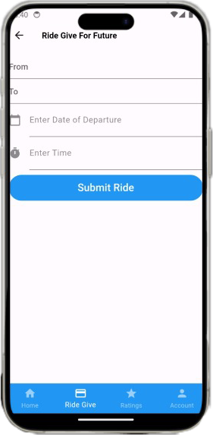
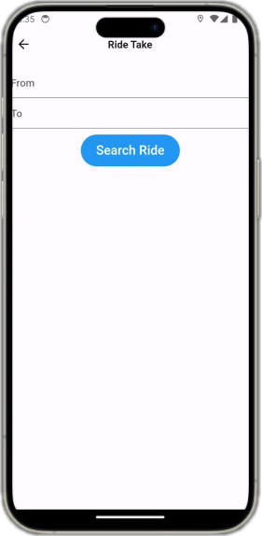
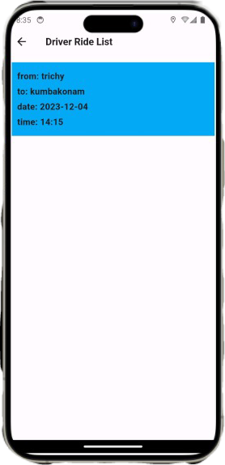
RIDE IN ADVANCE DETAILS

Slide 20
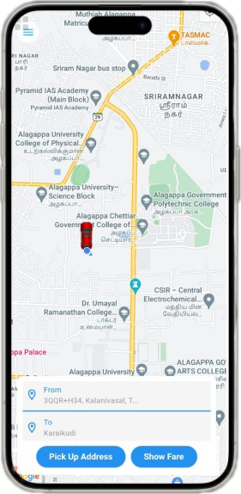
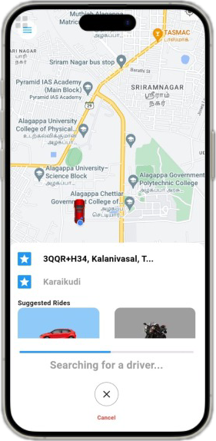
CURRENT RIDE TAKING

Slide 21
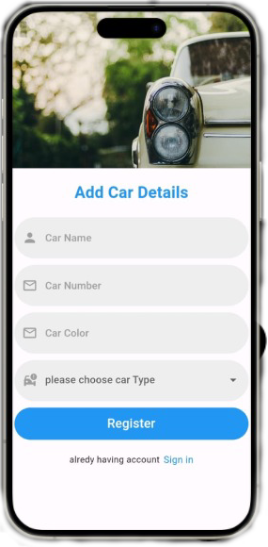
DRIVER CAR REGISTRATION
If the user is driver he has register his details in this page.
Give all details about the car and register himself as a driver.
Once registration is completed then he can give ride to the users.

Slide 22
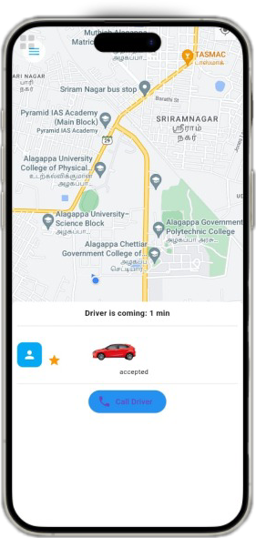
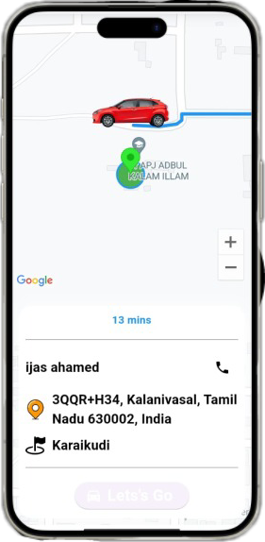
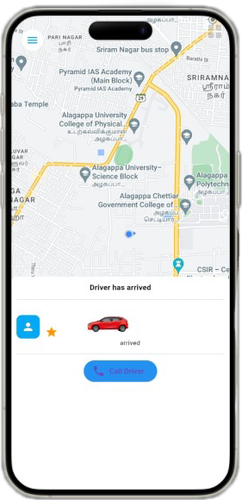
ARRIVING DETAILS
DRIVER APP
USER APP

Slide 23
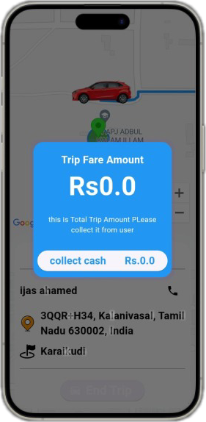
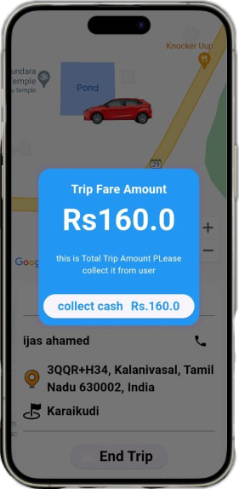
PAYMENT DETAILS

Slide 24
CONCLUSION
The development of the carpooling mobile application using Flutter has been a successful journey marked by innovation, efficiency, and a focus on user experience.
The cross-platform capabilities of Flutter allowed for the creation of a seamless and consistent application across both Android and iOS platforms, ensuring a wide-reaching impact.
Integration with Firebase played a pivotal role in establishing a robust backend, providing secure user authentication, real-time updates, and efficient serverless logic, contributing to the application's reliability and scalability.
The emphasis on features such as a comprehensive payment page, multi-modal transportation integration, and environmental impact tracking positions the app as a holistic solution, with future enhancements poised to explore emerging technologies and continuously improve the overall user experience.

Slide 25
REFERENCE VIDEO
EGON CASTLE- (youtube)
https://youtube.com/playlist?list=PL2OW6kiTqhAw2e9YlaxHzK0j8UWoswgJF&si=6gkR3IdlkRfyjaeN

Slide 26
THANK YOU

