Slide 1
The Generalizability of Subcortical Biomarkers for Early-Life Caregiving Adversity
Ian J. Douglas

Slide 2
Introduction
Healthy relationships with caregivers are necessary substrates of normative social and emotional development
Previous research reports that, relative to healthy relationships, abusive or neglectful child-caregiver bonds impact neural development and behavior in several ways
Subcortical development
Neuroendocrinology
CBCL of behavioral and psychological pathology
Currently no consensus exists to dictate the expected course of subcortical development following early-life caregiving adversity

Slide 3
Background
Current research has focused on explanatory models.
Such models are prone to overfitting if remedial measures (e.g., cross-validation) are not employed during and after model fitting
Such models cannot provide information about the generalizability of their interpretations
They do not help us understand what to expect when new individuals experience early-life caregiving adversity
They are insufficient for predicting any one person’s future course of development

Slide 4
The Present Study
This study focuses on subcortical development because
Past research suggests its vital role in determining social and emotional development
Subcortical structures such as the amygdala and hippocampus are further implicated in vital psychological and cognitive functions
Past research has generated myriad subcortical correlates of early-life
Approach: build predictive models through cross-validation, modeling the probability that a subject was exposed to early-life caregiving adversity, using volumetric measurements of the subcortex taken later in life.

Slide 5
Methods: Analysis
Predictive Models
Gradient Boosted Machine (GBM) Classifiers
FEATURES: Subcortical grey-matter volume (structural MRI)
RESPONSE: Previous orphanage institutionalization (yes/no)
Preprocessing
Cross-validated confound regression (CVCR; Snoek et al., 2019)
Cross-validation
Repeated (x100) 40/30/30 train-tune-test splits
Statistical significance assessed using permutation testing
All models are replicated 1000 times after randomizing PI/COMP group labels
Interpretation of the importance of subcortex features
Cross-Validated Permutation Variable Importance (CVPVI)
Likelihood ratio tests to parse out the unique contributions of subcortex features relative to confounds to model predictions (Dinga et al., in press)
Notes:
Need to double-check, are subjects from orphanages only or other forms of institutional care

Slide 6
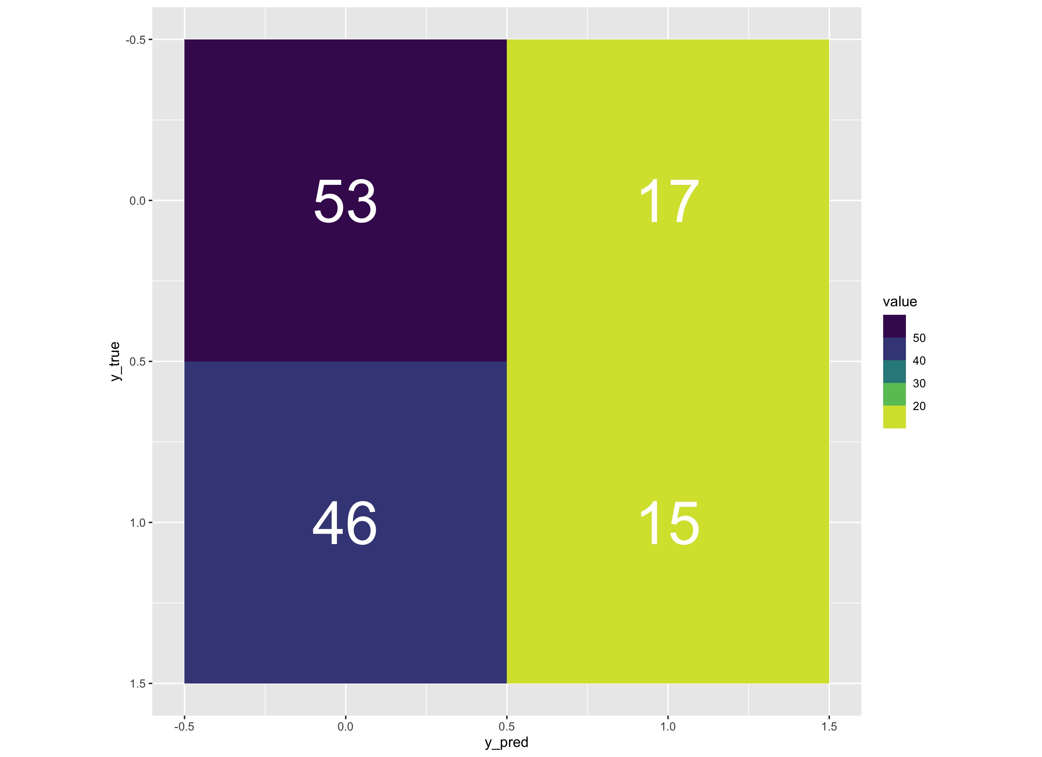
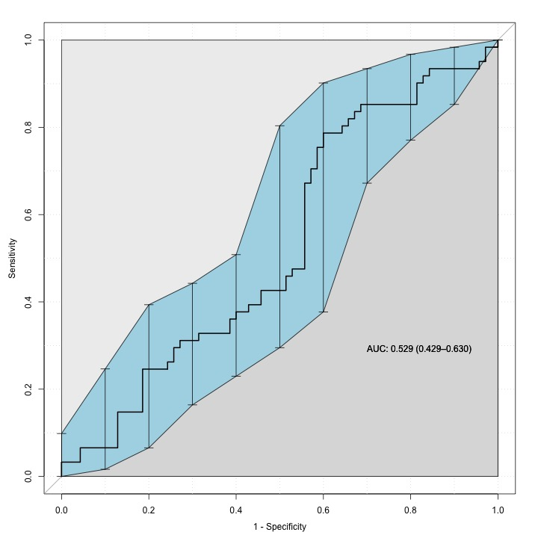

Results: Predictive Performance
False
Positive
Area Under the Receiver-Operator Characteristic Curve
True
Negative
False
Negative
True
Positive

Slide 7
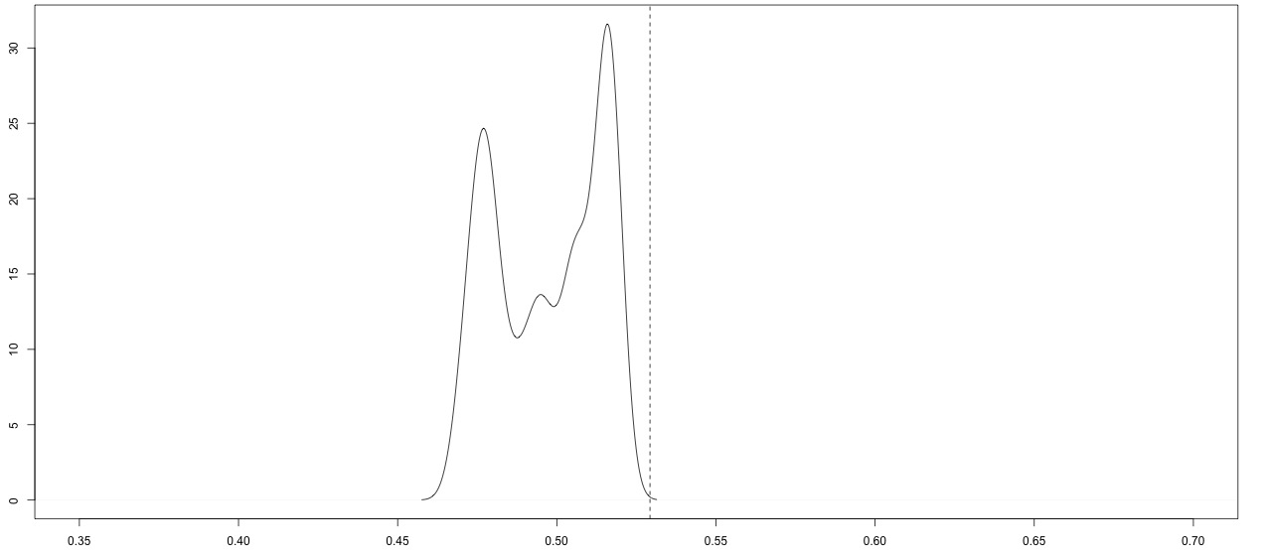
Results: Model Significance
The density of null AUC values (dotted line denotes the true model AUC)
Frequency
AUC

Slide 8
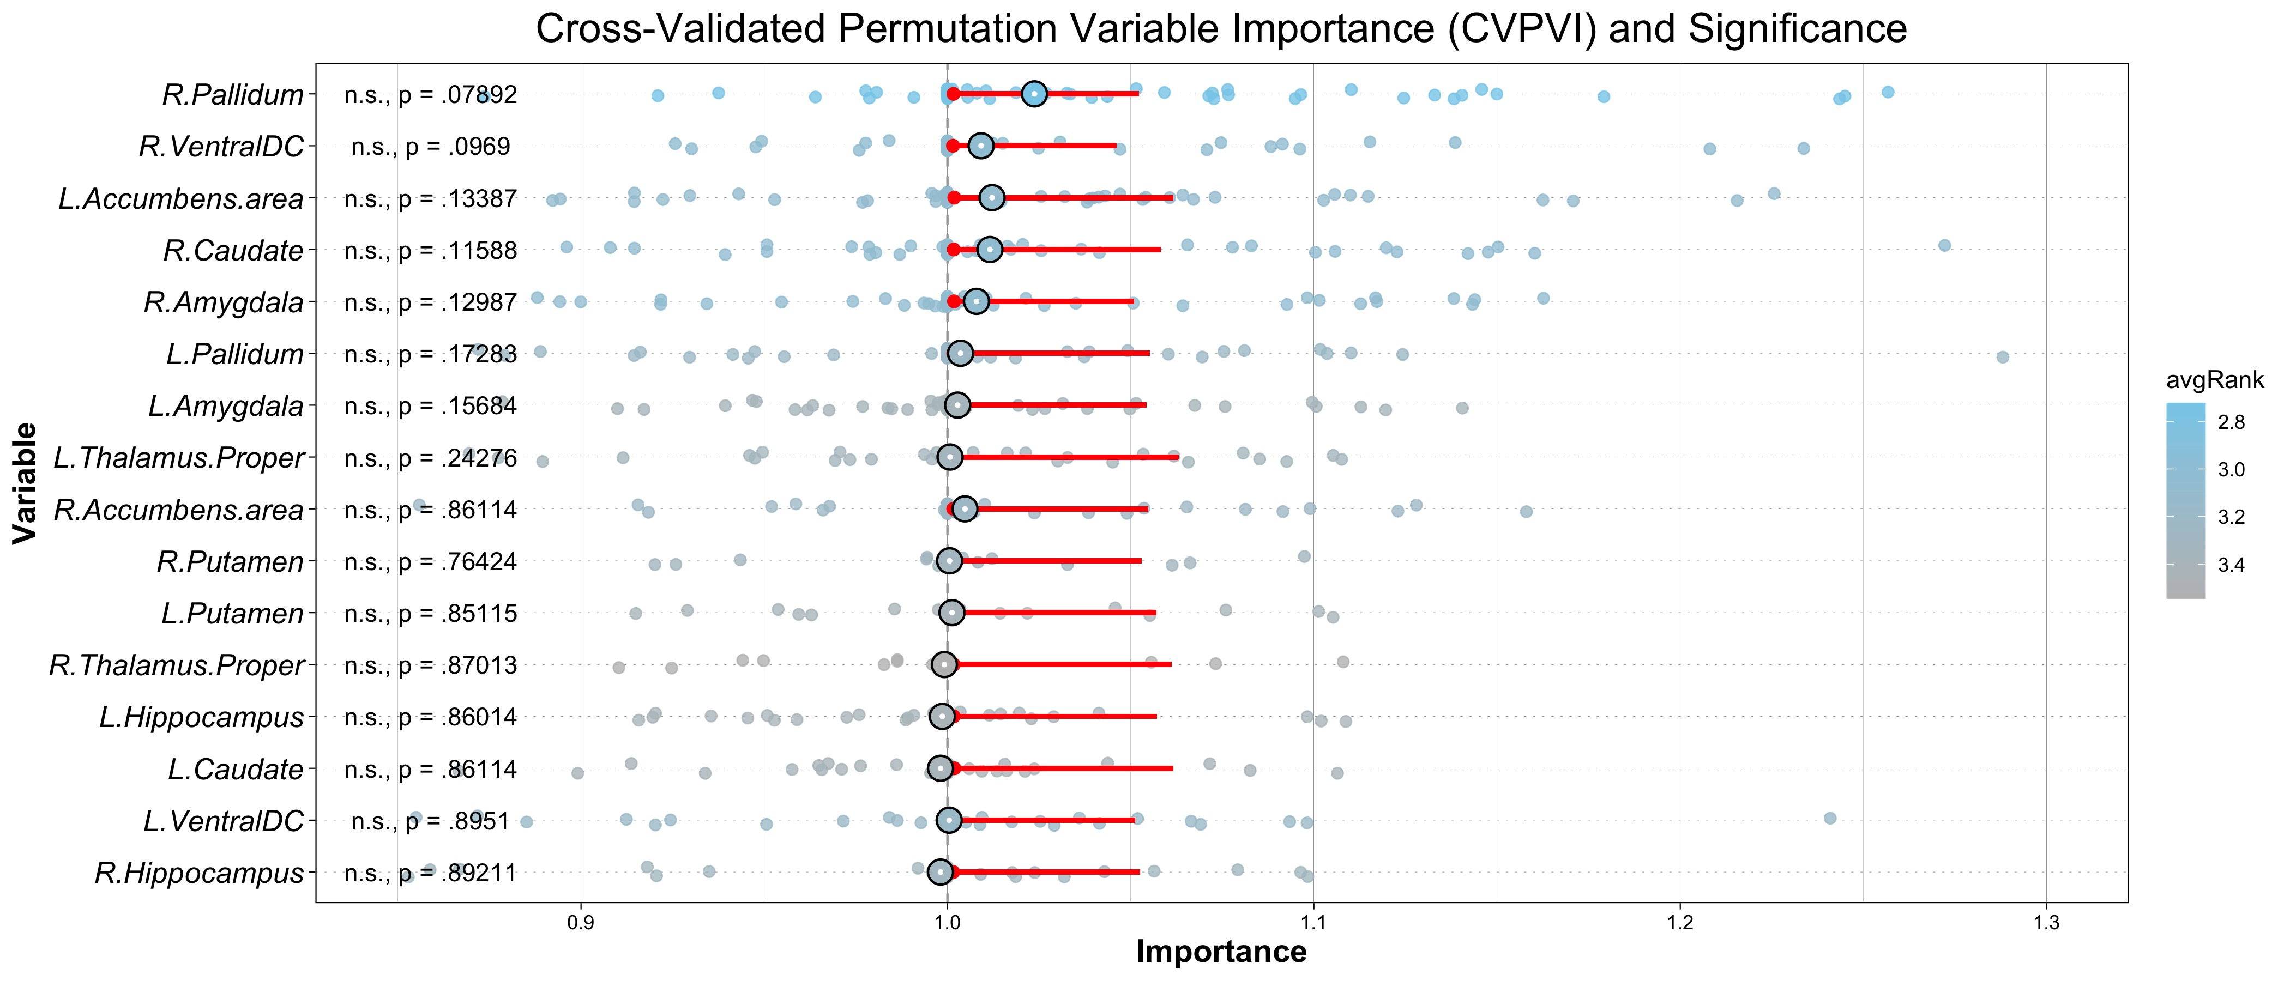
Results: Interpretation

