Slide 1

Deployment with High Availability (Deploy ยังไงไม่ให้เว็บล่ม)
NotAboutCode.com

Slide 2
Agenda
How Deployment Could Take your Site Down
Deployment Categorization & Example
In-Place vs Replace
All-at-once vs Rolling
Blue-Green Deployment
Canary Deployment

Slide 3
Standard 3-Tier Application
Web Browser/Mobile
Web Server
Database

Slide 4
High Availability 3-Tier Application
Web Server
#1
Web Server #2
Database
(Master)
Web Browser/Mobile
Load Balancer
Web Server #3
Database
(Replica)

Slide 5
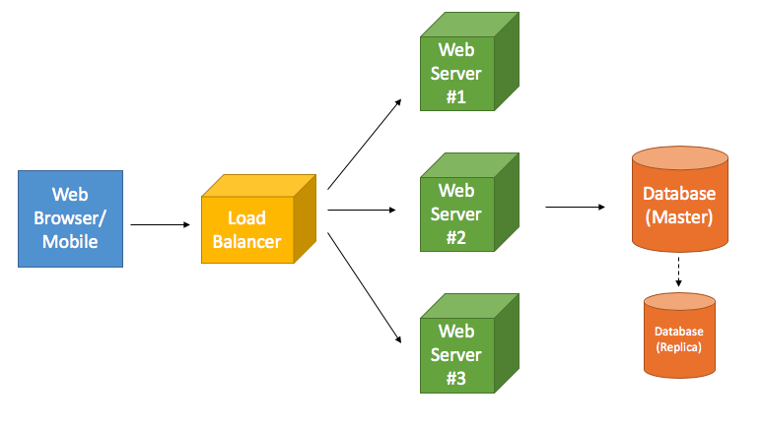
Why the Application is Down During Deployment?
4 Levels
Code
Config
Database
Infrastructure
Focus on Web Server
Reasons:
Redundancy
Backward Compatibility
Statefulness
No Available Server

Slide 6
Why the Application is Down During Deployment?
4 Levels
Code
Config
Database
Infrastructure
Focus on Web Server
Reasons:
Redundancy (Design)
Backward Compatibility (Design)
Statefulness (Design)
No Available Server (Deployment)

Slide 7
1. In-Place vs. Replace
v.
1.4
v. 1.3
v. 1.3
Load Balancer
v. 1.3

Slide 8
1. In-Place vs. Replace
v. 1.4
v. 1.4
Load Balancer
v. 1.4

Slide 9
1. In-Place vs. Replace
v. 1.3
v. 1.4
v. 1.3
v. 1.4
Load Balancer
v. 1.3
v. 1.4

Slide 10
1. In-Place vs. Replace
v. 1.3
v. 1.4
v. 1.3
v. 1.4
Load Balancer
v. 1.3
v. 1.4

Slide 11
1. In-Place vs. Replace
v. 1.4
v. 1.4
Load Balancer
v. 1.4

Slide 12
1. In-Place vs. Replace -- Summary
In-Place doesn’t spin up new server
There is a slight moment that the server is not available from:
Copying (code, binary, etc.)
Rebooting (server, OS, etc.)
Fast
Replace spin up new server
Almost no downtime
Rely on LoadBalancer to switch
Less risk
Start fresh, no state from previous server
Expensive if not in Cloud environment

Slide 13
2. All-at-once vs Rolling
v. 1.3
v. 1.3
Load Balancer
v. 1.3

Slide 14
2. All-at-once vs Rolling
v. 1.3
v. 1.4
v. 1.3
v. 1.4
Load Balancer
v. 1.3
v. 1.4

Slide 15
2. All-at-once vs Rolling
v. 1.3
v. 1.4
v. 1.3
Load Balancer
v. 1.3

Slide 16
2. All-at-once vs Rolling
v. 1.4
v. 1.3
Load Balancer
v. 1.3

Slide 17
2. All-at-once vs Rolling
v. 1.4
v. 1.3
v. 1.4
Load Balancer
v. 1.3

Slide 18
2. All-at-once vs Rolling
v. 1.4
v. 1.4
Load Balancer
v. 1.3

Slide 19
2. All-at-once vs Rolling
v. 1.4
v. 1.4
Load Balancer
v. 1.4

Slide 20
Rolling Considerations
Factors
Speed
x servers at a time
x% at a time
Capacity
Rollback
Example
10 servers
3 – 3 – 3 – 1
Guarantee at least 7 servers running

Slide 21
2. All-at-once vs Rolling -- Summary
All-at-once
Faster
Possibility of a slight moment of downtime
Risk of pushing bad version
Replace spin up new server
Slower
Minimum disruption if the new version causes failure (x % of users will be affected)
Rollback complexity
No downtime but Temporary Reduced capacity

Slide 22
Rolling with Minimum Capacity
v. 1.3
v. 1.4
v. 1.3
Load Balancer
v. 1.3

Slide 23
Rolling with Minimum Capacity
v. 1.3
v. 1.4
v. 1.3
Load Balancer
v. 1.3

Slide 24
Rolling with Minimum Capacity
v. 1.3
v. 1.4
v. 1.3
Load Balancer
v. 1.3

Slide 25
Matrix
 | All-at-once | Rolling
In-Place | Fastest Riskiest Simple
Replace |  | Slowest Saftest Complex

Slide 26
3. Blue-Green Deployment
v. 1.3
v. 1.3
Load Balancer
v. 1.3

Slide 27
3. Blue-Green Deployment
v. 1.3
v. 1.4
v. 1.3
v. 1.4
Load Balancer
v. 1.3
v. 1.4

Slide 28
3. Blue-Green Deployment
v. 1.3
v. 1.4
v. 1.3
v. 1.4
Load Balancer
v. 1.3
v. 1.4

Slide 29
3. Blue-Green Deployment
v. 1.3
v. 1.4
v. 1.3
v. 1.4
Load Balancer
v. 1.3
v. 1.4

Slide 30
3. Blue-Green Deployment
Can be done at DNS level, but mind the TTL
Essentially Replace + All-at-once
With mechanism to immediately rollback if the new version fail

Slide 31
4. Canary Deployment
Canary = a bird
If the issue happens, it is detected in the first batch
A set of server (“canary”) is deployed first
Wait for a certain time (Can be just 10 minutes or up to 1 day)
If there is no issue, deploy the rest
Examples:
10 servers
Deploy new version to 2 servers
Wait for 30 minutes
Deploy to 8 more servers

