Slide 1
HR Analytics Dashboard Employee Data Analysis (2006–2019)
Prepared by: Ijeoma Okeke
Data Analyst
Microsoft Excel | Power Query | PivotTables | PivotCharts | Dashboard

Slide 2
Project Overview
Content
Business Problem The HR department required an interactive reporting solution to analyze workforce trends and support data-driven decision-making using employee data from 2006–2019.
Objectives
Clean and transform the HR dataset.
Build an interactive Excel dashboard.
Analyze workforce trends.
Answer key business questions.
Provide actionable recommendations.
Dataset Summary
311 Employees
39 Variables
Reporting Period: 2006–2019

Slide 3
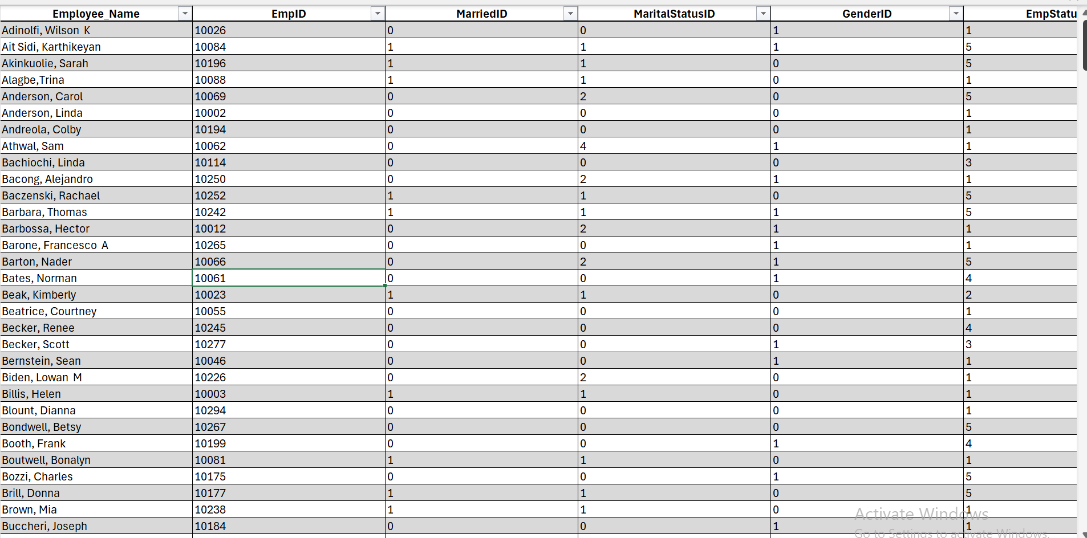
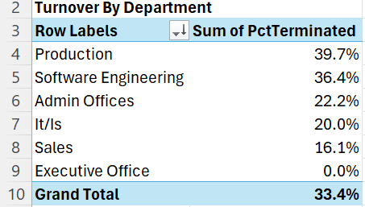
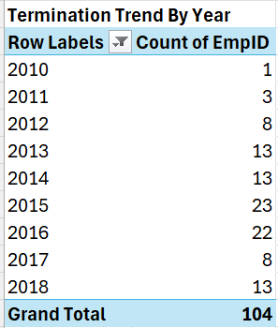
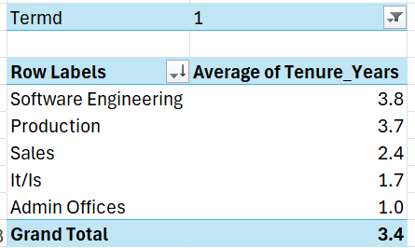
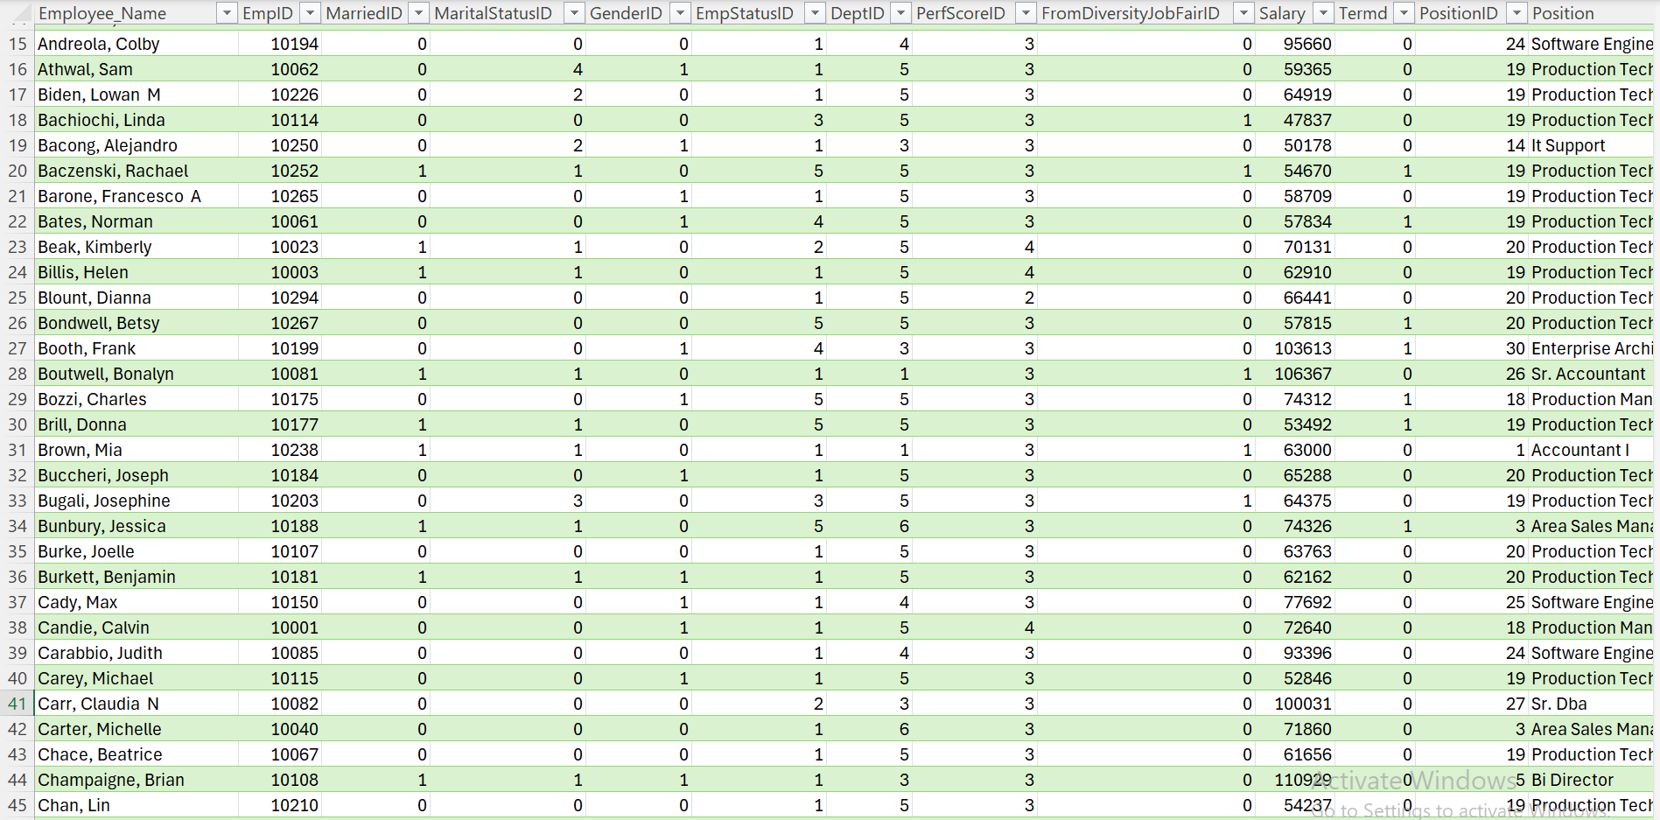
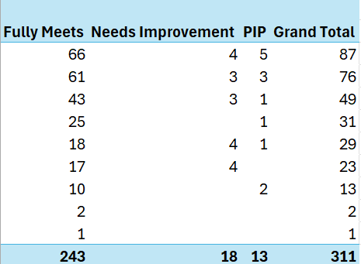
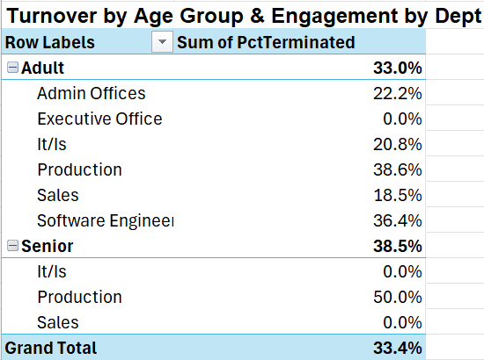
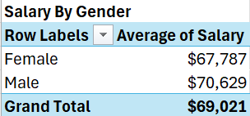
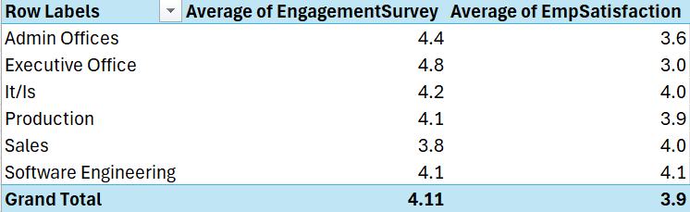
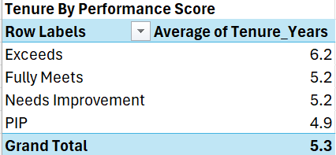
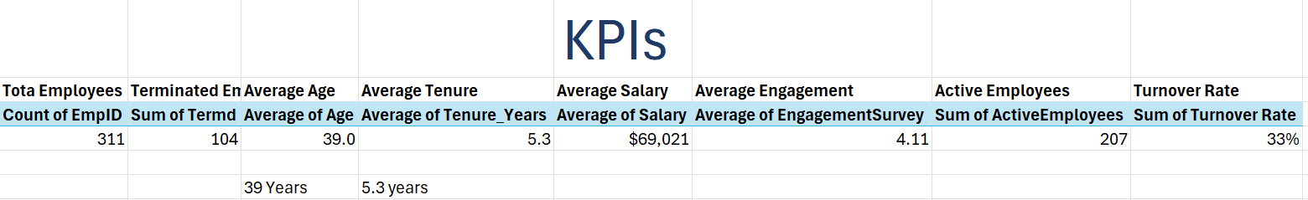
VISUALS

Slide 4
Data Cleaning and Preparation
Content
The following data quality issues were resolved:
✔ Corrected employee age calculations.
✔ Corrected tenure calculations.
✔ Filled missing Manager IDs.
✔ Standardized text formatting.
✔ Corrected employment status inconsistencies.
✔ Removed termination reasons for active employees.
✔ Created helper columns:
Age Group
Termination Year
Active Employees
Turnover Rate
✔ Loaded the cleaned dataset into Excel for analysis.

Slide 5
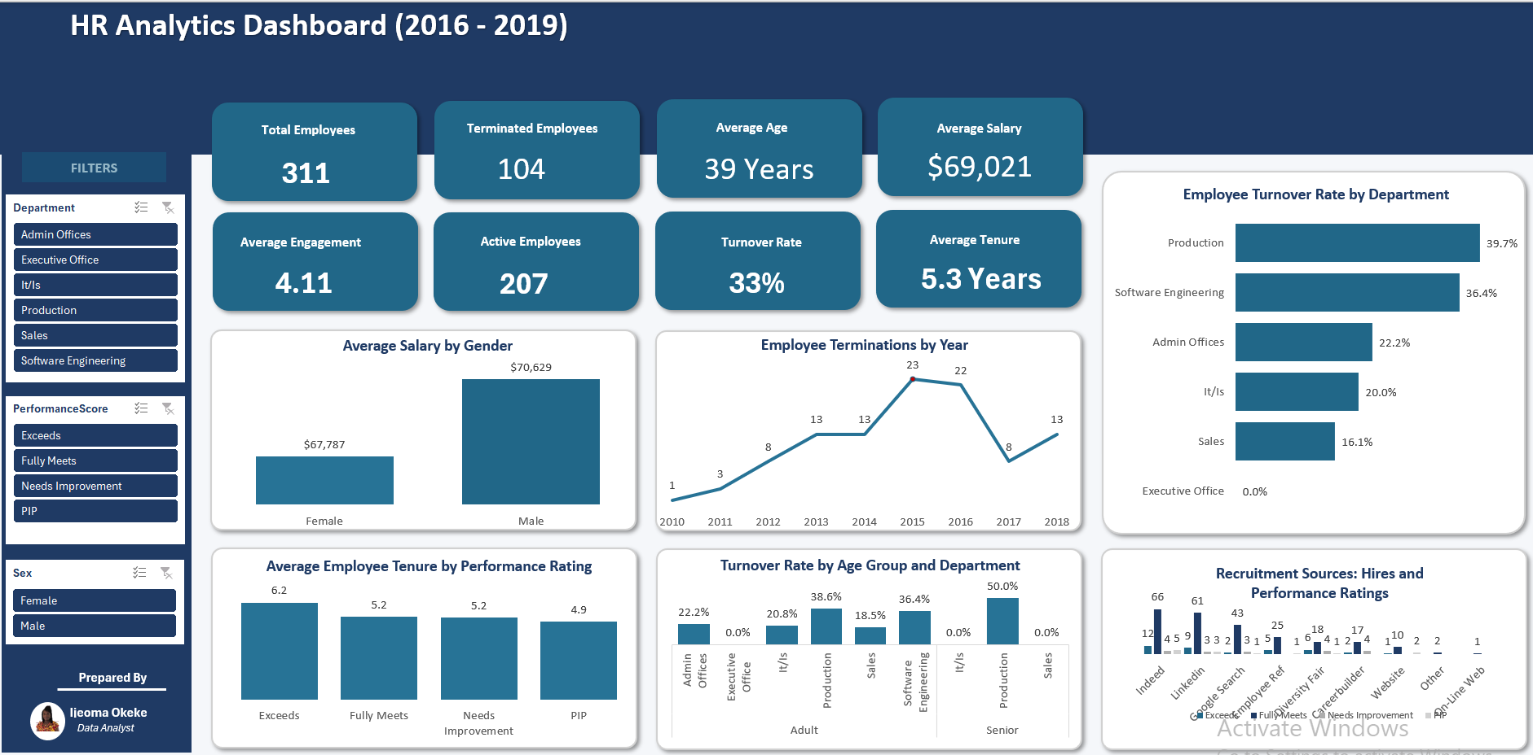
Dashboard Overview Interactive HR Analytics Dashboard
Dashboard Features
8 KPI Cards
6 PivotCharts
3 Interactive Slicers
Automated Filtering

Slide 7
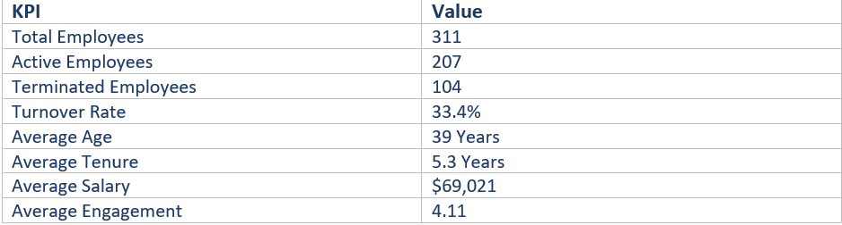
Key Workforce Metrics
Key Takeaway
The organization maintained a workforce of 311 employees, with an overall turnover rate of 33.4%.

Slide 8
Employee Turnover Analysis
Key Findings
Production recorded the highest turnover (39.7%).
Employee exits peaked in 2015.
Turnover declined after 2016.

Slide 9
Recruitment Effectiveness
Key Findings
Indeed generated the highest number of hires (87).
Indeed also produced the largest number of high-performing employees.
Employees rated "Exceeds Expectations" had the longest average tenure (6.2 years).

Slide 10
Compensation and Employee Experience
Key Findings
Male employees earned an average salary of $70,629.
Female employees earned an average salary of $67,787.
Executive Office recorded the highest engagement score.
Software Engineering recorded the highest employee satisfaction.

Slide 11








Strategic Recommendations
Improve retention strategies in the Production department.
Investigate early turnover within the IT/IS department.
Prioritize recruitment through Indeed and LinkedIn.
Conduct regular salary equity reviews.
Expand employee engagement initiatives across departments.
Strengthen career development and recognition programs.
Improve succession planning for experienced employees.
Continue monitoring workforce performance using the interactive dashboard.

Slide 12
Conclusion
Key Takeaways
The HR Analytics Dashboard transformed raw employee data into meaningful business insights.
The dashboard enables HR leaders to monitor workforce trends through interactive visualizations.
The findings support evidence-based decisions aimed at improving employee retention, recruitment, engagement, and organizational performance.
Thank You

