Slide 1
PORTFOLIO PROJECT | POWER BI | SQL | EXCEL
Istanbul Shopping
Analytics
A Data-Driven Analysis of Customer Behavior,
Sales Performance & Revenue Trends
Across 10 Istanbul Shopping Malls
Ijeoma Okeke | Data Analyst | July 2026
99,457
$251.5M
10
Transactions
Total Revenue
Shopping Malls

Slide 2
Project Agenda
What's
Inside
01
Project Overview & Dataset
Istanbul shopping data — 99,457 rows, 10 malls, Jan 2021–Mar 2023
02
Data Cleaning & Methodology
A complete end-to-end analytics project — from raw data to business decisions.
Excel cleaning, SQL setup, DAX measures
03
Executive Summary
KPIs, category revenue, mall performance, payment methods
04
Customer Analysis
Tools Used:
Gender, age group, category preference, payment by age
Excel • SQL • Power BI
05
Sales Trends
Monthly trends, YoY revenue, seasonal patterns
06
Recommendations & Conclusion
6 strategic actions for mall management

Slide 3
Dataset & Methodology
Source: Kaggle — Customer Shopping Dataset Istanbul | Jan 2021 – Mar 2023 | 99,457 rows
99,457
10
10
3 Yrs
Total Rows
Columns
Shopping Malls
Data Period
Data Cleaning Steps
Tools & Workflow
✓ Fixed mixed date formats (DMY via Text to Columns)
Excel
Cleaning, date formatting, feature engineering
✓ Verified zero missing values & zero duplicates
✓ Standardized all column headers
SQL / SSMS
10 analytical queries across 99,457 rows
✓ Created Revenue column = Quantity × Price
✓ Created Age_Group column (5 descriptive bands)
Power BI
4-page dashboard, 9 DAX measures, synced slicers
✓ Exported cleaned file as CSV for SQL & Power BI

Slide 4
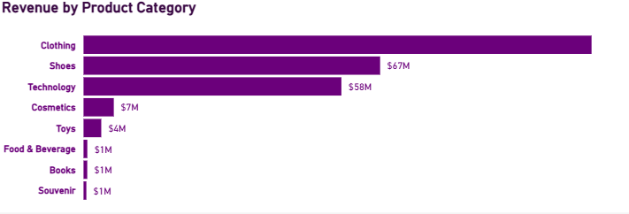
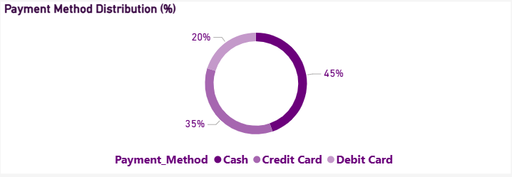
Executive Summary
Overall business performance across 99,457 transactions and 10 Istanbul shopping malls
$251.5M
99,457
298,712
99,457
$2,529
Total Revenue
Total Customers
Items Sold
Transactions
Avg Order Value

Slide 5
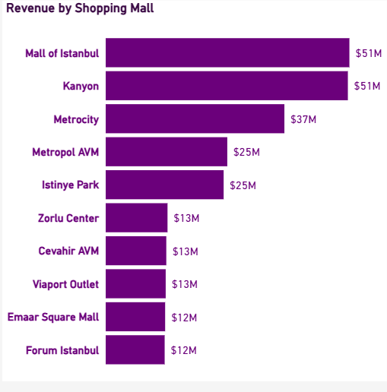
Mall Performance
Revenue breakdown across all 10 Istanbul shopping malls
🥇 Top 2 Malls = 40%
Mall of Istanbul ($51M) and Kanyon ($51M) together account for ~40% of all revenue.
👗 Clothing #1 Everywhere
Clothing is the #1 revenue category in every single mall — no exceptions across all 10.
📊 Revenue Gap
Top mall ($51M) earns 4.6× more than the bottom mall ($11M). Significant performance spread between malls.

Slide 6
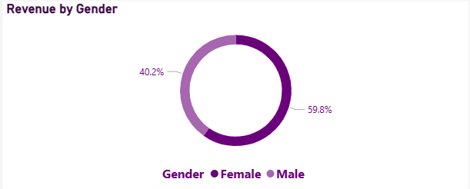
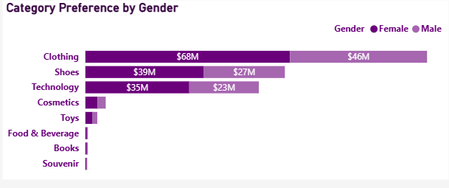
Customer Analysis — Gender
How does gender influence purchasing behavior and revenue contribution?
$150.2M
59.8%
$101.3M
40.2%
Female Revenue
Female Share
Male Revenue
Male Share
💡 Key Insights — Gender Analysis
• Female shoppers generate $150.2M (59.8%) — driven by higher shopping frequency, not higher spend per visit
• Male customers contribute $101.3M (40.2%) — a significant growth opportunity through targeted tech & sports campaigns
• Clothing is the #1 category for BOTH genders: Female $68M vs Male $46M — fashion is the universal driver
• Technology has the narrowest gender gap (Female $35M vs Male $23M) — most evenly split category across genders
• Cosmetics revenue is almost entirely female-driven — male spend is negligible in this category

Slide 7
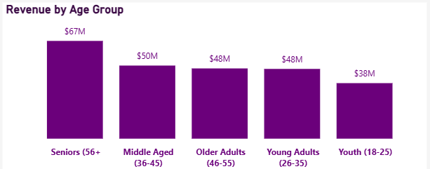
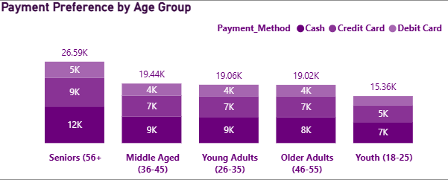
Customer Analysis — Age Groups
Which age groups represent the most valuable customer segments?
Seniors 56+
$67.1M
$29M Gap
$38.1M
Top Age Group
Senior Revenue
Top vs Bottom
Youth Revenue
💡 Key Insights — Age Group Analysis
• Seniors (56+) are the highest-spending group at $67.1M — yet the most underserved segment in retail marketing
• Youth (18-25) contribute the least at $38.1M — a $29M gap between the top and bottom age groups
• Seniors have the highest cash usage (12K transactions) — directly explaining the 44.69% overall cash dominance
• Middle Aged ($50M), Older Adults ($48M) and Young Adults ($48M) are tightly clustered with no clear leader

Slide 8
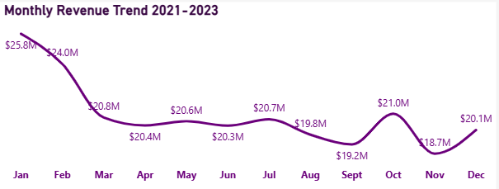
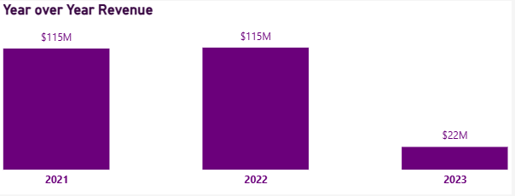
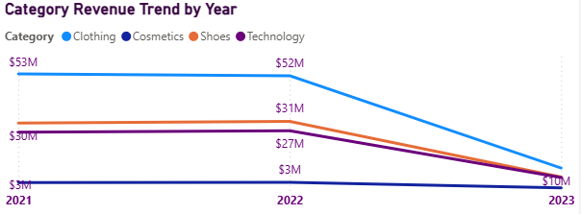
Sales Trends & Seasonality
Revenue over time, seasonal peaks, YoY performance and data anomalies
$251.5M
$115.4M
$25.8M
99,457
Total Revenue
Best Year 2022
Best Month Jan
Total Transactions
💡 Key Insights — Sales Trends & Seasonality
• January is the strongest month at $25.8M — nearly $7M more than November ($18.7M). Plan premium launches in January
• 2022 was the best full year at $115.4M — up 0.76% from 2021 ($114.6M). Revenue was stable and growing
• Mid-year revenue dips to ~$19-20M in Jul–Aug — a clear window for targeted promotions and seasonal campaigns
• ⚠ 2023 shows only $21.5M because dataset ends in March — this is a DATA issue, NOT a real business decline

Slide 9
Strategic Recommendations
6 data-driven actions for Istanbul shopping mall management
01
Protect Clothing Dominance
02
Build a Senior Loyalty Programme
Clothing is #1 in every mall. Expand premium tech zones to capture high avg order value ($11,581).
Seniors (56+) are highest-spending yet underserved. Weekday discounts + accessible facilities.
03
Target Male Shoppers for Growth
04
Modernise Payment Infrastructure
Males = 40% revenue. Tech & sports campaigns can close the gender revenue gap.
44.69% cash is unexpectedly high. Incentivise card payments with loyalty points.
05
Seasonal Campaign Planning
06
Investigate Top Customer Accounts
Jan peaks at $25.8M. Plan premium events for January; promotions for Jul–Aug dip.
Top 10 customers each spent exactly $26,250 — statistically anomalous, needs investigation.

Slide 10
Key Takeaways
$251.5M Total Revenue —
Across 99,457 transactions in 10 malls — Jan 2021 to Mar 2023 (full 2021 & 2022 data)
Clothing = Universal #1 —
Dominant revenue category in every single mall without exception
Seniors (56+) Lead Spending —
Highest-spending age group at $67M — yet chronically underserved by retail marketing
59.8% Female Revenue —
Female shoppers drive majority of revenue through higher shopping frequency
44.69% Cash Payments —
Cash dominates in a modern urban mall — surprising and highly actionable finding
2023 Is Incomplete Data —
$22M in 2023 = Jan–Mar only. The sharp drop is a dataset issue, NOT a business decline
Ijeoma Okeke | Data Analyst | Istanbul Shopping Analytics Portfolio Project | July 2026

