Slide 1
Laundry Online Project
Instructor: Mr. Ngo Phuoc Nguyen
Class: T1.1910.M1
Group 2: LaundryOnline Project
Team Members: Bui Quoc Tuan
Quach Gia Lam
Nguyen Ngoc Thach
Hoang Vu Ngoc Minh

Slide 2
Main content
1-Introduction
1.1Actual requirements
1.2Deployment diagram
2-Test result
3-Conclusion and development
4-Task list

Slide 3
1.1- Actual requirements
1-Existing scenario
2-For customers
3-For admin
4-Admin functional:
5-Customer functional
6-Non-functional
REQ.1: Notification by email.
REQ.2: A chat box.

Slide 4
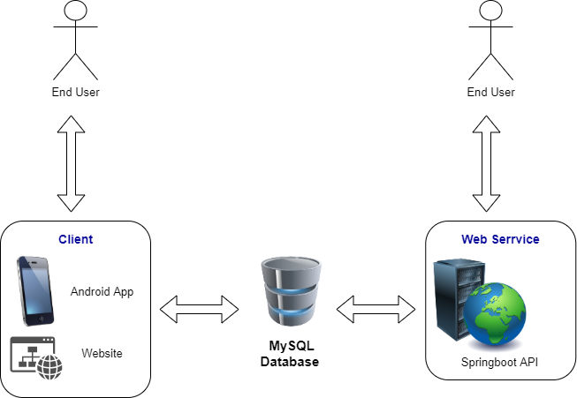
1.2-Deployment diagram

Slide 5
TEST RESULTS
Login Admin
Admin and Report
Services and Shippers
Users management
Orders and Order Details
Employee payroll & payslip
Services

Slide 6
Test for Employee Management
Task | Team Mate Names | Status
Create new payroll and payslip | Nguyen Ngoc Thach | Done
Show all payrolls |  | Done
Relative search |  | Done
Details payroll for Employee |  | Done
Economic efficiency |  | Done
Payroll_Report |  | Done
Chart Payroll |  | Done

Slide 7
Test Result for Services
Sign in, logout Admin | Bùi Quốc Tuấn Quách Gia Lâm Hoàng Vũ Ngọc Minh | Done
Sign in, logout Client |  | Done
Manage Admin |  | Done
Manage Users |  | Done
Manage Orders |  | Done
Manage Order details |  | Done
Google translate, Google search |  | Done
A chart that shows the most selected and ordered services |  | Done
Send email Admin |  | Done
Chatbox: Facebook, Zalo |  | Done
Contact: about us |  | Done
Shopping cart, demand |  | Done
Report user, orders |  | Done

Slide 8
Test Result for Android application
Manage Services | Bùi Quốc Tuấn | Done
Manage Shippers |  | Done
Report Shipper |  | Done
Chart show revenue of the day |  | Done
Show all Services |  | Done
Search by types and names of Services |  | Done
Send email |  | Done

Slide 9
3 - Development
Frontend | HTML5, CSS, Jquery 3.4.1
 | Javascript 1.5
 | Bootstrap 4
Backend | API
 | QR Code
 | Java
 | Springboot
 | Android
 | Tomcat
 | GSON

Slide 10
4-Task list
Login Admin (Lâm)
Admin and Report (Lâm –Minh)
Services and Shippers (Minh)
Users management (Lâm –Thạch)
Orders and Order Details (Lâm)
Employee payroll & payslip (Thạch)
Services (Lâm-Minh -Thạch)
Android Development (Tuấn –Minh)

Slide 11
3-Conclusion
-Through the project, we have learned a lot of valuable experience
about teamwork
-Working spirit and attitude play an important role
that directly affects the results.
-Must always learn, orient right and
correct mistakes promptly when detected
-Thank you to the teachers, the school has been dedicated to instructing, guiding and guiding us in the past time, hopefully in the near future we will continue to receive that valuable support, especially by Mr. Ngo Phuoc Nguyen and the school's teachers and staff.
- Due to limited time and limited qualifications, although the group and each member have tried their best, it is inevitable that there will be shortcomings.
Sincere thanks to the Council.

Slide 12

Thank You

