Slide 1
Introduction
Laundry Online
Instructor: Mr. Ngo Phuoc Nguyen
Class: T1.1910.M1
Group: 2
Team Members: Bui Quoc Tuan
Quach Gia Lam
Nguyen Ngoc Thach
Hoang Vu Ngoc Minh

Slide 2
Content
Introduction
Actual requirements
Requirements of the project
Deployment diagram
Test result
Conclusion and development
Task list

Slide 3
Introduction - Actual requirements
Existing scenario
During the period of information technology and computer development people can do anything at home vie internet connection and use online services. Therefore, we are developing a mobile app and website that order laundry named LaundryOnline.
“LaundryOnline” is a group of people who wants to develop an app were the user can order laundry combined with online payment and can be delivered by the shipper after finishing.

Slide 4
Introduction - Actual requirements
For customers:
Allow customers who enter the application to browse and search for products using search terms or filtering products’ categories.
Customers need to register an account in order to add product to cart, place order… because every thing is stored in the database.
Can create order, payment information and change their information with a registered account.

Slide 5
Introduction - Actual requirements
For admin:
View, add, update (when requirements are met) existing services, shipper, customers who have registered, orders which have been placed.
Aside from managing services, orders, etc. an admin can also view reports on employee, shipper, orders and users.

Slide 6
Introduction - Requirements of the project
Admin functional:
REQ.1: Login to the admin system (have 3 roles: Admin, Staff, Employee).
REQ.2: Manage order, order details.
REQ.3: Manage services.
REQ.4: Export report.
REQ.5: Manage reven
REQ.6: Manage shipper’s account, employee.
REQ.7: Manage proccess (new, received, processing, done).
Notes:
Non-functional (how the system works)
Functional (what the system should do)

Slide 7
Introduction - Requirements of the project
Customer functional:
REQ.1: If visitors are guests:
+REQ.1.1: See pages in the app.
+REQ.1.2: Register.
REQ.2: If visitors are registered:
+REQ.2.1: Login by account or logout.
+REQ.2.2: Order package.
+REQ2.3: See order’s history.
+REQ2.4: Payment by Momo, Paypal, Cash.
Notes:
Non-functional (how the system works)
Functional (what the system should do)

Slide 8
Introduction - Requirements of the project
Non-functional
REQ.1: Notification by email.
REQ.2: A chat box.
Notes:
Non-functional (how the system works)
Functional (what the system should do)

Slide 9
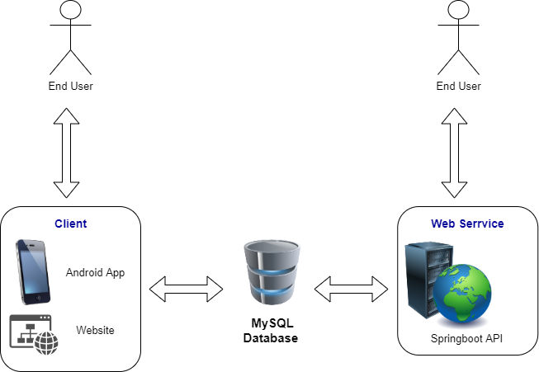
Introduction - Deployment diagram

Slide 10
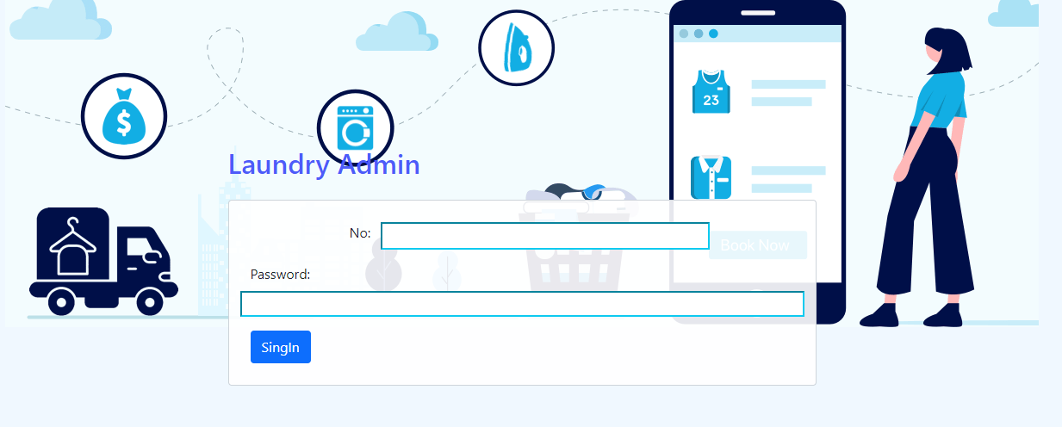
Login Admin

Slide 11
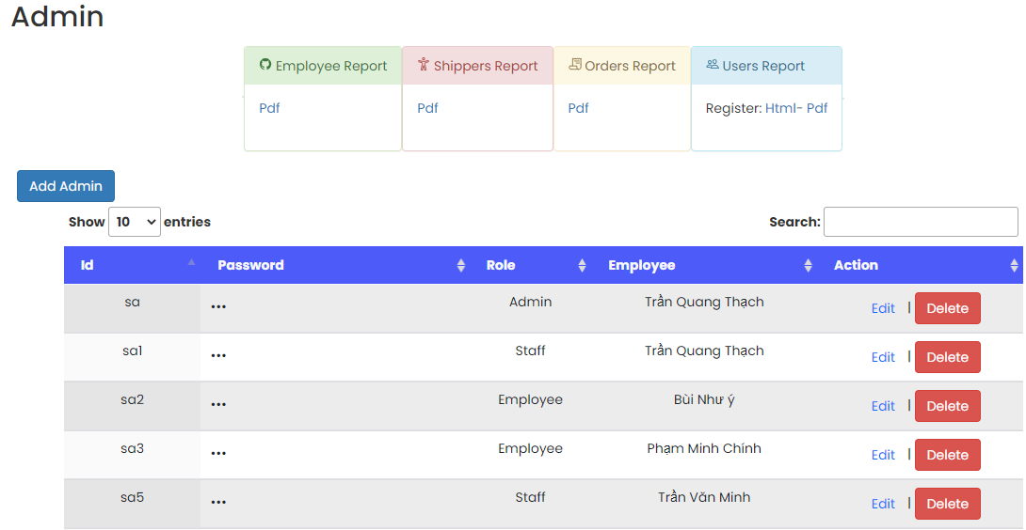
Admin and Report

Slide 12
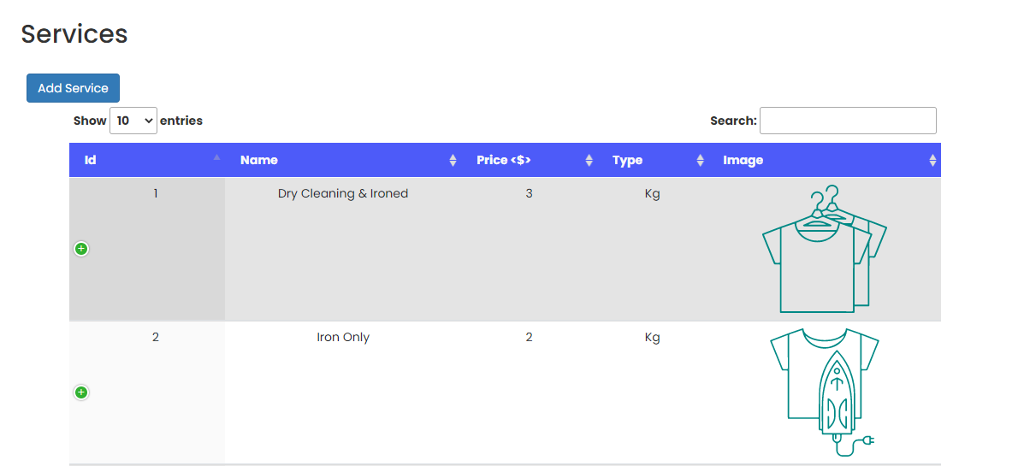
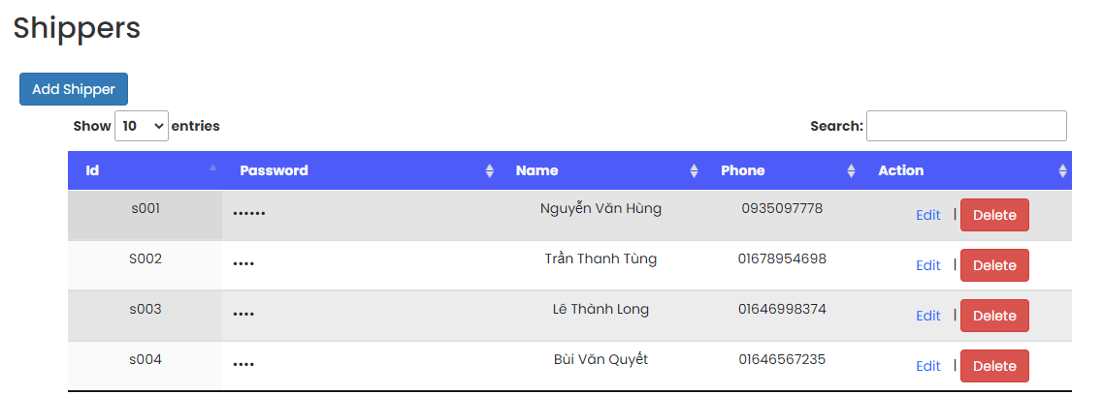
Services and Shippers

Slide 13
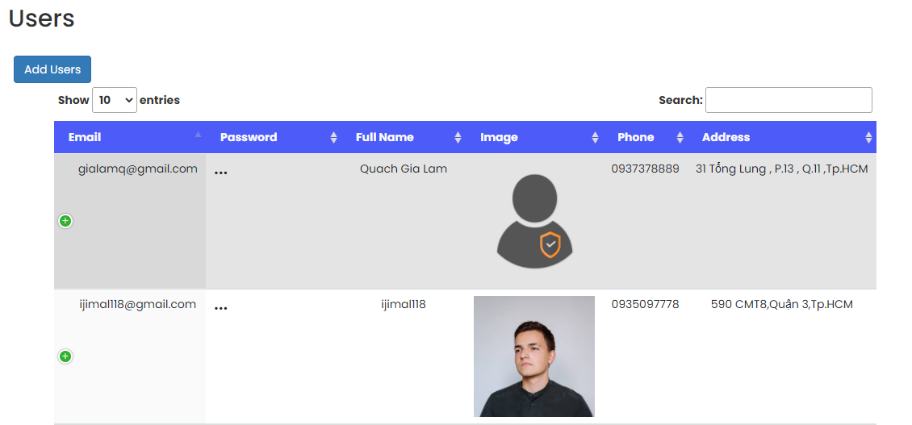
Users

Slide 14
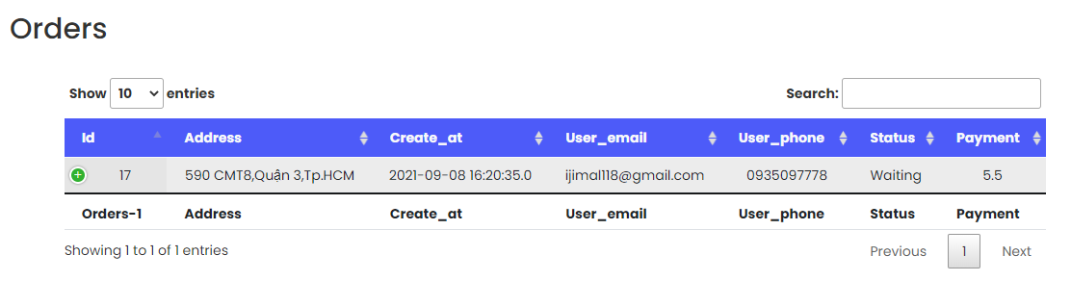
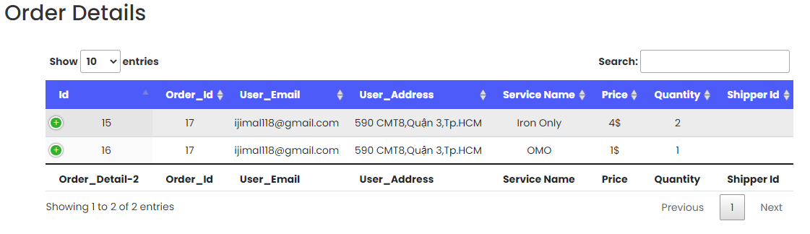
Orders and Order Details

Slide 15
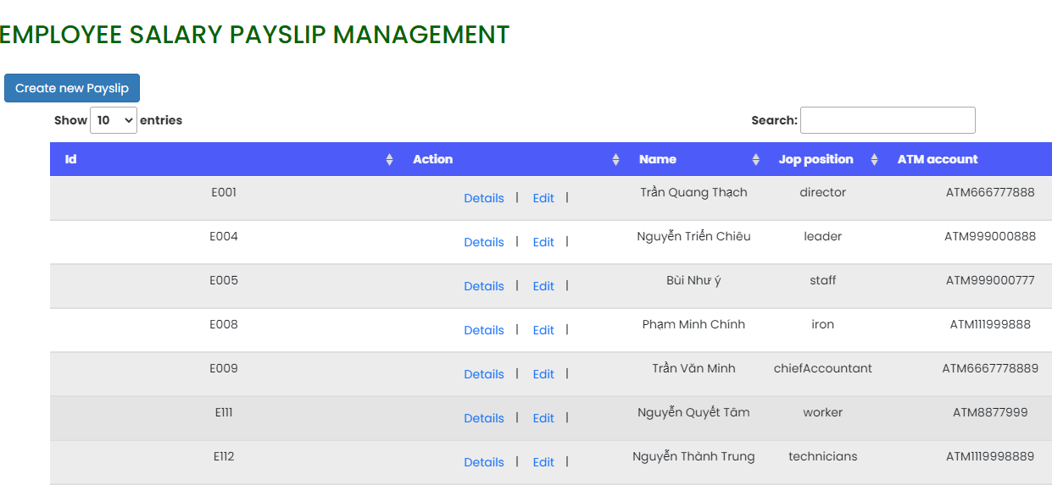
Employee

Slide 16
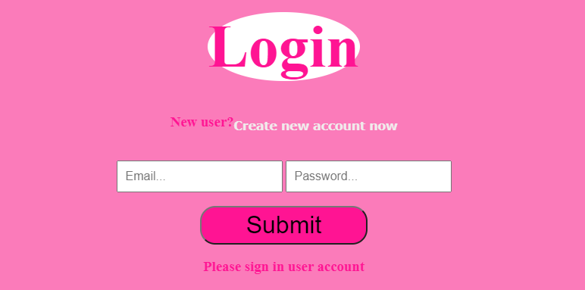
Login Client

Slide 17
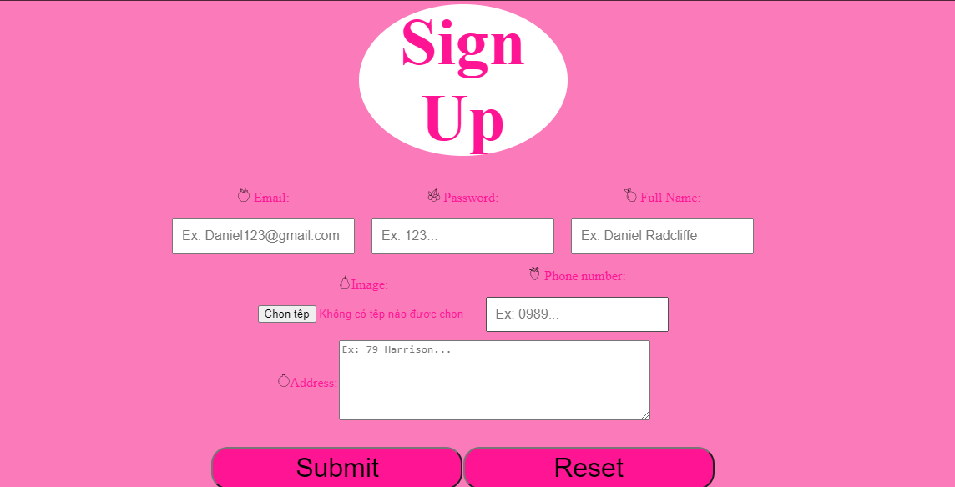
Sign up Client

Slide 18
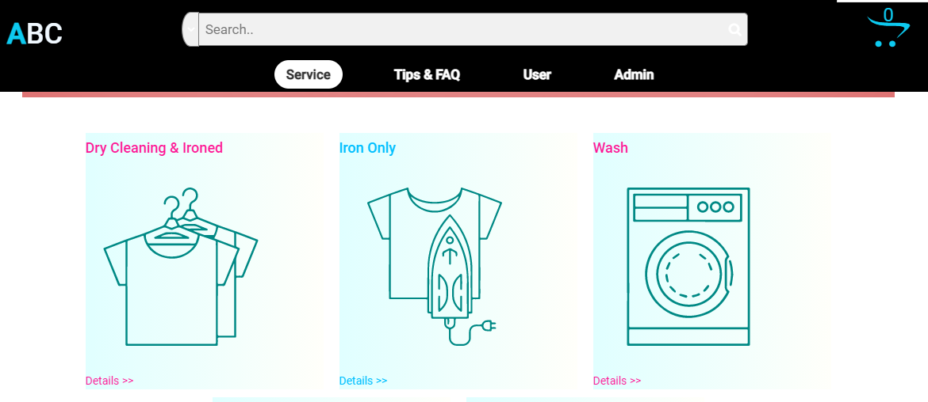
Show Services Client

Slide 19
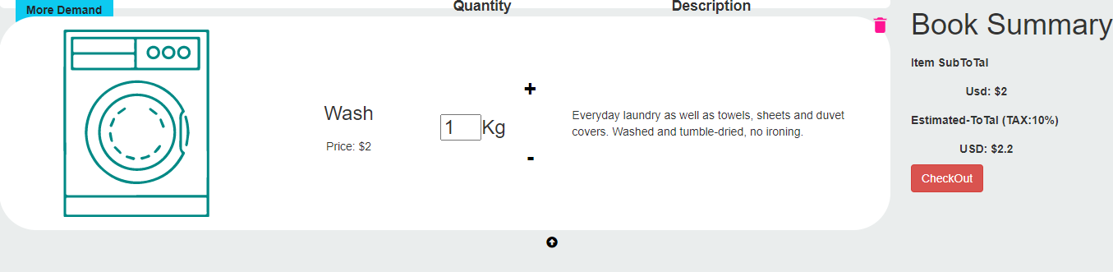
Orders Client

Slide 20
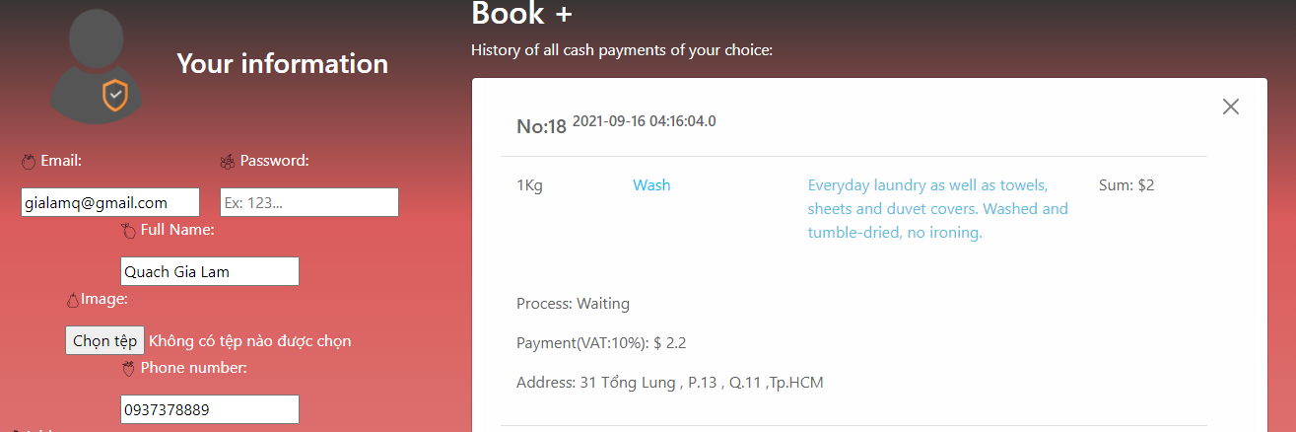
Users information and Order history

Slide 21
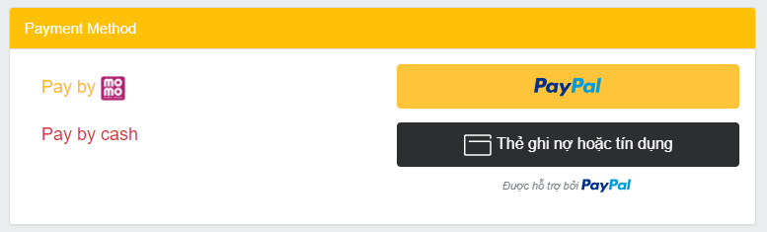
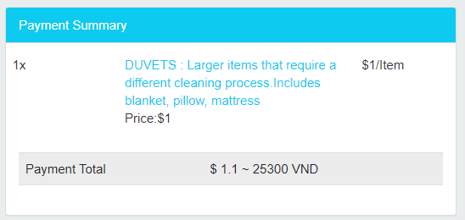
Payment method and Payment summary

Slide 22
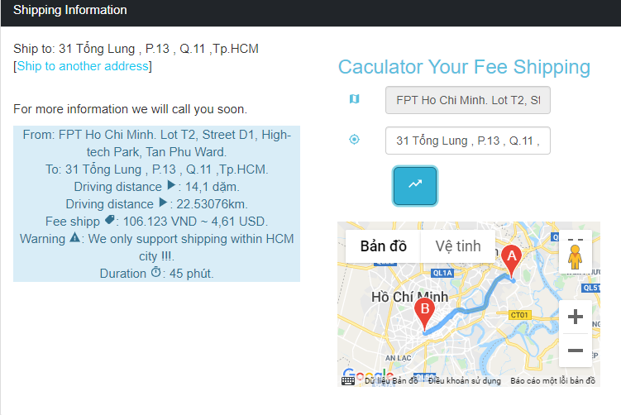
Shipping information

Slide 23
Test Result for Admin website
Task | Team Mate Names | Status
Create new payroll and payslip | Nguyen Ngoc Thach | Done
Show all payrolls |  | Done
Relative search |  | Done
Details payroll for Employee |  | Done
Economic efficiency |  | Done
Payroll_Report |  | Done
Chart Payroll |  | Done

Slide 24
Test Result for Android application
Sign in, logout Admin | Quach Gia Lam | Done
Sign in, logout Client |  | Done
Manage Admin |  | Done
Manage Users |  | Done
Manage Orders |  | Done
Manage Order details |  | Done
Google translate, Google search |  | Done
A chart that shows the most selected and ordered services |  | Done
Send email Admin |  | Done
Chatbox: Facebook, Zalo |  | Done
Contact: about us |  | Done
Shopping cart, demand |  | Done
Report user, orders |  | Done

Slide 25
Test Result for Android application
Manage Services | Hoang Vu Ngoc Minh | Done
Manage Shippers |  | Done
Report Shipper |  | Done
Chart show revenue of the day |  | Done
Show all Services |  | Done
Search by types and names of Services |  | Done
Send email |  | Done

Slide 26
Test Result for Android application
Show all services in Android | Bui Quoc Tuan | Done
Pay by Momo in Android |  | Done
Login Customer or Shipper in Android |  | Done
Register User and Shipper in Android |  | Done
Order history in Android |  | Done
Shippers choose order in Android |  | Done
Edit customer’s address in Android |  | Done
Edit order’s status in Android |  | Done

Slide 27
Development
Frontend | HTML5, CSS, Jquery 3.4.1
 | Javascript 1.5
 | Bootstrap 4
Backend | API
 | QR Code
 | Java
 | Springboot
 | Android
 | Tomcat
 | GSON

Slide 28

Thank You

