Slide 1

Engineering Project
Title: A Deep-Look into Chest X–ray Abnormality (X-ab)
Problem: Developing deep learning models to prescreen abnormal chest X-ray images
Name: Ijin Yu
School: Buena Park High School Teacher: Sonje Berg
Notes:
Hello, my name is Ijin Yu, I am in the 11th grade at Buena Park High school.
(Slower) The title of my project is A Deep-Look into Chest X-ray Abnormality.
In this project, I developed deep learning models that prescreen abnormal chest x-ray images.

Slide 2
Abstract
Problem: Building deep learning models that automatically classifies whether a chest x-ray image is abnormal or normal without doctors present.
Procedures:
Preprocess the data. (edit labels and unified image resolutions.)
Implement a basic CNN model using Python with Pytorch.
Use a pre-trained network, EfficientNet.
Apply a cost-sensitive learning to the basic CNN and EfficientNet.
Data and brief analysis:
The basic CNN model showed over 87% accuracy.
Using a pre-trained network, EfficientNet, produced over 91% accuracy and it is statistically significantly more accurate than the basic CNN model. (p-value < 0.01)
Applying the cost-sensitive learning improved the accuracies a little, but the improvements are NOT statistically significant. (p-value > 0.05)
Conclusion: Applying CNN and EfficientNet is effective for prescreening abnormal chest X-ray images (p-value < 0.01), but applying cost-sensitive learning may or may not work (p-value > 0.05).

Slide 3
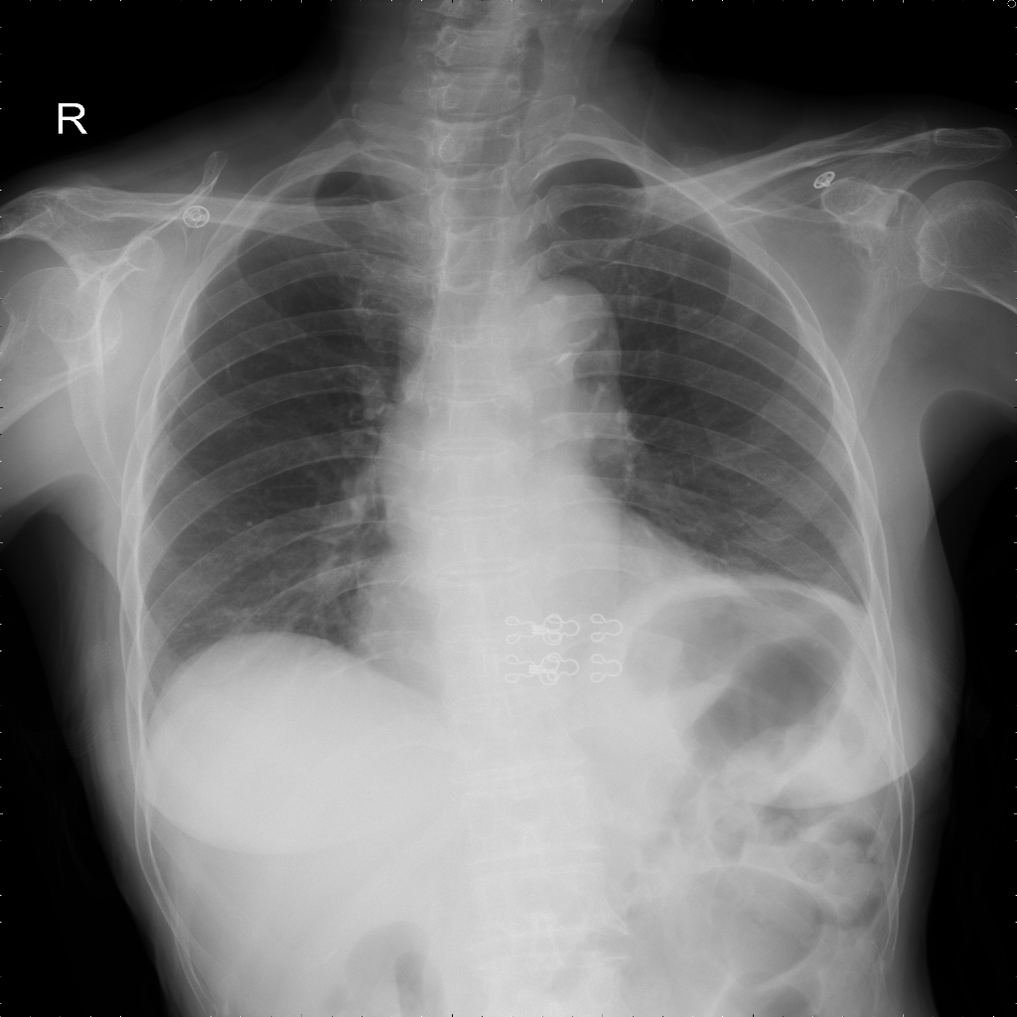
Introduction (Background Research)
Automatic diagnosis of lung diseases through chest X-ray images is being actively studied. However, existing deep learning models have difficulties in accurately diagnosing lung diseases due to (1) diversity of diseases and (2) difficulties in accurately locating abnormal regions in X-ray images. For example, the state-of-the-art model showed less than 40% accuracy for classifying 15 lung diseases on VinBigData (Nguyen et al, 2021) .
This project is to develop deep learning models that detect abnormal chest X-ray images, which is easier than classifying 15 different diseases. This model can be used as a prescreening tool in health checkup centers, and the images prescreened as abnormal can be sent to hospitals for further inspection.
I used the chest X-ray images from VinBigData (Nguyen et al, 2021), which contains 15,000 images, each manually labeled into 15 diseases by doctors. I preprocessed the labels into normal or abnormal to build the prescreening models. I used Python and Pytorch library for implementation and used a Linux machine with NVIDIA RTX3090 GPU for training deep learning models.
Aortic enlargement
Cardiomegaly
Pleural thickening
Pulmonary fibrosis
Nodule/Mass
Lung Opacity
Pleural effusion
Other lesion
Infiltration
ILD
Calcification
Consolidation
Atelectasis
Pneumothorax
X
Abnormal
O
Normal
Notes:
Existing deep learning models try to diagnose various types of lung diseases, but their accuracies are unreliable.
For example, the current state-of-the-art model from the 2021 Kaggle data science competition shows less than 40% accuracy for diagnosing 15 different lung diseases.
My project focuses on detecting abnormal chest X-ray images rather than diagnosing exact diseases.
And this model can be used as a prescreening tool in health checkup centers, to check if the patient’s chest x ray image is normal or abnormal.
The prescreened images labeled as abnormal can be sent to a hospital for further inspection.

Slide 4
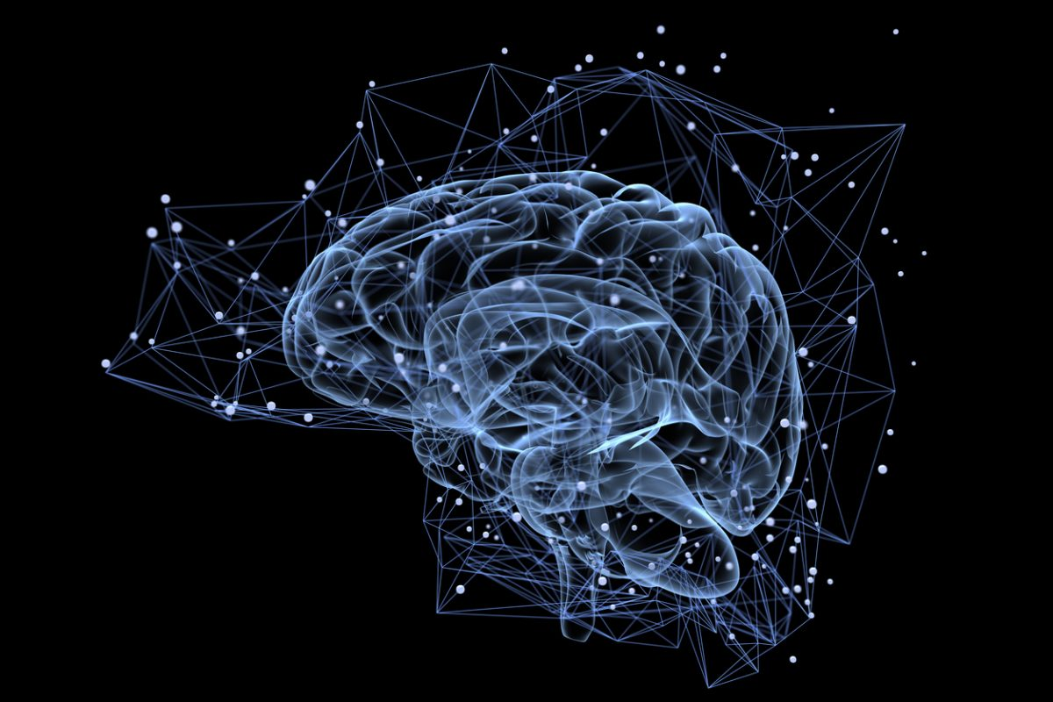
The Engineering Solution, Prototype/Model to be tested.
I first used Convolutional Neural Network (CNN) (LeCun et al, 1989) to build the model, because CNN is known to be effective for image recognition. After that, I tried two things to further improve the accuracy.
First, I used a pre-trained network, EfficientNet (Tan & Le, 2019), and trained the chest X-ray images over this network. EfficientNet is a recently published and increasingly popular pre-trained network.
Next, I tried a cost-sensitive learning (Lin et al, 2017) to reduce the bias toward normal. Note that there are much more normal images than abnormal images in practice, so the model could be easily biased toward normal if trained without caution.
Cost-Sensitive Learning
CNN
EfficientNet
ABNORMAL
NORMAL
Notes:
To build the prescreening models, I first used CNN because it is known to be effective for image recognition.
Then, I tried a pre-trained network called EfficientNet, because it has been recently published and is gaining popularity.
Finally, I tried cost-sensitive learning to reduce the bias toward normal, because in practice, there are much more normal images than abnormal images, and the model could easily be biased toward normal without careful inspection.

Slide 5
Materials
15,000 chest X-ray images from VinBigData (Nguyen et al, 2021), each of which manually labeled into 15 diseases by doctors: To use this dataset, I preprocessed the labels into normal or abnormal.
Python v3.10.1 and Pytorch library v1.10.1: I used this for implementing deep learning models.
Linux machine (Intel Xeon 4210, 96G mem) with NVIDIA RTX3090 GPU (10,752 cores, 24G mem): I used this for training and testing deep learning models.
Convolutional Neural Network (CNN) (LeCun et al, 1989): I used this for my prescreening models.
EfficientNet (Tan and Le, 2019): I used this as my pre-trained network.
Cost-sensitive learning (Lin et al, 2017): I applied this to reduce the bias toward normal.
Notes:
I used the chest x-ray images from VinBigData. VinBigData is a data set used at the 2021 Kaggle competition, and it contains 15,000 images, each manually labeled into 15 diseases by doctors.
I used Python and Pytorch library to implement deep learning models.

Slide 6
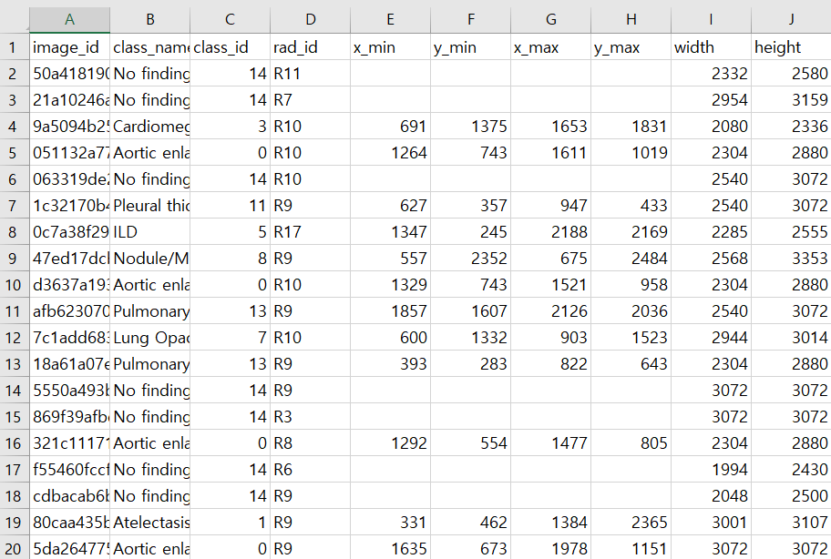
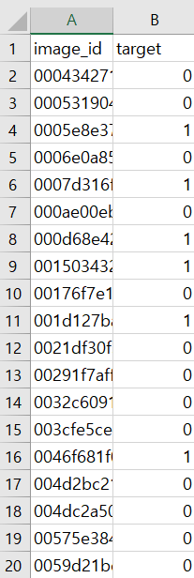
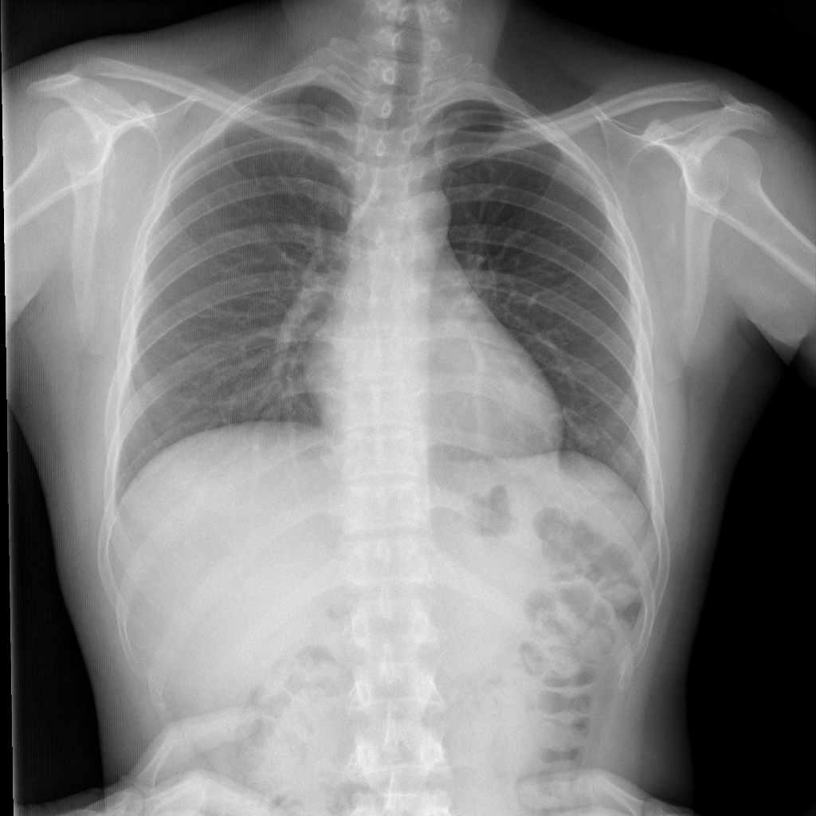
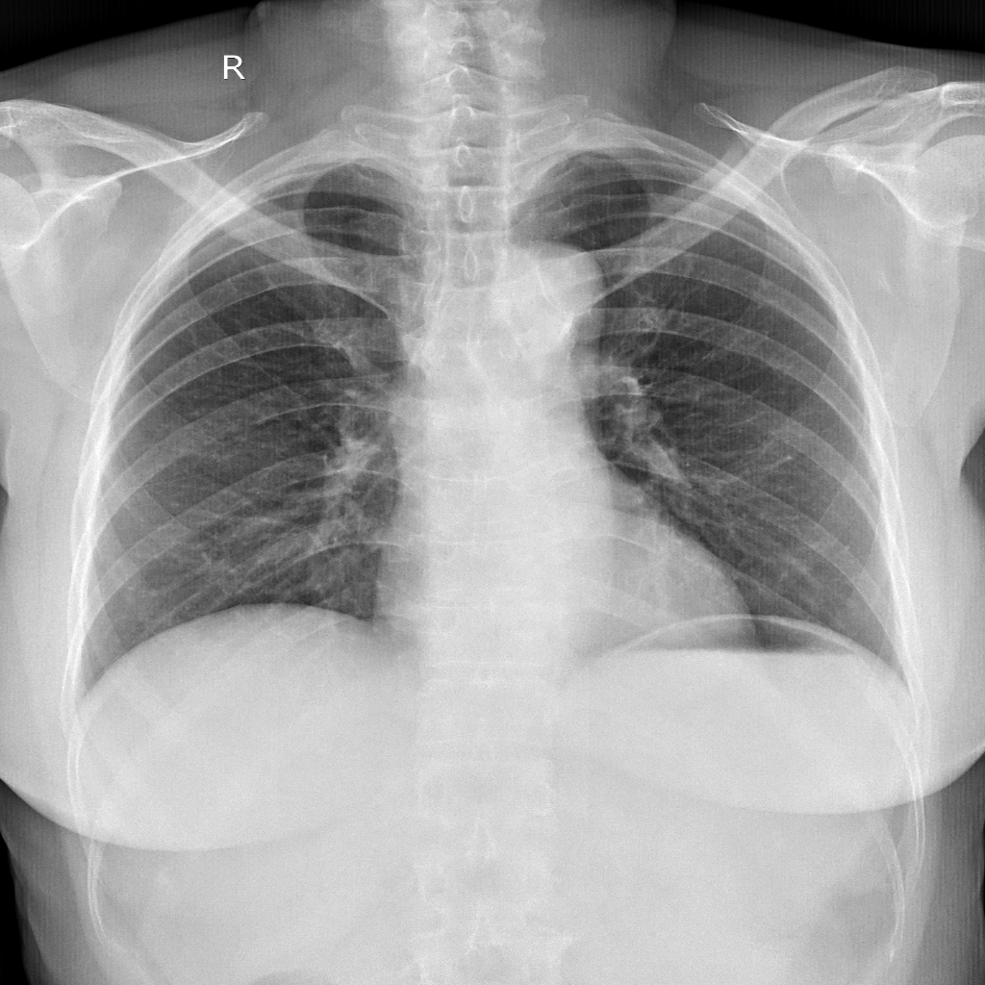
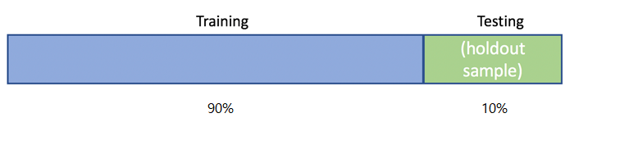
Procedure
1. Preprocessing label files: to extract image file names and edit their labels.
2. Preprocessing image files to unify image resolutions (224 * 224).
3. Divide the dataset into training set (90%) and testing set (10%).
Notes:
To build the prescreening models, I first preprocessed the labels into normal and abnormal, because the original labels showed 15 different diseases.
After that, I unified the image resolutions, because the resolutions were diverse in the original data set.
Then, I divided the 15,000 images into training and testing sets.

Slide 7
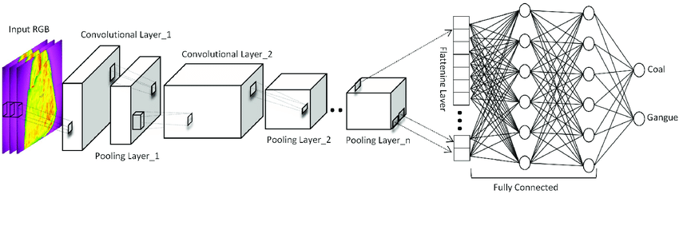
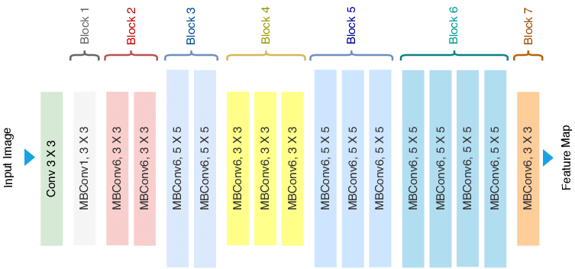
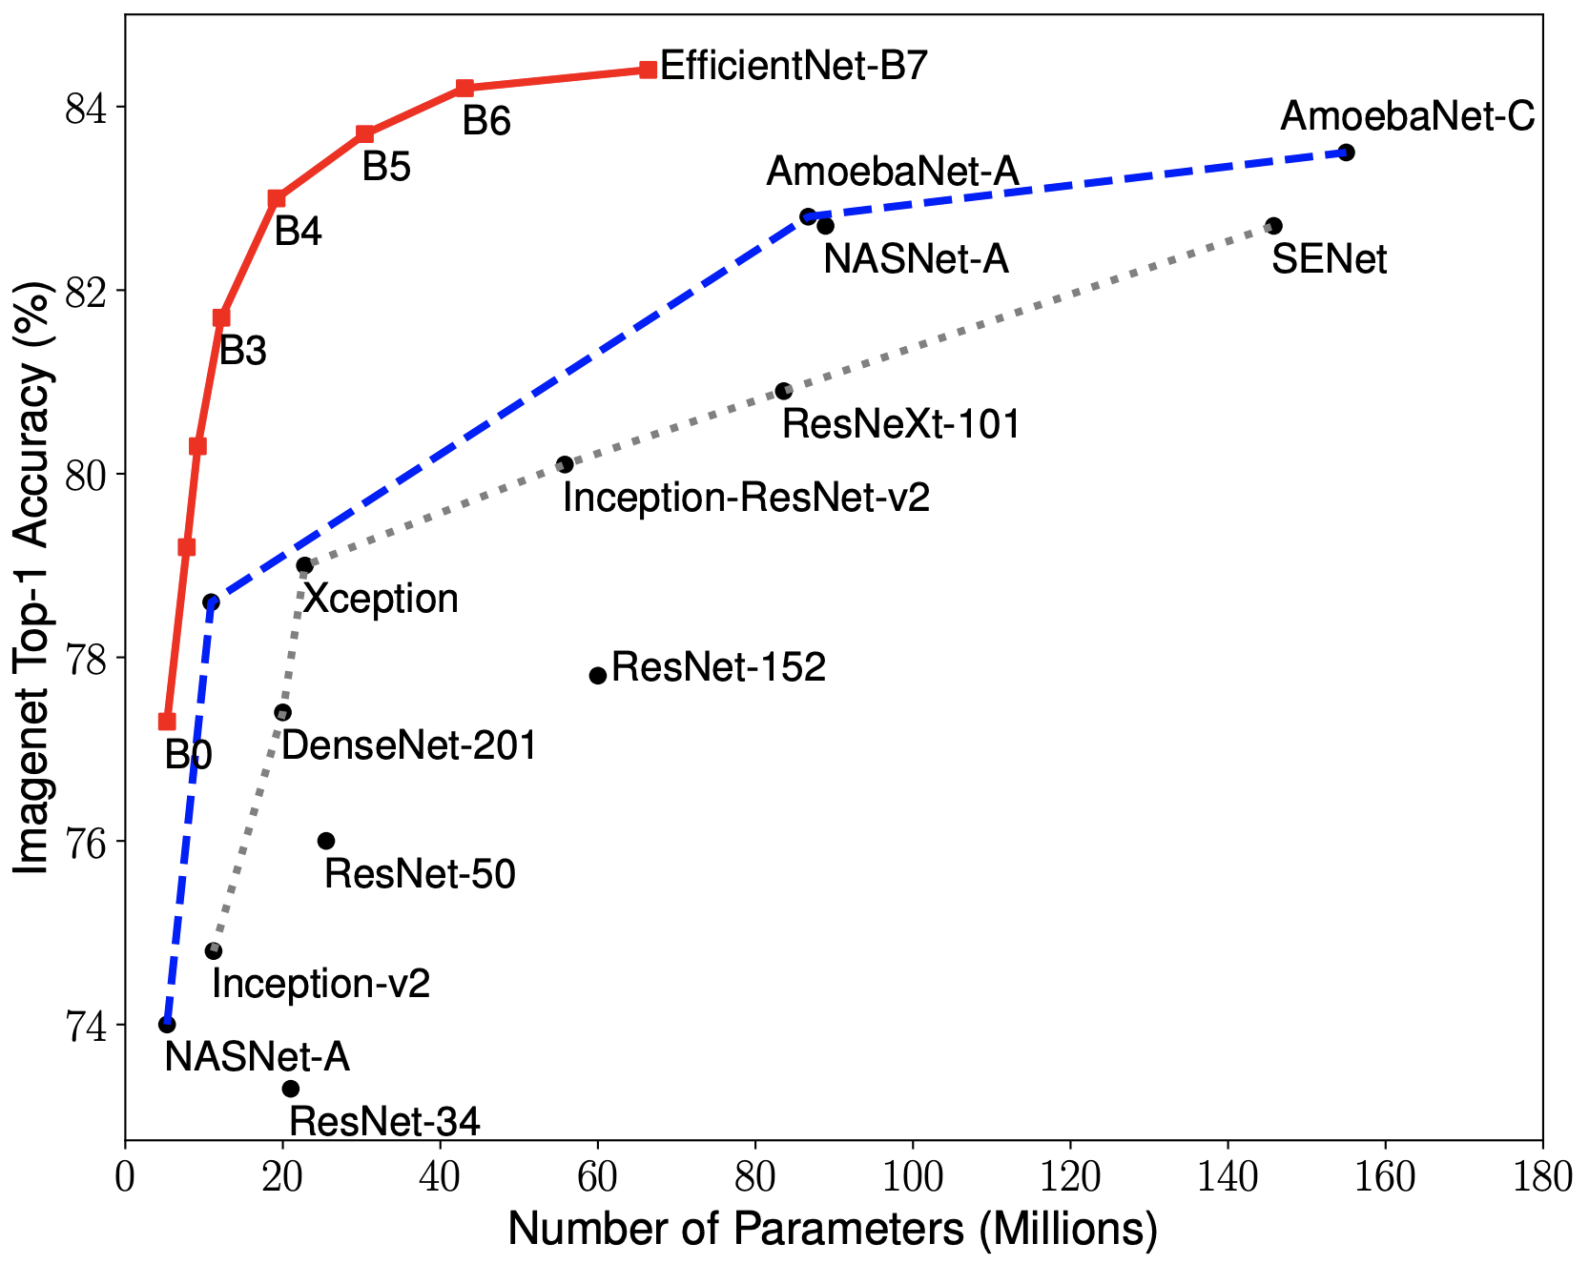
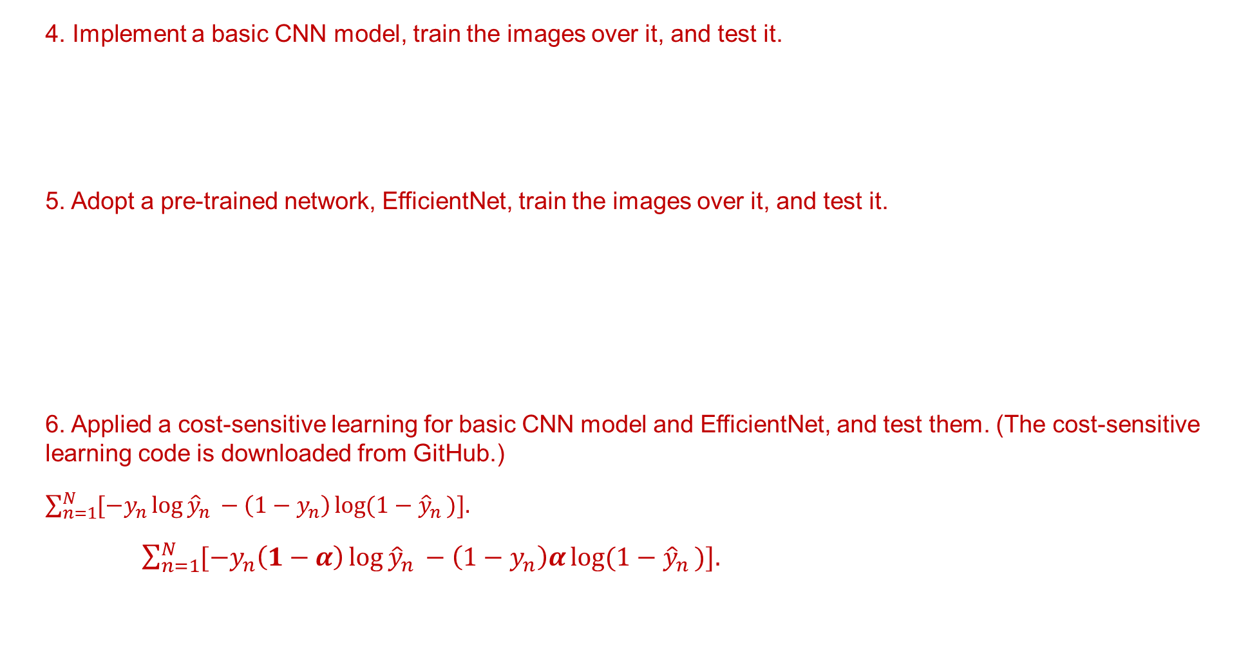
Procedure
4. Implement a basic CNN model, train the images over it, and test it.
5. Adopt a pre-trained network, EfficientNet, train the images over it, and test it.
6. Applied a cost-sensitive learning for basic CNN model and EfficientNet, and test them. (The cost-sensitive learning code is downloaded from GitHub.)
$\sum_{n=1}^{N}{[−y_{n}\log{{\hat{y}}_{n }}−\left(1−y_{n}\right)\log{{(1−\hat{y}}_{n })].}}$
$\sum_{n=1}^{N}{[−y_{n}\left(1−α\right)\log{{\hat{y}}_{n }}−\left(1−y_{n}\right)α\log{{(1−\hat{y}}_{n })].}}$
Notes:
Using the training set, I first built a basic CNN model, and tested the model accuracy using the testing set.
After that, I used EfficientNet, and trained the images over the network.
Finally, I tried cost-sensitive learning for the basic CNN model and EfficientNet.

Slide 8
Results – Data/Observations
Methods
Basic CNN
EfficientNet
Basic CNN + cost-sensitive learning
EfficientNet + cost-sensitive learning
Results (repeated over 30 trials)
The basic CNN model achieved over 87% accuracy.
Using a pre-trained network, EfficientNet, produced over 91% accuracy on average and it is statistically significantly more accurate than the basic CNN model. (p-value < 0.01)
Applying the cost-sensitive learning improved the accuracies a little, but the improvements are NOT statistically significant. (p-value > 0.05)
 | Basic CNN | EfficientNet
 | 87.76 ± 1.204 | 91.32 ± 2.159
Cost-sensitive | 88.31 ± 1.139 | 91.76 ± 2.092
Notes:
According to my experiments, the basic CNN model achieved over 87% accuracy rate.
But EfficientNet produced over 91% accuracy rate, and significantly more accurate than the basic CNN model.
Applying the cost-sensitive learning produced a higher accuracy than those without it, but the improvements were NOT statistically significant.

Slide 9
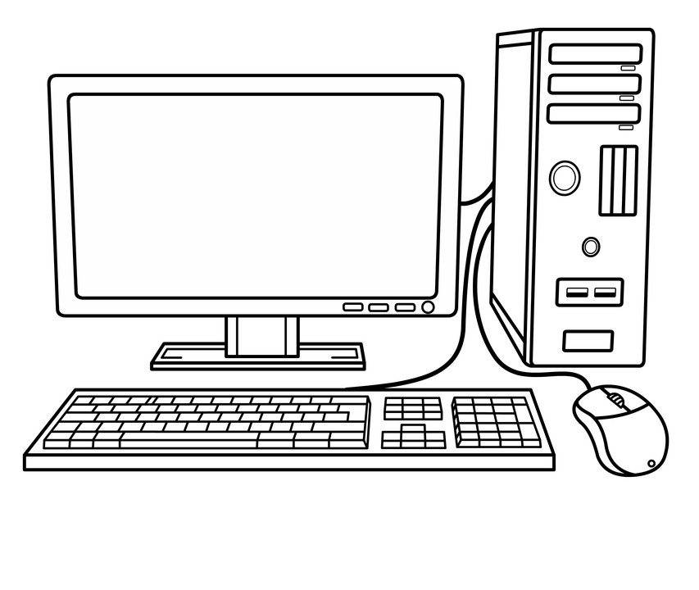

Conclusion
Applying CNN and EfficientNet is effective for prescreening abnormal chest X-ray images, because their accuracies are over 87% and 91% for prescreening respectively on VinBigData where the state-of-the-art model showed less than 40% accuracy for exact diagnosis.
Applying cost-sensitive learning may or may not work, because the improvements are not statistically significant (p-value > 0.05).
ABNORMAL
NORMAL
Accuracy > 91%
Notes:
In conclusion, applying CNN and EfficientNet turned out to be effective for prescreening abnormal chest X-ray images, but applying the cost-sensitive learning did not show significant improvement.

Slide 10
Discussion
Due to the limitation in time and resources, I used EfficientNet B0 (Tan and Le, 2019) with fixed hyper-parameter values, and still it took a couple of days to finish the training. Using higher version of EfficienetNet (with higher resolutions of images) and tuning hyper-parameters could further improve the accuracy, but it would take much longer to train and test.
The ratio of normal and abnormal in VinBigData (Nguyen et al, 2021) is about 3 to 1, but it will be more skewed in practice since normal people will take the majority in a health checkup center. To handle the data skewness or model bias problem, I revised the loss of the model (Lin et al, 2017), but there are more sophisticated approaches (Kang et al, 2020, Zhou et al, 2020) recently developed to handle the bias problem, which is a potential future work.
Heath checkup center
Normal
>>
Abnormal
Notes:
Due to the limitations in time and resources, I used fixed hyper parameters, and still it took me a couple of days to finish the experiments.
Tuning the hyper-parameters could further improve the accuracy, but it would take a much longer time to train the model.
The ratio of normal to abnormal in VinBigData is about 3 to 1.
But it will be more skewed in practice since people with normal conditions will take the majority in a health checkup center. **
It would be worth investing on more sophisticated methods to handle the bias problem in the future.

Slide 11
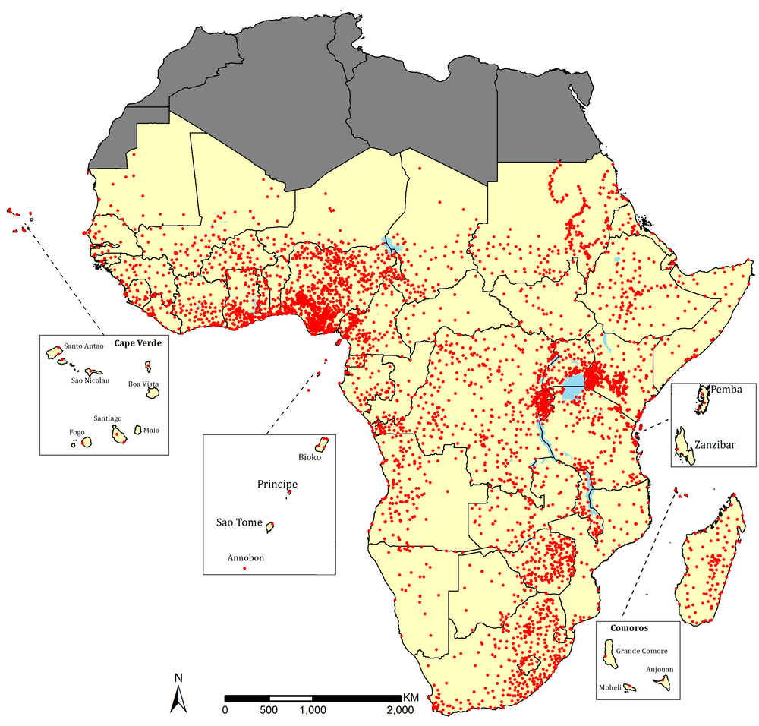
Reflection/Application
Prescreening is especially important for lung diseases, because it is difficult to cure once it develops into lung cancer, which is the second most common cancer in the US. My prescreening models can save money by reducing the labor cost of expensive doctors. Considering there are over 6,000 health checkup centers in the US, we can save money over $1,000,000,000 annually, assuming hiring a prescreening doctor costs about $170,000 a year.
My prescreening models can be also useful in places where access to health care is difficult, such as African countries.
Map of public hospitals in Africa
https://theconversation.com/people-across-africa-have-to-travel-far-to-get-to-a-hospital-we-worked-out-how-far-102585
Notes:
My prescreening models can save money for health checkup centers by reducing the labor cost of expensive doctors.
Furthermore, as AI advances, the automation technology of medical diagnosis such as my prescreening model will be able to replace the doctors and be especially useful in Africa countries where access to health care is limited.

Slide 12
References Cited
Kang, B., Xie, S., Rohrbach, M., Yan, Z., Gordo, A., Feng, J., Kalantidis, Y. (2020). Decoupling Representation and Classifier for Long-Tailed Recognition. International Conference on Learning Representation (ICLR). https://arxiv.org/pdf/1910.09217.pdf
LeCun, Y., Boser, B., Denker, J. S., Henderson, D., Howard, R. E., Hubbard, W., Jackel, L. D. (1989). Backpropagation Applied to Handwritten Zip Code Recognition. Neural Computation. doi:10.1162/neco.1989.1.4.541
Lin, T. Y., Goyal, R., Girshick, R., He, K. & Dollar, P. (2017). Focal Loss for Dense Object Detection. Computer Vision and Pattern Recognition (CVPR). https://arxiv.org/abs/1708.02002
Nguyen, H. D., Lam, K., Le, L T., Pham, H. H., Tran, D. Q., Nguyen, D. B., …, Vu, V. (2021). VinDr-CXR: An open dataset of chest X-rays with radiologist’s annotations. arXiv: https://arxiv.org/pdf/2012.15029.pdf
Tan, M. & Le, Q. V. (2019). EfficientNet: Rethinking Model Scaling for Convolutional Neural Networks. International Conference on Machine Learning (ICML). https://arxiv.org/pdf/1905.11946.pdf
Zhou, B., Cui, Q., Wei, X. S., Chen, Z. M. (2020). BBN: Bilateral-Branch Network with Cumulative Learning for Long-Tailed Visual Recognition. Computer Vision and Pattern Recognition (CVPR). https://arxiv.org/pdf/1912.02413.pdf
Notes:
Thank you for listening to my presentation.

