Slide 1

Made yours by:
John Absher, David Gutierrez,
Jason Joachim, Isaac Lee

Slide 2

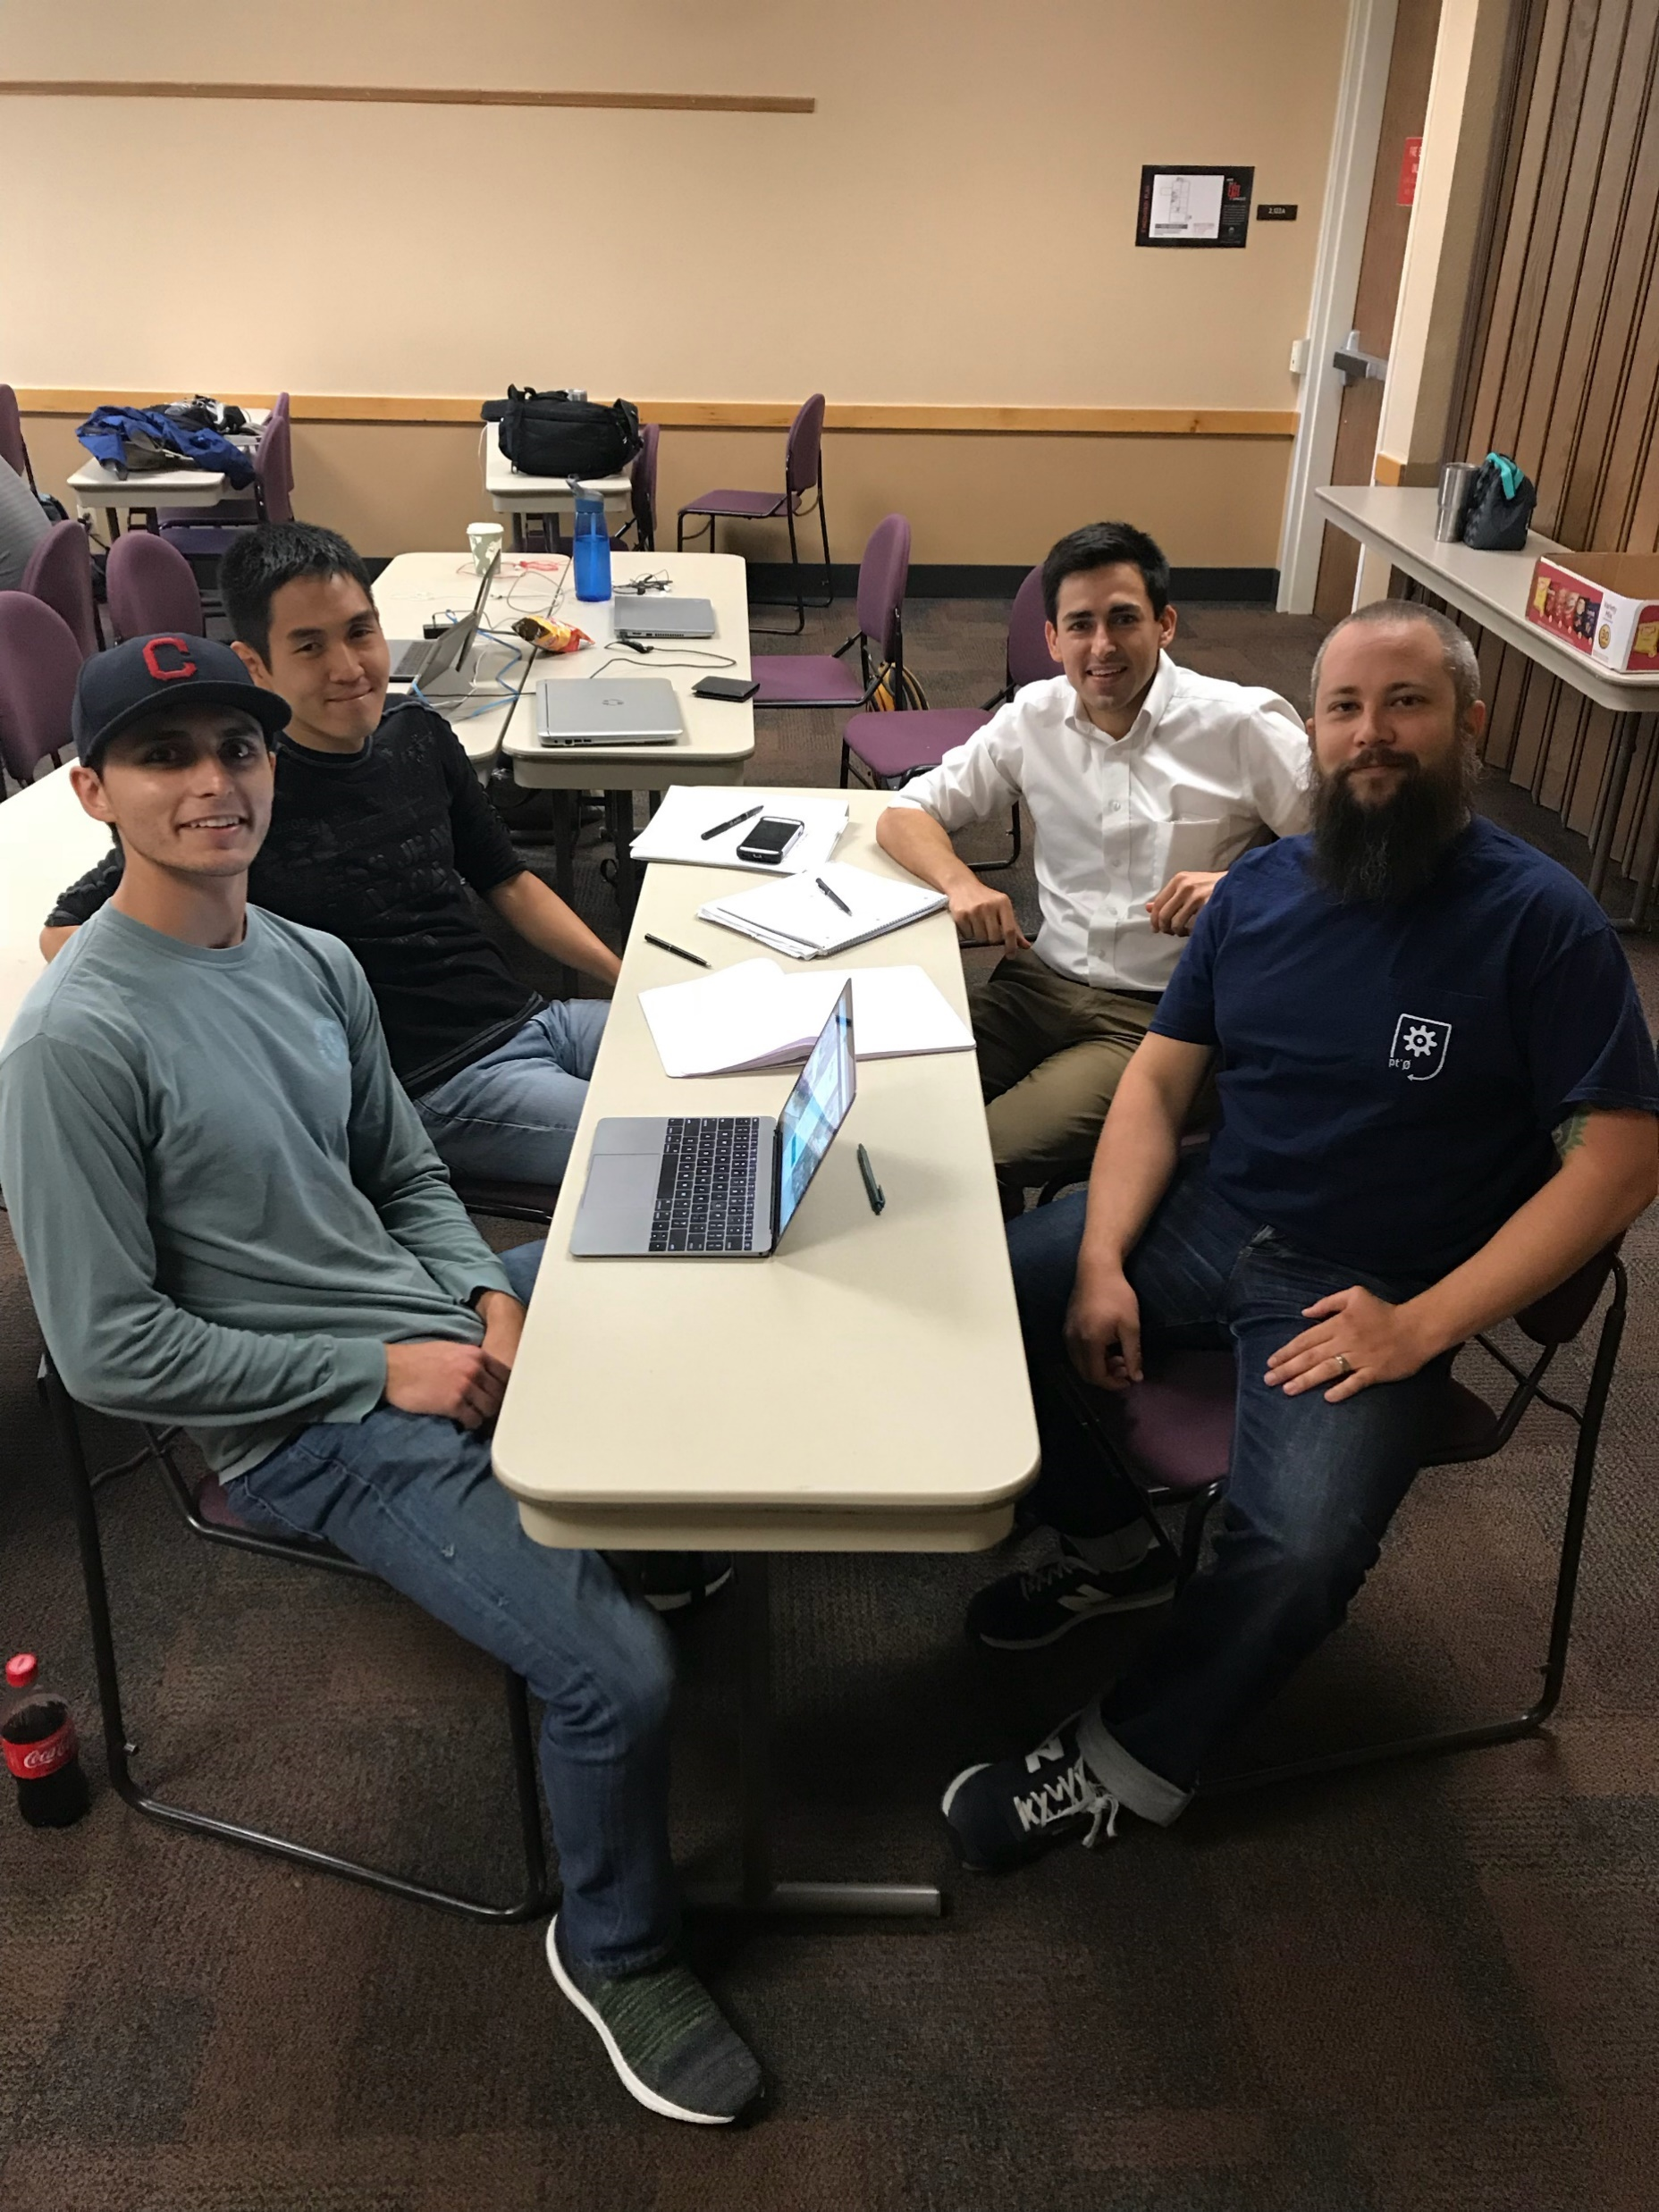


Slide 3






Mai Technologies

Slide 4
