Slide 1
Ian Morgan-Graham
Dr. Dingding Wang
CAP 6776 – Information Retrieval Fall 2022
November 6th, 2022
Information Retrieval Topic Survey:
“Text Summarization and Text-to-Speech ”

Slide 2
Goals of the this Presentation:
=> Discuss two types of text summarization
=> Review output text for the two types of text summarization
=> Compare the output texts visually
=> Demonstrate code for two types of text summarization
=> Demonstrate conversion of the output texts to audio for text-to-speech

Slide 3
Discuss two types of text summarization:
Abstractive Summarization: Selects summary words based on semantic understanding, even those words did not appear in the source documents. Similar to the way humans read information and then summarize the content using their own words.
Input document → understand context → semantics → create own summary.
Extractive Summarization: Extractive methods attempt to summarize articles by selecting a subset of words that retain the most important points. The method generates weights for content sentences and then ranks them based on importance and similarity among each other.
Input document → sentences similarity → weight sentences → select sentences with higher rank.

Slide 4
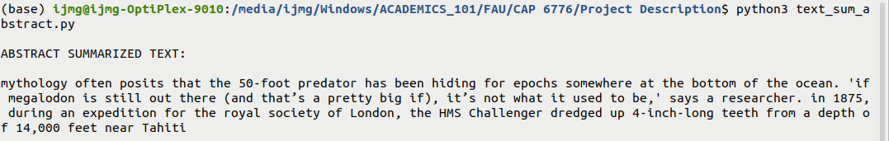
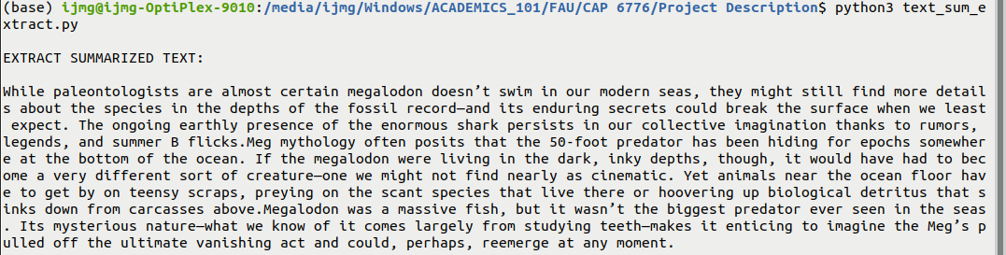
Review output text for the two types of text summarization:
Original article: https://www.popsci.com/story/science/megalodon-alive-myth/ --- 1465 words
Abstracted Summary: --- 73 words
Extracted Summary: --- 197 words

Slide 5
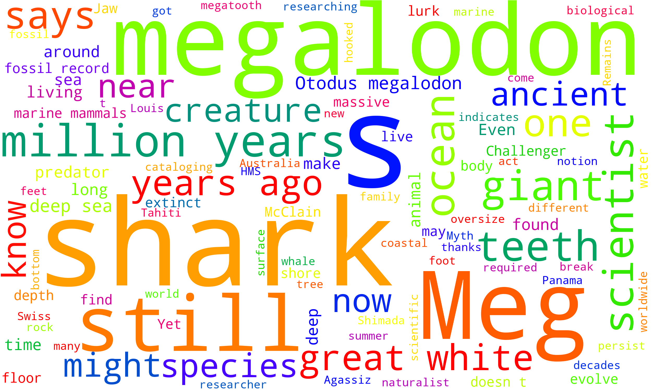
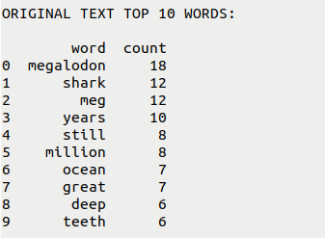
Compare the output texts visually:
Original Article:

Slide 6
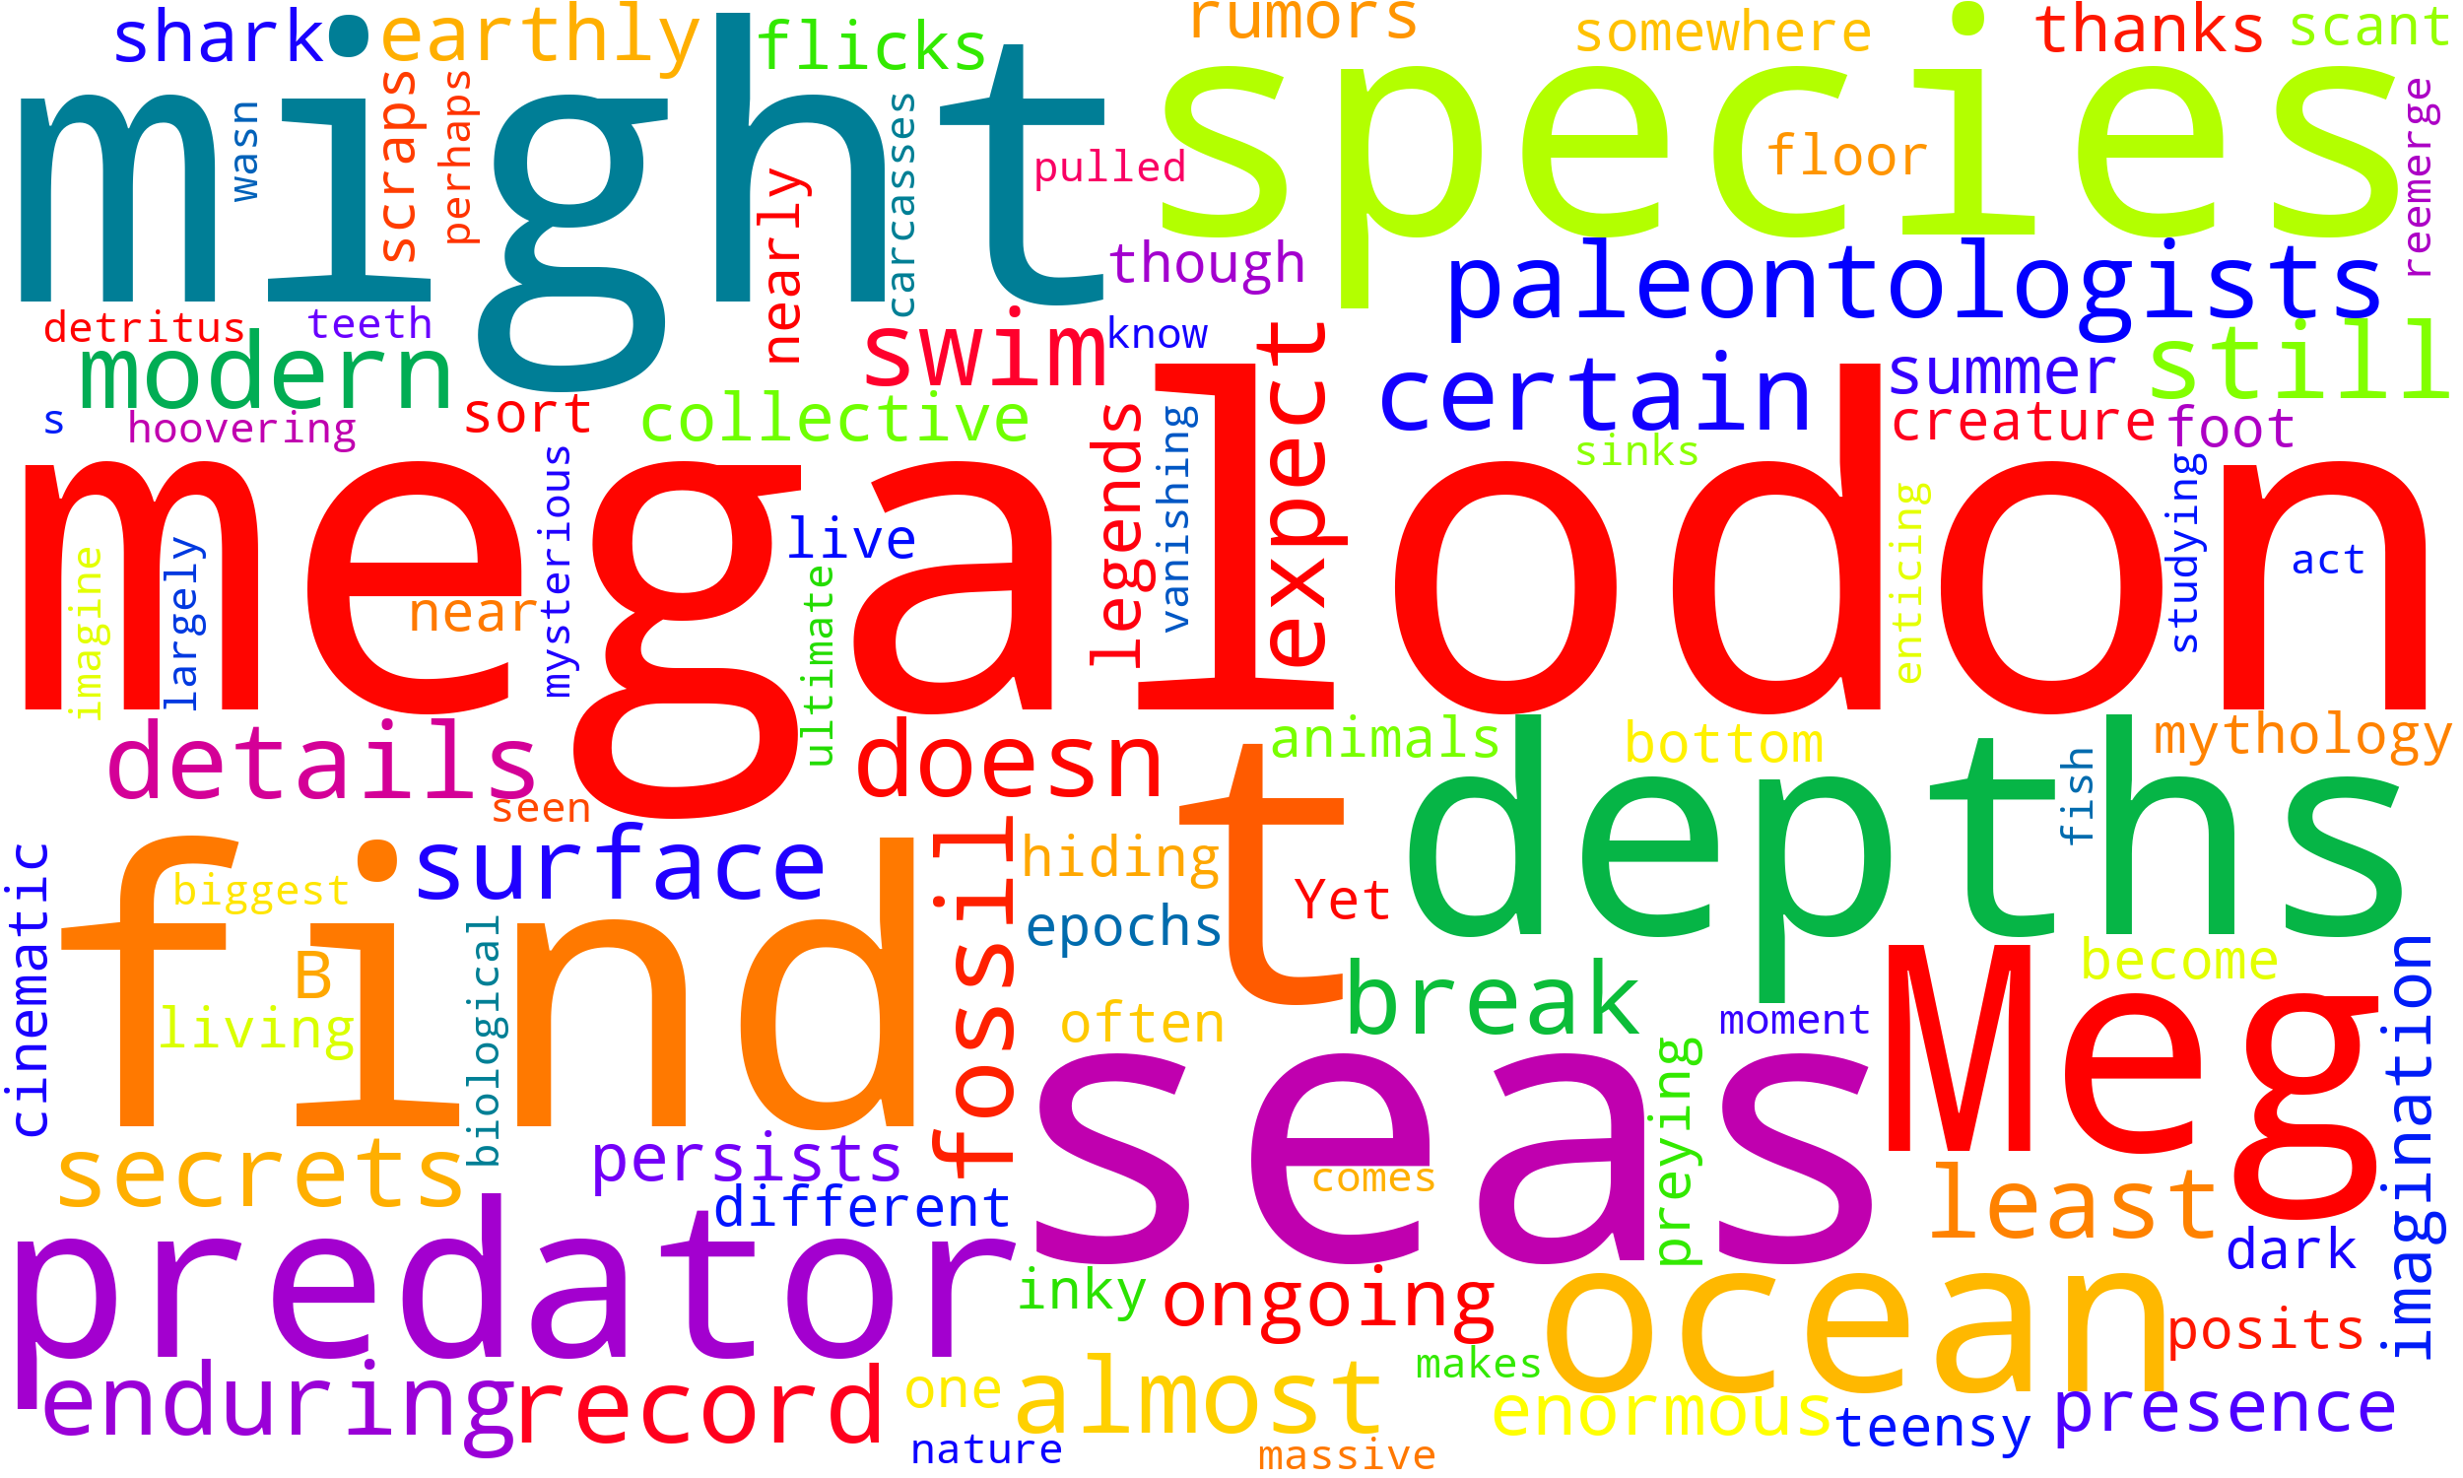
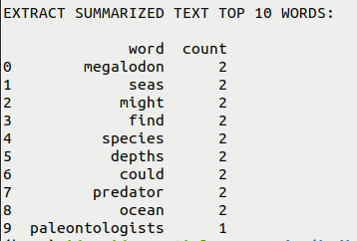
Compare the output texts visually:
Extracted Summary:

Slide 7
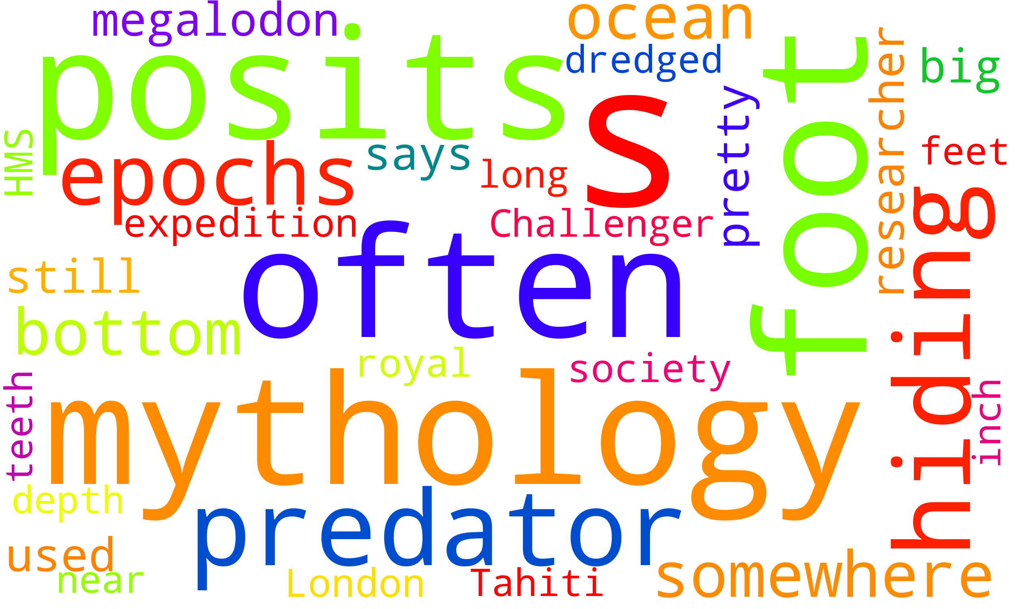
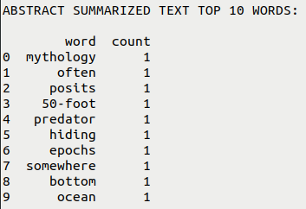
Compare the output texts visually:
Abstracted Summary:

Slide 8
Demonstrate code for two types of text summarization:
text_sum_abstract.py
text_sum_extract.py
wordcloud_maker.py

Slide 9
Demonstrate conversion of the output texts to audio for text-to-speech:
mp3_maker.py
Play file “Shark_Abstract_Sum.mp3”
Play file “Shark_Extract_Sum.mp3”

Slide 10
Final thoughts:
=> Extract summarization is faster, simpler to implement, and can handle larger text files
=> Abstract summarization is slower, more difficult to implement, and limited to smaller text files
=> The speed of the speech to text gTTS library is a function of input size.

