Slide 1
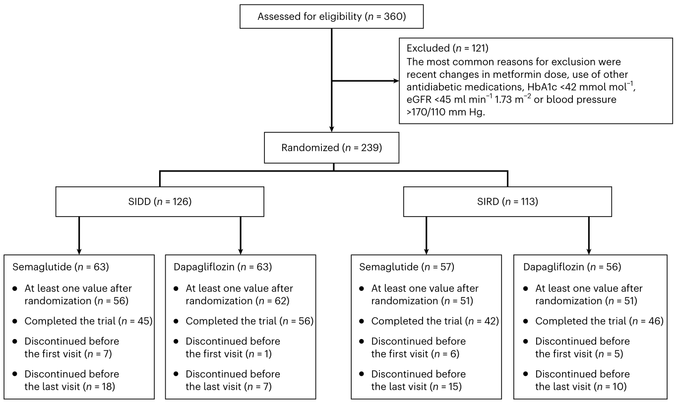
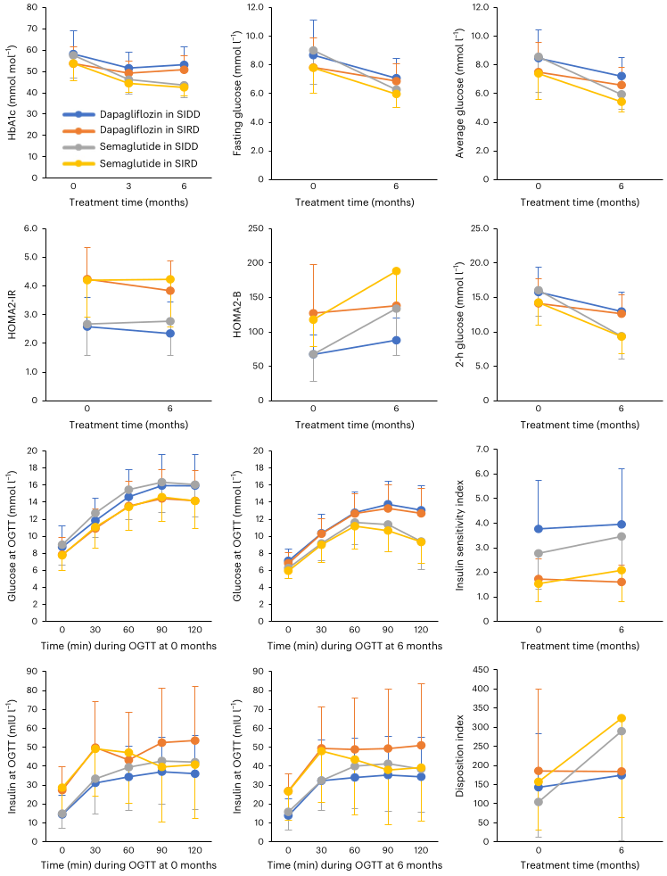
Randomized open-label trial of semaglutide and dapagliflozin in patients with type 2 diabetes of different pathophysiology
Chinmay Dwibedi^{1,2,7}, Ola Ekström^{3,7}, Jasmine Brandt^{4,5,7}, Martin Adiels², Stefan Franzén^{2,6}, Birgitta Abrahamsson¹, Anders H. Rosengren¹
Introduction
Treatment responses to glucose-lowering drugs vary widely, motivating more personalized therapy.
Diabetes “clusters” such as SIDD (severe insulin-deficient) and SIRD (severe insulin-resistant) have been proposed, but their value for predicting drug response is uncertain.
This trial tested whether subgrouping vs. continuous clinical measures better predicts response to semaglutide (GLP-1RA) or dapagliflozin (SGLT2i)
Methods
Open-label, randomized, 6-month add-on study: semaglutide vs. dapagliflozin on background metformin in type 2 diabetes with SIDD or SIRD features (n=239).
Primary endpoint: change in HbA1c; secondary endpoints included fasting/postprandial glucose, insulin secretion/sensitivity, BMI, CGM metrics.
Full analysis set included 220 participants with ≥1 post-randomization HbA1c value.
F
Fig. 1. Study profile shown as a CONSORT diagram.
Results
Glycemic efficacy: Semaglutide lowered HbA1c more than dapagliflozin (mean difference 8.2 mmol/mol; 95% CI −10.0 to −6.3).
Subgroups: Effects were numerically larger in SIDD than SIRD, but the treatment-by-subgroup interaction was not significant.
Secondary outcomes: Semaglutide improved fasting/postprandial glycemia and BMI more; dapagliflozin improved HOMA2-IR more.
Predictors: Continuous measures (baseline HbA1c, insulin secretion, fasting glucose, time-in-range, etc.) predicted response better than SIDD/SIRD labels.
Safety: No AE differences between SIDD and SIRD; semaglutide commonly caused GI effects (some dose reductions), while urinary symptoms were more frequent with dapagliflozin.
Fig. 2. Changes over time in fasting and postprandial measures.
Discussion
Cluster-based stratification (SIDD/SIRD) did not modify treatment effect; using continuous baseline traits is more informative for tailoring add-on therapy.
Patients with higher HbA1c/fasting & postprandial glucose and lower insulin secretion tend to derive larger glycemic benefit from semaglutide
Patients with higher HbA1c/BMI/blood pressure (and, relatively, higher insulin secretion/high time-in-range) show stronger relative or composite improvements with dapagliflozin.
¹Department of Neuroscience and Physiology, Sahlgrenska Academy at the University of Gothenburg, Gothenburg, Sweden. ²Institute of Medicine, Sahlgrenska Academy at the University of Gothenburg, Gothenburg, Sweden. ³Department of Clinical Sciences, Diabetes and Endocrinology, Lund University, Malmö, Sweden. ⁴Department of Clinical Chemistry and Pharmacology, Skåne University Hospital, Lund, Sweden. ⁵Clinical Studies Sweden, Forum South, Skåne University Hospital, Lund, Sweden. ⁶AstraZeneca, Gothenburg, Sweden. ⁷These authors contributed equally: Chinmay Dwibedi, Ola Ekström, Jasmine Brandt. e-mail: anders.rosengren@gu.se

