Slide 1
Recommended by the DAT Team Ian J Mitchell Dennis Behm Mathieu Dalbin

Slide 2
Agenda
Aims and Assumptions
Fundamentals of the branching strategy
Supported workflows
Implementing pipelines

Slide 3
Aims and Assumptions
Some aims and assumptions that guide our recommendations…
No baggage
Well… “travel light” perhaps!
Are we prescriptive or just opinionated?
Aim to be git-native!
We start with a recommendation
Confidently
We question everything
YAGNI - “you aren’t gonna need it”
We strive for simplicity
For each user’s experience
Scaling
The workflow and branching scheme should both scale up and scale down.
Small teams with simple and infrequent changes will be able to easily understand, adopt, and have a good experience.
Large, busy teams with many concurrent activities will be able to plan, track, and execute with maximum agility using the same fundamental principles.
Planning
Planning and design activities as well as code development aim to align to a regular release cadence.
The cadence of the next planned release is defined by the application team.
There is no magic answer to managing large numbers of “in-flight” changes, so planning assumptions should aim as much as possible to complete changes quickly, ideally within one release cycle.
DevOps/Agile practices to break down larger changes into sets of smaller, incremental deliverables that can each be completed within an iteration.
This reduces the number of “in-flight” changes, and allows the team to deliver value more quickly while still building towards a larger development goal.
We know it is sometimes unavoidable for work to take longer than one release cycle and we accommodate that as a variant of the base workflow.

Slide 4
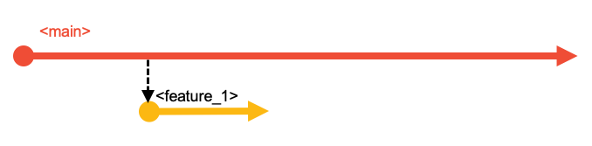
The Branching Strategy
Starting Simple
Every change starts in a branch.

Slide 5
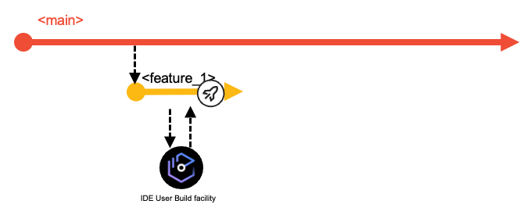
Developers work in the branch to make changes, perform user builds and unit tests.
A branch holds multiple commits (changes to multiple files).
Starting Simple
Every change starts in a branch.

Slide 6
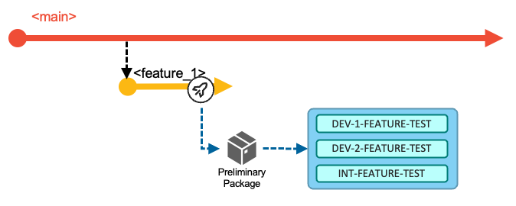
These changes on these branches are
built,
tested,
reviewed and
approved before merging to main.
Preparing to Merge into main
Feature Team/Developers will:
Build
Builds may be done to any commit on any branch
Feature branch must build cleanly for a Pull Request
Test
To prove quality of the changes in their feature branch

Slide 7
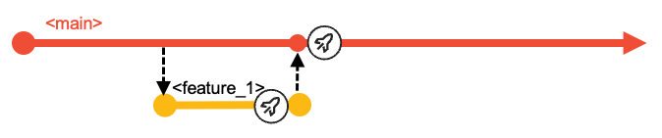
Merging into main
Create a Pull Request (PR) to signal to Team Leaders/Release Controllers to:
Review
Code and Test results
Approve
Safeguard the quality of main

Slide 8
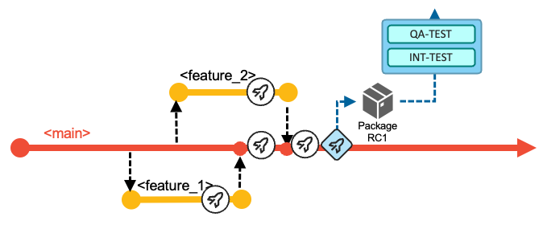
main and other long-lived branches are protected (not everyone can push or merge to them).
Before you ask… no, there is no Production branch
CI/CD decouples the building and deploying to test environments and production.
We have no branches named prod (or test or QA)
Those are environments to which builds can be deployed
Such extra branches:
are unnecessary
cause ambiguity
impose merging and building overheads
Deployment manager is maintaining what is deployed where and provides traceability from developer to production deployment
Testing a release candidate
Any point in the history of main can be declared a release candidate.
Build a release candidate package
Deploy it
Test it

Slide 9
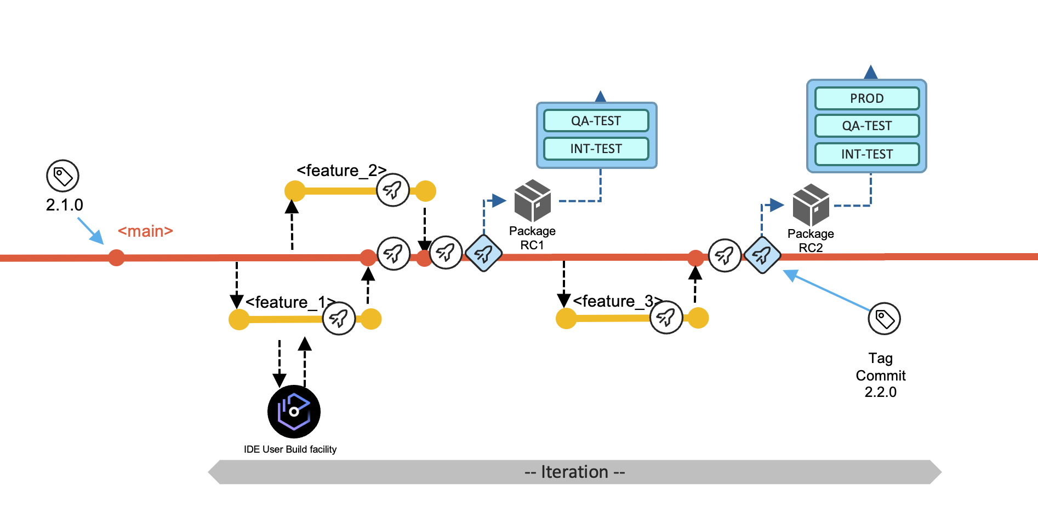
Tag the commit (point in main’s history) with a release name.
Deploying to production
When all the committed work items for the next planned release are ready to be shipped, and all quality gates have passed successfully and the required approvals have been issued by the appropriate reviewers, the release package and be deployed to production.

Slide 10
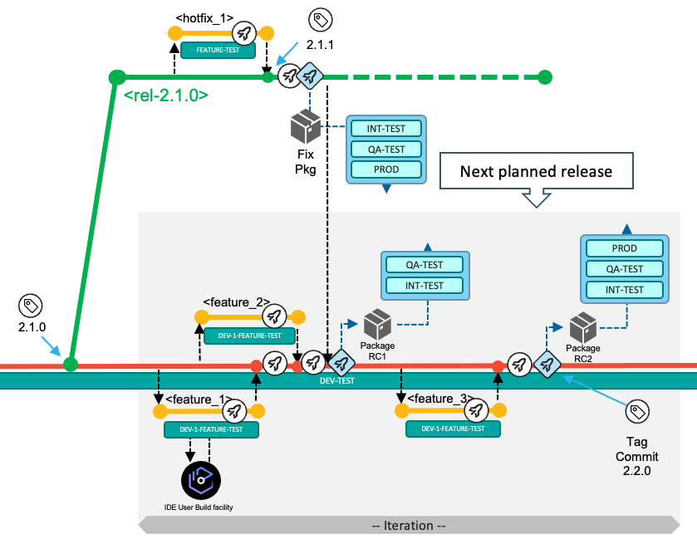
Tag the commit (point in main’s history) with a release name.
Release maintenance branches
A release maintenance branch will be used if hot-fixes must be developed and delivered.

Slide 11
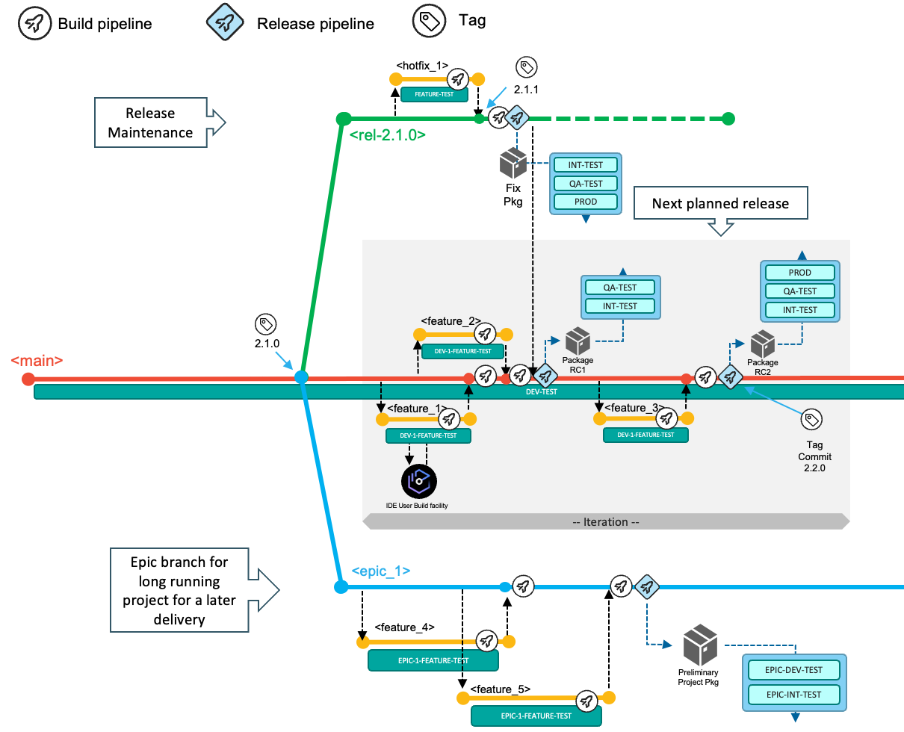
Scaling up
Concurrent feature branches scale very well, but assume short cycle times.
Ideally live within a release delivery cycle
But no big deal if they don’t
Epic branches can collect multiple features
Before going to main
When the delivery is planned beyond the next release
(Epic branches are a form of integration branch.)
Integration branches

Slide 12
Convention over configuration
The principles are more important that the tools and names.
Naming conventions - making purpose obvious:
main : single source of truth. The only long-living branch.
release/rel-2.0.1 : explicit versioning numbering to identify releases maintenance branch.
epic/47-ai-fraud-detection : development initiative identified by epic id and description.
feature/<jira-id|servicenow-id>/new-mortgage-calculation : references to other planning tools for new features for the next planned release.
feature/47-ai-fraud-detection/refactor-mortgage-calculation: feature implemented for development initiative
hotfix/rel-2.0.1/fix-mortgage-calc: fix implemented for release rel-2.0.1
Names of branches and tags flow through to builds and deployments.

Slide 13
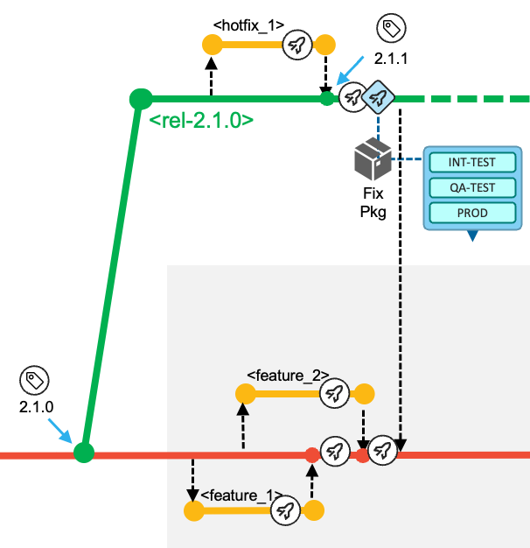
Workflows supported by the strategy
How do teams work with and benefit from the branch strategy?
The types of workflows
Work and focus on the next planned release via the main branch. After planning the work items for the next release, the development team is adding changes to the main branch.
Resolution of a production problem in the currently-released version of the application by leveraging a release maintenance branch that is used for maintenance purposes,
concurrent development activities for significant development initiatives, which include multiple planned work items for a later delivery (including starting development of a future release) by creating an epic branch from a commit point in the history of main.
The following narratives complement the structure.
Features for the next planned release
Developer activities:
Take item from backlog
Create feature branch
Code locally
Build with DBB User Build
Commit into feature branch, build and test feature functionality
Create Pull Request for review and approval
Features for the next planned release
Release control activities:
Merge approved branches to main and build
When planned features have merged, build and tag Release Candidate package
Deploy Release Candidate to test environments
(Release candidate can be superceded)
Finalise Release package in Artifactory (or equivalent)
Tag commit from step 8 as the production release and deploy
Fix a production defect
The process of urgent fixes for modules in the production environment follows the fix-forward approach, rather than rolling back the affected modules and reverting to the previous deployed state.
The development team starts this process by creating a release maintenance branch of the git tag that represents the most recent release, that was deployed to production.

Slide 14
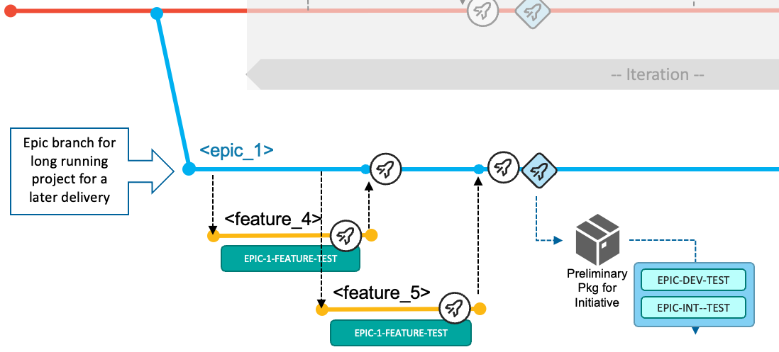
Fix a production defect
Developer activities resolving a production defect:
Creates the release/rel-2.1.0 branch based on the existing Git tag
Creates a feature branch hotfix/rel-2.1.0/urgent-fix from the release maintenance branch.
Implement the fix locally
Build with DBB User Build
Commit into hotfix branch, push, build and test feature functionality
Create Pull Request for review and approval
Fix a production defect
Release control activities resolving a production defect:
Merge hotfix branch to release maintenance branch and build
Use release pipeline to create fix package
Deploy fix package to controlled test environments and test it
Deploy fix package to production
Tag commit from step 8 indicating the new version
Merge release maintenance branch into main.
Using the Epic branch workflow
Dealing with significant development initiatives such as:
Updates in regulatory frameworks
Start the development phase of subsequent releases
→ A process to work independently from the base workflow.
Using the Epic branch workflow
Developer activities for implementing significant development initiatives:
Creates the epic/ai-fraud-detection branch based on the existing Git tag
Creates a feature branch feature/ai-fraud-detection/introduce-ai-model-to-mortgage-calculation from the epic branch.
Code locally
Build with DBB User Build
Commit into feature branch, push, build and test feature functionality
Create Pull Request for review and approval to merge into the integration branch
Using the Epic branch workflow
Release activities for implementing significant development initiatives:
Merge feature branch to epic branch and build
Use release pipeline to create preliminary package
Deploy package to project test environment
Frequently synchronize with main into the epic branch to avoid making the merge of the epic branch into main difficult.
Decision when the changes on the epic branch should be released
Merge epic branch into main and deliver via the base workflow.
Epic branch workflow

Slide 15
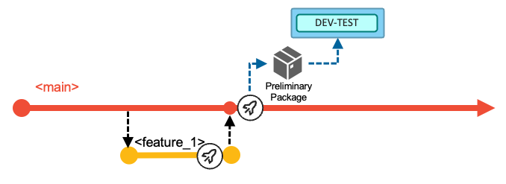
Pipeline implementations
Pipeline implementation conventions & principles
Basic Build pipeline characteristics
(Typically) runs on each commit added to the history of a branch
Can produce a preliminary package that is stored in a binary artifact repository
Can be deployed to test environments, but not production
May include an automated step to deploy it into the DEV-TEST environment

Slide 16
Release pipeline

Slide 17
Collateral
References

