Slide 1
Recommended by the DAT Team Ian J Mitchell Dennis Behm Mathieu Dalbin

Slide 2
Agenda
Aims and Assumptions
Choosing a branching model and workflow
Starting simple
Scaling up
Integration branches
Delivering changes via a release
Hot-fix for production
Using an Epic branch

Slide 3
Aims and Assumptions
Some aims and assumptions that guide our recommendations…
No baggage
Well… “travel light” perhaps!
Are we prescriptive or just opinionated?
We start with a recommendation
Confidently
We question everything
YAGNI - “you aren’t gonna need it”
We strive for simplicity
For each user’s experience
Scaling
The workflow and branching scheme should both scale up and scale down.
Small teams with simple and infrequent changes will be able to easily understand, adopt, and have a good experience.
Large, busy teams with many concurrent activities will be able to plan, track, and execute with maximum agility using the same fundamental principles.
Planning
Planning and design activities as well as code development aim to align to a regular release cadence.
There is no magic answer to managing large numbers of “in-flight” changes, so planning assumptions should aim as much as possible to complete changes quickly, ideally within one release cycle.
DevOps/Agile practices typically encourage that, where possible, development teams should strive to break down larger changes into sets of smaller, incremental deliverables that can each be completed within an iteration. This reduces the number of “in-flight” changes, and allows the team to deliver value (end-to-end functionality) more quickly while still building towards a larger development goal.
We know it is sometimes unavoidable for work to take longer than one release cycle and we accommodate that as a variant of the base workflow.

Slide 4
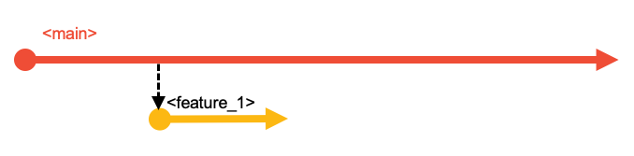
The Branching Strategy
Starting Simple
Every change starts in a branch.

Slide 5
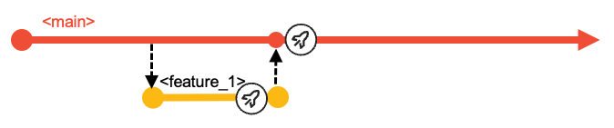
Developers work in the branch to make changes, perform user builds and unit tests.
A branch holds multiple commits (changes to multiple files).
Starting Simple
Every change starts in a branch.

Slide 6
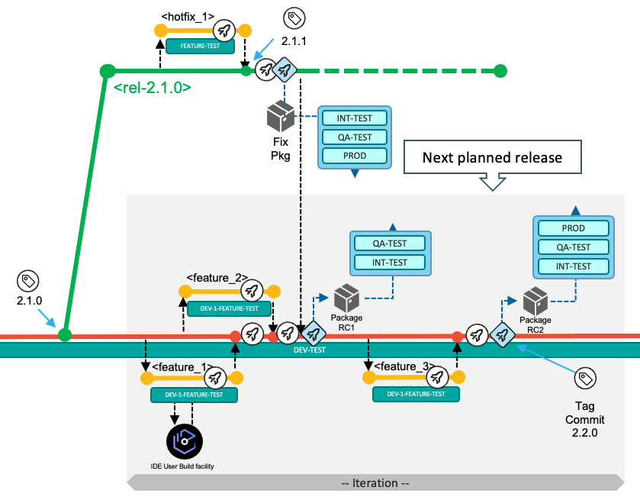
These branches are
built,
tested,
reviewed and
approved before merging to main.
Merging into main
Feature Team/Developers will:
Build
Builds may be done to any commit on any branch
Feature branch must build cleanly for a Pull Request
Test
To prove quality of the changes in their feature branch
Create a Pull Request (PR) to signal to Team Leaders/Release Controllers to:
Review
Code and Test results
Approve
Safeguard the quality of main
Before you ask… no, no Production branch
We have no branches named prod (or test or QA)
Those are environments to which builds can be deployed
Such extra branches:
are unnecessary
cause ambiguity
impose merging and building overheads
Release branches
Any point in the history of main can be declared a release candidate.
Build a release candidate package
Test it
Deploy it
Tag the commit (point in main’s history) with a release name.
A release maintenance branch will be used if hot-fixes must be developed and delivered.
Release branches

Slide 7
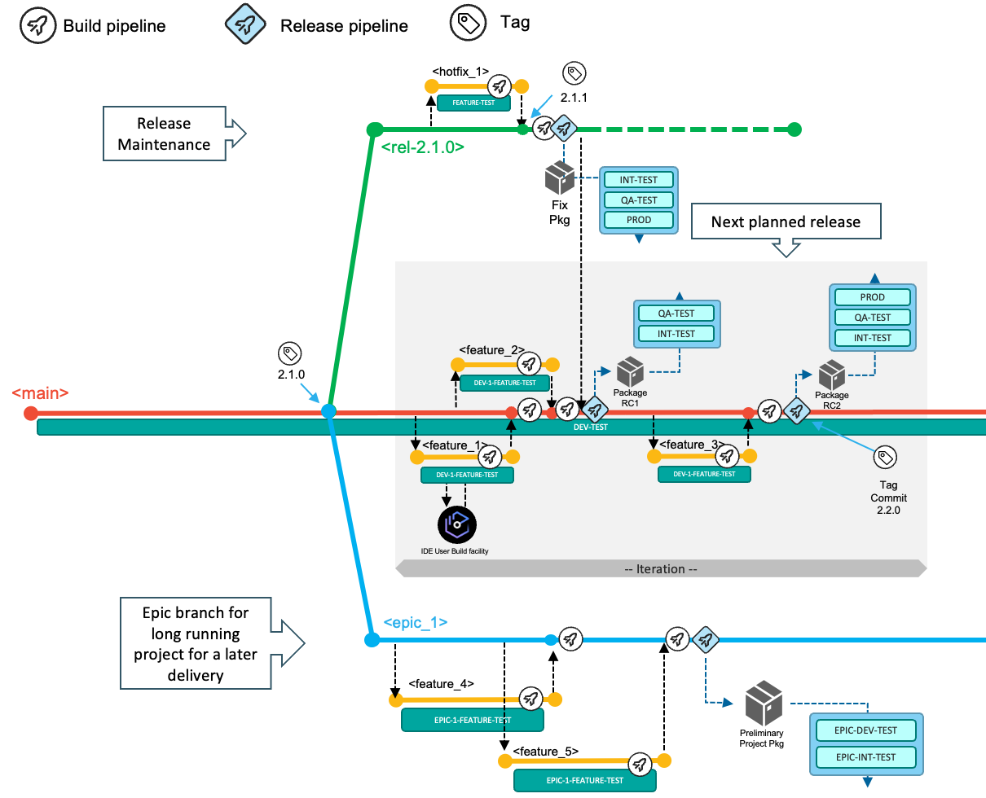
Scaling up
Concurrent feature branches scale very well, but assume short cycle times.
Ideally live within a release delivery cycle
But no big deal if they don’t
Epic branches can collect multiple features
Before going to main
When the delivery is planned beyond the next release
(Epic branches are a form of integration branch.)
Integration branches

Slide 8
Worflows supported by the strategy
What do teams do?
Three foundation workflows
Deliver changes with the next planned release
Implement a fix for the current production state
Use an epic branch for a significant development initiative
Delivering changes via a release

Slide 9
Hot-fix for production
Using an Epic branch

