Slide 1
SPACE X
Predicting Falcon 9
First-Stage Landings
Applied Data Science Capstone • Technical Report
A reproducible pipeline from API and web data to interactive
analytics and classification.
Armando Romero Mariscal Guasp
https://github.com/ijontichyai/IBM-Data-Science-Capstone
21 August 2026

Slide 2
02
DECISION STORY
Executive summary
Can launch history reveal when a Falcon 9 first stage is likely to land?
90
4
90.4%
83.3%
launch records analyzed
launch sites compared
highest cross-validation score
best holdout accuracy
What we did
What we learned
Collected Falcon 9 launch data via API and web scraping
Launch site, payload, orbit, and booster context are associated
with landing outcomes
Cleaned, encoded, queried, mapped, and visualized the data
Decision Tree achieved the highest CV score (90.4%), but
Logistic Regression, SVM, and KNN tied for the best holdout
accuracy at 83.3%.
Tuned Logistic Regression, SVM, Decision Tree, and KNN
LR, SVM, and KNN each produced 3 false positives and 0 false
negatives on the holdout set.
Executive summary
IBM Applied Data Science Capstone

Slide 3
03
INTRODUCTION
Business context and analytical problem
WHY IT MATTERS
Research question
First-stage reuse can
reduce launch cost and
improve mission
economics.
Given launch conditions and historical outcomes, will the first stage land successfully?
A reliable landing prediction helps
planners estimate reuse potential before launch.
INPUTS
Payload • Orbit • Site • Booster • Flight history
TARGET
Class = 1 landed | Class = 0 did not land
OUTPUT
Transparent evidence for decision support
Introduction
GitHub • https://github.com/ijontichyai/IBM-Data-Science-Capstone

Slide 4
04
END-TO-END METHODOLOGY
From raw launch records to decision evidence
01
02
03
04
05
COLLECT
WRANGLE
EXPLORE
INTERACT
PREDICT
API + Wikipedia
Normalize + label
Plots + SQL
Folium + Dash
GridSearchCV
Design principle
Each analysis stage is traceable to source data, transformations, and a reproducible notebook or Python file in the repository
Methodology overview
GitHub • https://github.com/ijontichyai/IBM-Data-Science-Capstone

Slide 5
05
METHODOLOGY
Data collection — SpaceX REST API
GET
LOOK UP
NORMALIZE
FILTER
EXPORT
/v4/launches/past
rockets · payloads · launchpads · cores
JSON → pandas DataFrame
Falcon 9 launch records
structured CSV
Core fields retained
Quality controls
Flight number and date
Resolve related IDs before analysis
Booster / core configuration
Filter irrelevant records and inspect missing values
Payload mass and orbit
Preserve a repeatable extraction path
Launch site and landing outcome
Store the final analytical table
Data collection — API
GitHub • https://github.com/ijontichyai/IBM-Data-Science-Capstone

Slide 6
06
METHODOLOGY
Data collection — web scraping
1
Request static Wikipedia launch-history snapshot
Fields extracted
Flight No.
2
Parse HTML tables with BeautifulSoup
Launch site
3
Extract rows and normalize cell text
Payload / orbit
Customer
4
Build a structured launch-record DataFrame
Launch outcome
5
Validate columns and export for analysis
Booster landing
Data collection — web scraping
GitHub • https://github.com/ijontichyai/IBM-Data-Science-Capstone

Slide 7
07
METHODOLOGY
Data wrangling and feature engineering
CLEAN
LABEL
Impute missing payload mass with the mean and inspect remaining missing values
Convert landing outcome to binary class 0 / 1
ENCODE
SCALE
One-hot encode orbit, site, landing pad, and serial
Standardize the feature matrix before model training
Result: one analysis-ready feature matrix X and one target vector Y.
Data wrangling
GitHub • https://github.com/ijontichyai/IBM-Data-Science-Capstone

Slide 8
08
EDA METHODOLOGY
Exploratory analysis — questions before models
SITE
PAYLOAD
ORBIT
Where do launches succeed most often?
How does mass relate to outcome?
Which mission profiles are most successful?
BOOSTER
TIME
RISK
Which configurations perform best?
Does success improve as experience grows?
Under which conditions are
failures more common?
Bar charts compare site and booster performance; scatter plots examine payload vs. outcome; line charts show yearly success trends; SQL verifies exact aggregations.
EDA methodology
GitHub • https://github.com/ijontichyai/IBM-Data-Science-Capstone

Slide 9
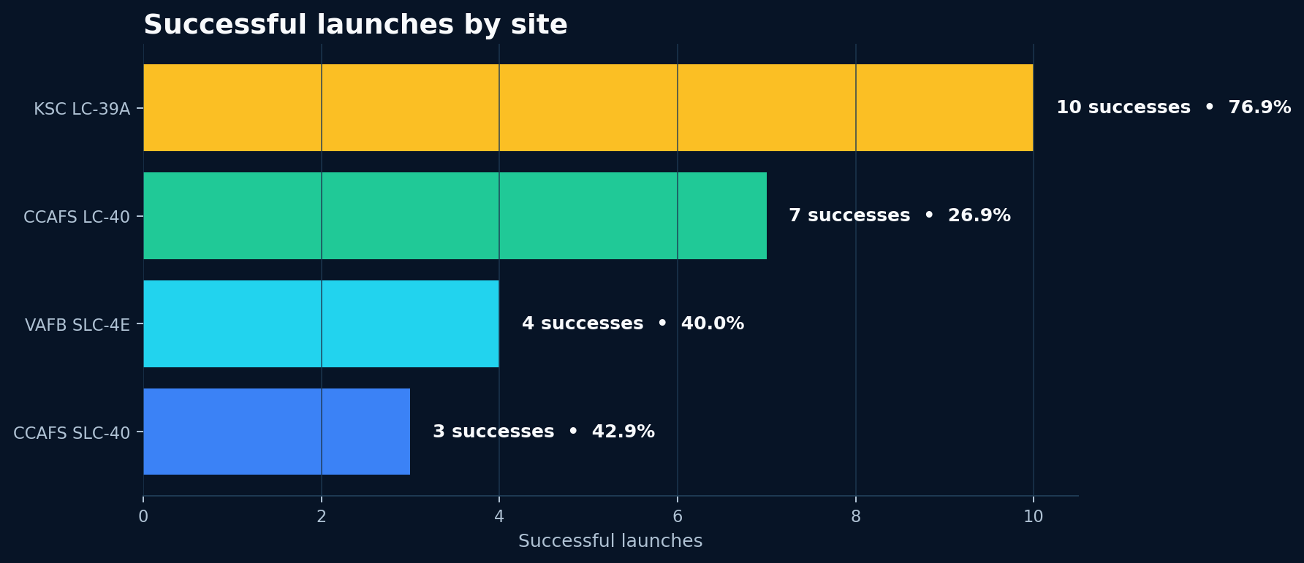
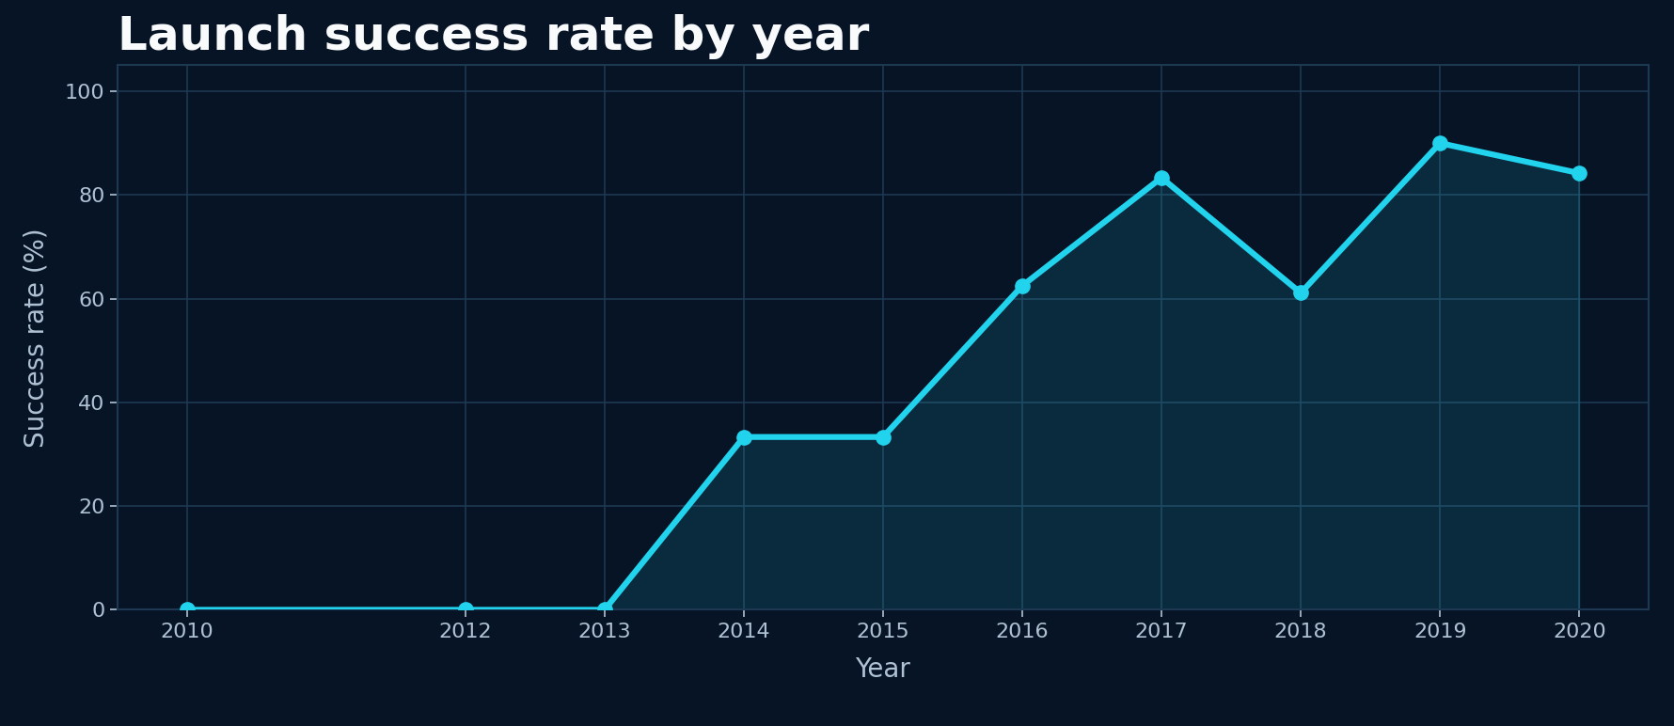
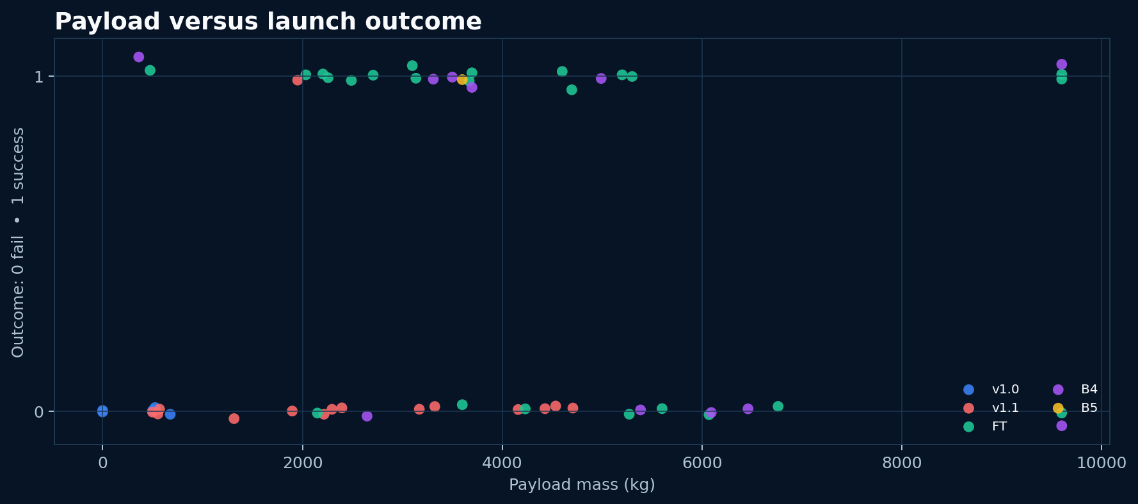
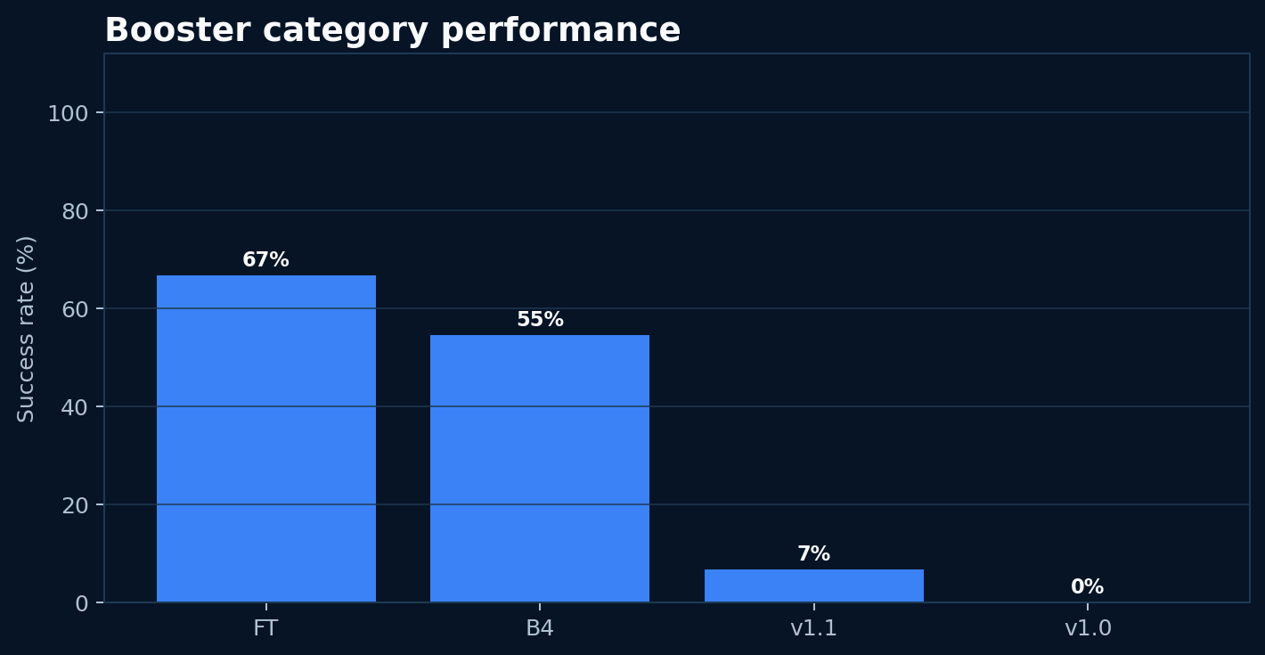
09
VISUALIZATION RESULTS
EDA results — site, payload, and experience
EDA visualization results
GitHub • https://github.com/ijontichyai/IBM-Data-Science-Capstone

Slide 10
10
SQL METHODOLOGY
EDA with SQL — reproducible analytical questions
01
SITE COVERAGE
DISTINCT launch sites and CCA-prefixed records
02
PAYLOAD
SUM and AVG payload mass by customer / booster
03
SUCCESS
COUNT outcomes and drone-ship landings
04
RANKING
GROUP BY landing outcome and ORDER BY count
05
TIME
Filter launch dates and compare historical periods
Typical pattern: SELECT → WHERE → GROUP BY → SUM / AVG / COUNT → ORDER BY
EDA with SQL
GitHub • https://github.com/ijontichyai/IBM-Data-Science-Capstone

Slide 11
11
SQL RESULTS
SQL results — exact summaries support the story
QUESTION
RESULT
USE
Launch sites
4 unique launch sites identified
Coverage
NASA (CRS) total payload
45,596 kg total payload for NASA (CRS)
Aggregation
F9 v1.1 average payload
≈2,928 kg average payload (F9 v1.1)
Aggregation
First ground-pad landing
First success: 2015-12-22
Time
Landing-outcome ranking
No attempt 10; drone-ship failure 5; drone-ship success 5
Ranking
EDA with SQL results
GitHub • https://github.com/ijontichyai/IBM-Data-Science-Capstone

Slide 12
12
MAP METHODOLOGY
Interactive geospatial analytics with Folium
MAP LAYERS
PROXIMITY TESTS
1
Launch sites
Circles + labels
Coastline
2
Launch records
Green success / red failure markers
Highway
Railway
3
Clusters
MarkerCluster for overlapping launches
City / population center
4
Proximity
MousePosition + distance lines
Goal: explore geographic patterns around launch facilities.
Interactive maps — Folium
GitHub • https://github.com/ijontichyai/IBM-Data-Science-Capstone

Slide 13
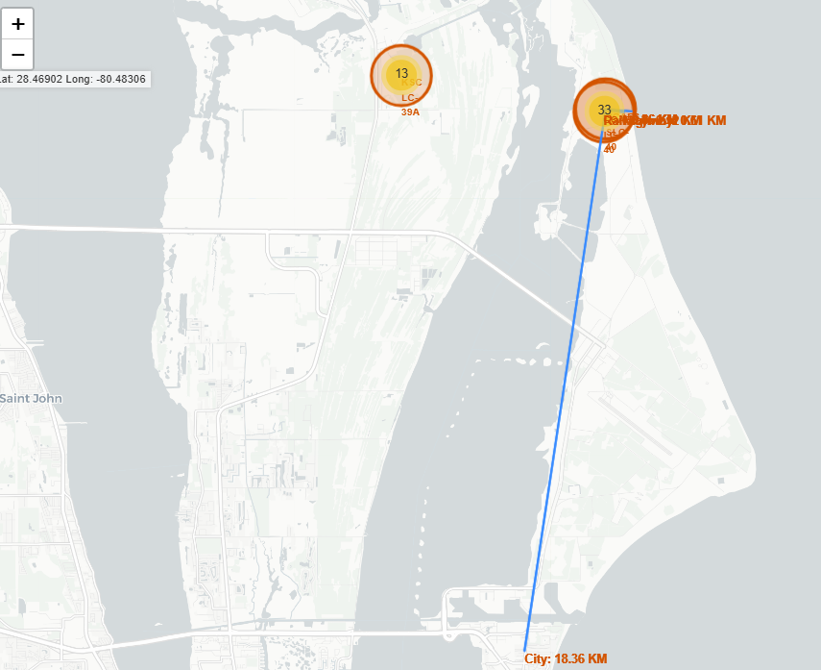
13
MAP RESULTS
Folium results — CCAFS SLC-40 proximity analysis
Key geographic findings
Measured proximity from CCAFS SLC-40
Railway: 0.12 km
Highway: 0.61 km
Coastline: 0.86 km
City: 18.36 km
Folium result summary
GitHub • https://github.com/ijontichyai/IBM-Data-Science-Capstone

Slide 14
14
DASHBOARD METHODOLOGY
Plotly Dash — turning analysis into an interface
INPUTS
CALLBACKS
OUTPUTS
Launch-site dropdown
Site dropdown → success pie chart
Success pie chart
Payload range slider
Payload scatter plot
Site dropdown + payload slider → payload scatter plot
USER ACTION
Figures update interactively when relevant inputs change.
Select a site and constrain payload mass.
Interactive dashboard — Plotly Dash
GitHub • https://github.com/ijontichyai/IBM-Data-Science-Capstone

Slide 15
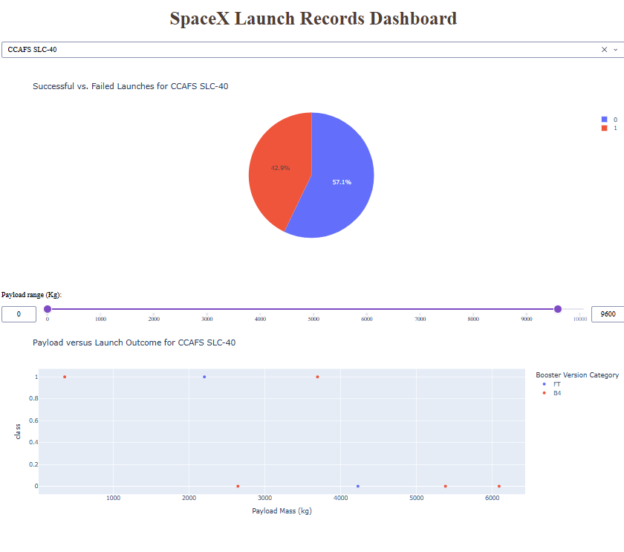
15
DASHBOARD RESULTS
Dash results — site selection and payload filtering
Observed insights
42.9%
CCAFS SLC-40 success rate
3 of 7
launches at CCAFS SLC-40 were successful
The payload slider filters the scatter plot; the site dropdown updates both visuals through callbacks.
Plotly Dash result evidence
GitHub • https://github.com/ijontichyai/IBM-Data-Science-Capstone

Slide 16
16
CLASSIFICATION METHODOLOGY
Predictive analysis — model training and comparison
SPLIT
STANDARDIZE
TUNE
EVALUATE
80% train / 20% test
random_state = 2
Fit scaling on X
reassign transformed X
GridSearchCV
10-fold CV
Holdout accuracy
confusion matrix
Models evaluated
Logistic Regression
C · penalty · solver
Support Vector Machine
C · gamma · kernel
Decision Tree
criterion · depth · splitter · features · samples
K-Nearest Neighbors
neighbors · algorithm · p
Predictive analysis methodology
GitHub • https://github.com/ijontichyai/IBM-Data-Science-Capstone

Slide 17
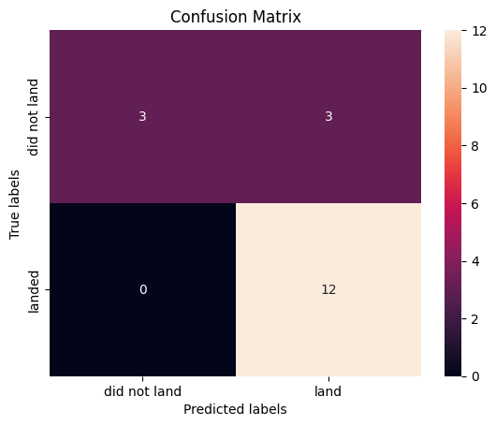
17
CLASSIFICATION RESULTS
Model results — cross-validation vs. holdout performance
Verified accuracy
Confusion matrix — LR / SVM / KNN
Logistic Regression
CV 84.6%
Test 83.3%
SVM — sigmoid
CV 84.8%
Test 83.3%
Decision Tree
CV 90.4%
Test 66.7%
KNN
CV 84.8%
Test 83.3%
Decision Tree achieved the highest CV score (90.4%), while Logistic Regression, SVM, and KNN tied for the best holdout accuracy at 83.3%.
Predictive analysis results
GitHub • https://github.com/ijontichyai/IBM-Data-Science-Capstone

Slide 18
18
DECISION IMPLICATIONS
Conclusions and innovative next steps
What the evidence supports
Beyond the template
Launch outcomes improve across the flight sequence
COST-AWARE THRESHOLD
1
Penalize false positives more heavily than false negatives.
Decision Tree achieved the highest cross-validation
score at 90.4%
CALIBRATED PROBABILITY
Logistic Regression, SVM, and KNN tied for the best holdout accuracy at 83.3%
2
Report landing probability—not only a binary class.
LR, SVM, and KNN each produced 3 false positives
and 0 false negatives
DRIFT MONITORING
3
Retrain as new booster versions and mission profiles appear.
Recommendation: use as decision support, not an autonomous go/no-go rule.
Conclusions and innovative insights
GitHub • https://github.com/ijontichyai/IBM-Data-Science-Capstone

