Slide 1
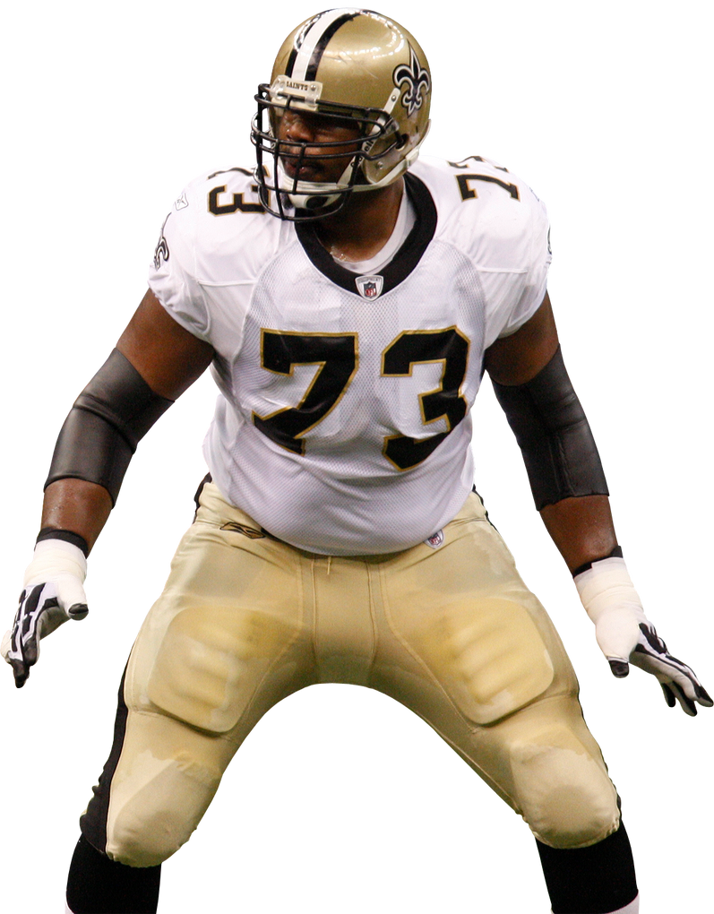
PREDECTING PRESSURES IN THE NFL
BY IAN POPE
-Changing How We Evaluate the Offensive Line

Slide 2

EVALUATING OFFENSIVE LINE PLAY
Data Analytics and player evaluation has taken over the National Football League
Methods used to evaluate offensive line play are outdated. Often just looking at sacks allowed, team rushing yards, or the eye test
With the rise of pass-heavy offences, we need a new way to measure the quality of offensive linemen on passing plays
PROBLEM

Slide 3
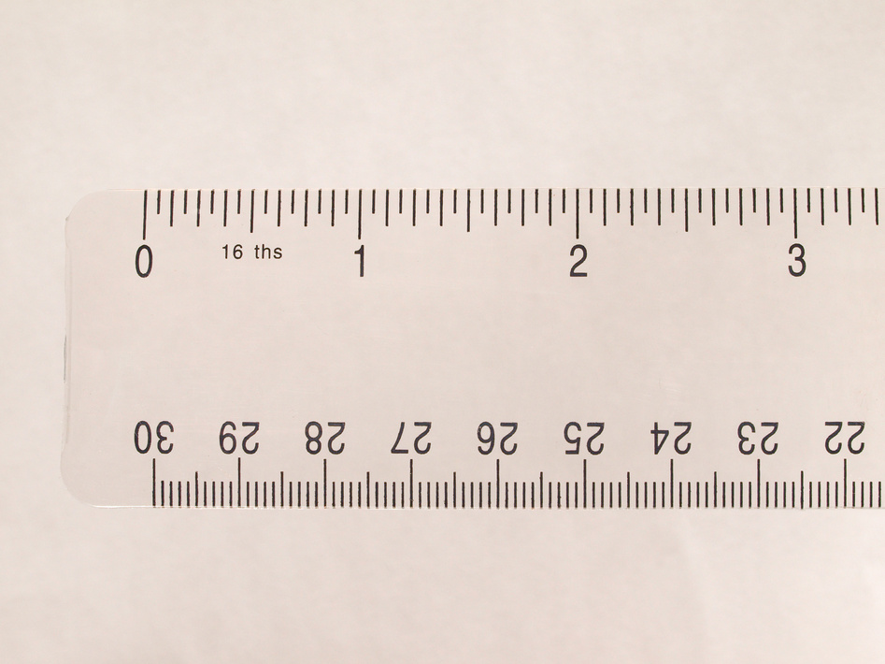
CREATE NEW METRIC-
EXPECTED PRESSURES
Create a new metric for evaluating offensive line play by utilizing NFL tracking and charting data to feed a neural network
Use that new metric to evaluate play across the league

Slide 4
DATASETS
Five datasets: game, play, players, player_play, and tracking (8+ GB)
Data taken from NFL Big Data Bowl 2025, hosted by Kaggle
Tracking data is taken every 0.1 seconds on for every play and every player
Play (50 total fields): contains data about what happened on that play. The time in the game, down, distance, scores, play concepts, and more
Player Play (49 total fields): contains data surrounding what a player did on a play. Relevant fields are hadDropback, allowedPressureAsBlocker, and blockedPlayerNFLID
Tracking (18 total fields): Contains data regarding player positioning and speed across a play. Also includes field ‘event’ to track notable events at that moment in time
Player: Fields are nflId, height, weight, birthDate, collegeName, position, and displayName

Slide 5
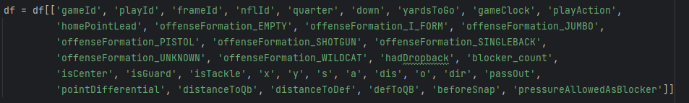
FEATURES
distanceToQb, distanceToDef, defToQB based on tracking data
gameId, playId, frameId, nflId not used in training
pressureAllowedAsBlocker (1 or 0) is the predicted value
blocker_count based on number of players with same blocker ID

Slide 6
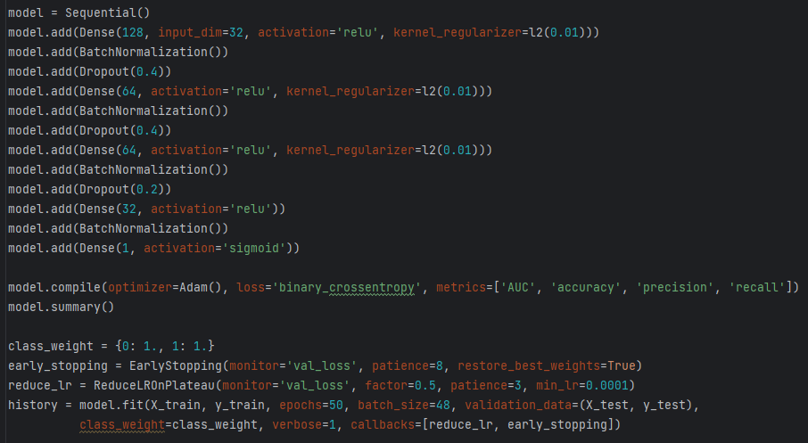
NEURAL NETWORK
Utilizes Keras Library
Network fed frame by frame, but when grouping fames by game, play, and player there are only 30,000 unique combinations
l2 regularizer and dropout layers to prevent over fitting
Batch Normalization
Final sigmoid activation function

Slide 7
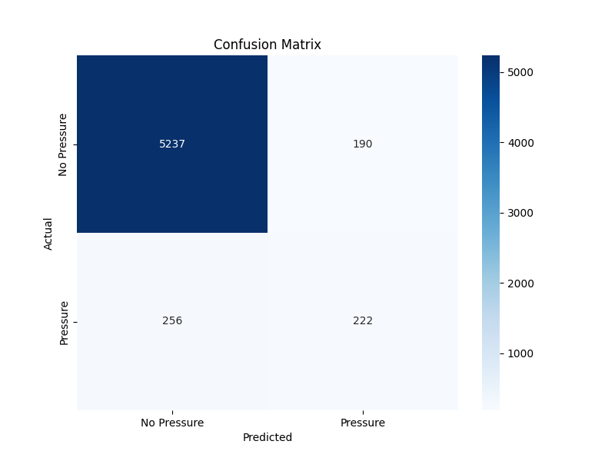
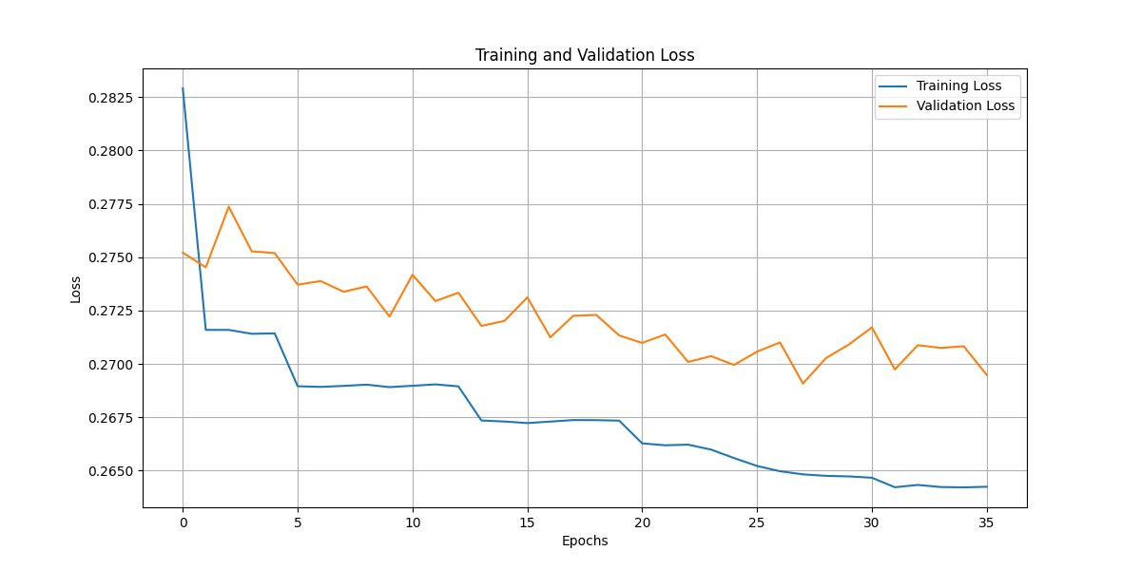
TRAINING RESULTS
After running predictions on every frame, frames are then grouped and examined if any frame hit the pressure threshold.
Validation Loss: <0.27, Recall: 0.464, Precision of 0.539
Training ended early after 36 epochs

Slide 8
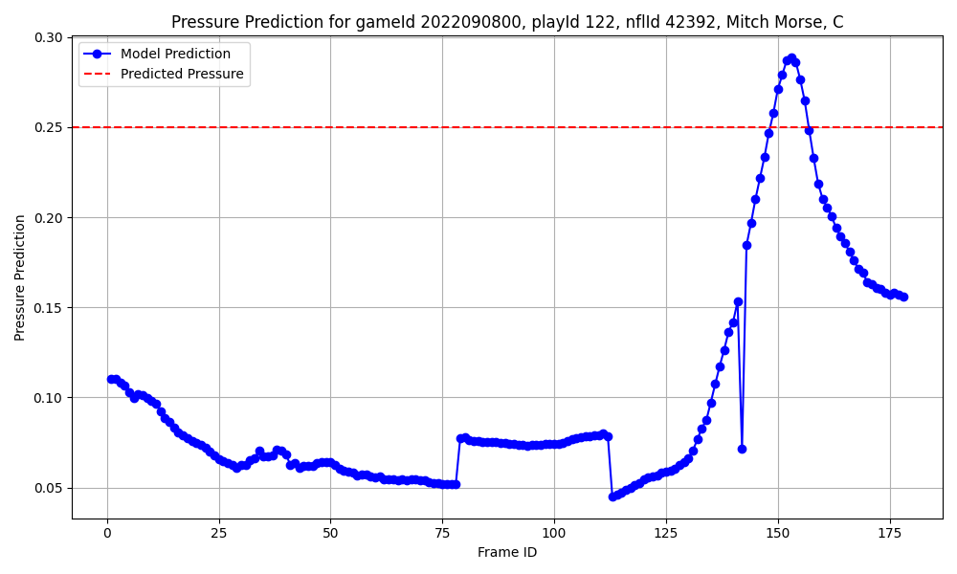
HOW TO DETERMINE AN EXPECTED PRESSURE
Get the score returned from the sigmoid function in the neural network model
Group predictions on game, play, and player
Check if any frame scores higher than the 0.25 threshold
If yes, the entire play is considered an expected pressure

Slide 9
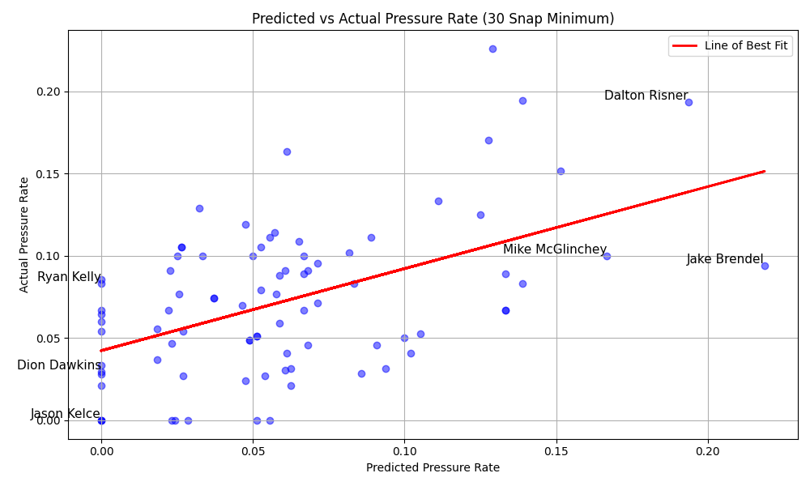
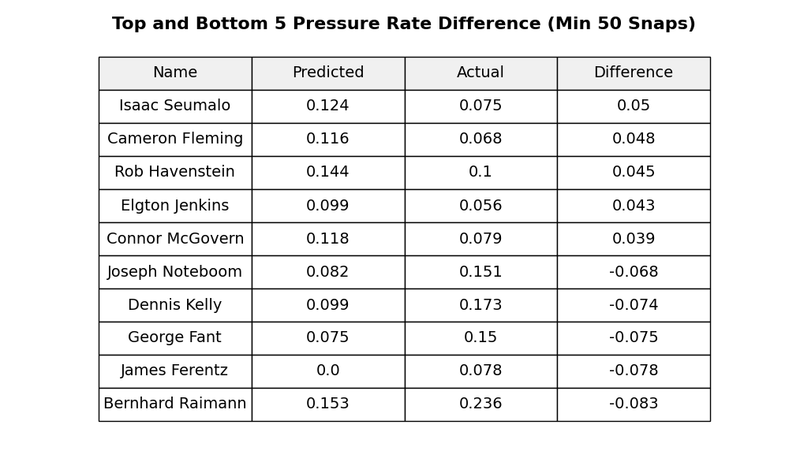
RESULTS
TESTING SCATTERPLOT
COMBINED RATE CHART

Slide 10
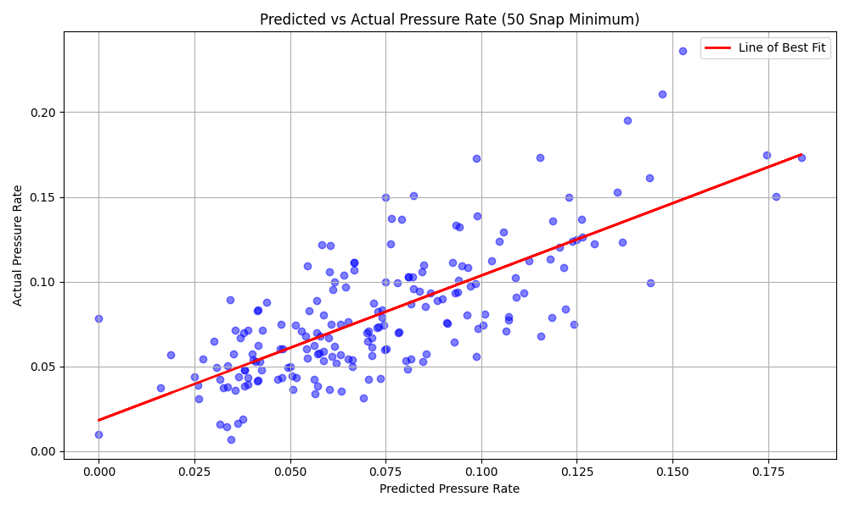
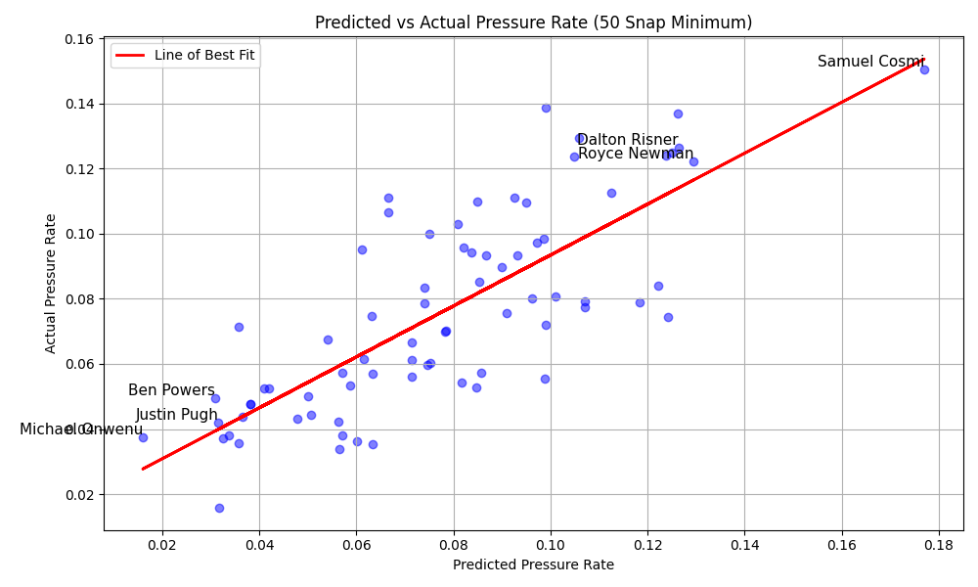
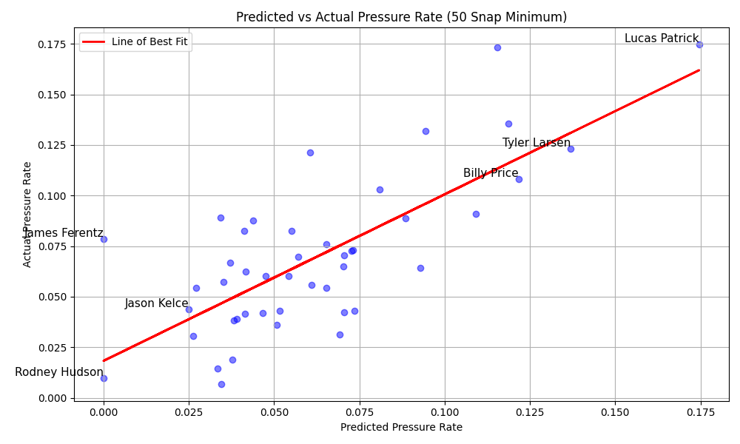
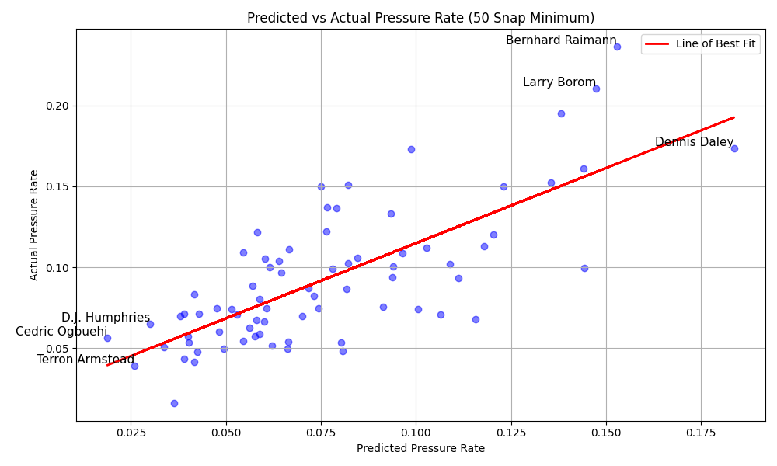
A
G
C
T

Slide 11
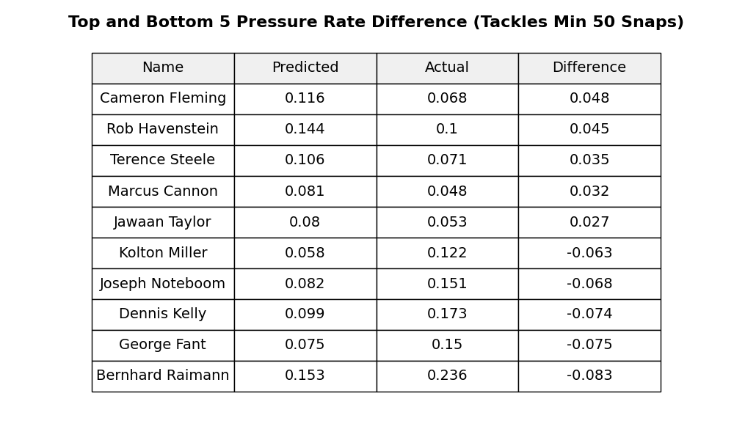
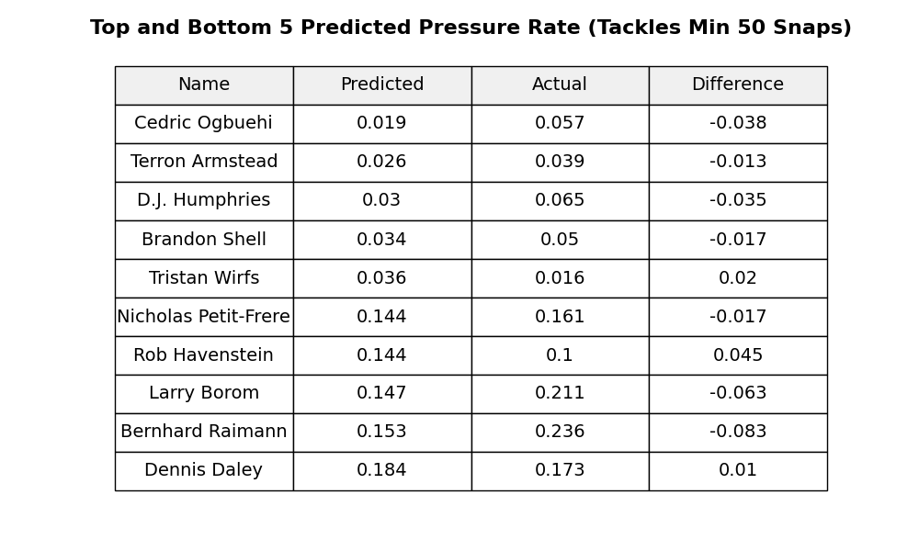
OFFENSIVE TACKLES
RATE DIFFERENCE
PREDICTED PRESSURE RATE

Slide 12
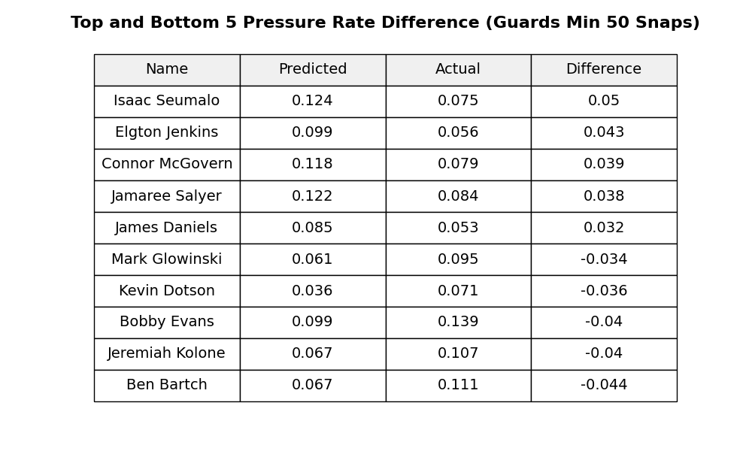
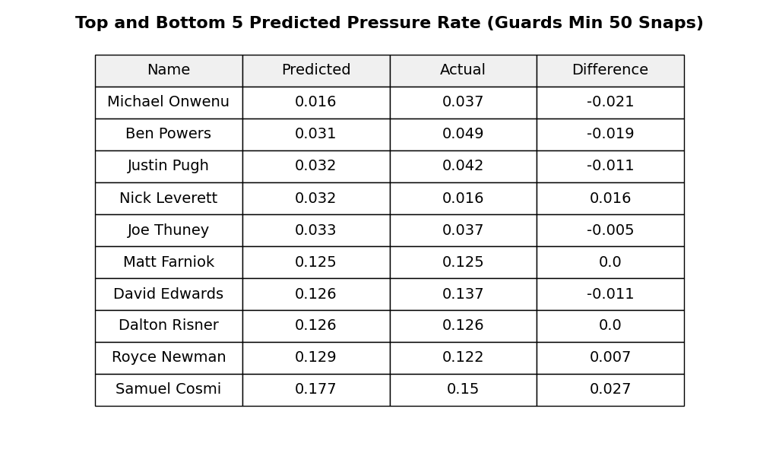
OFFENSIVE GUARDS
RATE DIFFERENCE
PREDICTED PRESSURE RATE

Slide 13
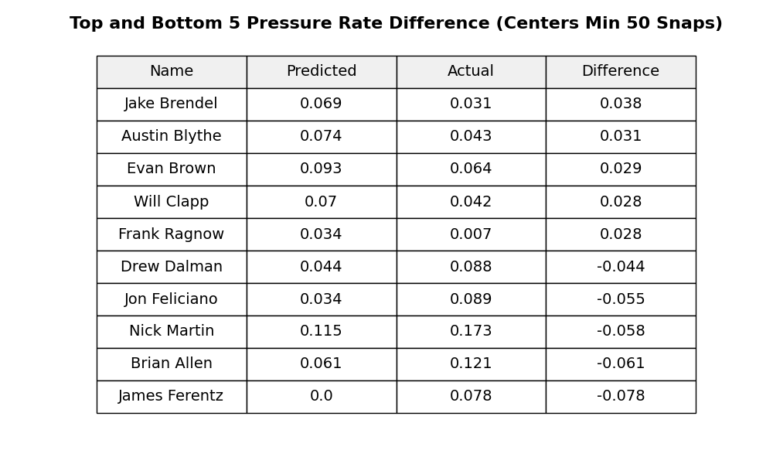
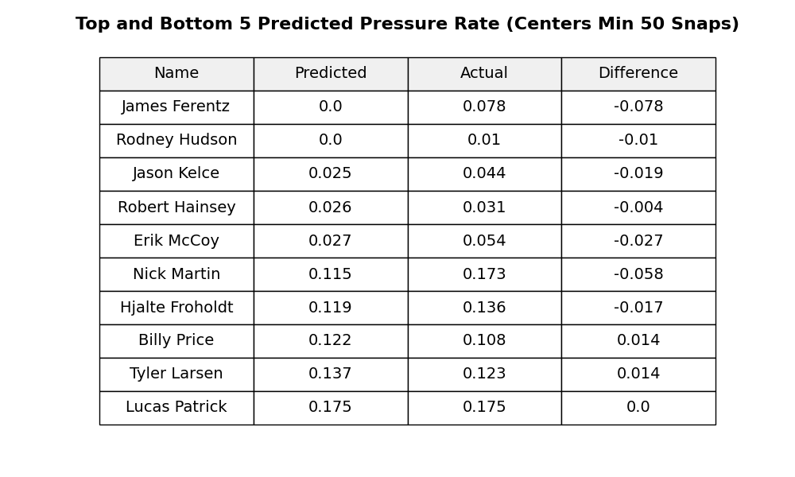
CENTER
RATE DIFFERENCE
PREDICTED PRESSURE RATE

Slide 14
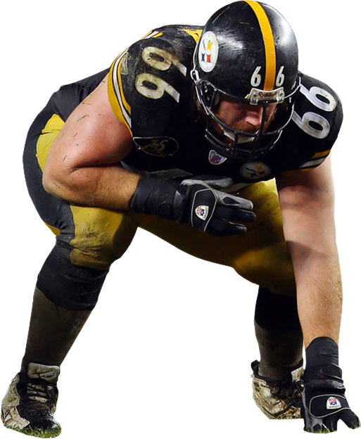
Expected Pressure
Through the use of NFL tracking and charting data, was the creation of expected pressure rate. Although there are aspects I wish to change and experiment on, I am hopeful and confident that expected pressures can be a useful tool for NFL evaluators and decision makers to further create an edge. As the NFL continues to evolve, our methods of evaluation must evolve as well, ensuring that every aspect of the game, including offensive line play, is assessed with the precision and depth it deserves.
CONCLUSION

Slide 15
RESOURCES
[1]
N. Byanna and D. Klabjan, “Evaluating the Performance of Offensive Linemen in the NFL.” Accessed: Dec. 01, 2024. [Online]. Available: http://dynresmanagement.com/uploads/3/5/2/7/35274584/nfl_offensive_linemen.pdf
[2]
M. Lopez, T. Bliss, A. Blake, P. Mooney, and A. Howard, “NFL Big Data Bowl 2025,” @kaggle, Oct. 10, 2024. https://www.kaggle.com/competitions/nfl-big-data-bowl-2025/overview/ (accessed Dec. 01, 2024).
[3]
T. C. Nokeri, Data Science Solutions with Python. Berkeley, CA: Apress, 2022. doi: https://doi.org/10.1007/978-1-4842-7762-1.
[4]
J. Schad, “Why do the Dolphins allow hundreds of quarterback pressures?,” TCA Regional News, Nov. 2021, Accessed: Nov. 30, 2024. [Online]. Available: https://www.proquest.com/docview/2595203614?pq-origsite=primo&accountid=6143&sourcetype=Wire%20Feeds

