Slide 1

Introduction to CQRS and Event Sourcing
Ian Russell
@ijrussell

Slide 2

About me
Software Developer for over 20 years
Co-founder of CraftyCoders

Slide 3
Agenda
Domain-Driven Design
Layered Architecture
CQRS
Event Sourcing

Slide 4
Domain Driven Design
Entities
Value Objects
Aggregates
Aggregate Root
Repositories
See code sample

Slide 5
Domain Driven Design
Ubiquitous Language
Bounded Context
Context Mapping

Slide 6
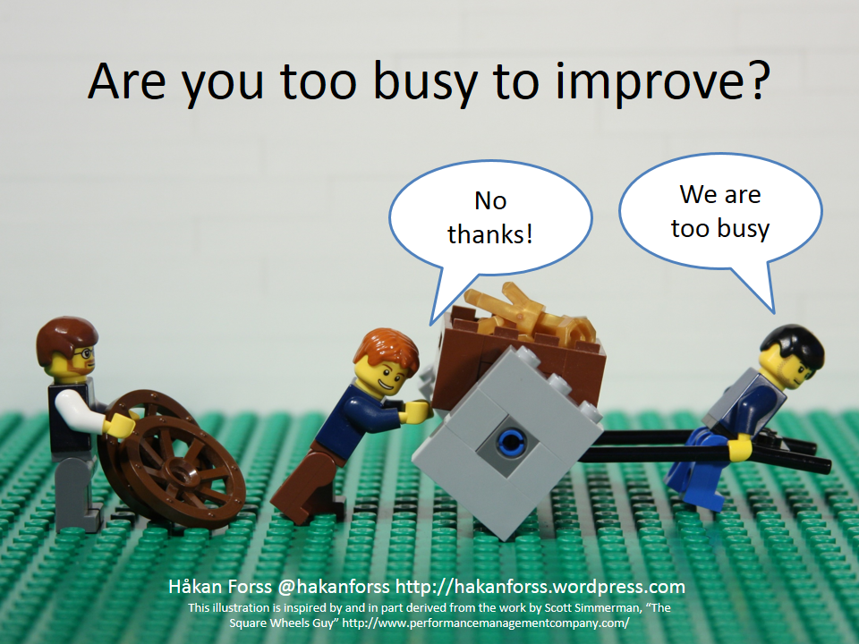
Layered Architecture

Slide 7
Layered Architecture
UII
Service Layer
Domain Layer
Data Layer (ORM)I

Slide 8
Layered Architecture
UII
Data-centric Model + ORM

Slide 9
Layered Architecture
Store State
Lose Intent
Single data-centric model/store
Collaboration difficult
Scalability
Caching/Stale data
DB optimised for writes
One architecture to rule them all
Is some functionality more important?

Slide 10
CQRS
Command Query Responsibility Segregation
Greg Young and Udi Dahan
Write model != Read model
Task-based UI
not CRUD
Express intent

Slide 11
CQRS - Simple
UII
Query
Command
Service Layer
Service Layer
Thin Read Layer
Domain Layer
Data Layer (ORM)I

Slide 12
CQRS – Different Datastores
UII
Query
Command
Service Layer
Service Layer
Thin Data Layer
Domain Layer
Data Layer (ORM)I
Optimised for reads
Optimised for writes

Slide 13
CQRS – Alternate
UII
Query
Command
Service Layer
Service Layer
Thin Data Layer
Domain Layer
Data Layer
Optimised for reads
Optimised for writes

Slide 14
CQRS – Eventual Consistency
UII
Query
Command
Service Layer
Service Layer
Thin Data Layer
Domain Layer
Queue or Bus
Optimised for reads
Optimised for writes

Slide 15
CQRS – Document Store
UII
Query
Command
Service Layer
Service Layer
Thin Data Layer
Domain Layer
Queue or Bus
Optimised for reads
Optimised for writes

Slide 16
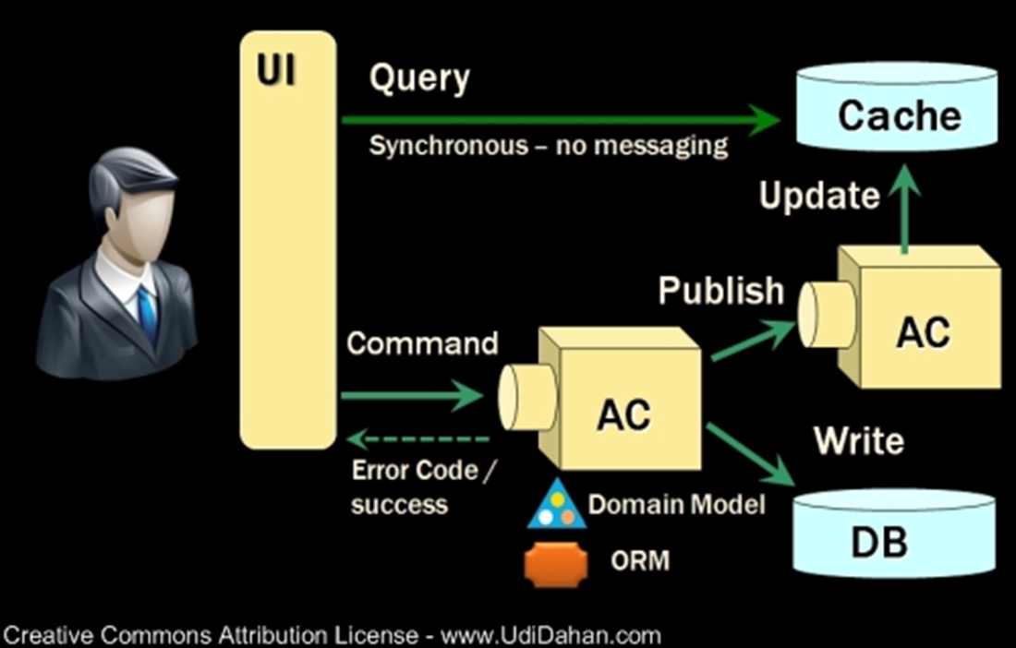
CQRS – The Udi Dahan Way

Slide 17
CQRS Summary
Split read and write sides
Task-based UI

Slide 18
Event Sourcing
Explicitly store what happened
Events
Past tense
Immutable
Making the implicit explicit
Audit Trail for free
Banking, Accountancy & mainframe

Slide 19
Event Sourcing
Rebuild aggregate state by replaying Events
Conceptually, first to last
Last to first
If not a snapshot add to stack
When you find snapshot, pop each event off stack in turn and apply

Slide 20
Event Sourcing
UII
Query
Command
Service Layer
Service Layer
Thin Data Layer
Domain Layer
Denormaliser
Event Store

Slide 21
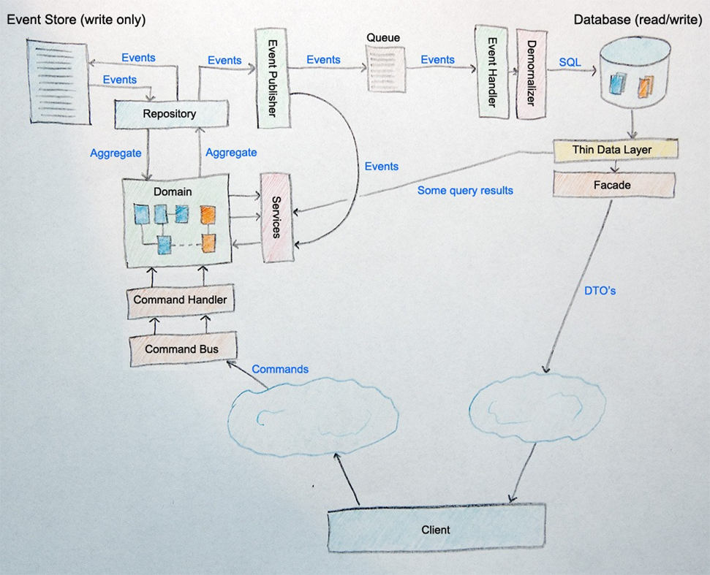
Event Sourcing + CQRS + DDD
Image by Mark Nijhof

Slide 22
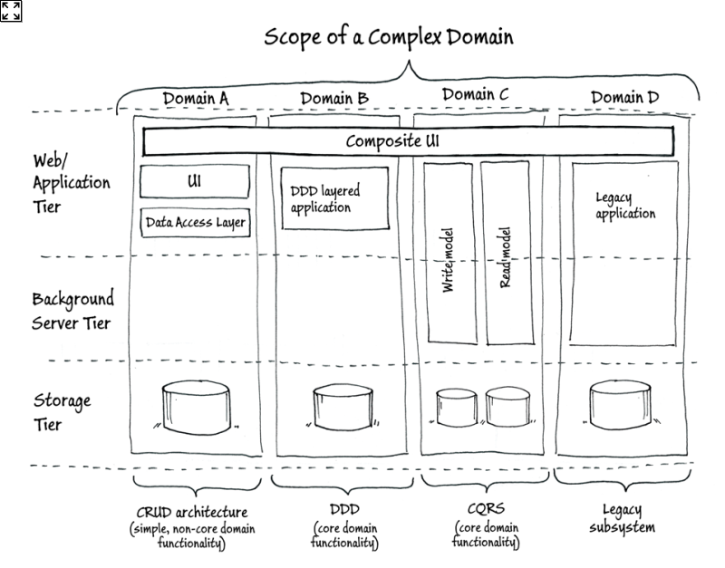
Where to use CQRS & ES
Image by Cesar de la Torre

Slide 23
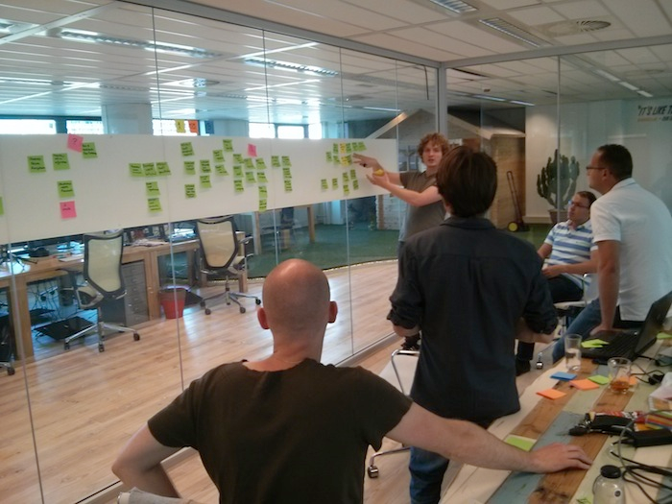
Domain Modelling
Ubiquitous Language
Domain Experts
Event Storming
Domain Events
Commands

Slide 24
Summary
Domain Driven Design
Bounded Context, Ubiquitous Language and Context Mapping
Aggregates, Entities, Value Objects and Repositories
Layered Architecture
Problems with intent, collaboration and scalability
CQRS
Write model != Read model
Task-based UI
Eventual Consistency
Event Sourcing
Making the implicit explicit

Slide 25
Resources
Domain-Driven Design AKA ‘the blue book’
Architecting Applications for the Enterprise
2nd Edition (Microsoft Books)
CQRS Journey
https://msdn.microsoft.com/en-us/library/jj554200.aspx
CQRS
https://leanpub.com/cqrs
Blogs and videos by Udi Dahan and Greg Young

Slide 26
Questions?

Slide 27
Thank you
Ian Russell
@ijrussell

