Slide 1

An Introduction to Functional Programming
Ian Russell
@ijrussell

Slide 2

About me
Software Developer for 20 years
Co-founder of CraftyCoders

Slide 3
Agenda
Introduction
Dive in to some code
Building blocks
Monads
Resources
Ask questions as we go!

Slide 4
Warning
Functional programming requires a paradigm shift in your thinking about how to structure and write software.

Slide 5
Why change from OO?
We’re crap not very good at OO
"I invented the term Object-Oriented, and I can tell you I did not have C++ in mind."
- Alan Kay
Laws of Physics
multi-core processors + shared state = BAD

Slide 6
Definition
"Functional programming (FP) is a style of software development emphasizing functions that don't depend on program state. Functional code is easier to test and reuse, simpler to parallelize, and less prone to bugs than other code."
- Runar Bjarnason
- Co-author of Functional Programming in Scala

Slide 7
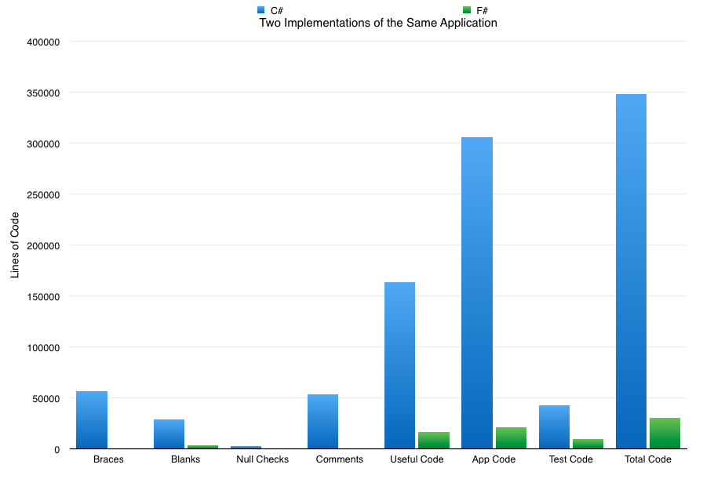
OO vs FP
http://www.simontylercousins.net/does-the-language-you-use-make-a-difference-revisited/

Slide 8
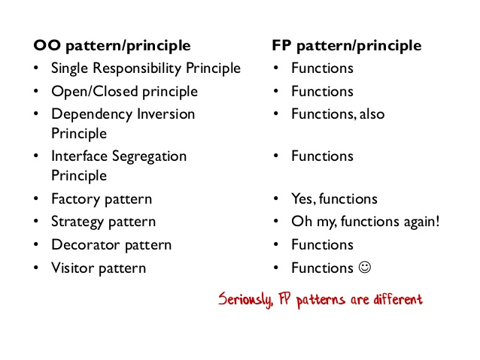
OO vs FP
Source: Scott Wlaschin

Slide 9
OO vs FP
We are uncovering better ways of developing software by doing it and helping others do it. Through this work we have come to value:
Functions and Types over classes
Purity over mutability
Composition over inheritance
Higher-order functions over method dispatch
Options over nulls
That is, while there is value in the items on the right (except for nulls), we value the items on the left more.
http://notonlyoo.org/manifesto/
11100011 Ian Russell

Slide 10
Let’s dive in!

Slide 11

Monads
SAY WHAT??

Slide 12
Monoids
3 Rules
Closure
a’ ~ a’ -> a’
Associativity
a’ ~ (a’ ~ a’) = (a’ ~ a’) ~ a’
Identity Element
a’ ~ i = a’ and i ~ a’ = a’

Slide 13
Monad
Allows the programmer to build pipelines that process data in steps, in which each action is decorated with additional processing rules provided by the monad.
f : a’ -> Ma’
g : a’ -> Ma’
\a’ -> (f a’) >>= \a’ -> (g a’)
[>>= is bind/shove => composition for monads]
[Function a’ -> Ma’ is a monoid and data Ma’ is a monad]

Slide 14
Monad
Formally, a monad consists of a type constructor M and two operations, bind and return (where return is often also called unit):
The return operation takes a value from a plain type and puts it into a monadic container using the constructor, creating a monadic value.
The bind operation takes as its arguments a monadic value and a function from a plain type to a monadic value, and returns a new monadic value.

Slide 15
Monad
Maybe some code will help

Slide 16
Summary
Functions
Immutable
Types (Record, Option and Union)
List, Array and Sequence
Pattern matching
Currying and Partial application
Recursion
Monads and Monoids

Slide 17
Resources
http://fsharpforfunandprofit.com
http://www.tryfsharp.org
http://fsharp.org
https://channel9.msdn.com/Shows/Going+Deep/Brian-Beckman-Dont-fear-the-Monads
* Other functional languages are available

Slide 18
Thank you
Ian Russell
@ijrussell

