Slide 1

The good, the bad and the ugly of mocking
Ian Russell
@ijrussell

Slide 2
About me
Programmer for over 20 years
Polyglot
F#, Elixir & Erlang
C#, node.js & ruby

Slide 3
Agenda
Definitions & Vocabulary
Role of mocks
Hand-written
Frameworks
Test Structure
Questions?

Slide 4
What are mocks?
“Mock objects are simulated objects that mimic the behaviour of real objects in controlled ways.”
“… in much the same way that a car designer uses a crash test dummy to simulate the dynamic behaviour of a human in vehicle impacts.”
[Source: Wikipedia]

Slide 5
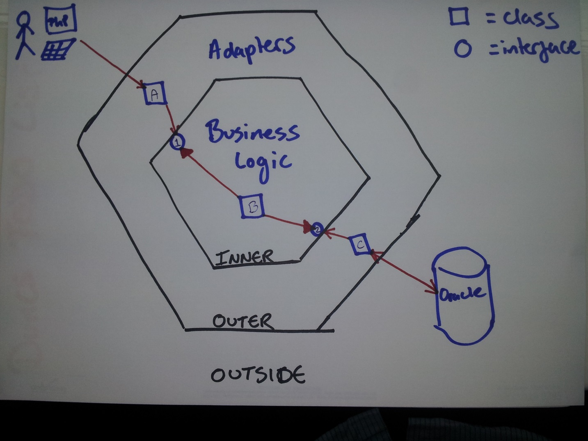
Hexagonal Architecture
http://www.duncannisbet.co.uk/hexagonal-architecture-for-testers-part-1

Slide 6
Properties of Unit Tests
FIRST
Fast
Independent
Repeatable
Self-validating
Timely
Trustworthy
Maintainable
Readable

Slide 7
Vocabulary
Test Double
Dummy
Stub
Spy
Mock
Fake
Gerard Meszaros [xUnit Test Patterns (Addison Wesley)]

Slide 8
Simplified Vocabulary
Fake
Stub
Mock

Slide 9
Isolation Frameworks
Open source
Rhino Mocks, Moq, NMock
FakeItEasy, NSubstitute
Free
MS Fakes, JustMock Free
Commercial
Isolator, JustMock

Slide 10
Let’s see some code!

Slide 11
Summary
Mock things that cause you test pain
Use mocks wisely
Use Test Data Builder, SUT Builder and IEqualityComparer<T>
Choose a framework and stick with it

Slide 12
Resources
http://pluralsight.com/training/Courses/TableOfContents/advanced-unit-testing
http://pluralsight.com/training/Courses/TableOfContents/outside-in-tdd
The Art of Unit Testing (2nd Ed.) (Mannings)
Growing Object-Oriented Software (Addison Wesley)
xUnit Test Patterns (Addison Wesley)

Slide 13
Thank you
Ian Russell
@ijrussell

