Slide 1

The good, the bad and the ugly of mocking
Ian Russell
@ijrussell

Slide 2
About me
Programmer for over 20 years
Polyglot

Slide 3
Agenda
Definitions & Vocabulary
No tool mocking
Using a framework
Questions?

Slide 4
What are mocks?
“Mock objects are simulated objects that mimic the behaviour of real objects in controlled ways.”
Wikipedia

Slide 5
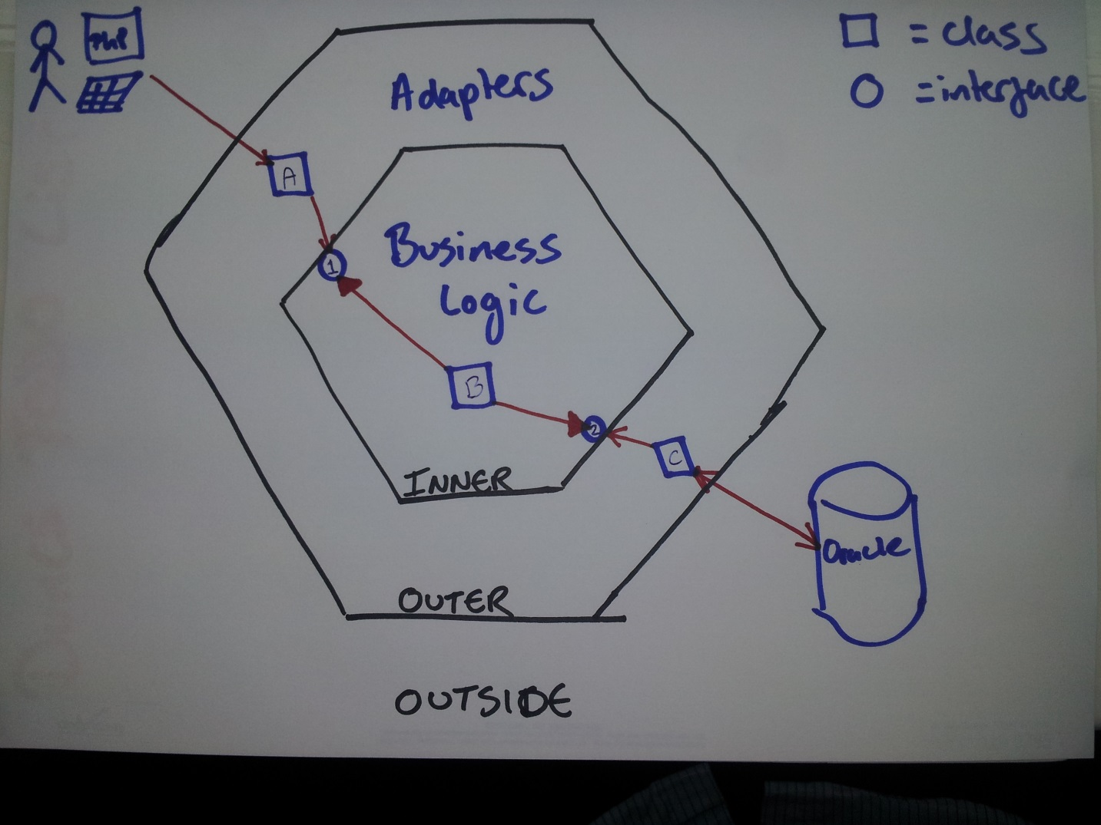
What should you mock?
http://www.duncannisbet.co.uk/hexagonal-architecture-for-testers-part-1

Slide 6
Vocabulary
Test Double
Dummy
Stub
Spy
Mock
Fake
Gerard Meszaros [xUnit Test Patterns (Addison Wesley)]

Slide 7
Simplified Vocabulary
Fake
Stub
Mock

Slide 8
Stubs
“A stub is a controllable replacement for an existing dependency (or collaborator) in the system. By using a stub, you can test your code without dealing with the dependency directly.”
Roy Osherove [The Art of Unit Testing (Manning)]

Slide 9
Mocks
“A mock object is a fake object in the system that decides whether the unit test has passed or failed. It does so by verifying whether the object under test interacted as expected with the fake object. There’s usually no more than one mock per test.”
Roy Osherove [The Art of Unit Testing (Manning)]

Slide 10
No framework examples

Slide 11
No framework summary
Easy to write
Maintenance cost may be high
Lots of work for complicated interfaces
Hard to reuse

Slide 12
Isolation Frameworks
Open source
Rhino Mocks, Moq, NMock
FakeItEasy, NSubstitute
Free
MS Fakes, JustMock Free
Commercial
Isolator, JustMock

Slide 13
With framework examples

Slide 14
Framework summary
Open source
Rhino Mocks, Moq, NMock
FakeItEasy, NSubstitute
Free
MS Fakes, JustMock Free
Commercial
Isolator, JustMock

Slide 15
Summary
Test behaviour not implementation
Only mock external dependencies
Use mocks wisely
Tests should be readable
Use Test Data Builder, SUT Builder and IEqualityComparer<T>

Slide 16
Resources
The Art of Unit Testing (2nd Ed.) (Mannings)
Growing Object-Oriented Software (Addison Wesley)
xUnit Test Patterns (Addison Wesley)
http://cleancoders.com/
http://pluralsight.com/training

Slide 17
Thank you
Ian Russell
@ijrussell

