Slide 1

Using F# for Line of Business Applications
Ian Russell
@ijrussell

Slide 2

About me
Software Developer for over 20 years

Slide 3
Agenda
Interoperability with C#
Case Study (F# vs C#)
WPF and Web
Data
Domain Modelling

Slide 4
C#/F#
"F# is excellent at concisely expressing business and domain logic. Developers trying to achieve explicit business logic within an application may opt to express their domain in F# with the majority of plumbing code in C#"
ThoughtWorks Technology Radar, March 2012

Slide 5
C#/F# Demo

Slide 6
Case Study – Eon Energy
C#
8 devs
5 years
Slow, incomplete and inaccurate
F#
3 devs including 1 F# newbie
1 year
Fast, complete and accurate
http://www.simontylercousins.net/does-the-language-you-use-make-a-difference-revisited/

Slide 7
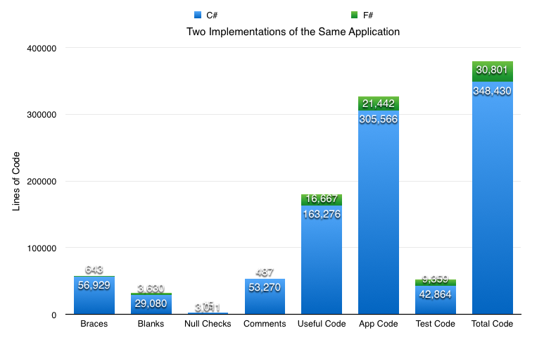
Case Study – Eon Energy
http://www.simontylercousins.net/does-the-language-you-use-make-a-difference-revisited/

Slide 8
Case Study – Eon Energy
“I reckon that if you have .NET experience you can pick up enough F# in a week to start cutting production code. In a month you will have stopped mutating state for a living and have become a functional developer.”
http://www.simontylercousins.net/does-the-language-you-use-make-a-difference-revisited/

Slide 9
Case Study – Eon Energy
“I can fit the whole F# solution in the blank lines of the C# solution with 7,000 lines to spare.
WTF C#! OMG F#!
I have spent most of my life writing buggy, bloated software that was impossible to reason about. What was I thinking?”
http://www.simontylercousins.net/does-the-language-you-use-make-a-difference-revisited/

Slide 10
The F# UI Story
Web
ASP.NET MVC
NancyFx
And more
WPF

Slide 11
F# and WPF Demo
Taken from F# Succinctly by Robert Pickering
[Free ebook from Syncfusion]

Slide 12
F# and ASP.NET MVC Demo

Slide 13
External Data
Type Providers
Introduced in F# 3.0
Make accessing external data easy/fun/exciting!
Loads of sources supported
You can write your own or extend existing ones

Slide 14
Demo
CSV
XML
JSON
SQL

Slide 15
Domain Modelling
Define Entities and Value Types
Prevent invalid state

Slide 16
Demo

Slide 17
And …
Testing
Concurrency/Async
Unit of Measure
Xamarin/Mono
and lots more!

Slide 18
Summary
C#/F#
Case Study
WPF and MVC
External Data
Domain Modelling

Slide 19
Resources
http://fsharp.org/
http://fsharpforfunandprofit.com/
http://www.tryfsharp.org/
The Book of F# (No Starch Press)
F# Deep Dive MEAP (Mannings)
Building Web, Cloud and Mobile Solutions with F# (Oreilly)
Expert F# 3.0 (Apress)

Slide 20
Thank you
Ian Russell
@ijrussell

