Slide 1


Strategic Domain-Driven Design
Ian Russell
@ijrussell

Slide 2
Agenda
Quick overview of Domain-Driven Design
What is Strategic DDD?
What’s happened in the last 15 years?

Slide 3
Domain-Driven Design
The Blue Book
Tackling complexity in the heart of software
Eric Evans 2004
Strategic
Modelling and decomposition
Tactical
Code structures and patterns

Slide 4
What is Strategic DDD?
Shared model of understanding
Discovering the most important parts of the problem space
Transform the problem space into a useful solution space
Notes:
“All models are wrong, some are useful” – Eric Evans

Slide 5
Domain Decomposition
Domain
HR
Facilities
Sales
Warehouse
Billing
Delivery
Accounting
Marketing
Decomposition of Domain into sub-domains

Slide 6
Domain Decomposition
HR
Domain
Facilities
Sales
Warehouse
Marketing
Delivery
Billing
Accounting
Decomposition of Domain into sub-domains

Slide 7
Classifying Sub-domains
Core
Supporting
Generic
HR
Facilities
Sales
Warehouse
Marketing
Delivery
Billing
Accounting

Slide 8
Bounded Context
Sales
Warehouse
Product
Billing
Customer
Delivery
Use Business Capability or Sub-domain as starting point
Notes:
Sub-domain (Problem space – real) vs Bounded Context (Solution space – logical)
Business Capability = something the business does to generate value

Slide 9
Bounded Context & Ubiquitous Language
Sales
Warehouse
Customer
Product
Product
Billing
Delivery
Product
Customer
Customer

Slide 10
Context Map
Sales
Billing
Communication between all bounded contexts
Notes:
Note that there is a direction of travel

Slide 11
Relationship Types
Shared Kernel
Domain logic - not cross-cutting concerns
Customer - Supplier
Conformist
Open Host Service
Separate Ways
Anti-Corruption Layer

Slide 12
Summary of Strategic DDD
Shared model of understanding
Discovering the most important parts of the problem space
Transform the problem space into a useful solution space
Notes:
“All models are wrong, some are useful” – Eric Evans

Slide 13
The Next 15 Years
Domain Events
Structural Modelling -> Temporal Modelling
Sociotechnical Architecture

Slide 14
CQRS & Event Sourcing
Client
Command
Query
Domain Event
Event
Store

Slide 15
CQRS & Event Sourcing
Command
Request (e.g. CreateUser)
Domain Event
Verb in past tense (e.g. UserCreated)
Event Store
Projections, Snapshotting & Versioning
Replay of events & Log for free
CQRS + ES or CQRS alone
Notes:
Greg Young – Versioning ES book on Leanpub

Slide 16
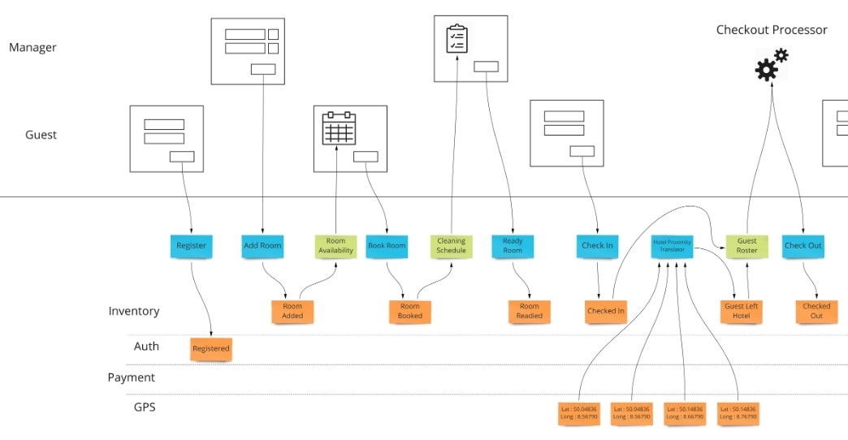
Event Modelling
https://eventmodeling.org/posts/what-is-event-modeling/
Notes:
User/API/Job -> Command -> Domain Event + Query

Slide 17
Event Modelling
Brainstorm Domain Events
Create a timeline for a story/process
Mock screens/wireframes
Identify inputs (Commands)
Identify outputs (Queries)
Arrange Domain Events into logical swimlanes
Validate

Slide 18
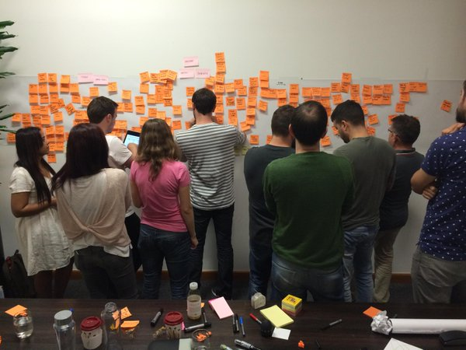
Event Storming
https://pbs.twimg.com/media/CJi5-W7UcAAEpMF.jpg

Slide 19
Event Storming
User
Command
Query
Hot Spot
External System
Domain Event
Policy
Time Event
Domain Event
Command
Create a key for what each colour represents

Slide 20
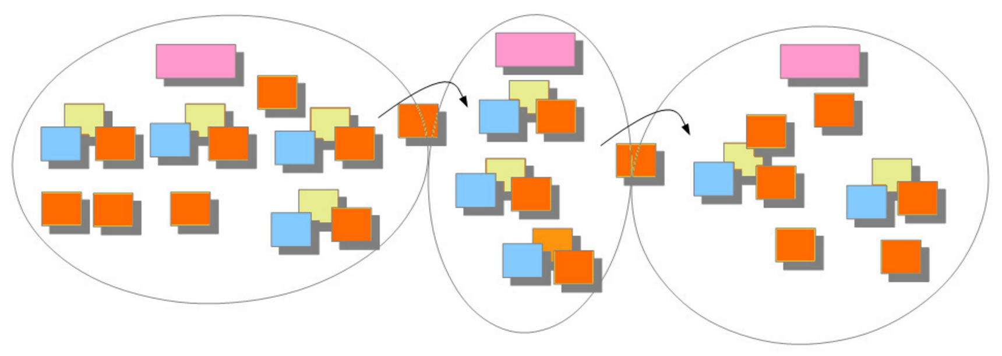
Event Storming
Domain-Driven Design Distilled – Vaughn Vernon

Slide 21
Event Storming
Facilitator role is vital
Set goals beforehand
Big Picture (Legacy vs experimental)
Focussed
Knowledge Transfer

Slide 22
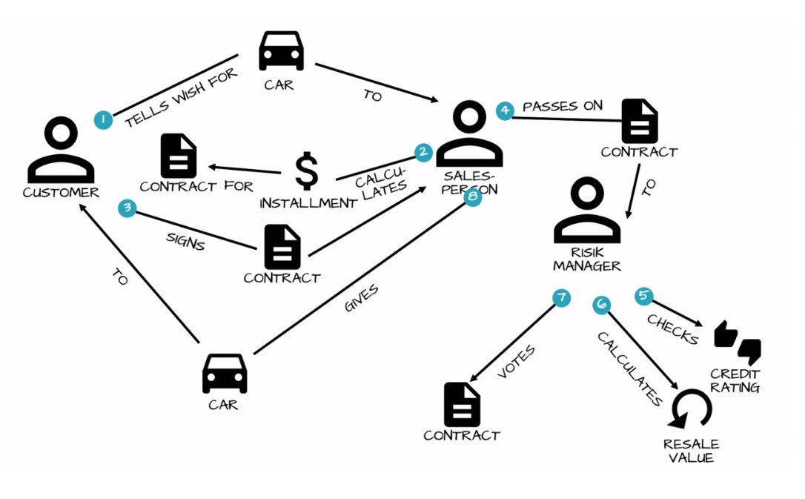
Domain Storytelling
https://domainstorytelling.org/

Slide 23
Sociotechnical Architecture
"Organisational politics will be mirrored as architectural complexity" - Nick Tune
"A loosely coupled software architecture and org structure to match is a key predictor of:
1. Continuous Delivery Performance
2. Ability to scale org and increase performance linearly"
- Accelerate by Nicole Forsgren PhD, Jez Humble & Gene Kim

Slide 24
Summary
Strategic DDD
Focus on Core sub-domains
Decomposition into Bounded Contexts
Ubiquitous Language
Domain Events
CQRS + Event Sourcing
Structural modelling -> Temporal modelling
Event Modelling
Event Storming
Domain Storytelling

Slide 25
Resources
Domain-Driven Design - Eric Evans
Domain Modelling Made Functional - Scott Wlaschin
DDD: The First Fifteen Years
Event Storming - Alberto Brandolini
https://medium.com/nick-tune-tech-strategy-blog
YouTube
DDD Europe
Explore DDD

Slide 26
Questions
Ian Russell
@ijrussell

Slide 27
Thanks
Ian Russell
@ijrussell

