Slide 1

Introduction to CQRS and Event Sourcing
Ian Russell
@ijrussell

Slide 2

About me
Software Developer for over 20 years
Co-founder of CraftyCoders

Slide 3
Agenda
Layered Architecture
CQRS
Event Sourcing
Domain Driven Design

Slide 4
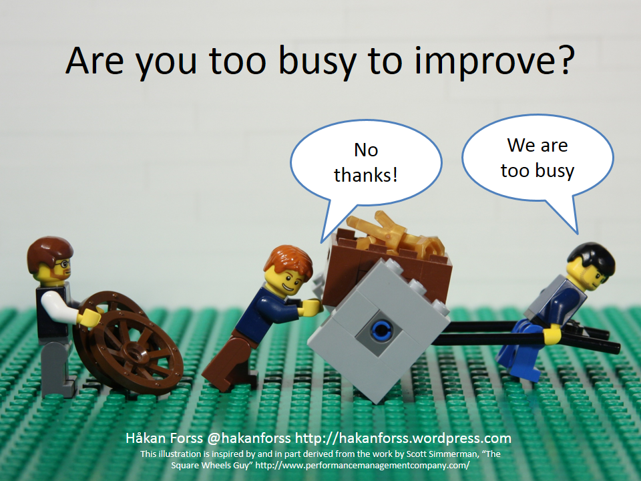
Layered Architecture

Slide 5
Layered Architecture
UII
Service Layer
Domain Layer
Data Layer (ORM)I

Slide 6
Layered Architecture
Store State
Lose Intent
Single data-centric model
Collaboration
Scalability
Caching/Stale data
DB optimised for writes
One architecture to rule them all
Is some functionality more important?

Slide 7
CQRS
Command Query Responsibility Segregation
Write model != Read model
Task-based UI
not CRUD
Express intent
Greg Young and Udi Dahan

Slide 8
CQRS - Simple
UII
Query
Command
Service Layer
Service Layer
Thin Data Layer
Domain Layer
Data Layer (ORM)I

Slide 9
CQRS – Different Datastores
UII
Query
Command
Service Layer
Service Layer
Thin Data Layer
Domain Layer
Data Layer (ORM)I
Optimised for reads
Optimised for writes

Slide 10
CQRS – Alternate
UII
Query
Command
Service Layer
Service Layer
Thin Data Layer
Domain Layer
Data Layer
Optimised for reads
Optimised for writes

Slide 11
CQRS – Eventual Consistency
UII
Query
Command
Service Layer
Service Layer
Thin Data Layer
Domain Layer
Queue or Bus
Optimised for reads
Optimised for writes

Slide 12
Event Sourcing
Explicitly store what happened
CustomerAddressChangedEvent
Audit Trail
Banking & Accountancy
Rebuild objects by replaying Events
Conceptually, first to last
Shapshots

Slide 13
Event Sourcing
UII
Query
Command
Service Layer
Service Layer
Thin Data Layer
Domain Layer
Denormaliser

Slide 14
Domain Driven Design
Analytical
Ubiquitous Language
Bounded Context
Context Mapping
Strategic
Entities, Value Objects, Repositories etc.

Slide 15
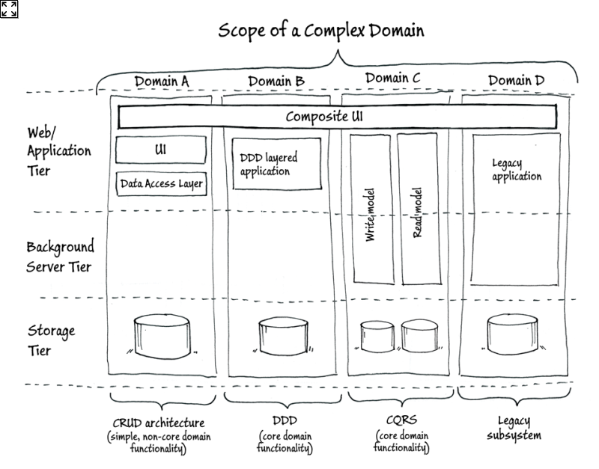
Domain Driven Design
Image by Cesar de la Torre

Slide 16
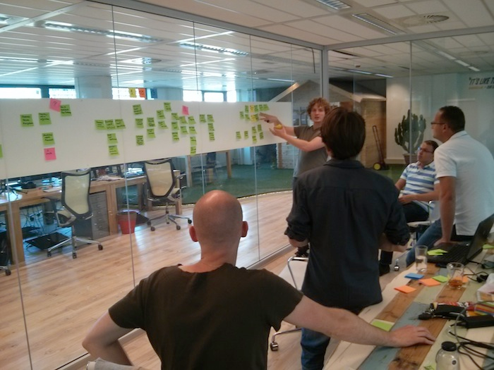
Domain Modelling
Ubiquitous Language
Domain Experts
Event Storming
Domain Events
Commands

Slide 17
Summary
Layered Architecture
Problems with intent, collaboration and scalability
CQRS
Write model != Read model
Task-based UI
Event Sourcing
Store intent and snapshots
Domain Driven Design
Bounded Context, Ubiquitous Language and Context Mapping

Slide 18
Resources
Architecting Applications for the Enterprise
2nd Edition (Microsoft Books)
CQRS Journey
https://msdn.microsoft.com/en-us/library/jj554200.aspx
CQRS
https://leanpub.com/cqrs
Domain Driven Design -> the ‘blue book’
Udi Dahan
Greg Young

Slide 19
Questions?

Slide 20
Thank you
Ian Russell
@ijrussell

