Slide 1


Why you should write functional C#
Ian Russell
Twitter: @ijrussell

Slide 2
Agenda
Introduction to Functional Programming
OOP vs FP
Dive into code samples

Slide 3
Introduction
History
LINQ (2008 C# 3.0)
Functions
Treated as first-class citizen
Pure -> Referential Transparency
Higher-order
Composition
Expressions > Statements
Immutability

Slide 4
OOP vs FP
Object-Oriented
State and behavior together
Imperative code in classes
Functional Programming
Clear separation between data and behaviour
Functions acting on data structures in a pipeline

Slide 5
OOP vs FP
“OOP makes code understandable by encapsulating moving parts. FP makes code understandable by minimizing moving parts”
– Michael Feathers

Slide 6
Let’s look at some code
C# & F#
Composition
Immutability
Pattern matching
Tuples
Nulls/Missing data
Success/Exceptions/Validation

Slide 7
Summary
Pure functions
Higher-order functions
Function composition
Immutability
Pattern matching
Tuples
Option<T>
Result<TSuccess, TError>

Slide 8
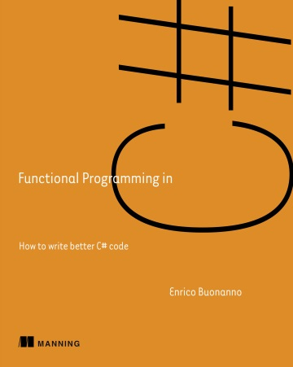
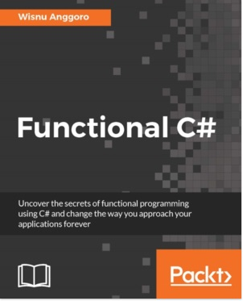
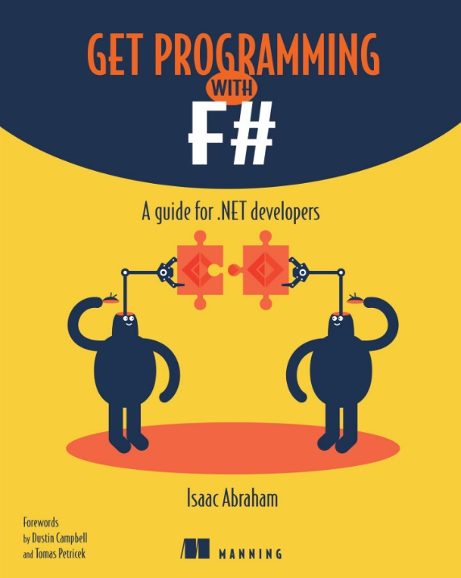
Resources

Slide 9
Thank you
Ian Russell
Twitter: @ijrussell

