Slide 1

Outside-In TDD
Ian Russell
Twitter: @ijrussell

Slide 2
Agenda
Testing 101
Outside-In vs Inside-Out
Dive into some code

Slide 3
Introduction – Test Structure
Four phase tests
Setup
Exercise SUT
Verification
Teardown

Slide 4
Introduction – Acceptance Tests
End-to-end
Only the test code you own

Slide 5
Introduction – Integration Tests
Test your adaptors
Third-party services
Verify nothing has changed

Slide 6
Introduction – Unit Tests
FIRST
Fast
Isolated (Independent)
Repeatable
Self-Validating
Timely

Slide 7
Introduction – Unit Tests
Arrange – Act – Assert
One logical Assertion per test
Treat test code with respect
Test names are important
As small as possible

Slide 8
Introduction - Mocking
“Mock objects are simulated objects that mimic the behaviour of real objects in controlled ways.” - Wikipedia
Mock
Verify behavior against mock
Stub
Return known data

Slide 9
Outside-In - History
London XP community
2000 – Initial ideas
2006 – Initial paper
2006 – JMock
2010 – GOOS book

Slide 10
Outside-In vs Inside-Out
Outside-In
Validate behaviour
Mockist
CQS -> Tell, don’t ask
Inside-Out
Verify state
Triangulation

Slide 11
Outside-In – Walking Skeleton
"an implementation of the thinnest possible slice of REAL FUNCTIONALITY that we can automatically build, deploy, and test end-to-end“
Growing Object-Oriented Software, Guided by Tests –
Steve Freeman & Nat Pryce [2010]

Slide 12
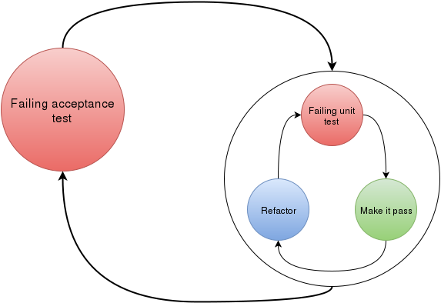
Outside-In - Overview
https://blog.novoda.com/approaching-tdd-outside-in-on-android-i/

Slide 13
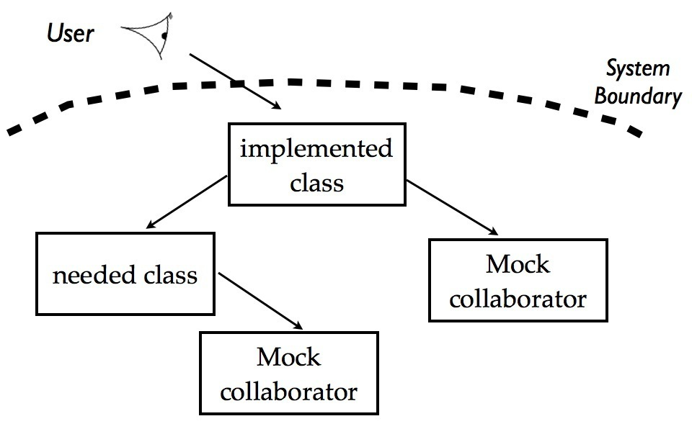
Outside-In - Process
http://coding-is-like-cooking.info/2013/04/outside-in-development-with-double-loop-tdd/

Slide 14
Outside-In – Let’s look at code

Slide 15
Outside-In - Summary
Find collaborators
Verify interactions using mocks
TDD all the way
Design at each stage
Acceptance test will fail for a while

Slide 16
Resources
Growing Object-Oriented Software, Guided by Tests –
Steve Freeman & Nat Pryce [2010]
https://app.pluralsight.com/library/courses/outside-in-tdd/table-of-contents
Mark Seemann

Slide 17
Thank you
Ian Russell
Twitter: @ijrussell

