Slide 1

Outside-In TDD
Ian Russell
Twitter: @ijrussell

Slide 2
Agenda
Introduction to Testing
Outside-In vs Inside-Out
Dive in to a problem

Slide 3
Introduction – Acceptance Tests
End-to-end
Four phase tests
Fixture Setup
Exercise SUT
Result Verification
Fixture Teardown

Slide 4
Introduction – Unit Tests
FIRST
Fast
Isolated (Independent)
Repeatable
Self-Validating
Timely

Slide 5
Introduction – Unit Tests
Arrange – Act – Assert
One logical Assertion per test
Treat test code with respect

Slide 6
Introduction - Mocking
“Mock objects are simulated objects that mimic the behaviour of real objects in controlled ways.” - Wikipedia
Mock
Verify behavior against mock
Stub
Return known data

Slide 7
Outside-In vs Inside-Out
Outside-In
Validate behaviour
Mockist
Tell, don’t ask
Inside-Out
Verify state
Triangulation

Slide 8
Outside-In – Walking Skeleton
"an implementation of the thinnest possible slice of REAL FUNCTIONALITY that we can automatically build, deploy, and test end-to-end“
Growing Object-Oriented Software, Guided by Tests –
Steve Freeman & Nat Pryce [2010]

Slide 9
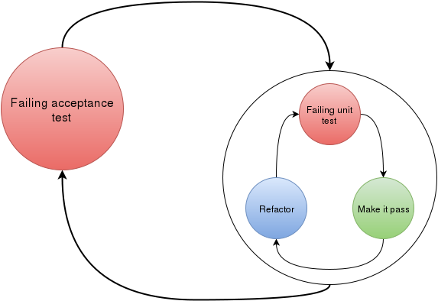
Outside-In - Overview
https://blog.novoda.com/approaching-tdd-outside-in-on-android-i/

Slide 10
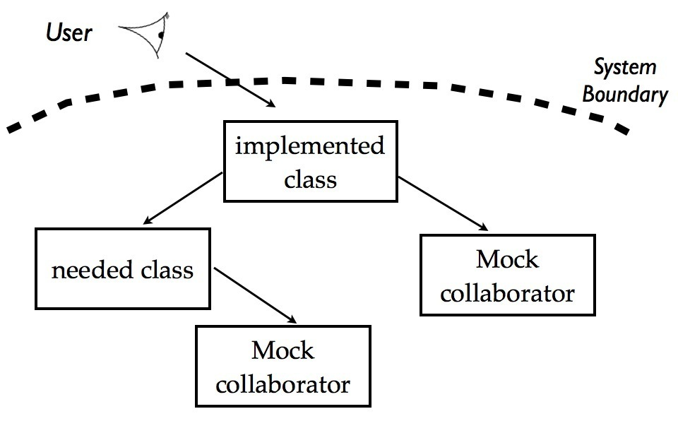
Outside-In - Process
http://coding-is-like-cooking.info/2013/04/outside-in-development-with-double-loop-tdd/

Slide 11
Outside-In – Some code

Slide 12
Outside-In - Summary
Find collaborators
Verify interactions
TDD all the way
Design at each stage
Acceptance Test will fail for a while

Slide 13
Resources
Growing Object-Oriented Software, Guided by Tests –
Steve Freeman & Nat Pryce [2010]
https://app.pluralsight.com/library/courses/outside-in-tdd/table-of-contents
Mark Seemann

Slide 14
Thank you
Ian Russell
Twitter: @ijrussell

