Slide 1

Strategic Domain-Driven Design
Ian Russell
@ijrussell

Slide 2
Agenda
Overview of Domain-Driven Design (DDD)
What is Strategic DDD?
What’s happened in the last 15 years?
Final Thoughts/Guidance

Slide 3

Waterfall
https://www.roberthalf.com/blog/salaries-and-skills/waterfall-methodology-101-the-pros-and-cons

Slide 4
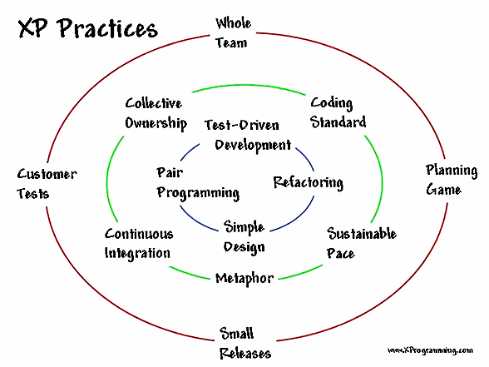
Agile

Slide 5
Domain-Driven Design
The Blue Book written by Eric Evans 2004
Tackling complexity in the heart of software
Strategic vs Tactical
  Build the right thing
  Build the thing right

Slide 6
Guiding Principles of DDD
Focus on the core domain.
Explore models in a creative collaboration of domain practitioners and software practitioners.
Speak a ubiquitous language within an explicitly bounded context

Slide 7
What is Strategic DDD?
Shared model of understanding
Transform the problem space into a useful solution space
Discover the important parts of the problem space

Slide 8
Types of Subdomains
Core
Supporting
Generic

Slide 9
Domain Modelling
Problem Space
Solution Space
Sales
Stock
Sales
Stock
Delivery
Billing
Billing
Delivery
Design Process
Domain Model
Real World

Slide 10
Bounded Context & Ubiquitous Language
Solution Space
Product
Sales
Stock
Customer
Billing
Delivery

Slide 11
Finding Core Domain(s)
Business Model Canvas
Mission Statement
“Our vision is to be earth's most customer-centric company; to build a place where people can come to find and discover anything they might want to buy online.”

Slide 12
Context Map
Solution Space
Sales
Stock
Billing
Delivery

Slide 13
Relationship Types
Shared Kernel
Anti-Corruption Layer
Customer - Supplier

Slide 14
Shared Kernel
Context 1
Context 2

Slide 15
Anti-Corruption Layer
Context 1
Context 2

Slide 16
Customer - Supplier
Context 1
Context 2

Slide 17
Summary of Strategic DDD
Problem space to Solution space
Subdomains (Core, Supporting & Generic)
Ubiquitous Language/Bounded Context
Context Map
  Shared Kernel
  Anti-Corruption Layer
  Customer - Supplier

Slide 18
Guiding Principles of DDD
Focus on the core domain.
Explore models in a creative collaboration of domain practitioners and software practitioners.
Speak a ubiquitous language within an explicitly bounded context

Slide 19
The Next 15 Years
Heuristics
Behaviour Driven Design
User Story Mapping
Event Storming
CQRS & Event Sourcing

Slide 20
Heuristics
“A heuristic technique, often called simply a heuristic, is any approach to problem solving or self-discovery that employs a practical method, not guaranteed to be optimal, perfect, logical, or rational, but instead sufficient for reaching an immediate goal.” - Wikipedia

Slide 21
Heuristics

Slide 22
Heuristics

Slide 23
Heuristics
Linguistic
Data
Domain Expert
Existing Organisational Boundaries
Business Process Steps

Slide 24
Behaviour Driven Design
Features
Scenarios
  Given-When-Then
Acceptance Criteria
Written in collaboration with Domain Experts
Uses Ubiquitous Language

Slide 25
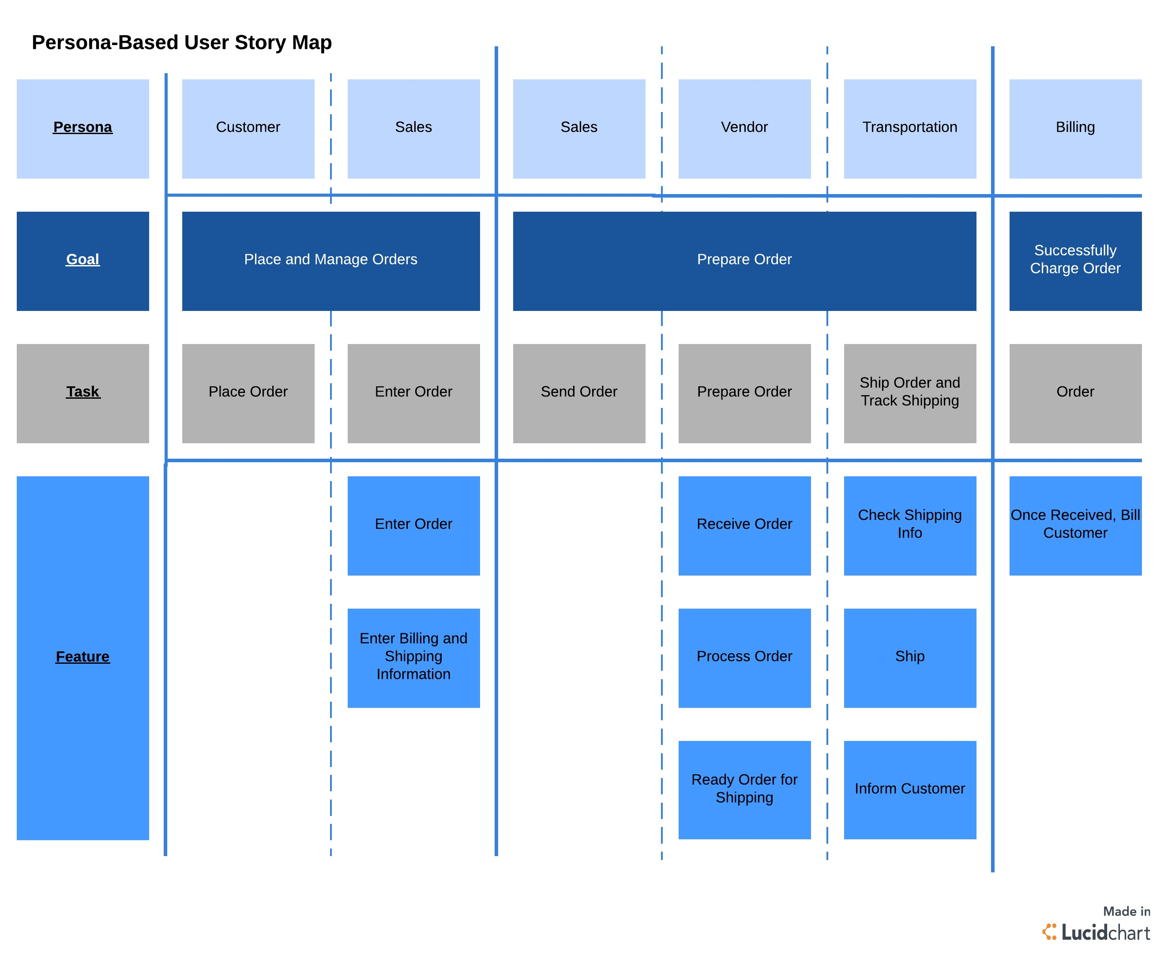
User Story Mapping
https://www.lucidchart.com/blog/how-to-create-a-user-story-map

Slide 26
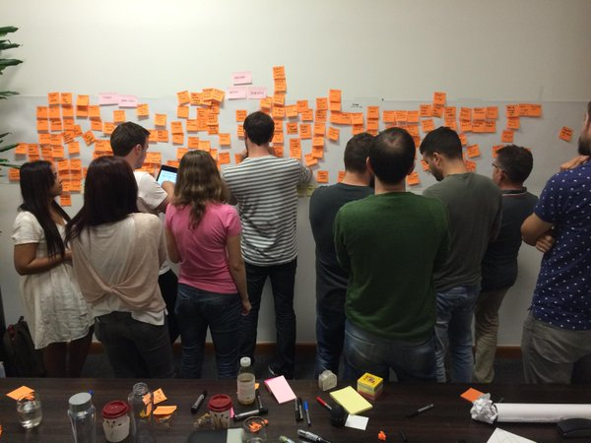
Event Storming
https://pbs.twimg.com/media/CJi5-W7UcAAEpMF.jpg

Slide 27
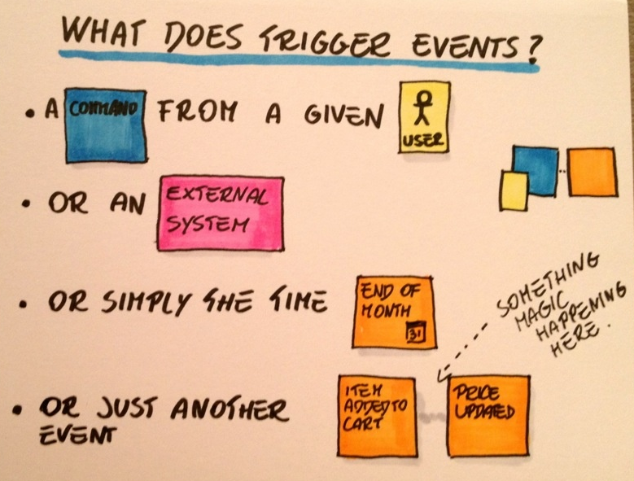
Domain Events
Alberto Brandolini (https://www.slideshare.net/ziobrando/event-storming-recipes)

Slide 28
Event Storming Rules (1)
Invite a range of Domain Experts
Remove chairs
Put a long roll of paper on a wall
Have too many post-it notes and pens
Have a visible legend
Create an atmosphere of exploration
Record everything on the paper
Don’t be afraid to move stuff around or remove

Slide 29
Event Storming Rules (2)
Focus on Domain Events first
Discover source(s) of the event
Investigate who’s interested in the event
Start looking for Bounded Contexts
Discover/use Ubiquitous Language
Concentrate on core domain & complexity
Discover missing concepts

Slide 30
Event Storming Tips
You need lots of wall space, post-it notes & pens.
Must have REAL Domain Experts
Experiment. Move stuff around. Discuss.
Concentrate on core areas first
Don’t mention technical patterns/terminology
Use Big Picture and Deep Dive sessions

Slide 31
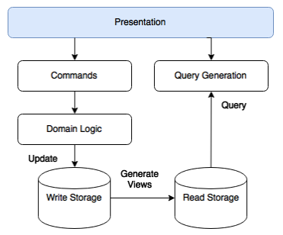
CQRS
http://sensetecnic.com/cqrs-and-event-sourcing-for-the-iot/

Slide 32
Event Sourcing
Store Domain Events
Immutable
Versioning schema
Playback/Log/Recovery
Snapshot
Projection

Slide 33
I Strongly Suggest …
Focus on the core domain(s)
Explicit context boundaries > perfect models
Exploration and experimentation (1st useful model may not be the best)
Creative collaboration of domain experts and software experts
Emerging models shape and reshape the shared understanding

Slide 34
Guiding Principles of DDD
Focus on the core domain.
Explore models in a creative collaboration of domain practitioners and software practitioners.
Speak a ubiquitous language within an explicitly bounded context

Slide 35
Books
Domain-Driven Design
  Eric Evans
Implementing Domain-Driven Design
  Vaughn Vernon
DDD: The First Fifteen Years
  The DDD Community
Event Storming
  Alberto Brandolini

Slide 36
Questions
Ian Russell
@ijrussell

Slide 37
Thanks
Ian Russell
@ijrussell

