Slide 1

Surviving Legacy Code
Ian Russell
@ijrussell
Notes:
Or just hot air?

Slide 2

About me
Software Developer for over 20 years
Active Software Craftsmanship member

Slide 3
Agenda
Introduction
Introducing the problem
The 4 Rules of Simple Design
Solving the problem(?)

Slide 4
Introduction
What is Legacy Code?

Slide 5
The Problem
https://github.com/jbrains/trivia

Slide 6
The 4 Rules of Simple Design
Tests Pass
Expresses Intent
Remove Duplication (DRY)
Small

Slide 7
The 4 Rules of Simple Design
Passes its tests
Minimizes duplication
Reveals intent
Has fewer elements

Slide 8
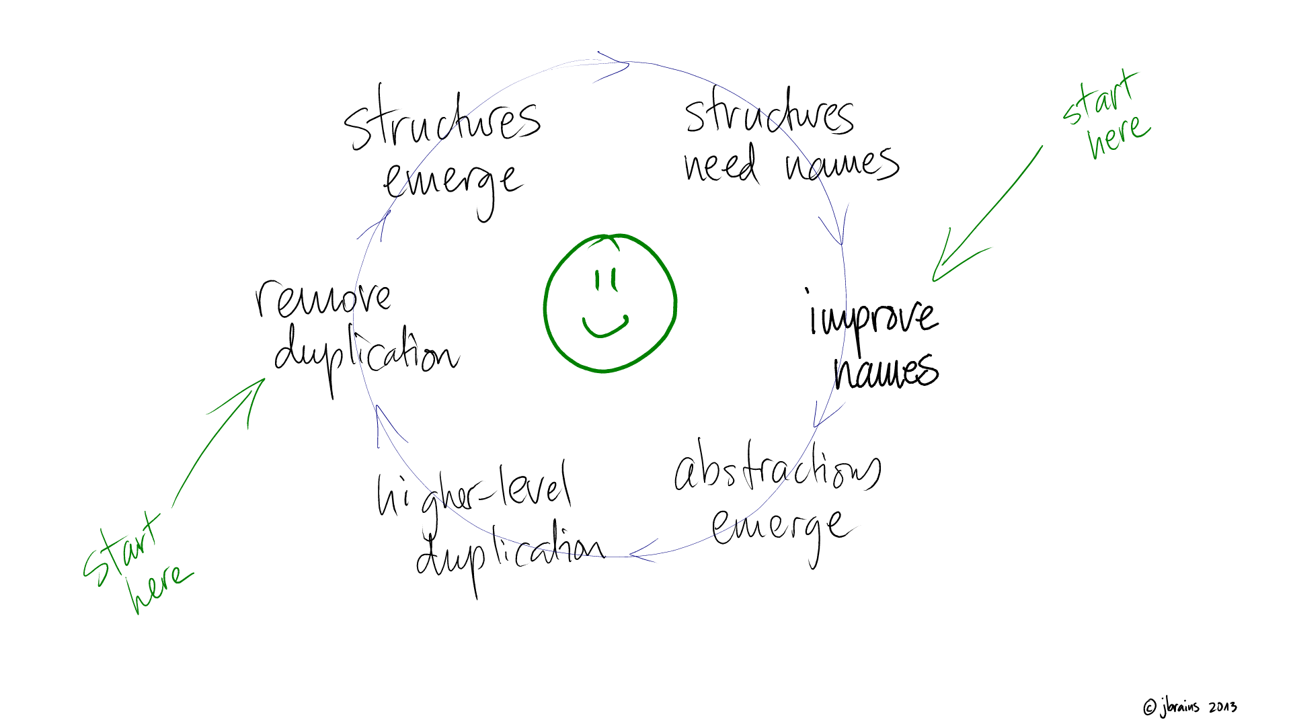
The 4 Rules of Simple Design

Slide 9
Writing Tests
Known inputs => expected output
Golden Master
Characterisation Tests

Slide 10
Refactoring
Refactoring is changing the structure of the code without changing the behaviour.
Refactoring without tests is just hacking
"Don't write code that guesses the future, arrange code so that you can adapt to the future when it arrives." - Sandi Metz

Slide 11
Refactoring
Use the 4 Rules of Simple Design

Slide 12
Summary
Write tests around existing code
Golden Master
Characterisation Tests
Follow the 4 Rules of Simple Design

Slide 13
Resources
Working Effectively With Legacy Code
Michael Feathers
Understanding the 4 Rules of Simple Design
Corey Haines
Beyond Legacy Code
David Scott Bernstein
http://blog.thecodewhisperer.com/

Slide 14
Code Retreat
Global Day of Code Retreat
http://globalday.coderetreat.org/
Saturday 14th November
Venues around the world
Free
Lunch provided

Slide 15
Thank you
Ian Russell
@ijrussell

