Slide 1
Extreme Programming
Ian Russell
@ijrussell
Notes:
Or just hot air?

Slide 2
Agenda
History of XP
Values and Practices in 1999
What changed in 2004
Modern XP

Slide 3
The Agile Manifesto
We're uncovering better ways of developing software by doing it and helping others do it. Through this work we have come to value:
Individuals and interactions over processes and tools.
Working software over comprehensive documentation.
Customer collaboration over contract negotiation.
Responding to change over following a plan.
That is, while there's value in the items on the right-hand side, we value the items on the left-hand side more.
Source: http://www.agilemanifesto.org/

Slide 4
Where did XP start?
"my goal in laying out the project style was to take everything I know to be valuable about software engineering and turn the dials to 10."
Chrysler C3 Project - Kent Beck

Slide 5
What is XP?
"Extreme Programming (XP) was conceived and developed to address the specific needs of software development conducted by small teams in the face of vague and changing requirements."
Extreme Programming Explained – Kent Beck

Slide 6
XP Values (1999)
Communication
Simplicity
Feedback
Courage

Slide 7
Communication
Sharing knowledge and understanding
Helps prevent mistakes, misunderstandings and omissions

Slide 8
Simplicity
The simplest thing that could possibly work
Don’t guess the future
Simple code easier to adapt to future requirements

Slide 9
Feedback
Current progress
Features complete (value)
Quality of system
Passing tests
Sustained velocity

Slide 10
Courage
Do the simplest thing that works
Improve code/design with confidence

Slide 11
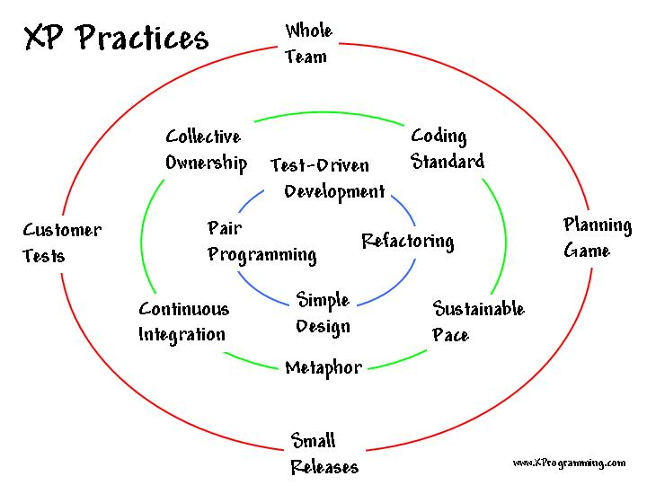
XP Practices (1999)

Slide 12
Whole Team
Sit together with the customer
Multi-skilled generalists
Specialists?

Slide 13
Planning Game
Release planning
Rough estimates/priorities
Plan revised regularly
Iteration planning
2 weeks iterations
Stories broken down into tasks and estimated
Done/Not Done

Slide 14
Customer Tests
Automated acceptance tests
Tests must always pass
Tests are code

Slide 15
Small Releases
Deliver real value every iteration
Working
Tested
Visible
Release often = reduced drama

Slide 16
Simple Design
Four rules of simple design
Design suits current functionality
Continual Design
Planning
Coding

Slide 17
Pair Programming
Two heads are better than one
Better code
Better design
Better tests
Swap partners regularly
Knowledge, skills and teamwork improve

Slide 18
Test-Driven Development
Fast feedback
Red, Green, Refactor
Tests are run all the time
Refactoring without tests is very bad

Slide 19
Design Improvement
Refactoring
Not improving will slow progress later
You must have tests to safely refactor

Slide 20
Continuous Integration
Regularly integrate code with master
Long gaps between integration is very bad
Merge Hell is a real place

Slide 21
Collective Code Ownership
Increase Bus numbers
Shared knowledge

Slide 22
Coding Standards
Have standards and stick to them

Slide 23
Sustainable Pace
Ideal dev day < one normal day
Work sensible hours
Lots of overtime will result in lower quality code

Slide 24
Metaphor
Common vision of how the system works

Slide 25
XP Practices Summary (1999)

Slide 26
XP Roles
Team Member
Customer
Coach

Slide 27
Team Member
Estimate work
Usually a generalist with special skills

Slide 28
Customer
Domain expert
Provides requirements
Sets priorities
Steers the project

Slide 29
Coach
Keep team on track
Facilitates the process

Slide 30
Adopting XP
Pick your worst problem.
Solve it the XP way.
When it’s no longer your worst problem, repeat.
Extreme Programming Explained – Kent Beck

Slide 31
XP (2004)
Added ‘Respect’ as a Value
New Practices
10-minute build
Sit Together
Informative Workspace
13 Primary and 11 Corollary Practices

Slide 32
Post 2004
XP is going strong in London
Software Craftsmanship
Scrum
Flaccid Scrum/Scrum by the book
Scrum + XP = ☺

Slide 33
Modern XP
Turning the dials up to 11

Slide 34
Mob Programming
3 or more people and 1 keyboard
6 people + big screen is popular
Quickly spread knowledge
2 minds good, more minds better!

Slide 35
Continuous Deployment
Deploy to production many times per day
10 minute deploy

Slide 36
Collective Product Ownership
If you deploy often, you need to own the product
Planning, coding and deployment

Slide 37
Hypotheses
Help planning by validating assumptions
Focus on what to learn and build

Slide 38
Monitoring-First Programming
Think about how you would monitor code in production before writing it

Slide 39
Continuous Learning
20% time to focus on improving
Team member rotations
Dev exchanges
Meetups and conferences

Slide 40
Modern XP Summary
This is the future!

Slide 41
Summary
History of XP
Values and Practices
Modern XP

Slide 42
Resources
Extreme Programming Explained – Kent Beck
http://rachelcdavies.github.io/archive/
http://ronjeffries.com/
http://benjiweber.co.uk/blog/posts/xp/

Slide 43
Thank You
Ian Russell
@ijrussell

