Slide 1

AML-2103 Visualization for AI and ML
Lambton College
School of Computer Studies
[Prepared By: Vahid Hadavi, PhD]

Slide 2
Lecture8 8. Explore Business Intelligence Platform for visualization
Major Topics:
8.1 Describe analytical platforms such as Tableau
8.2 Use Tableau to load data from various sources
8.3 Produce business Intelligent (BI) dashboard done in Tableau

Slide 3
8.1 Describe analytical platforms such as Tableau

Slide 4
Tableau overview
Tableau is the fastest growing data visualization tool used in the Business Intelligence Industry.
It helps in simplifying raw data into the very easily understandable format.
Tableau was founded by Pat Hanrahan, Christian Chabot, and Chris Stolte from Stanford University in 2003.
The main idea behind its creation is to make the database industry interactive and comprehensive.
Data analysis is very fast with Tableau and the visualizations created are in the form of dashboards and worksheets.
The data that is created using Tableau can be understood by professional at any level in an organization.
The great thing about Tableau software is that it doesn't require any technical or any kind of programming skills to operate.

Slide 5
Tableau products
The Tableau Product Suite consists of:
Tableau Desktop
Tableau Public
Tableau Online
Tableau Server
Tableau Reader

Slide 6
Tableau classification
Data analytics in tableau can be classified into two section:
Developer Tools: The Tableau tools that are used for development such as the creation of dashboards, charts, report generation, visualization fall into this category. The Tableau products, under this category, are the Tableau Desktop and the Tableau Public.
Sharing Tools: The purpose of the tool is sharing the visualizations, reports, dashboards that were created using the developer tools. Products that fall into this category are Tableau Online, Server, and Reader.

Slide 7
8.2 Use Tableau to load data from various sources

Slide 8
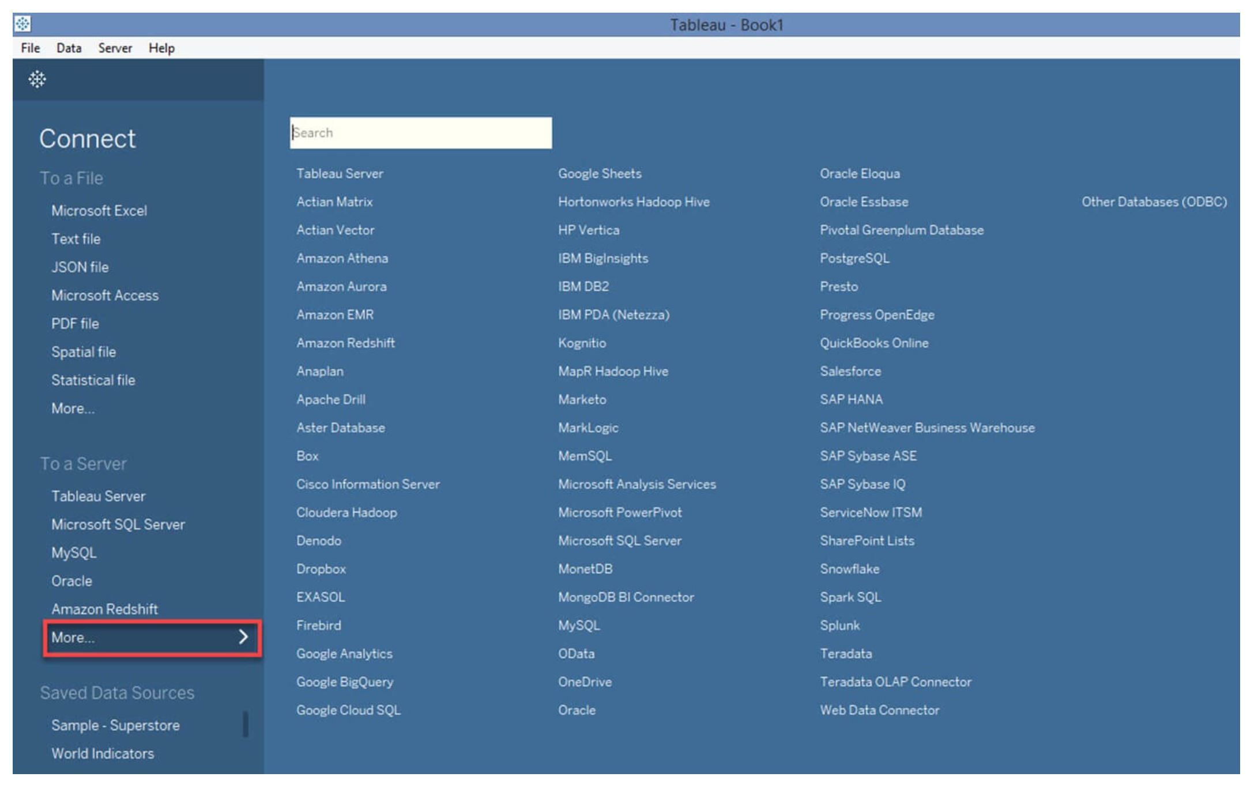
Tableau data sources
Tableau can connect to various types of data sources. It can connect to text files, excel files, PDF files, etc.
Tableau has the capability to connect to servers and web connectors.

Slide 9
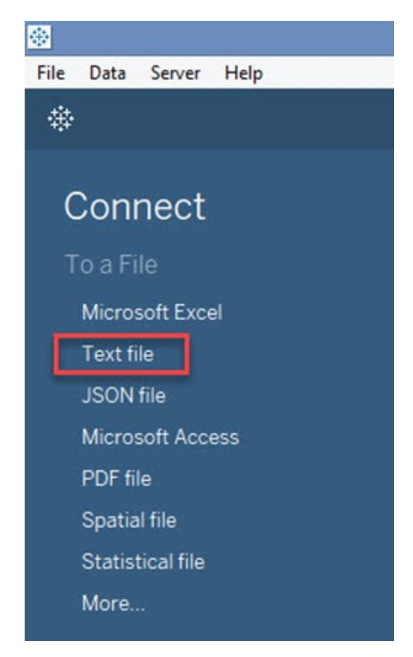
Tableau data sources; texts

Slide 10
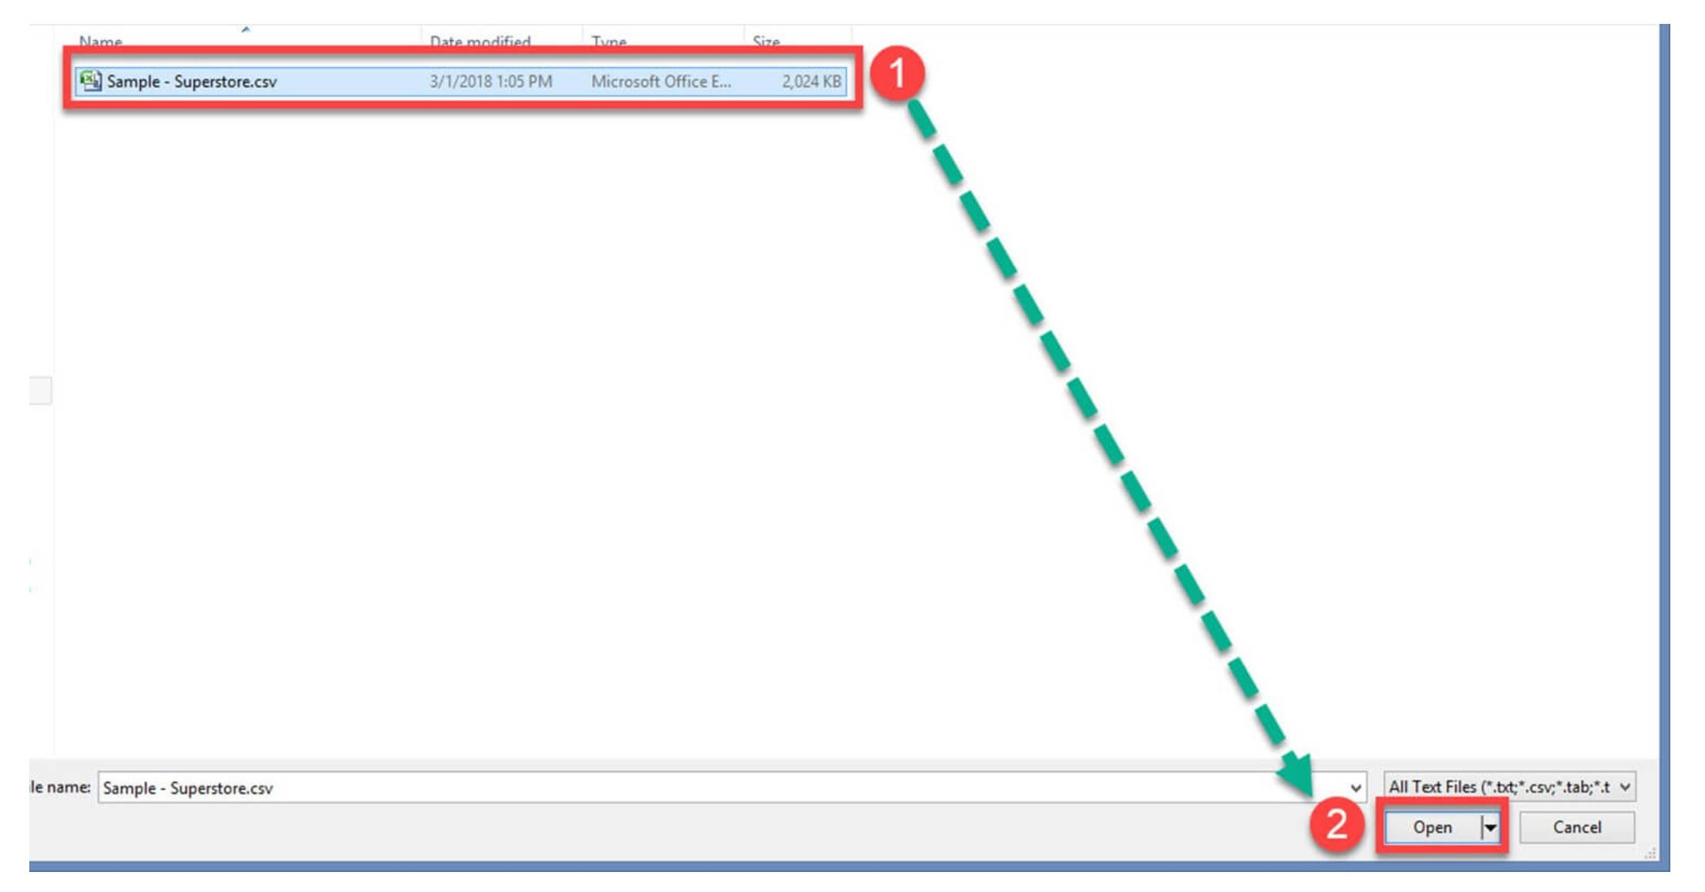
Tableau data sources; texts

Slide 11
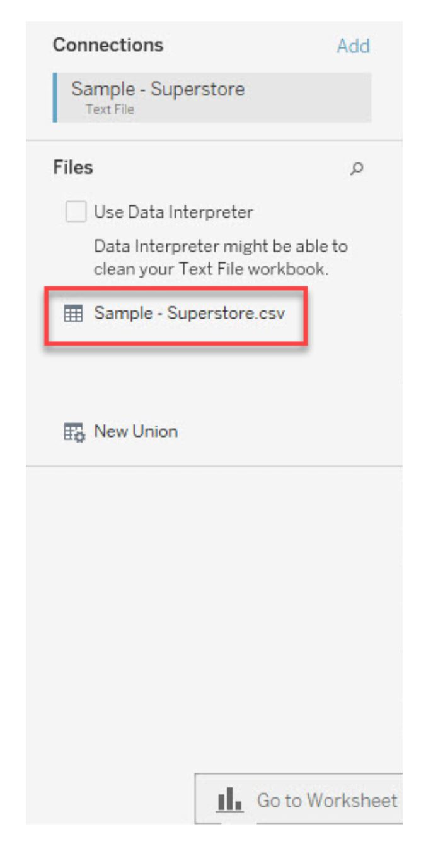
Tableau data sources; texts
In the connections pane we can see the connected csv file.

Slide 12
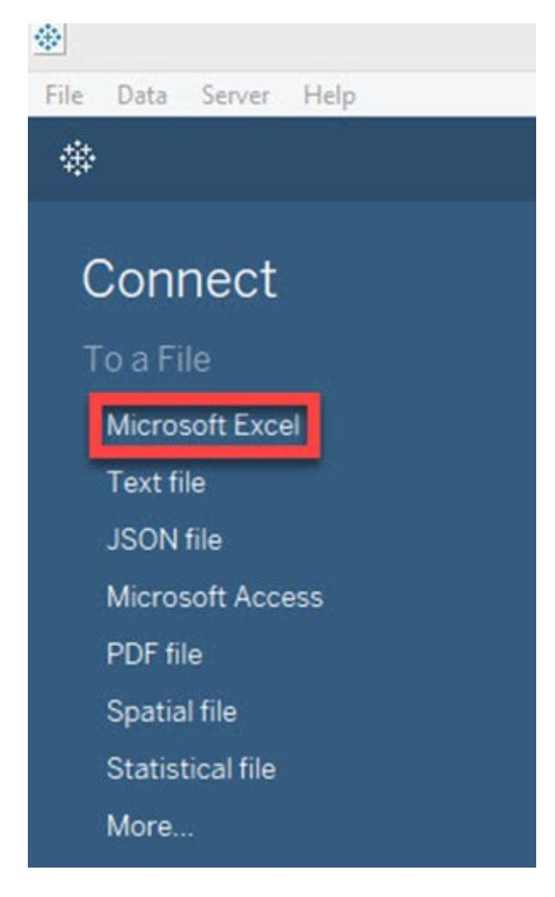
Tableau data sources; excel file

Slide 13
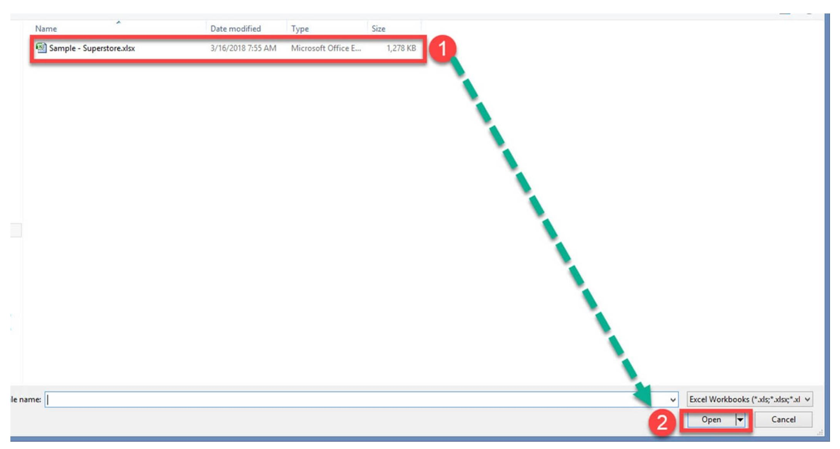
Tableau data sources; excel file

Slide 14
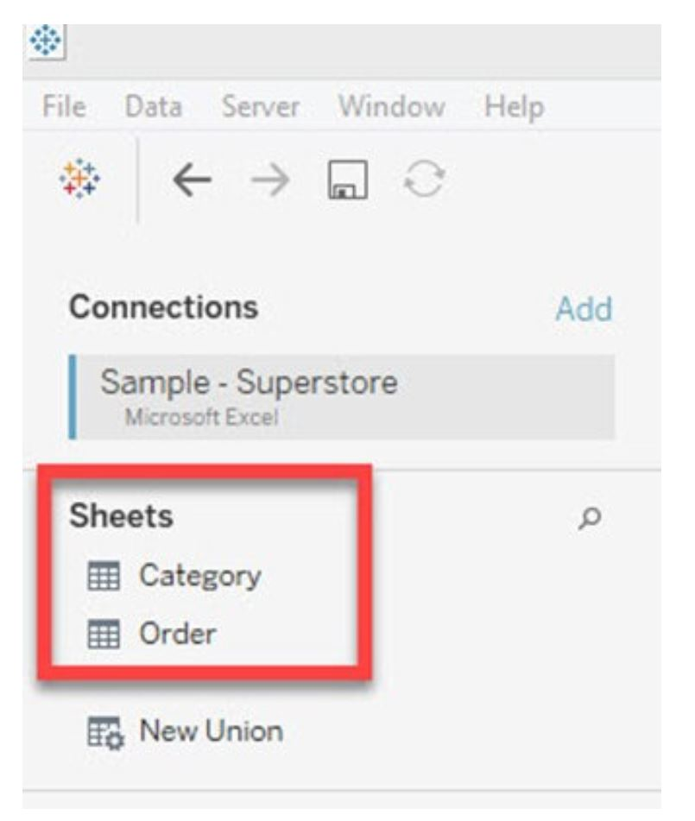
Tableau data sources; excel file
In the connections pane we can see the connected excel file and its sheets.

Slide 15
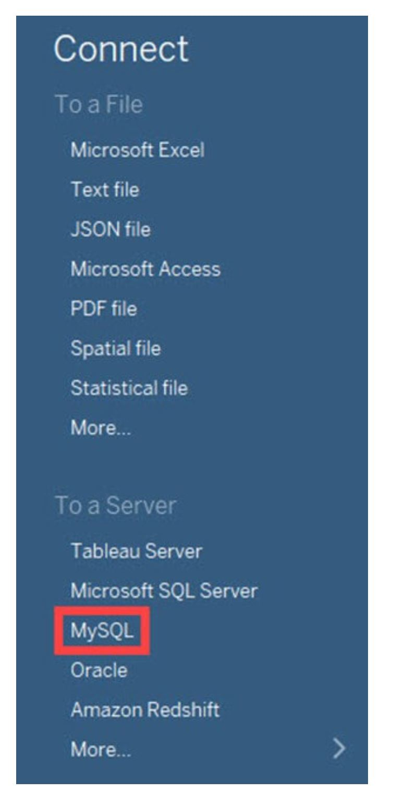
Tableau data sources; database
We need to provide the server, username and password to connect to the data base.

Slide 16
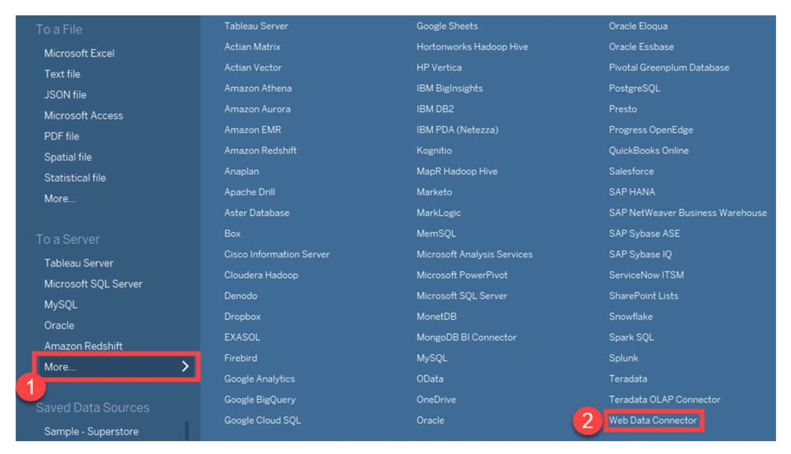
Tableau data sources; websites

Slide 17
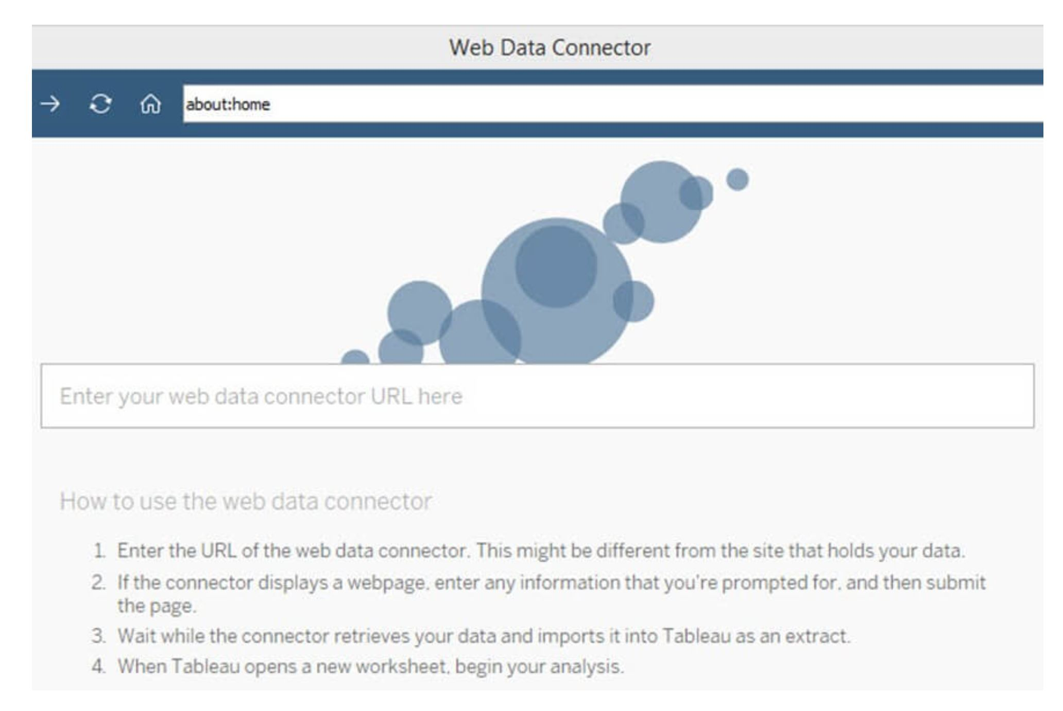
Tableau data sources; websites

Slide 18
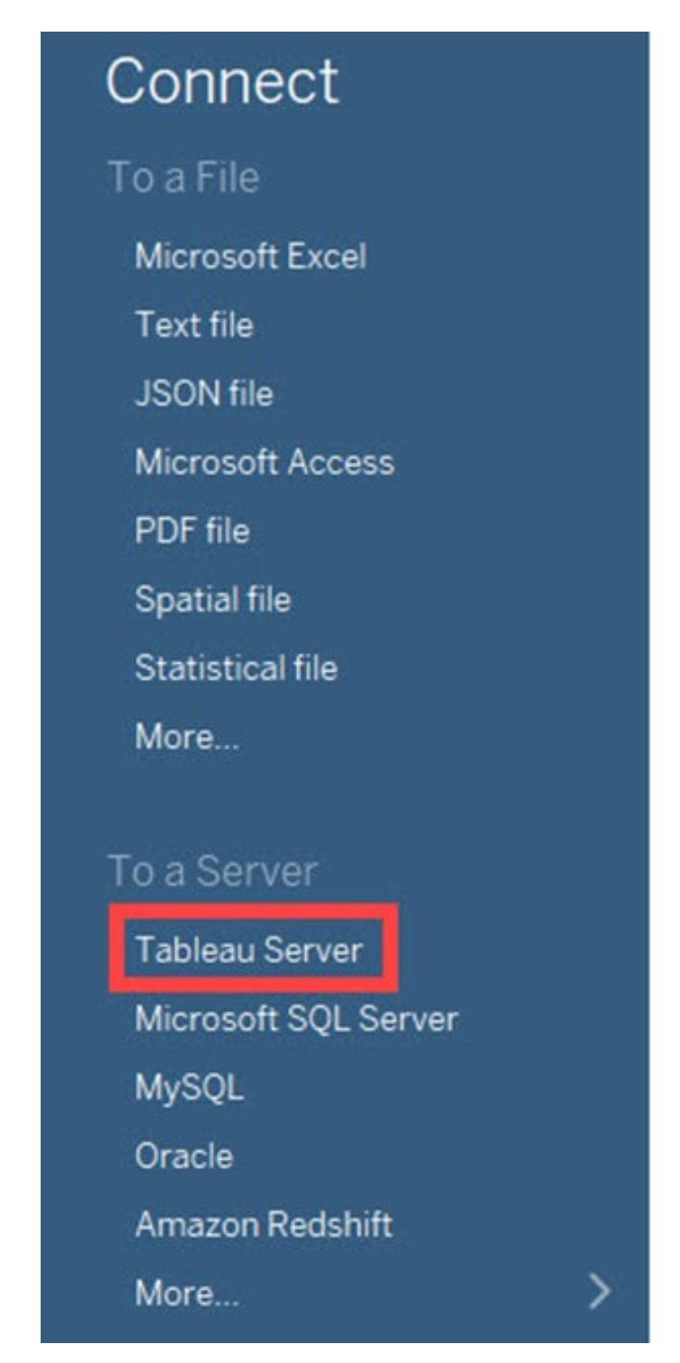
Tableau data sources; server
Tableau Server can store extracted data sources and database connections.
In enterprise level, it is important to keep all the required data connections in Tableau Server.
It helps all the users of the enterprise to connect to the data source easily.

Slide 19
8.3 Produce business Intelligent (BI) dashboard done in Tableau

Slide 20
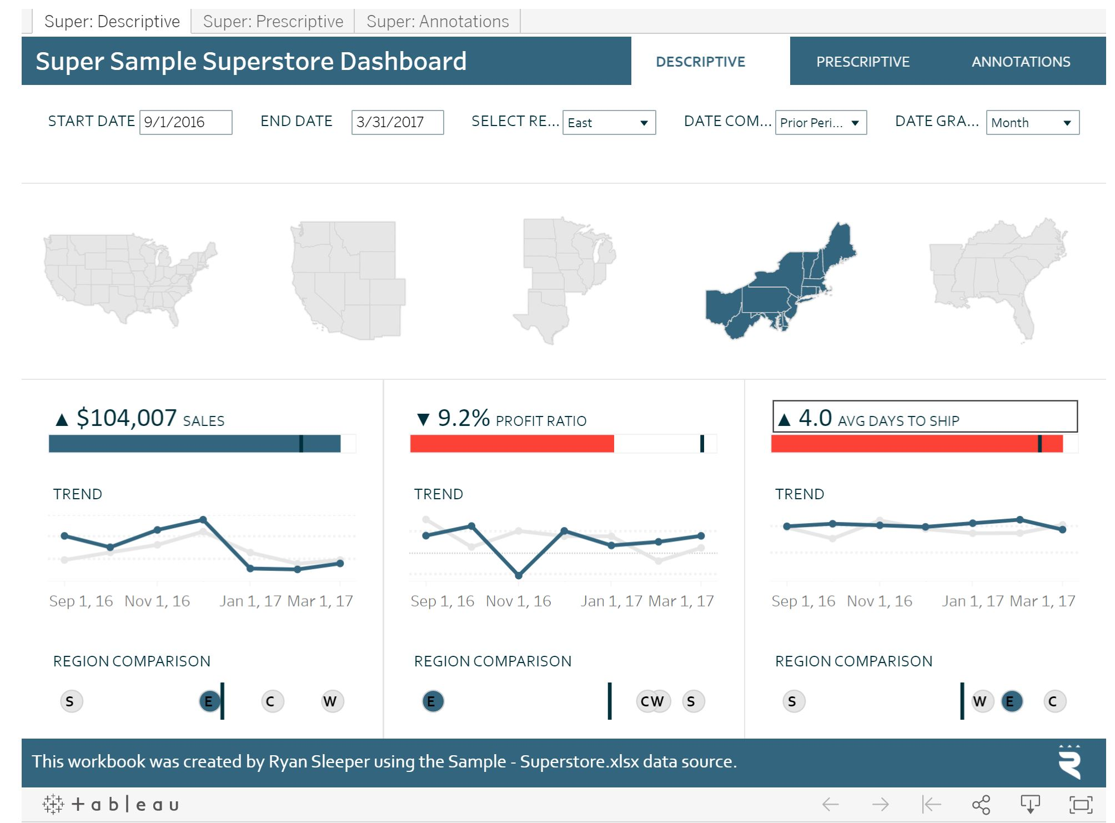
Super Sample Superstore Dashboard
Quickly spot increases or decreases in sales, profit ratio, and shipping time, and switch to the Prescriptive tab to pinpoint the root cause.

Slide 21
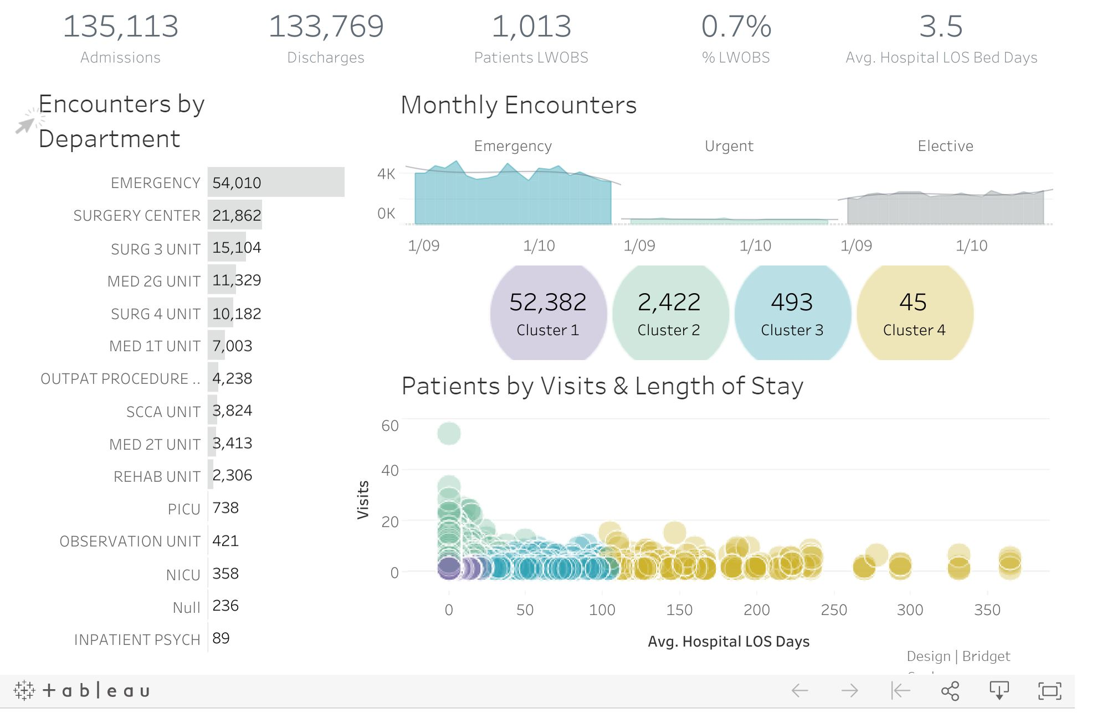
Healthcare dashboard
Explore patient demographics and trends by department.
This viz uses Tableau's clustering feature to uncover insights in hospital data, identifying frequent short-stay patients compared to extended-stay patients.

Slide 22
Any questions so far? Any comments?

