Slide 1

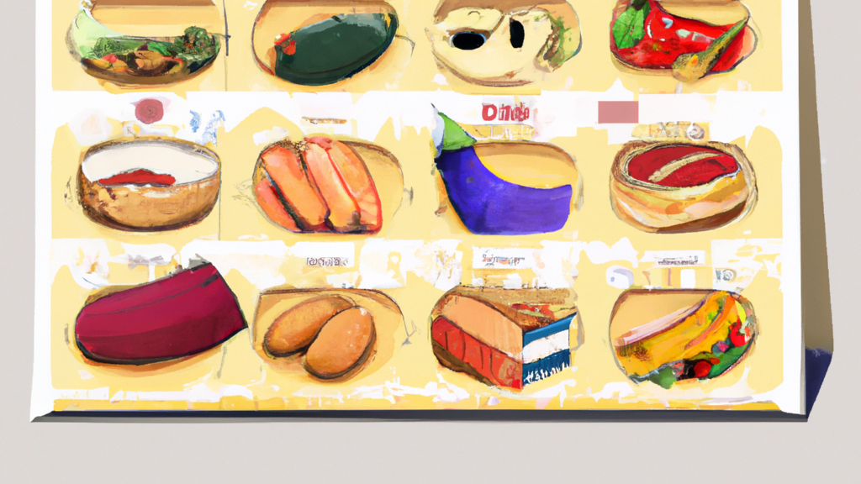
Notes:
Hey there, foodies and future Foodier enthusiasts!
Are you tired of spending precious time deciding simple daily tasks? what to eat? what to buy? keep track of calories? Are you eating healthy?
Allow me to introduce you to "Foodier" – your ultimate culinary companion that's going to change the way you eat, think, and live!

Slide 2

Simplifying Meal Planning
Problem: Daily struggle of deciding what to cook, prepare, and shop for.
Solution: AI-powered system that creates weekly meal plans and shopping lists tailored to your preferences and body type.
Objective: Save time, reduce decision fatigue, and promote healthier eating habits.
Motto: "Your Food, Your Rules, Your Time."
Notes:
Picture this: You wake up every morning, and there it is – a weekly meal plan curated just for you, based on your preferences, allergies, and nutritional requirements. No more wandering aimlessly through supermarket aisles, no more staring blankly into the fridge, and definitely no more food decision fatigue. Say goodbye to the endless cycle of "What's for dinner?" and embrace the freedom to focus on what truly matters.

Slide 3
How Foodier Works
Personalization: Provide body type, dietary preferences, and allergies.
AI algorithms learn from your feedback and adapt meal plans accordingly.
Recipes tailored to your unique tastes.
Convenience: Effortless meal planning and shopping.
Weekly meal plans generated for breakfast, lunch, and dinner.
Detailed shopping list for each recipe.
Health Focus: Nourish your body with balanced meals.
Nutritionally sound recipes to keep you energized and focused.
Promote a healthier lifestyle.
Notes:
With Foodier, it's all about YOU! Your food choices, your dietary rules, and your time – we respect and adapt to your lifestyle like your best foodie friend.
Foodier is not just about convenience; it's about nourishing your body and soul. Our recipes are curated for balanced nutrition and lip-smacking goodness.
Bored of the same old dishes? Get ready for a culinary adventure with Foodier's diverse and exciting recipes, tailor-made to surprise your taste buds.
Say hello to a more productive you! By removing the mental clutter of meal planning, Foodier lets you focus on your passions and pursuits.
Foodier is built to adapt and evolve. We keep exploring new technologies, like the latest API from Cohere, to make your experience even more delightful.

Slide 4


Architecture
LLM: Cohere
AI algorithms learn from your feedback and adapt meal plans accordingly.
Backend: FastAPI
Weekly meal plans are generated for breakfast, lunch, and dinner.
Frontend ReactJs:
Nutritionally sound recipes to keep you energized and focused.
Pipeline:
CI/CD Pipeline with Github Actions
Notes:
Now, let me take you behind the scenes! Our ingenious architecture utilizes cutting-edge AI technology from Cohere. We feed this powerful engine with your preferences, tastes, and dietary data, enabling it to create meal plans that are as unique as you are.
we've designed a user-friendly interface. Our FastAPI integration ensures lightning-fast performance and a seamless experience while accessing your personalized meal plans anytime, anywhere.

Slide 5
Challenges
Time Constraints: Transition from OpenAI to Cohere.
Cohere offered stability and faster results for the hackathon.
Fine-tuning AI Models:
Ensuring dietary restrictions and user information in recipes.
Constant Format:
Responses from the API vary from prompt to prompt. Cover different scenarios

Slide 6
Future work
Customization:
Offer more options for different meals
Keep track of favourite dishes and ones that were not that good
Portions: Provide the amount of ingredients for number of people
Offer pre-designed diets for different objectives
Partnership:
Work alongside food distributors and ship food directly to users.
Work with dieticians and doctors.

Slide 7
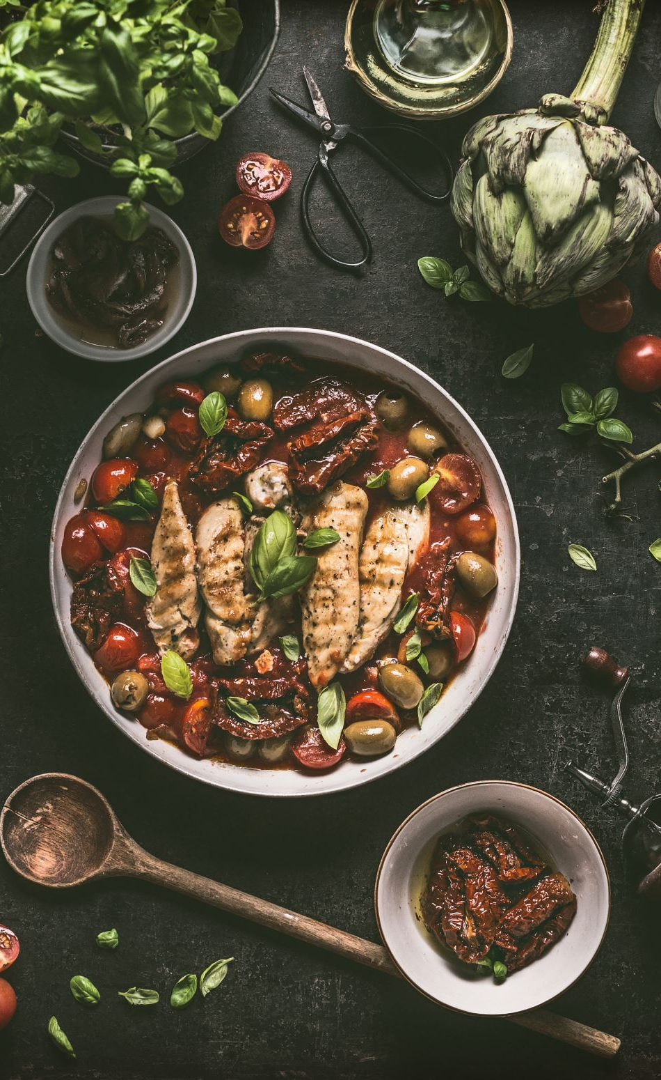
Early Adopters stories
"Foodier has changed my life! I'm eating better, feeling energized, and I can't wait to see what tasty surprises the next meal plan holds!"
"As a busy professional, Foodier is a game-changer. It takes the stress out of meal planning, giving me more time to focus on my career and passions."
"I never thought eating healthy could be so delicious and effortless! Foodier has made healthy eating a joy for me and my family."

