Slide 1
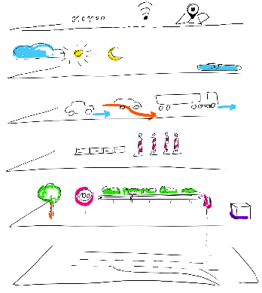
Layer 6 Data and communacation
Layer 5 Environment conditions
Layer 4 Movable objects
Layer 3 Temporal modifications
Layer 2 Traffic infrastructure
Layer 1 Street layer

