Slide 1
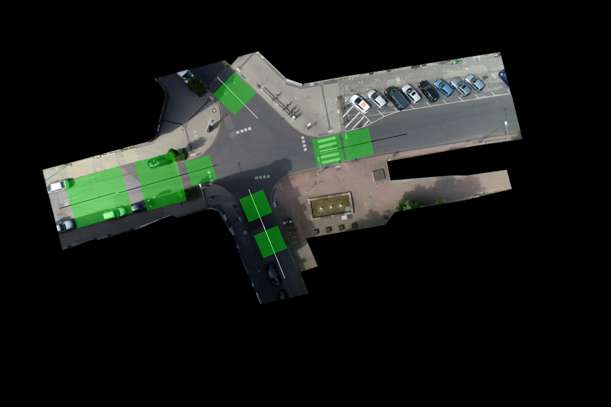
x
Image coordinate system
(0,0)
-y
y
x
(0,0)
y
x
y
-y
(0,0)
x
(0,0)
scene coordinate system

