Slide 1
Cp476 Final Project
Warehouse management System

Slide 2
Group Members
Faiq Ahmed
Ryan Jiffri
Abdirahman Yassin
Ismail Kabar

Slide 3
Project Objectives
Easily insert data into a database for cars and clients and ability to modify/see data at a glance.We will also be using an algorithm to calculate the size of a container for the car shipment. It will recommend a minimum container size depending on the length of vehicles shipped.

Slide 4
Main Features and Pages
Features include:
Log in (required to view other pages or use other features)
View Cars ,edit and delete cars.
View Clients ,insert Clients ,edit clients and delete Clients.
Calculator for minimum container size .
Search cars by vin,make,model or year.

Slide 5
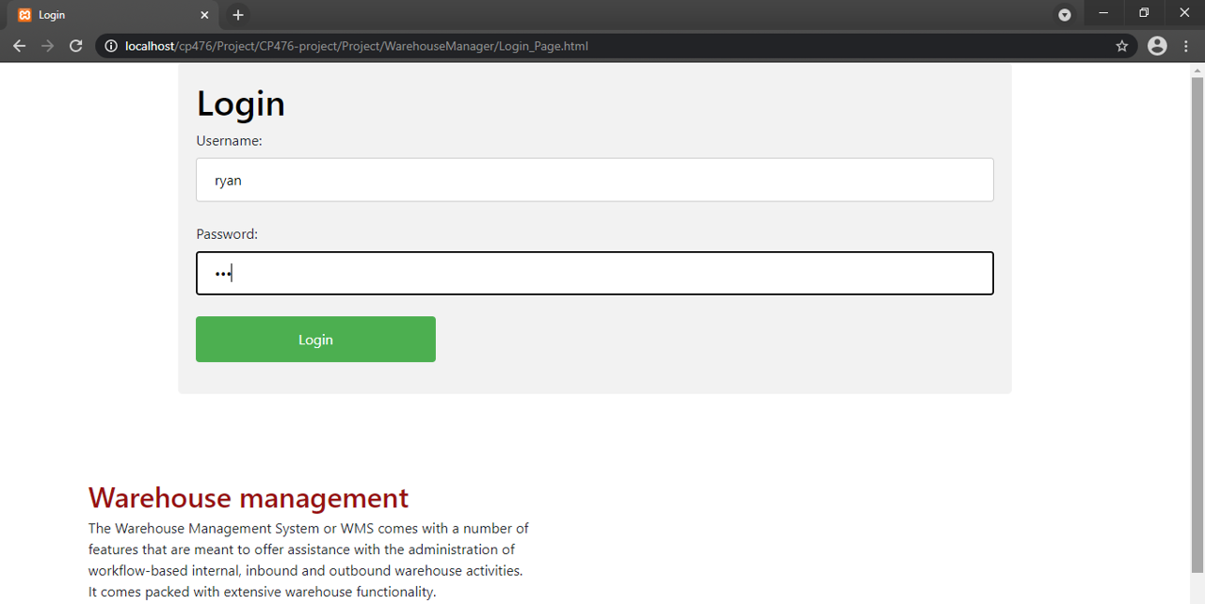
Sample Pages

Slide 6
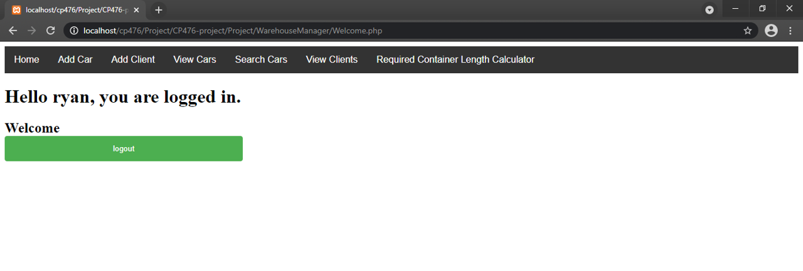
Navigator

Slide 7
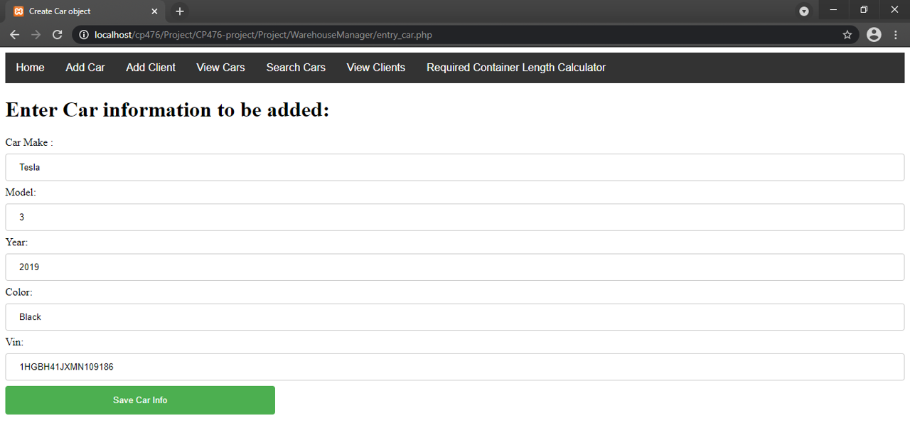
Add cars

Slide 8
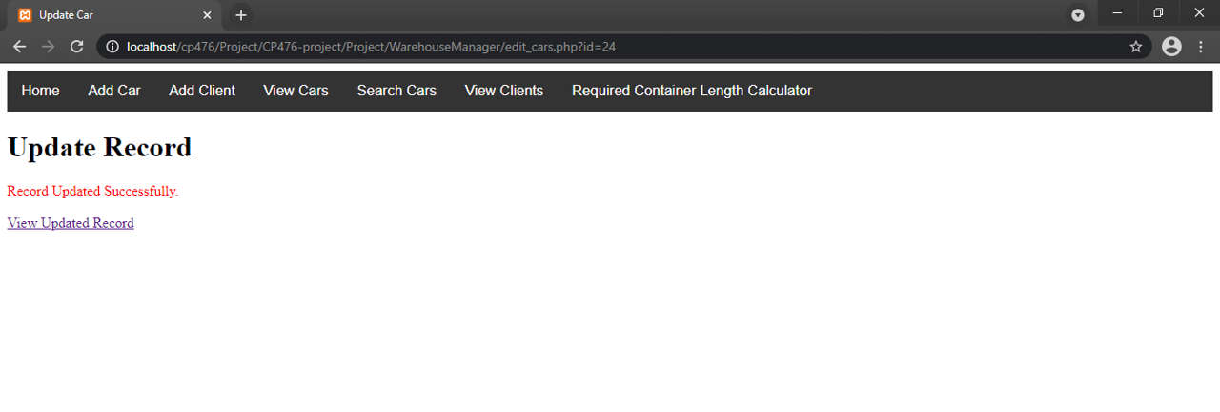
Update cars

Slide 9
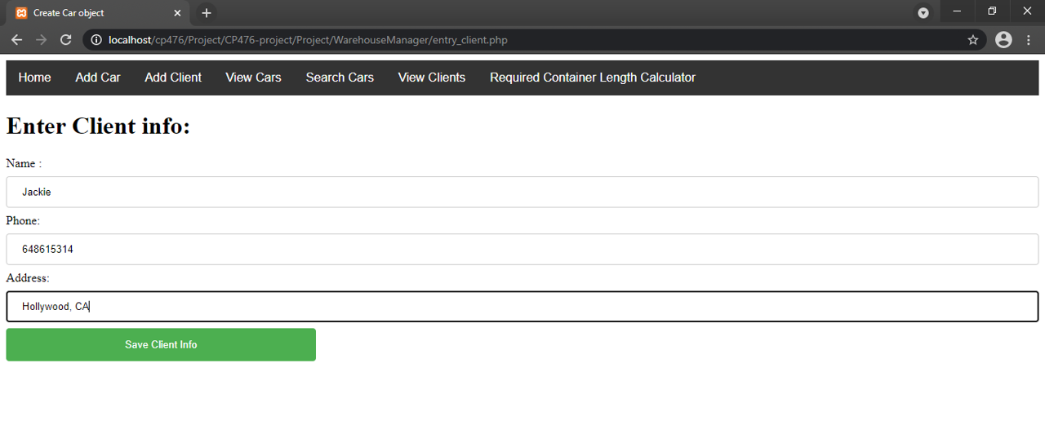
Add clients

Slide 10
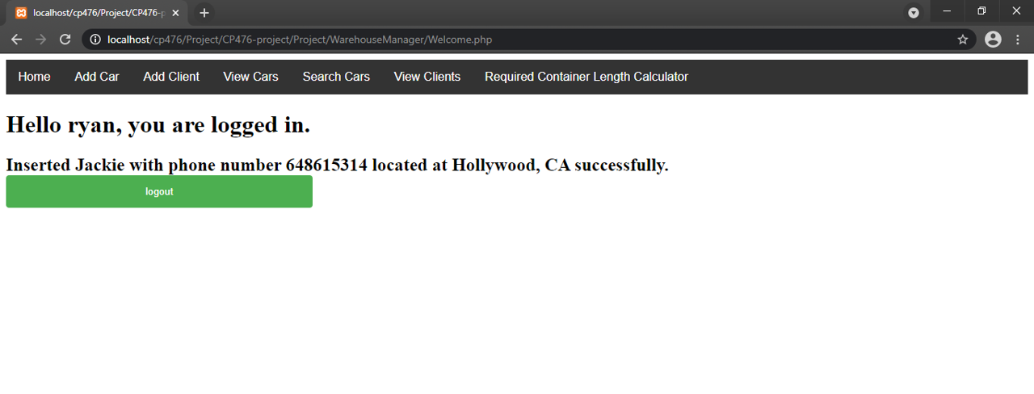
Client added confirmation

Slide 11
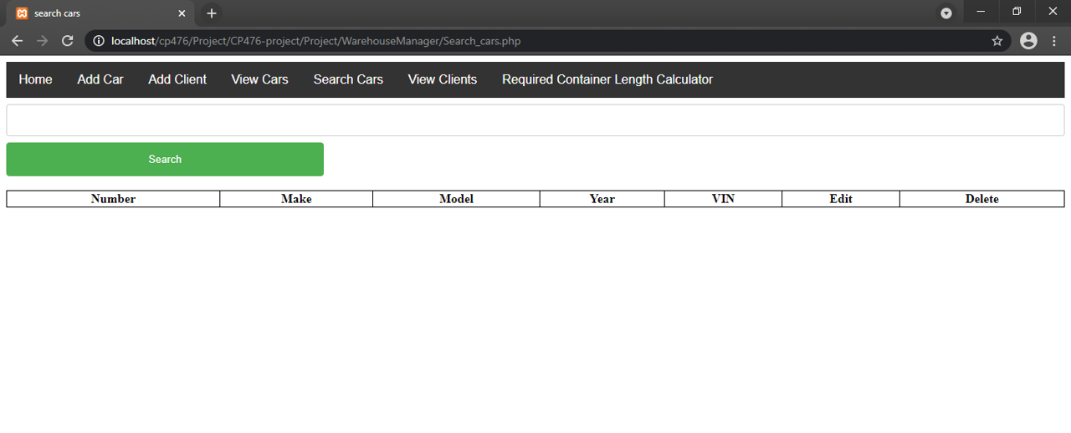
Search cars

Slide 12
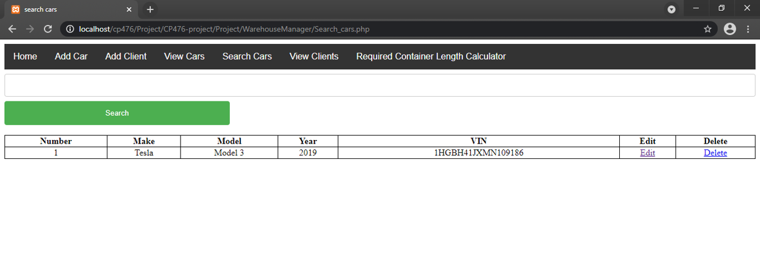
Search result

Slide 13
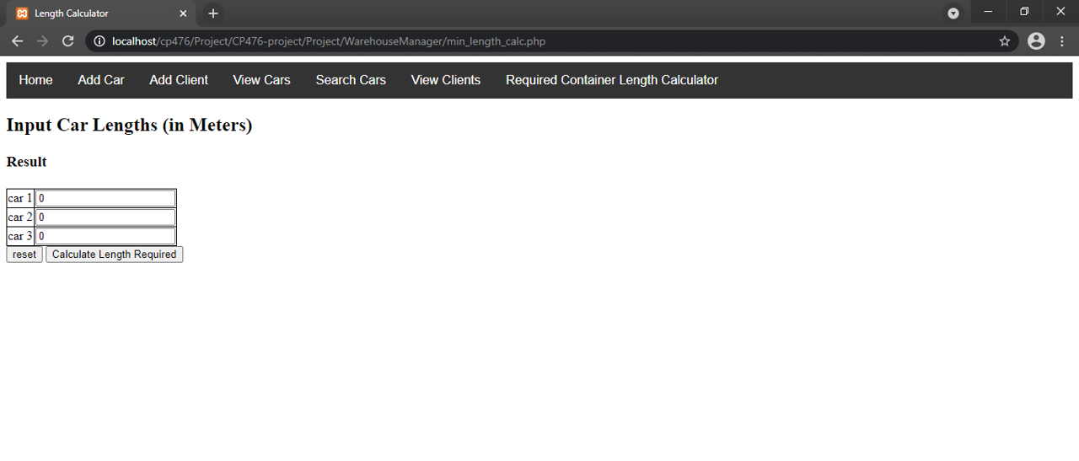
Calculate container size

Slide 14
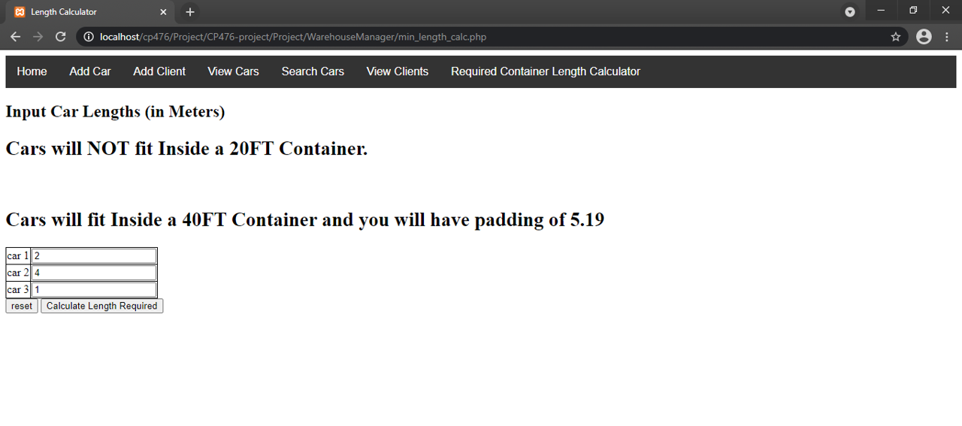
Container calculator result

Slide 15
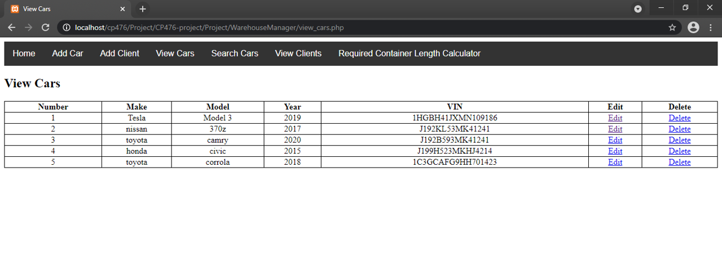
View cars

