Slide 1

Asymptotic Notations

Slide 2
RAM: The Random-Access Machine
RAM stands for Random Access Machine, which is a very useful model of computation.
can access any memory location in constant time
each basic instruction requires one unit of time
running time proportional to the number of operations
We will study functions 𝑓𝑓(𝑛𝑛) that is
asymptotically
nonnegative, i.e., there exists constant 𝑁𝑁 such that
𝑓𝑓(𝑛𝑛) ≥ 0 for all 𝑛𝑛 ≥ 𝑁𝑁.

Slide 3
Four important summations
1+2+3+4+...+n = n(n+1)/2
1+1/2+1/4+1/8+...+(1/2)^{n} = (1 - (1/2)^{n+1})/(1-1/2)
1+x+x²+x³+...+x^{n} = (1 - x^{n+1})/(1-x), provided that |x|<1
1²+2²+3²+...+n² = n(n+1)(2n+1)/6
1+1/2+1/3+1/4+...+1/n ∈ (ln(n) + 1/n, ln(n) + 1)

Slide 4
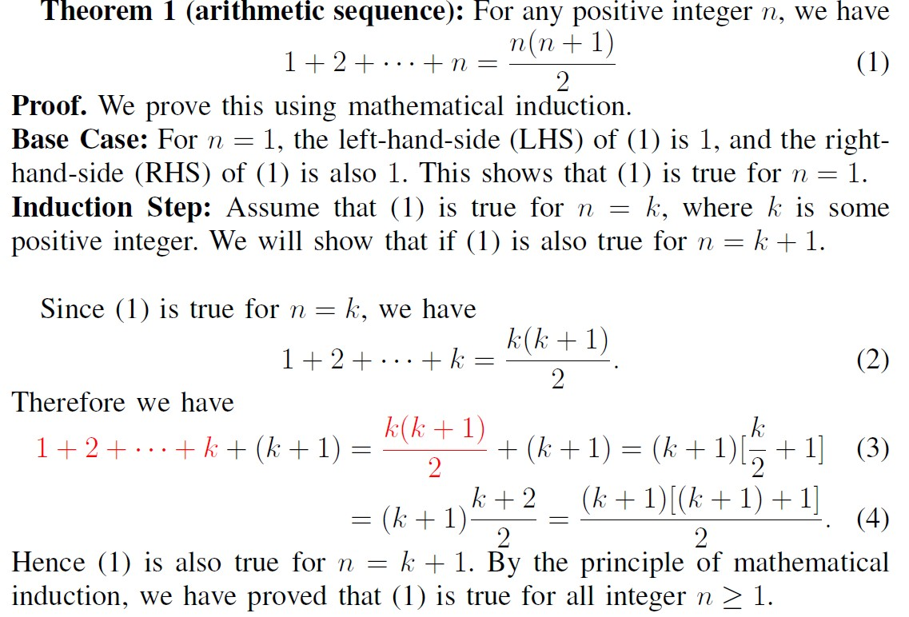
Proofs

Slide 5
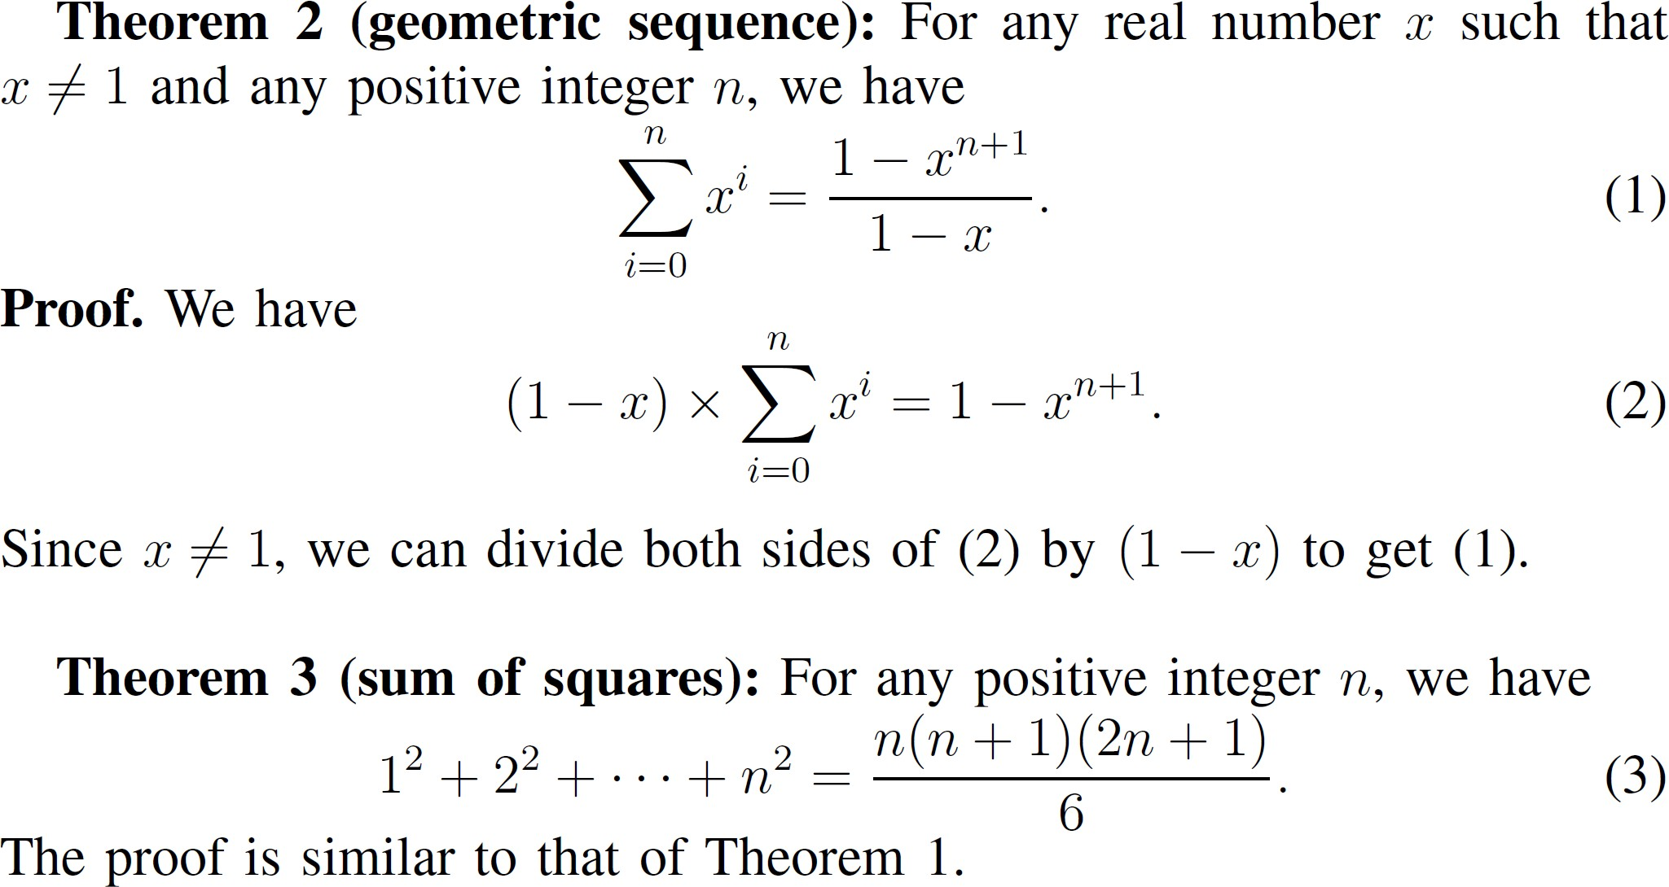
Proofs

Slide 6
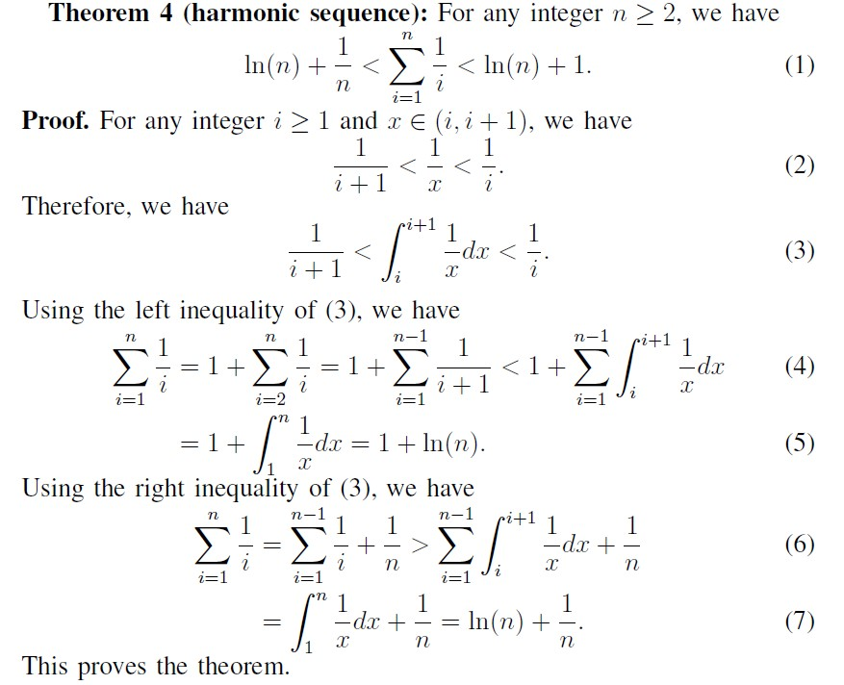
Proofs

Slide 7
Takeaways
1+2+3+4+...+n = n(n+1)/2
1+x+x²+x³+...+x^{n} = (1 - x^{n+1})/(1-x), provided |x|<1
1²+2²+3²+...+n² = n(n+1)(2n+1)/6
1+1/2+1/3+1/4+...+1/n ∈ (ln(n) + 1/n, ln(n) + 1)
We will use these frequently in this course.
Know them (and their variants) by heart.

Slide 8
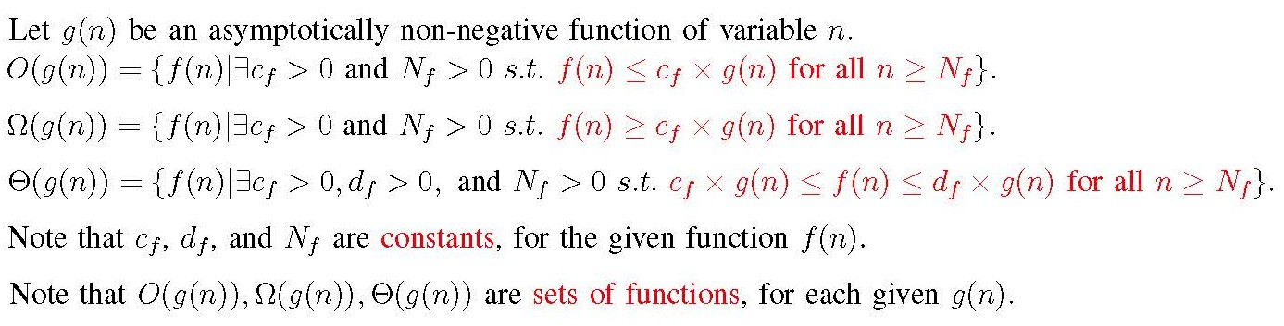
Definitions of Big-O, Big-Ω, and Big-Θ
Big-O: asymptotic upper bound
Big-Ω : asymptotic lower bound
Commonly uses choices of g(n)
1, log(n), n, n log(n), n², n³, 2^{n}.

Slide 9
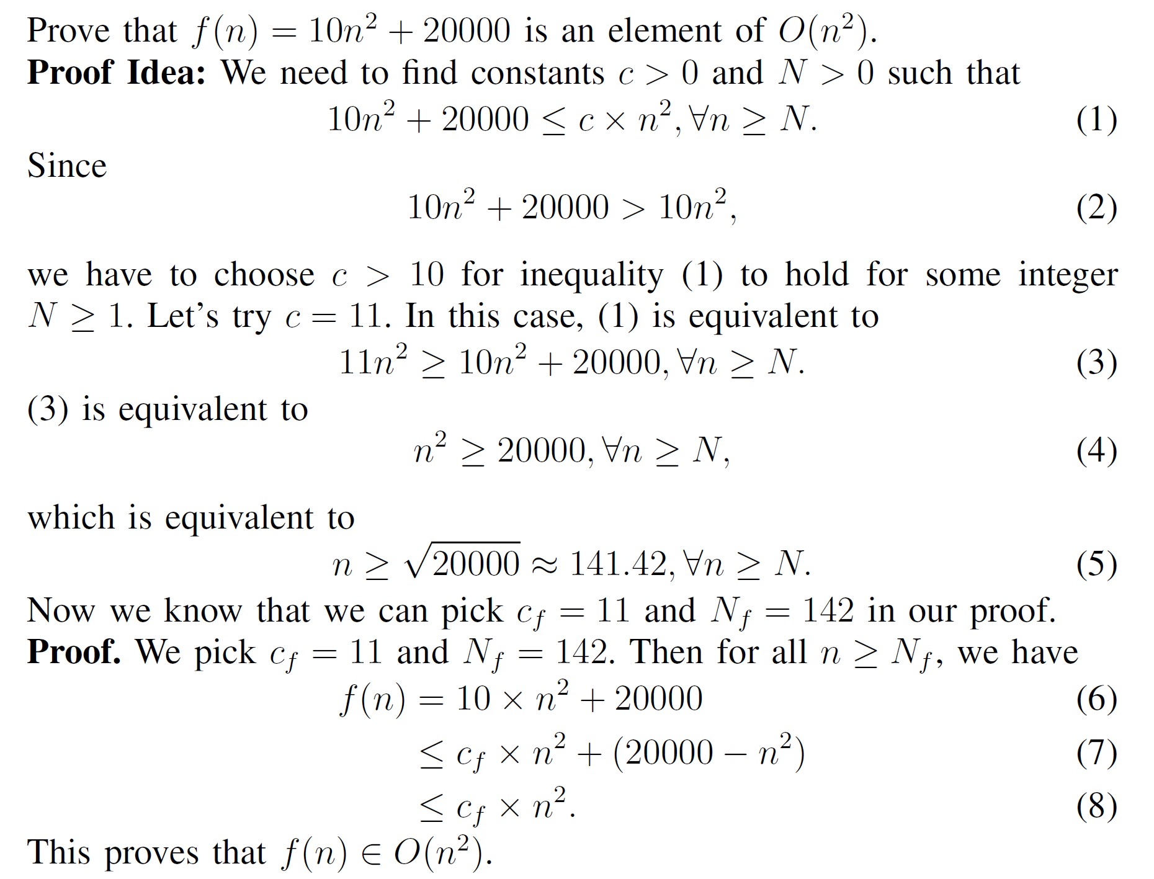
Proof example for Big-O

Slide 10
Example: O(1), O(5), O(1000000)
f(n) = 1, for all n ≥ 1.
f(n) = 0, for all n ≥ 1.
f(n) = 1 + 1/n, for all n ≥ 1.
f(n) = (1 + 1/n)^{n}, for all n ≥ 1.
f(n) = 10000000000, for all n ≥ 1.
What about f(n) = n?
What about f(n) = log(n)?
Is O(1) equal to O(5)?

Slide 11
Example: O(log(n))
If f(n)
∈ ∈
■
O(1), then f(n)
O(log(n)).
f(n) = 1 + ½ + 1/3 + ¼ + ... + 1/n, for all n ≥ 1.
What about f(n) = n?
What about f(n) = log(n)²?

Slide 12
Example: O(n), O(2n+5), O(3n+1000000)
If f(n)
∈ ∈
■
O(1), then f(n)
O(n).
f(n) = n, for all n ≥ 1.
f(n) = 8n + 10000, for all n ≥ 1.
What about f(n) = n²?
What about f(n) = n log(n)?
Is O(n) equal to O(2n+5)?

Slide 13
Example: O(n²)
f(n) = 1 + 2+ 3 + 4 + ... + n, for all n ≥ 1.
What about f(n) = n³?
What about f(n) = n² log(n)?

Slide 14
Example: O(n³)
f(n) = 1² + 2² + 3² + ... + n², for all n ≥ 1.
What about f(n) = n⁴?
What about f(n) = n³ log(n)?

Slide 15
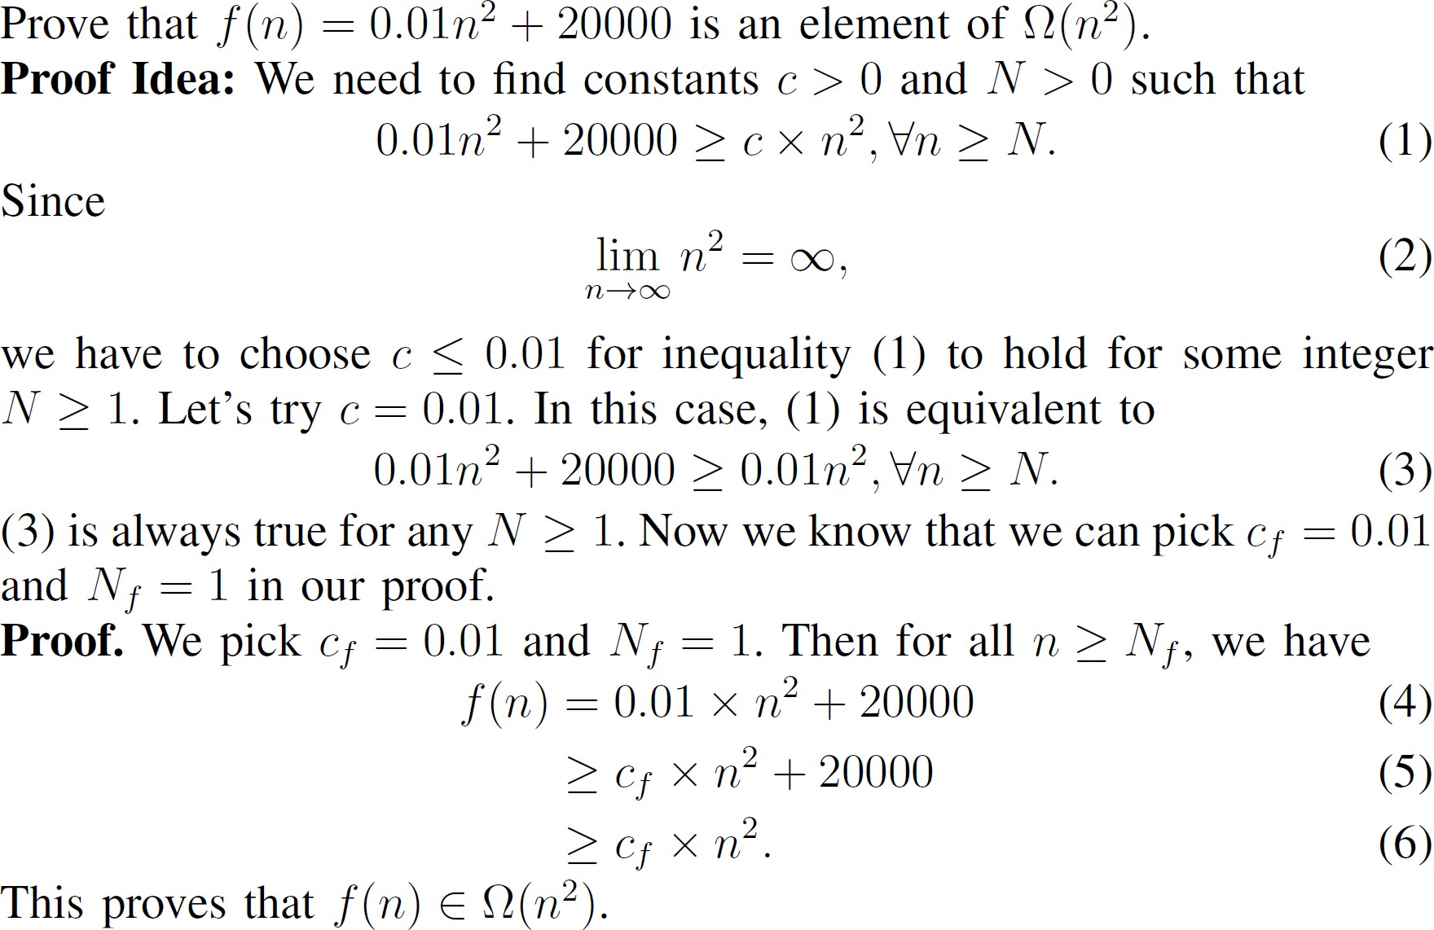
Proof example for Big-Ω

Slide 16
Example: Ω(1), Ω(5), Ω(0.0001)
f(n) = 1, for all n ≥ 1.
f(n) = log(n), for all n ≥ 1.
f(n) = n, for all n ≥ 1.
f(n) = n², for all n ≥ 1.
f(n) = 2^{n}, for all n ≥ 1.
What about f(n) = 0?
What about f(n) = 1/n?
Is Ω(1) equal to Ω(5)?

Slide 17
Example: Ω(log(n))
f(n) = 1 + ½ + 1/3 + ¼ + ... + 1/n, for all n ≥ 1.
What about f(n) = 10000?

Slide 18
Example: Ω(n), Ω(2n+5), Ω(3n+1000000)
f(n) = n, for all n ≥ 1.
f(n) = 0.0001n - 10000, for all n ≥ 1.
What about f(n) = log(n)?
Is Ω(n) equal to Ω(2n+5)?

Slide 19
Example: 𝚯𝚯(1), 𝚯𝚯(5)
f(n) = 1, for all n ≥ 1.
f(n) = (1+1/n)^{n}, for all n ≥ 1.
f(n) = 0.01, for all n ≥ 1.
f(n) = 1000, for all n ≥ 1.
∈ ∈
■
If f(n)
O(1) and f(n)
Ω(1), then f(n)
𝚯𝚯
(1)
∈
If f(n)
𝚯𝚯
(1), then f(n)
∈
O(1) and f(n)
Ω(1).
∈
∈

Slide 20
Example: 𝚯𝚯(n), 𝚯𝚯(5n)
∈ ∈
■
If f(n)
O(n) and f(n)
Ω(n), then f(n)
𝚯𝚯
(n)
∈
If f(n)
𝚯𝚯
(n), then f(n)
∈
O(n) and f(n)
Ω(n).
∈
∈

Slide 21
Takeaways
To prove f(n)∈O(g(n)), you need to find the constants c_{f} and N_{f}, and prove using the definition.
The pair of constants are not unique. You just need to find a pair that works.
To prove f(n)∈Ω(g(n)), you need to find the constants c_{f} and N_{f}, and prove using the definition.
To prove f(n)∈Θ(g(n)), you need to find the constants c_{f}, d_{f}, N_{f}, and prove using the definition.

Slide 22
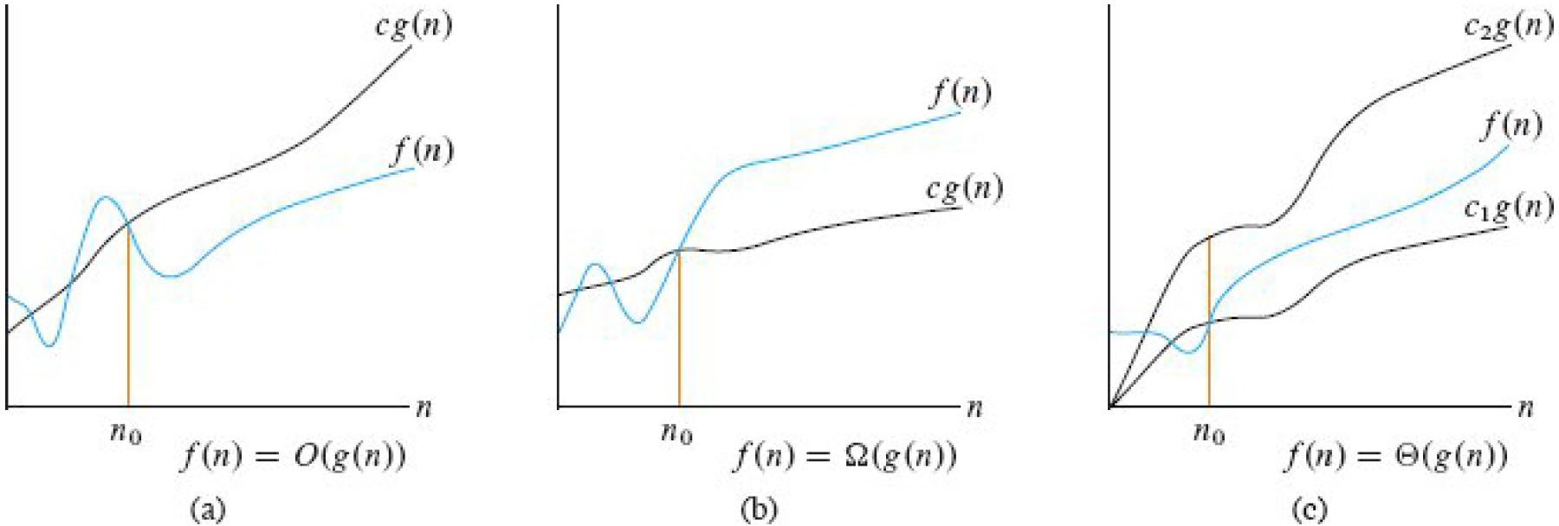
Asymptotic bounds

Slide 23
Asymptotic bounds
f(n)≤g(n) implies f(n)∈O(g(n)).
f(n)∈O(g(n)) does not imply f(n)≤g(n).
Example
f(n) = 1000n for all n, g(n) = n for all n.
We have f(n)∈O(g(n)).
Similarly, f(n)∈Ω(g(n)) does not imply f(n)≥g(n).

Slide 24
Mathematical Proofs for Asymptotic Notations
There are two main methods to analyze asymptotic notations
Method 1: Use definitions
Method 2: Use limit on the ratio of the two functions
If 𝒍𝒍𝒍𝒍𝒎𝒎_{𝒏𝒏→∞}
If 𝒍𝒍𝒍𝒍𝒎𝒎_{𝒏𝒏→∞}
If 𝒍𝒍𝒍𝒍𝒎𝒎_{𝒏𝒏→∞}
𝒇𝒇(𝒏𝒏)
= 𝒄𝒄 > 𝟎𝟎, then f(n) ∈ Θ(g(n))
𝒈𝒈(𝒏𝒏)
𝒇𝒇(𝒏𝒏)
< ∞, then f(n) ∈ O(g(n))
𝒈𝒈(𝒏𝒏)
𝒈𝒈(𝒏𝒏)
< ∞, then f(n) ∈ Ω(g(n))
𝒇𝒇(𝒏𝒏)

Slide 25
Some Facts
O(1) ⊆ O(ln (n)) ⊆ O(n) ⊆ O(n ln(n)) ⊆ O(n²)
Ω(n²) ⊆ Ω(n ln (n)) ⊆ Ω(n) ⊆ Ω(ln(n)) ⊆ Ω(1)

Slide 26
Commonly used (bad) notations
When we read f(n) = O(g(n)), read it as f(n) ∈ O(g(n))
When we read f(n) = Ω(g(n)), read it as f(n) ∈ Ω(g(n))
When we read O(n) = O(n²), read it as O(n) ⊆ O(n²).
When we read Ω(n²) = Ω(n), read it as Ω(n²) ⊆ Ω(n).

Slide 27
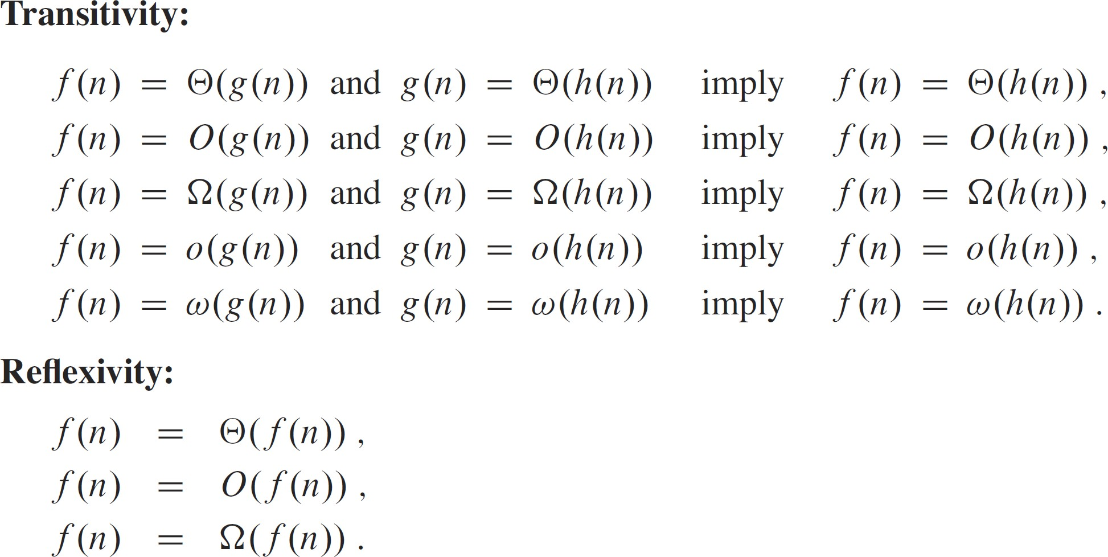
Properties

Slide 28
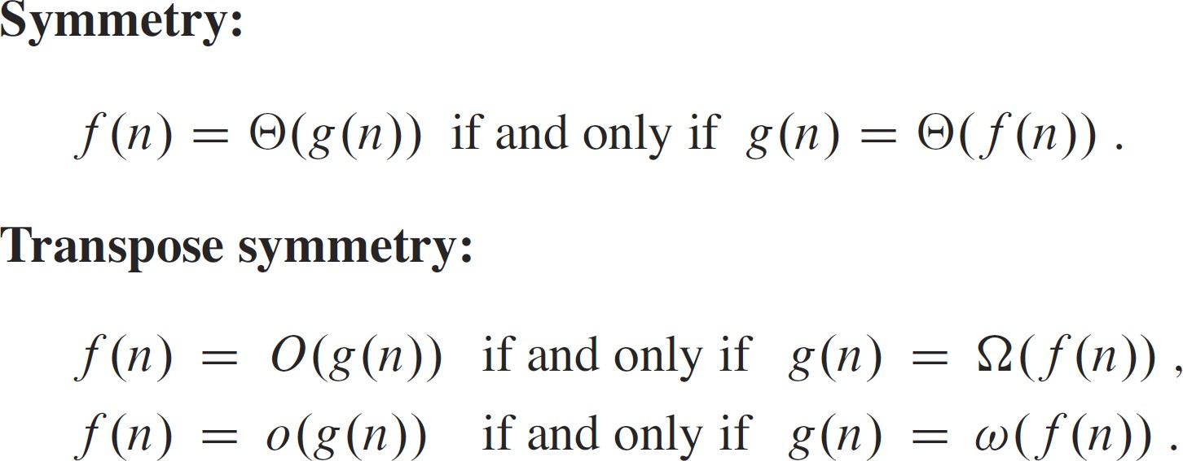
Properties

Slide 29
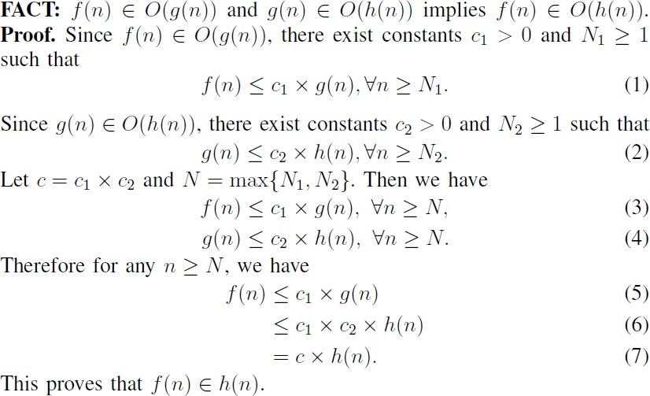
Example Proof

Slide 30
Summary
The Random Access Machine
Four commonly used formulas
Big-O, Big-Ω, Big-Θ notations

