Slide 1

Algorithm Execution Insertion Sort

Slide 2
Algorithm Execution
We will study the execution of an algorithm on a given instance and predict the execution process.
We will use Insertion Sort as an example.

Slide 3
Sorting
Sorting is the process of arranging a sequence of objects into order (either increasing or decreasing)
There are many sorting algorithms
Different sorting algorithms may have different time complexities.
The problem also has a complexity.
There is a difference between problem complexity and algorithm complexity.

Slide 4
Insertion Sort
Insertion-Sort(A, n)
for i := 2 to n do
key := A[i]
// insert A[i] into sorted A[1:i-1]
j := i -1
while j > 0 and A[j] > key do
6
7
8 A[j+1] := key
A[j+1] := A[j]
j := j - 1
Trace the algorithm using inputs: 3 5 2 8 3

Slide 5
Walk through example
A
3 | 5 | 2 | 8 | 3
n=5
1 2 3 4 5 6 7

Slide 6
Walk through example
A
3 | 5 | 2 | 8 | 3
n=5
i=2
key=5
1 2 3 4 5 6 7

Slide 7
Walk through example
A
3 | 5 | 2 | 8 | 3
n=5
i=2
key=5
1 2 3 4 5 6 7
j=1

Slide 8
Walk through example
A
3 | 5 | 2 | 8 | 3
n=5
i=2
key=5
1 2 3 4 5 6 7
j=1
j > 0?
Yes

Slide 9
Walk through example
A
3 | 5 | 2 | 8 | 3
n=5
i=2
key=5
1 2 3 4 5 6 7
j=1
j > 0?
Yes
A[j]>key?
No

Slide 10
Walk through example
A
3 | 5 | 2 | 8 | 3
n=5
i=2
key=5
1 2 3 4 5 6 7
j=1
j > 0?
Yes
A[j]>key?
No
A[j+1] := key

Slide 11
Walk through example
A
3 | 5 | 2 | 8 | 3
n=5
i=2
key=5
1 2 3 4 5 6 7
j=1
j > 0?
Yes
A[j]>key?
No
A[j+1] := key
Array A is overwritten.

Slide 12
Walk through example
A
3 | 5 | 2 | 8 | 3
n=5
i=2
key=5
1 2 3 4 5 6 7

Slide 13
Walk through example
A
3 | 5 | 2 | 8 | 3
n=5
i=3
key=2
1 2 3 4 5 6 7

Slide 14
Walk through example
A
3 | 5 | 2 | 8 | 3
n=5
i=3
key=2
1 2 3 4 5 6 7
j=2

Slide 15
Walk through example
A
3 | 5 | 2 | 8 | 3
n=5
i=3
key=2
1 2 3 4 5 6 7
j=2
j > 0?
Yes

Slide 16
Walk through example
A
3 | 5 | 2 | 8 | 3
n=5
i=3
key=2
1 2 3 4 5 6 7
j=2
j > 0?
Yes
A[j]>key?
Yes

Slide 17
Walk through example
A
3 | 5 | 5 | 8 | 3
n=5
i=3
key=2
1 2 3 4 5 6 7
j=2
j > 0?
Yes
A[j]>key?
Yes
A[j+1] := A[j]
Array A is overwritten.

Slide 18
Walk through example
A
3 | 5 | 5 | 8 | 3
n=5
i=3
key=2
1 2 3 4 5 6 7
j=1

Slide 19
Walk through example
A
3 | 5 | 5 | 8 | 3
n=5
i=3
key=2
1 2 3 4 5 6 7
j=1
j > 0?
Yes

Slide 20
Walk through example
A
3 | 5 | 5 | 8 | 3
n=5
i=3
key=2
1 2 3 4 5 6 7
j=1
j > 0?
Yes
A[j]>key?
Yes

Slide 21
Walk through example
A
3 | 3 | 5 | 8 | 3
n=5
i=3
key=2
1 2 3 4 5 6 7
j=1
j > 0?
Yes
A[j]>key?
Yes
A[j+1] := A[j]
Array A is overwritten.

Slide 22
Walk through example
A
3 | 3 | 5 | 8 | 3
n=5
i=3
key=2
1 2 3 4 5 6 7
j=0

Slide 23
Walk through example
A
3 | 3 | 5 | 8 | 3
n=5
i=3
key=2
1 2 3 4 5 6 7
j=0
j > 0?
No

Slide 24
Walk through example
A
2 | 3 | 5 | 8 | 3
n=5
i=3
key=2
1 2 3 4 5 6 7
j=0
j > 0?
No
A[j+1] := key
Array A is overwritten.

Slide 25
Walk through example
A
2 | 3 | 5 | 8 | 3
n=5
i=3
key=2
1 2 3 4 5 6 7

Slide 26
Walk through example
A
2 | 3 | 5 | 8 | 3
n=5
i=4
key=8
1 2 3 4 5 6 7

Slide 27
Walk through example
A
2 | 3 | 5 | 8 | 3
n=5
i=4
key=8
1 2 3 4 5 6 7
j=3

Slide 28
Walk through example
A
2 | 3 | 5 | 8 | 3
n=5
i=4
key=8
1 2 3 4 5 6 7
j=3
j > 0?
Yes

Slide 29
Walk through example
A
2 | 3 | 5 | 8 | 3
n=5
i=4
key=8
1 2 3 4 5 6 7
j=3
j > 0?
Yes
A[j]>key?
No

Slide 30
Walk through example
A
2 | 3 | 5 | 8 | 3
n=5
i=4
key=8
1 2 3 4 5 6 7
j=3
j > 0?
Yes
A[j]>key?
No
A[j+1] := key
Array A is overwritten.

Slide 31
Walk through example
A
2 | 3 | 5 | 8 | 3
n=5
i=4
key=8
1 2 3 4 5 6 7

Slide 32
Walk through example
A
2 | 3 | 5 | 8 | 3
n=5
i=5
key=3
1 2 3 4 5 6 7

Slide 33
Walk through example
A
2 | 3 | 5 | 8 | 3
n=5
i=5
key=3
1 2 3 4 5 6 7
j=4

Slide 34
Walk through example
A
2 | 3 | 5 | 8 | 3
n=5
i=5
key=3
1 2 3 4 5 6 7
j=4
j > 0?
Yes

Slide 35
Walk through example
A
2 | 3 | 5 | 8 | 3
n=5
i=5
key=3
1 2 3 4 5 6 7
j=4
j > 0?
Yes
A[j]>key?
Yes

Slide 36
Walk through example
A
2 | 3 | 5 | 8 | 8
n=5
i=5
key=3
1 2 3 4 5 6 7
j=4
j > 0?
Yes
A[j]>key?
Yes
A[j+1] := A[j]
Array A is overwritten.

Slide 37
Walk through example
A
2 | 3 | 5 | 8 | 8
n=5
i=5
key=3
1 2 3 4 5 6 7
j=3

Slide 38
Walk through example
A
2 | 3 | 5 | 8 | 8
n=5
i=5
key=3
1 2 3 4 5 6 7
j=3
j > 0?
Yes

Slide 39
Walk through example
A
2 | 3 | 5 | 8 | 8
n=5
i=5
key=3
1 2 3 4 5 6 7
j=3
j > 0?
Yes
A[j]>key?
Yes

Slide 40
Walk through example
A
2 | 3 | 5 | 5 | 8
n=5
i=5
key=3
1 2 3 4 5 6 7
j=3
j > 0?
Yes
A[j]>key?
Yes
A[j+1] := A[j]
Array A is overwritten.

Slide 41
Walk through example
A
2 | 3 | 5 | 5 | 8
n=5
i=5
key=3
1 2 3 4 5 6 7
j=2

Slide 42
Walk through example
A
2 | 3 | 5 | 5 | 8
n=5
i=5
key=3
1 2 3 4 5 6 7
j=2
j > 0?
Yes

Slide 43
Walk through example
A
2 | 3 | 5 | 5 | 8
n=5
i=5
key=3
1 2 3 4 5 6 7
j=2
j > 0?
Yes
A[j]>key?
No

Slide 44
Walk through example
A
2 | 3 | 3 | 5 | 8
n=5
i=5
key=3
1 2 3 4 5 6 7
j=2
j > 0?
Yes
A[j]>key?
No
A[j+1] := key
Array A is overwritten.

Slide 45
Walk through example
A
2 | 3 | 3 | 5 | 8
n=5
i=5
key=3
1 2 3 4 5 6 7

Slide 46
Walk through example
A
2 | 3 | 3 | 5 | 8
n=5
i=6
1 2 3 4 5 6 7

Slide 47
Invariance of Insertion Sort
Before the for-loop with i=k, A[1:k-1] are in sorted order
A[i] is copied to the variable key
The for-loop with i=k inserts key into A[1..k-1].
Each element in A[1..k-1] that is larger than key is copied to its right neighbor, from right to left.
key is inserted into the correct position.
After the for-loop with i=k, A[1:k] are in sorted order

Slide 48
Running Time
Number of time steps required for the algorithm to terminate
In terms of the size of the input to the algorithm, which is related to the amount of work to be done. E.g., sorting 1000 integers takes longer than sorting 3 integers.
running time = function(input size)

Slide 49
Running Time
Insertion-Sort(A[1..n])
times n
n-1
n-1
for i := 2 to n do
key := A[i]
4 j := i -1
5
6
7
8
while j > 0 and A[j] > key do
A[j+1] := A[j]
j := j- 1
A[j+1] := key n-1
𝑛𝑛
�(𝑡𝑡_{𝑖𝑖}+1)
𝑖𝑖=2
𝑛𝑛
� 𝑡𝑡_{𝑖𝑖}
𝑖𝑖=2
𝑛𝑛
� 𝑡𝑡_{𝑖𝑖}
𝑖𝑖=2
where t_{i} is the number of elements in A[1..i-1] that is larger than A[i]

Slide 50
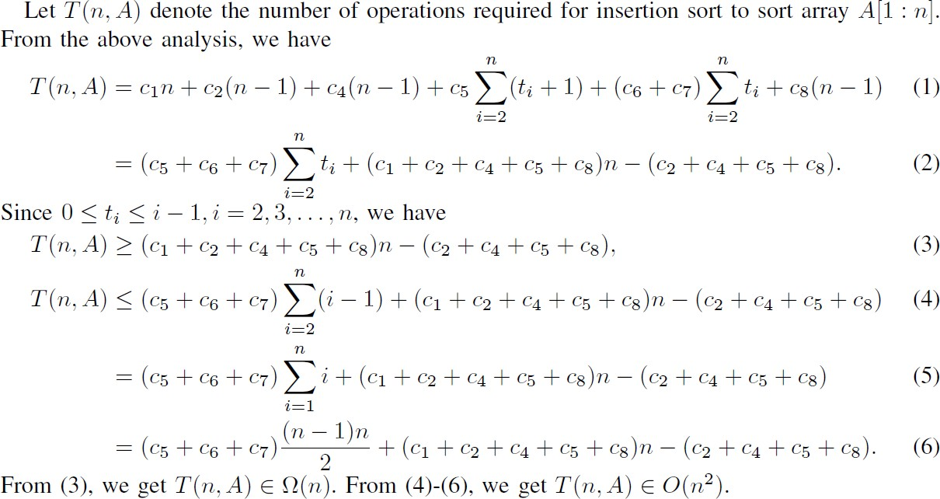
Running time of Insertion Sort

Slide 51
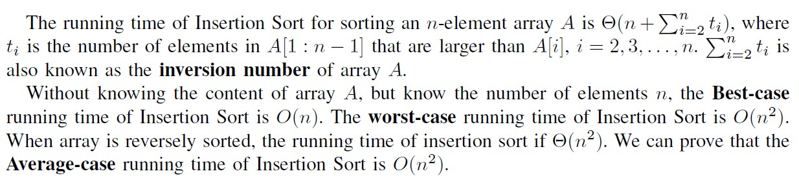
Running time of Insertion Sort

Slide 52
Inversion Number of A Sequence
Let A[1..n] be a sequence of n numbers.
For 1 <= i< j <= n, we say <i, j> is an inversion if A[i]>A[j]. Note that <i, j> is the inversion, not <A[i], A[j]>.
The inversion number of A is the total number of inversions for the sequence.
The inversion number of 3 5 2 8 3 is 4
The inversion number of 2 3 3 5 8 is 0

Slide 53
In-class example
The inversion number of 5 4 3 2 1
<1, 2>, <1, 3>, <1, 4>, <1, 5>
<2, 3>, <2, 4>, <2, 5>
4 + 3 + 2 + 1 = 10
(n-1)n/2

Slide 54
Inversion Number of A Sequence
How many times are we copying elements to the right while applying insertion sort on the input sequence 3 5 2 8 3?
How many times are we copying elements to the right while applying insertion sort on the input sequence 5 4 3 2 1?
The running time of insertion sort is Θ(n + Inversion(A)), where Inversion(A) is the inversion number of A.

Slide 55
Summary
An algorithm is a well-defined step by step computational procedure.
We studied Insertion Sort, and analyzed its best case time complexity and worst-case time complexity.
Inversion number and its relationship with the time complexity of insertion sort.

